Slide 1
Mapping in Biotics
Core Methodology Training
February 2023
Whitney Weber

Slide 2
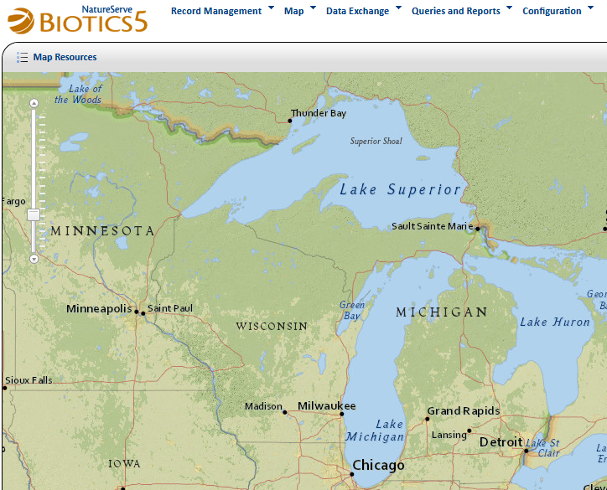
What are we doing?
Learn basic map navigation
Map new Source Features & EOs
Update an existing Source Feature & EO record
Modify the spatial representation of an existing Source Feature and hence EO
More, as time allows

Slide 3
Agenda
Each topic will be demonstrated, followed by hands-on exercises:
  Map Resources
  Map Navigation
  Map Tools
  Creating Source Features and EOs
  If time allows…

Slide 4
Demo:
Basics

Slide 5
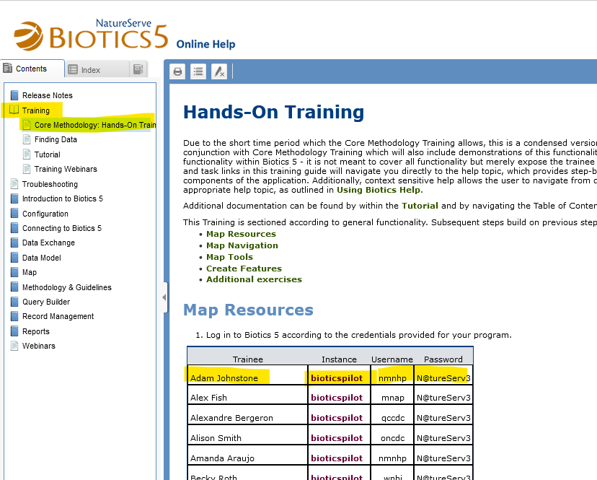
Hands-On Training:
Login to the Biotics 5 Pilot
Go to the Hands-On Training help topic
Access the Biotics Pilot by clicking the Biotics Instance link associated with your name
Log in according to your credentials, provided

Slide 6
Demo:
Map Resources

Slide 7
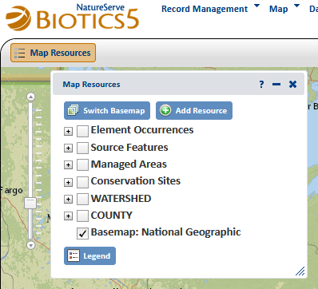
Hands-On Training:
Map Resources
Perform Map Resources section of the Hands-On Training
https://help.natureserve.org/biotics/#Training/Training_CMT.htm

Slide 8
Demo:
Map Navigation

Slide 9
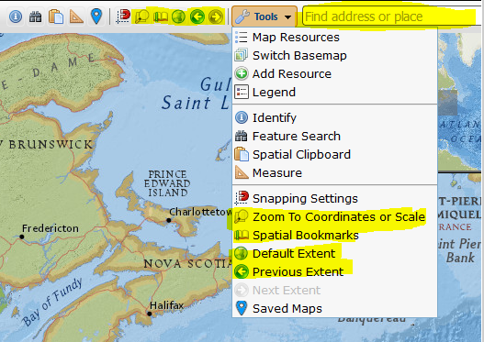
Hands-On Training:
Map Navigation
Perform Map Navigation section of the Hands-On Training
https://help.natureserve.org/biotics/#Training/Training_CMT.htm

Slide 10
Demo:
Map Tools

Slide 11
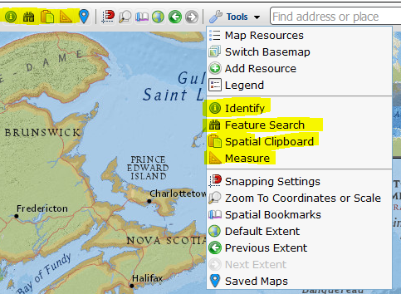
Hands-On Training:
Map Tools
Perform Map Tools section of the Hands-On Training
https://help.natureserve.org/biotics/#Training/Training_CMT.htm

Slide 12
Creating SFs & EOs:
Overview
Demo and discussion of Example 1 in the Mapping Worksheet
Demo and shadow Example 2 in the Mapping Worksheet
Perform Example 1 of Create Features section of the Hands-On Training
Demo and discussion of Example 3 in the Mapping Worksheet
Perform Example 2 of Create Features section of the Hands-On Training
Demo and discussion of Example 4 in the Mapping Worksheet
Perform Example 3 of Create Features section of the Hands-On Training
Demo and discussion of Example 5 in the Mapping Worksheet
Perform Example 4 of Create Features section of the Hands-On Training
Perform Example 5 of Create Features section of the Hands-On Training (data collected in field)

Slide 13
Demo:
Creating Source Features & EOs

Slide 14
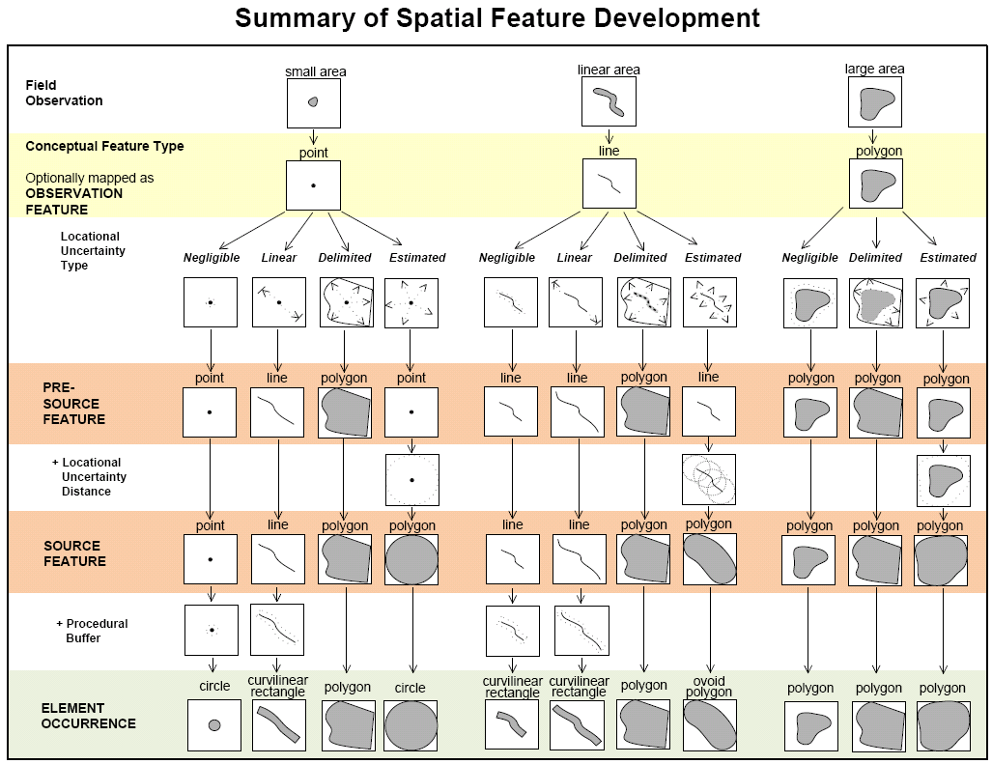
Hands-On Training

Slide 15
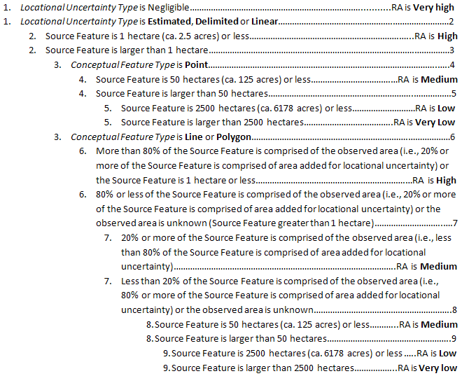
Hands-On Training

Slide 16
Hands-On Training:
Advanced
Done it a million times and bored senseless by this training or just working through it more quickly than the pace of the class? Here are some additional options for hands-on activities:
Create the Source Features & EOs in the worksheet
  Download Lake_Zoom.zip file for Little Whaley Lake, Ludington Lake, and Whaley Lake referenced in Exercises 4, 7, 8, & 9.
Enter data collected in field
Go through the Tutorial in the online help
Do some Advanced Editing!
Do the Finding Data training

Slide 17
Additional Training
A variety of training topics can be found listed in the Training Webinars help topic.
Training specific to the Map include:
Map Session I: Map Content & Tools
Map Session II: Creating Features
Map Session III: Modifying & Deleting Features

