Slide 2
Methodology for Developing Spatial Features
Whitney Weber
www.NatureServe.org
February 8, 2023

Slide 3
What you will Learn
What is and what differentiates one from the other:
Observation
Source Feature (SF)
Element Occurrence (EO)
Key terms/fields used in the development of SFs & EOs
How to decide when to add to an existing EO or create a new one, according to:
EO Specifications
Separation distance

Slide 4
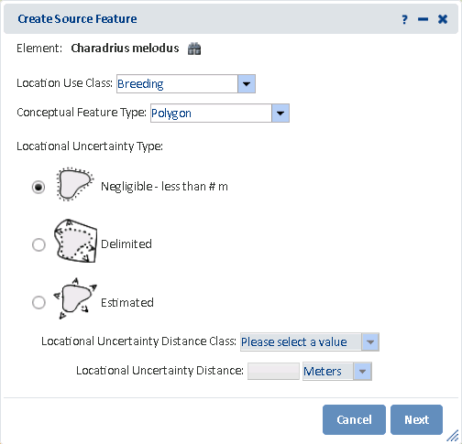
Purpose & Context of Methodology
Biotics 5 is based on and actually applies the standard methodology, as reflected in:
Required data fields
Data analysis
Training:
Today: introduce methodological concepts
Field Day (on your own using Observations survey): reinforce methodological concepts by collecting required data in field
Mapping session: apply methodology by entering data in Biotics 5
Notes:
What you may not realize is that the methodology is not just a concept, but is actually applied within Biotics 5 as reflected in:
Required data fields
Data analysis
Training:
Today I will introduce the methodological concepts
During the Field Day, we will reinforce these concepts by collecting required data in field
And in the Mapping session we will apply the methodology as we enter the collected data
Now I realize that the theoretical nature of concepts makes them very hard to grasp on their own, but in subsequent training sessions we will reinforce the concepts by applying them, hopefully solidifying your understanding.

Slide 5
Stages in the Mapping Process
SPATIAL FEATURE | DESCRIPTION | SYSTEM UTILIZED | SPATIAL FEATURE RELATIONSHIPS
Observation Feature (Optional) | Created to represent raw observation data Locational Uncertainty is not included in the mapped feature Developed for ANY element (including EO Track Status = N) | Survey123 (or alternative database)
Source Feature | Developed from one or more field observations Locational Uncertainty is always included in the mapped feature, ensuring that the location of the underlying observation(s) is captured within the mapped feature Developed for ANY element (including EO Track Status = N) | Biotics
Element Occurrence | Developed from one or more Source Features Consistency is achieved using standard criteria and rules of separation as defined within the EO Specifications record Developed to define potentially viable conservation units Developed for Tracked elements (EO Track Status = Y, P, or W) | Biotics
Notes:
This is a brief overview of the various stages in the mapping process, all of which I’ll subsequently touch on in greater detail.

Slide 6
Observation Feature
Point, line, or polygon
Represents raw observation data (optional)
Locational uncertainty NOT included in the mapped feature; however
Locational uncertainty can be recorded as an attribute
Developed for ANY element (including EO Track Status = N)

Slide 7
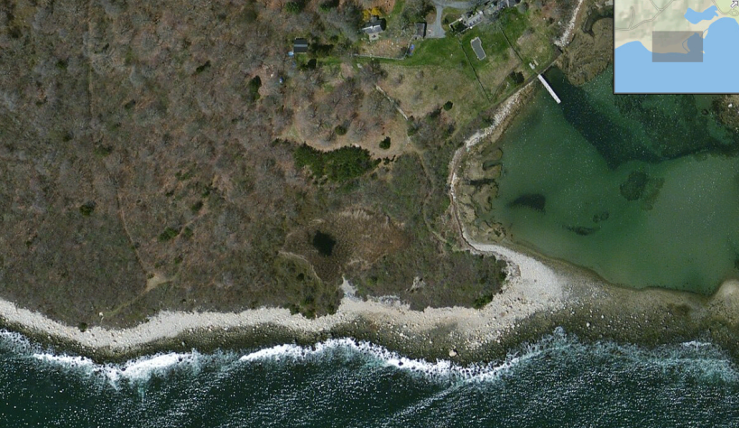
Observation Feature
© Dennis Donahue
Field Observation:
Piping plover recorded using a GPS with 20 m accuracy
Observation Feature:
Point
Locational Uncertainty (attribute):
20 m

Slide 8
Observation Feature: Summary of Spatial Feature Development

Slide 9
Source Features
Notes:
Now we’re going to define the key attributes associated with the various features, starting with Source Features.

Slide 10
Source Feature (SF)
Point, line, or polygon
Reflects KNOWN occupied habitat and any area of locational uncertainty associated with the location to ensure that the actual on-the-ground location is captured
Spatial feature type (point, line, or polygon) depends on
Locational Uncertainty associated with the data
&
Conceptual Feature Type
(based on size of the observation compared to the minimum mapping unit [9m])
Developed for ANY element (including EO Track Status = N)
Can remain independent, or can be used to create a new, or modify an existing, EO Rep

Slide 11
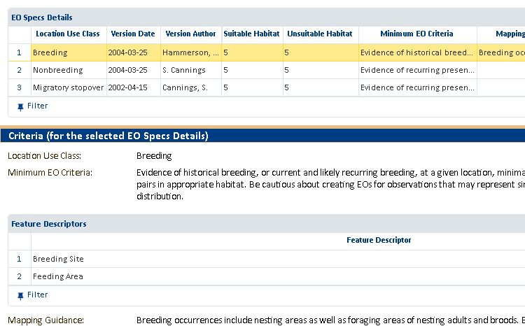
Location Use Class
Applies to: migratory animals that occupy disjunct locations by season
Identifies season/behavior associated location, ensuring all life cycles are considered for protection
Dropdown values reflect those defined within EO Specifications record of element or element group

Slide 12
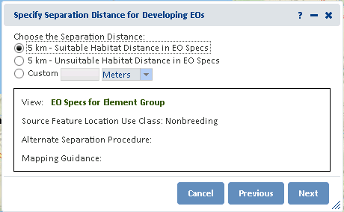
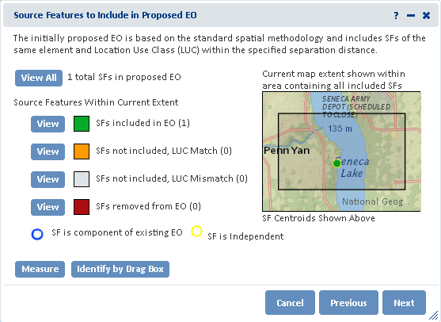
Location Use Class
Purpose: Ensure that locations utilized throughout the entire life cycle of the animal are considered for conservation
How: EOs should be comprised of SFs of a single Location Use Class
Creating Element Occurrence
Notes:
When creating an EO, it should be comprised of SFs…

Slide 13
Minimum Mapping Unit
Can’t represent actual size of what was observed in the field on a map, obviously.
So, the field data is translated into mapped features at a reduced scale
Minimum mapping unit (mmu): Size of smallest feature that can be visualized (delineated with boundaries) on a map of a given scale
Minimum mapping unit differs by map scale
Notes:
When mapping,..

Slide 14
MMUs utilized in Biotics 5
Map Scale | Diameter of Minimum Mapping Unit
 | Meters | Feet (approx.)
1:18, 056 | 9 | 29.5
1:36,112 | 18 | 59
1:72,224 | 36 | 118.1
Defined by the size of a feature, visible at a given scale
Anything smaller would not be visible on a map of the given scale
Critically important as MMU is:
Used to determine Conceptual Feature Type
Used to determine Locational Uncertainty Type
Applied as a Procedural Buffer, in certain cases
Notes:
The Map Scales are universally defined within digital maps – NatureServe did not make these up!
MMU is defined by a feature that can be seen at a given scale

Slide 15
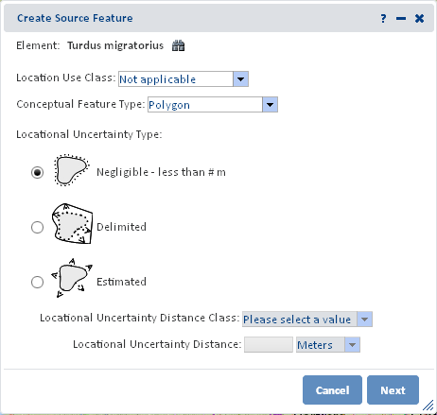
Conceptual Feature Type
Reflects (Cartographic) spatial feature (point, line, polygon) that would result from mapping the underlying field data:
based on the observed feature
determined by comparing the size of the observed area with the minimum mapping unit (mmu) for the scale map used.
Notes:
So, what is this elusive Conceptual Feature Type?

Slide 16
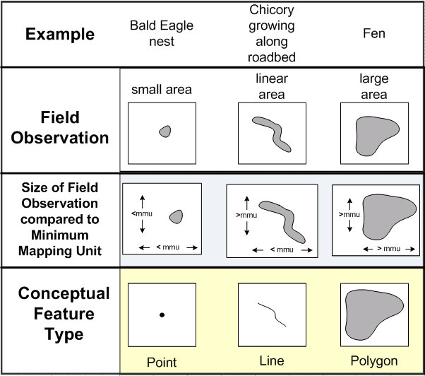
Conceptual Feature Type
Compare the observed area of the element with the minimum mapping unit (mmu – 9 m by default) for the scale map used.
Small area: < mmu in any direction
Linear area: < mmu in a single direction
Large area: > mmu in each direction
Notes:
This is easier to understand via examples.
Ask for additional examples of each CFT – Point, Line, Polygon

Slide 17
Locational Uncertainty
Reflects uncertainty in the mapped location of an observation compared with its actual on-the-ground location
Affected primarily by survey techniques and equipment, e.g.:
GPS waypoint with Precision = 20 m
Within quadrangle X
On Golden Pond
Source Features include locational uncertainty in mapped feature

Slide 18
Locational Uncertainty Type
Four uncertainty types:
Negligible
Linear
Determined by:
Size of observed data compared with the minimum mapping unit (mmu), indicated as the Conceptual Feature Type
amount and direction of uncertainty associated with the location of the observation
Delimited
Estimated

Slide 19
Locational Uncertainty Type
Source Feature Record

Slide 20
Negligible
Uncertainty:
Locational variability that is less than or equal to ½ mmu (i.e. <= 4.5 m)
in any direction
Criteria applied to entire feature
Resulting Source Feature: Point, line, or polygon
E.g. bald eagle nest recorded location with sub-meter GPS unit

Slide 21
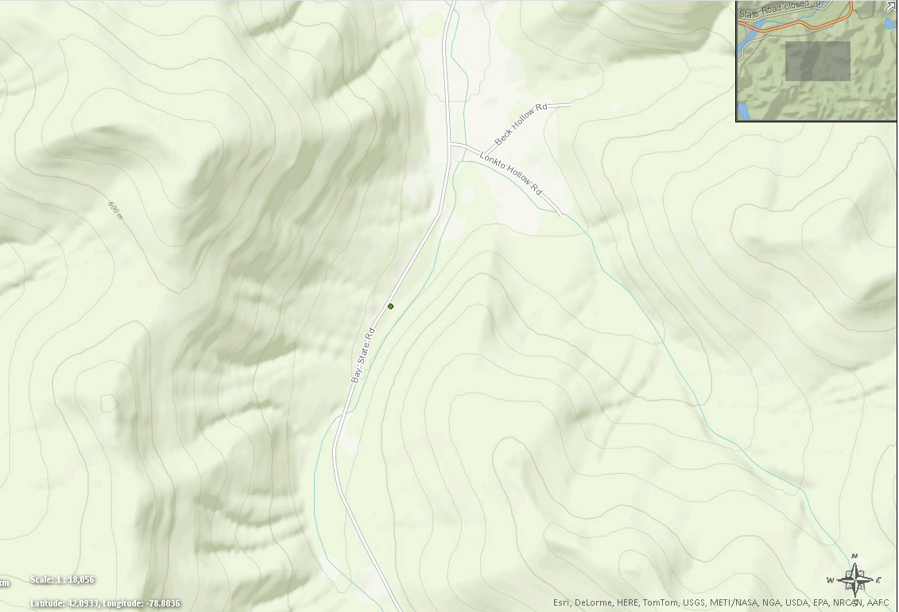
Negligible
Conceptual Feature Type: Point
Observation: There are 12 plants reproducing in good quality habitat within a well-protected and extensive park. The plants are growing on the floodplain at UTM (NAD 83, Zone 18) 185087 E, 4665610 N. (EO ID = 13065)

Slide 22
Linear
Uncertainty:
Locational variability that is greater than ½ mmu
along a single axis, only
Endpoints can be based on physical features and/or biologist’s determination
Resulting Source Feature: Line
e.g.: oysters along river bed
Notes:
Does anyone know of other examples of Linear Uncertainty?

Slide 23
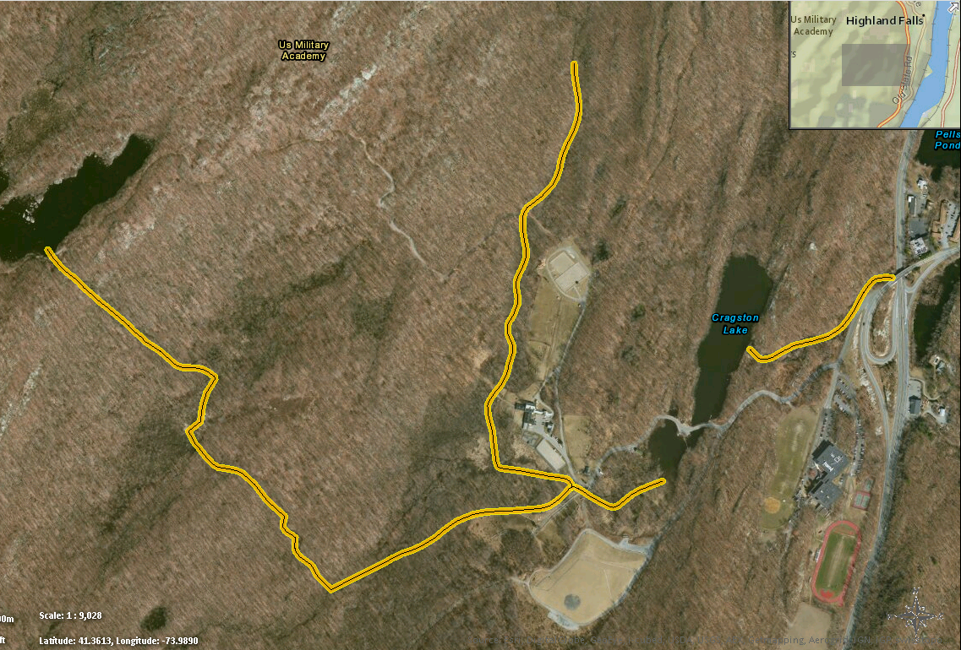
Linear Somatochlora linearis – Mocha Emerald Dragonfly
Conceptual Feature Type: Point
Observation: The odonates were observed in the brooks associated with the lakes. (EO ID 11269)

Slide 24
Delimited
Uncertainty:
Locational variability that is greater than ½ mmu
in more than one direction
Location can be delimited by a boundary
based on physical features and/or biologist’s determination
Resulting Source Feature: Polygon
E.g.: bog turtle observed somewhere within Lake Ojibwa
Notes:
Ask for additional examples

Slide 25
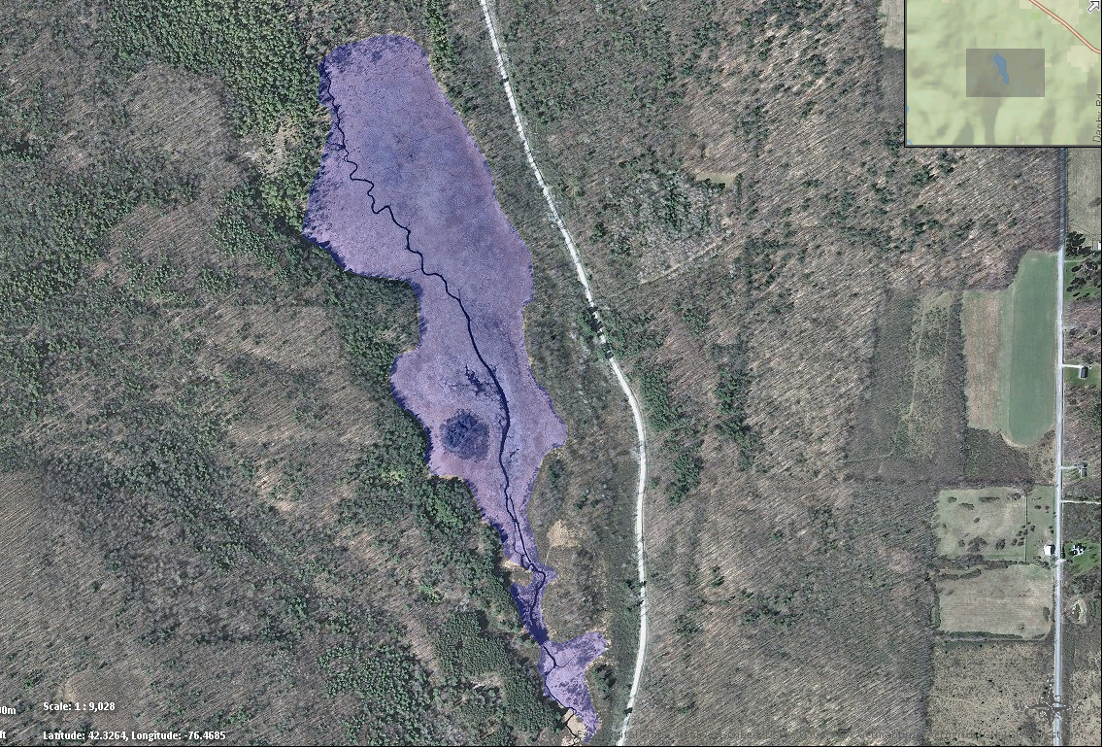
Delimited Shallow Emergent Marsh
Conceptual Feature Type: Polygon
A single patch of grass- and sedge-dominated open wetland within the floodplain of Michigan Hollow Creek. (EO ID 11351)

Slide 26
Estimated
Uncertainty:
Locational variability that is greater than ½ mmu
in more than one direction
A boundary cannot be drawn
Uncertainty distance specified by biologist
Distance automatically applied to entire feature as a buffer, by application
E.g. GPS point with accuracy of 23 m

Slide 27
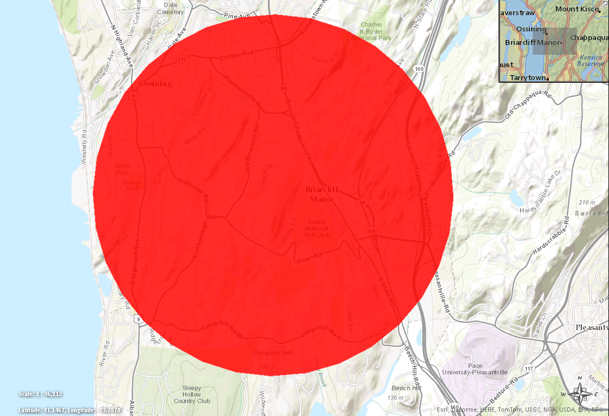
Estimated Oporornis formosus – Kentucky Warbler
Conceptual Feature Type: Point
Observation: The birds were reported near Ossining, Westchester County.
Locational Uncertainty Distance: 2400 m (EO ID = 10154)
Notes:
Now, looking at this, you might get the impression that Estimated reflects imprecise data.
That may be the case here, where the LUD is 2400 m, but that is not always the case.
Estimated LUT also applies to GPS coordinates which may be very precise.
Which brings us to the question of, how do we know the accuracy of a Source Feature?
That accuracy is reflected within the …

Slide 28
Representation Accuracy
Indicates the level of accuracy associated with the Source Feature
Varies on the basis of the area observed to be occupied by the Element (Field Observation) , reflected by Conceptual Feature Type, relative to the area contained within the footprint of the Source Feature
Differences in the two sizes reflect the locational uncertainty included in the feature’s boundary
RA provides a common index for consistent comparison, enabling correct analysis and interpretation
Values: Very High, High, Medium, Low, Very Low

Slide 29
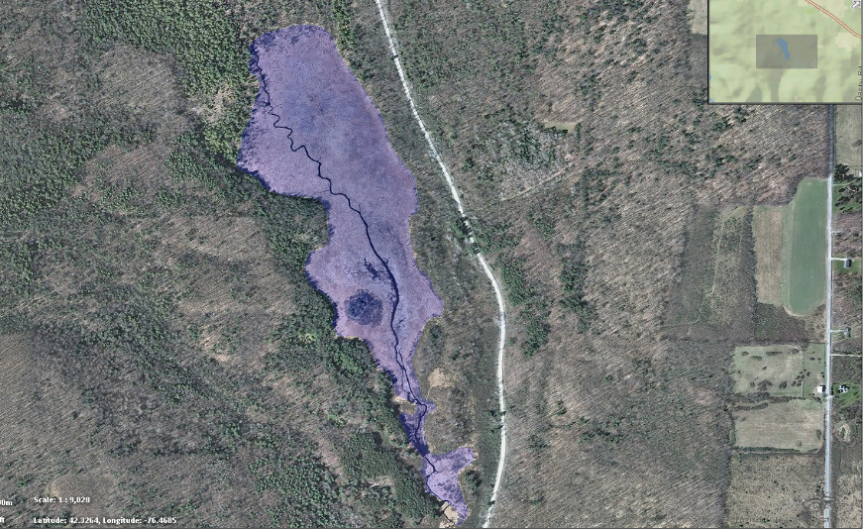
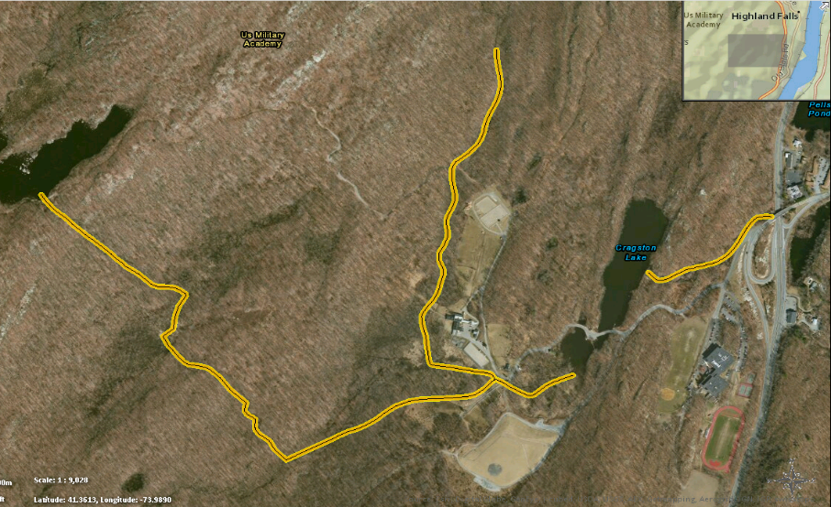
Representation Accuracy
Notes:
Looking at these, how do we know the accuracy of these spatial features?

Slide 30
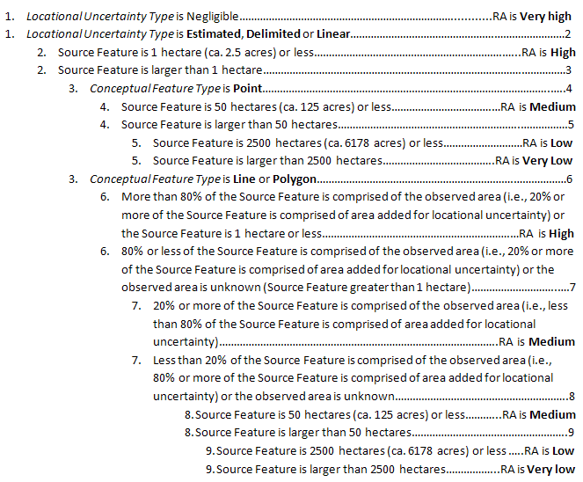
Representation Accuracy Dichotomous Key
Notes:
The accuracy is determined using the Representation Accuracy Dichotomous Key – we’ll go through some examples during the Mapping session.

Slide 31
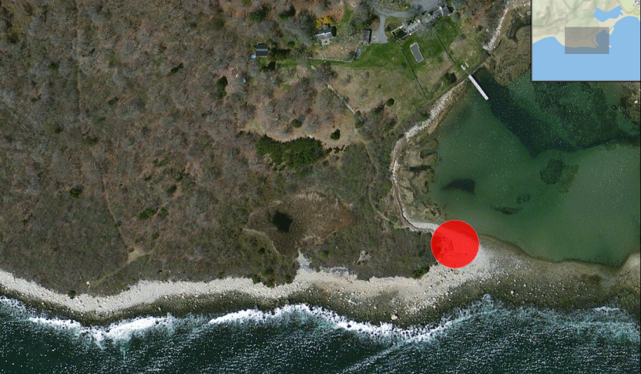
Source Feature
Field Observation:
Piping plover nest recorded using a GPS with 20 m accuracy
Location Use Class: Breeding, Nonbreeding, Migratory Stopover or Undetermined
Conceptual Feature Type (Observation Feature): Point
Locational Uncertainty Type: Estimated
Pre-Source Feature Type: Point
Locational Uncertainty Distance: 20 m
Source Feature: Polygon
Representation Accuracy: High
© Dennis Donahue
Notes:
Now we can look at that same Piping Plover observation in the context of a Source Feature.

Slide 32
Source Features: Summary of Spatial Feature Development
Notes:
And here, we can see the Source Feature in the larger context of the Spatial Feature Development.

Slide 33
Element Occurrences

Slide 34
Element Occurrence (EO)
Polygon
Area of land and/or water in which a species or natural community is, or was, present
Based on an observation; a KNOWN location – not based on a model or suitable habitat
Should have practical conservation value for the Element as evidenced by potential continued (or historical) presence and/or regular recurrence at a given location
Developed from one or more Source Features
Developed for Tracked elements (EO Track Status = Y, P, or W)
Developed using standards defined in Element Occurrence Specifications (EO Specs) & EO Rank Specifications (EO Rank Specs) to ensure consistency across the range of an Element:
Taxonomic and classification standards
Minimum criteria for an EO
Rules for separating EOs
Criteria to rank potential for an EO to persist if current conditions remain

Slide 35
Procedural Buffer
Buffer added to Source Features with Negligible or Linear Locational Uncertainty
Ensures that features are visible at target map scale of 1:xx,xxx
Buffer used is ½ mmu
Area NOT included in actual Source Feature – just used for visualization purposes.
Area IS included in Element Occurrence
Resulting EO feature: Polygon
NOTE: For features smaller than the mmu, a Procedural Feature is added strictly for the purposes of visualization on a map of scale 1:xxxxx. The Procedural Feature is not included in the SF as it does not represent spatial uncertainty. Evident by downloading and reviewing in SF shapefiles.
Notes:
The first thing we’re going to address is the EO as a polygon.
How do those points and lines become polygons?
Well, the next step in the Spatial Feature Development is the addition of the Procedural Buffer which is added….

Slide 36
Summary of Spatial Feature Development

Slide 37
What does ‘Practical Conservation Value’ mean?
Defined for each Element/Element Group within EO Specifications (EO Specs) record within Minimum EO Criteria field
Yes or No?:
Bald eagle fledgling
Rare sighting of bird not previously recorded in area during El Nino/hurricane
Bengal tiger in local park
Notes:
Next, let’s focus on what Practical Conservation Value means – what do you think ‘practical conservation value’ means?

Slide 38
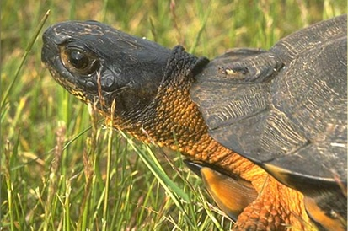
Why is an EO important?
Defines meaningful conservation units (e.g., an area which can sustain a species population or habitat)
Supports range-wide assessments of species and ecosystems

Slide 39
How to distinguish one EO from another?
Element Occurrence Specification (EO Specs) record provides guidance on how to define and delineate valid EOs:
Define what evidence constitutes valid EOs
SPECIES: Minimum size, quality, or persistence
ECOLOGICAL ELEMENTS: Minimum size
Delineate and differentiate EOs according to:
Separation distances (suitable, unsuitable habitat, barriers)
Other factors (e.g., use of habitat, system characteristics)
Notes:
So how do we distinguish one EO from another?

Slide 40
Element Occurrence Specifications (EO Specs)

Slide 41
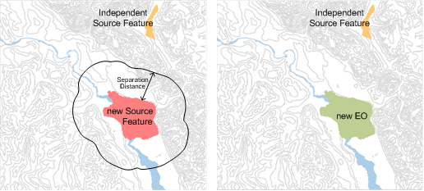
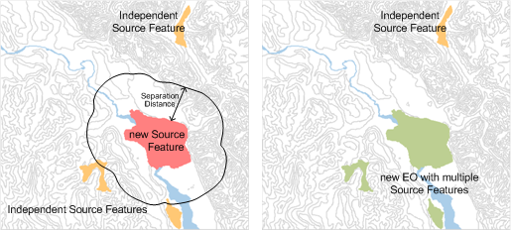
Separation Distance (SD) Analysis & Application
Independent SFs within SD
New EO developed with multiple SFs
No other SFs within SD
New EO developed from new SF
Separation Distance
Independent Source Feature
new Source Feature
Element Occurrence (EO)
Notes:
As mentioned, the EO Specs record includes information on Separation Distance which is used to delineate EOs.
The Separation Distance analysis determines which Source Features should be grouped into a given EO.
For example…

Slide 42
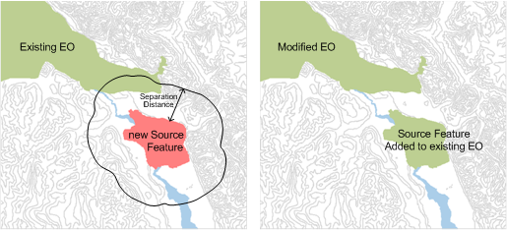
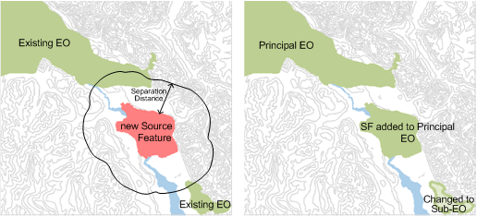
Separation Distance (SD) Analysis & Application
Principal EO chosen, SF added to Principal EO, additional EO made into Sub-EO of Principal
Multiple existing EOs within SD
One existing EO within SD
Existing EO modified by adding new SF
Separation Distance
Independent Source Feature
new Source Feature
Element Occurrence (EO)

Slide 43
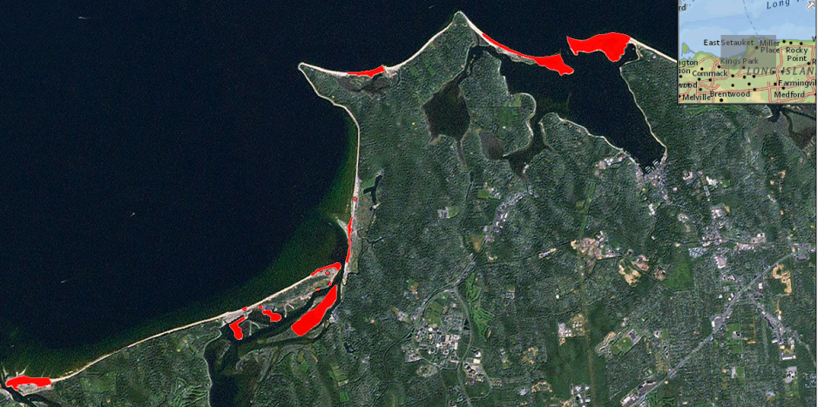
Element Occurrence
Field Observation:
Multiple observations of Piping Plover recorded
across Smithtown Bay
Source Features:
One or many Source Features of feature type Point, Line, &/or Polygon
Separation Distance:
5 km – Suitable Habitat Distance
Element Occurrence: Polygon
Representation Accuracy:
depends on that of the component SFs
© Dennis Donahue

Slide 44
Summary of Spatial Feature Development

Slide 45
Learning More
Element Occurrence Data Standard
Summary of Spatial Feature Development
Methodology for Developing Spatial Features
Recorded Training Sessions
Online Help Documentation
Technical Support

