Slide 1
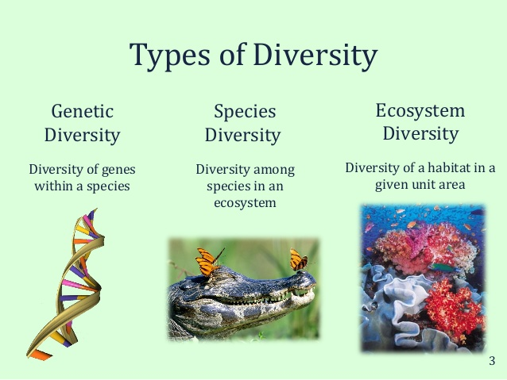
Biodiversity

Slide 2
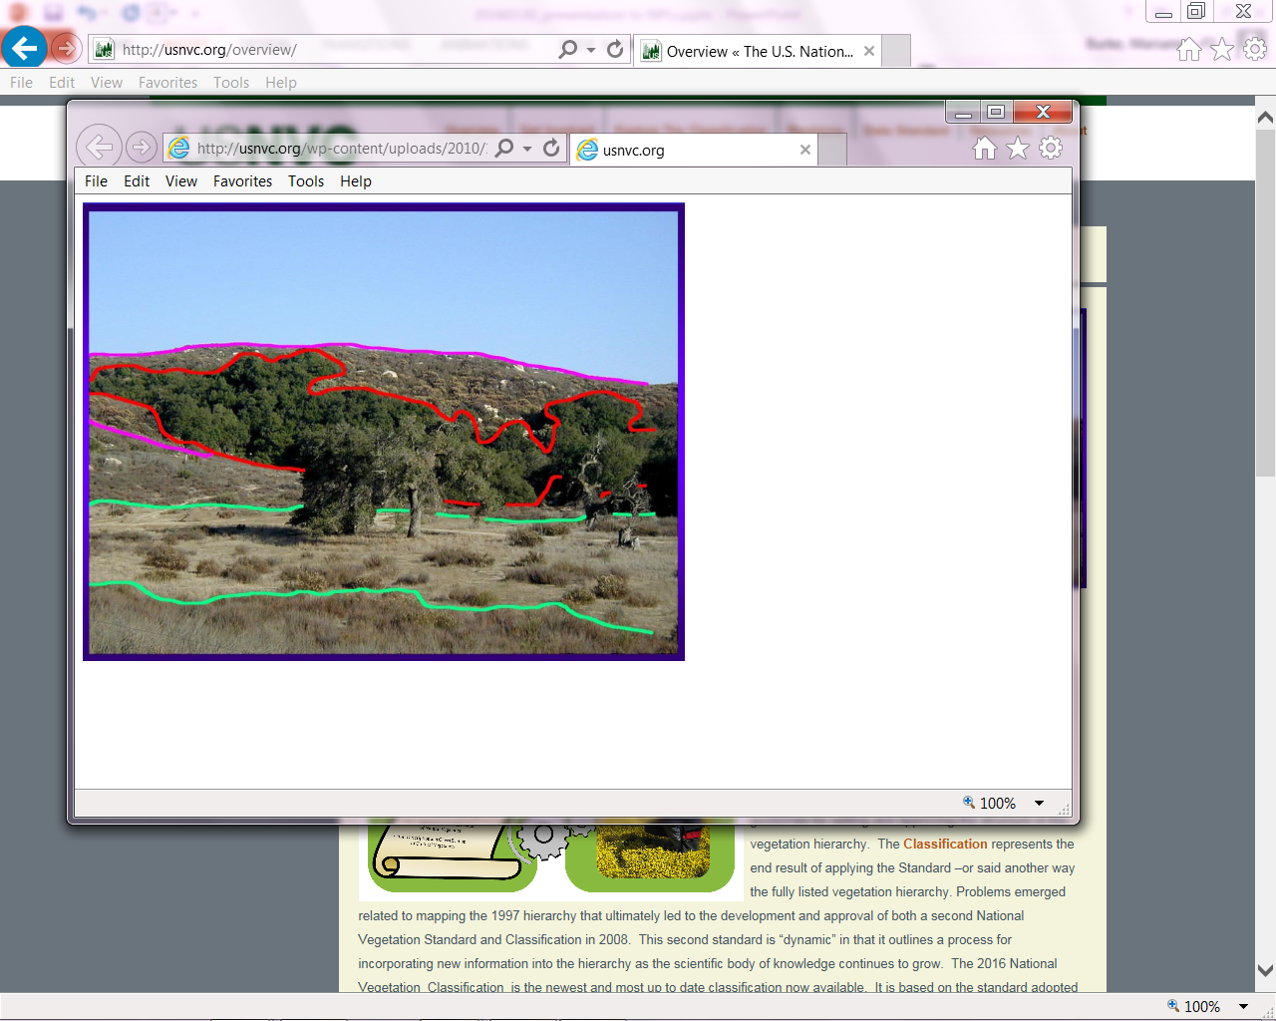
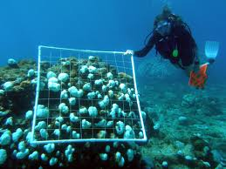
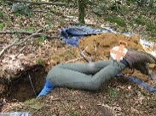
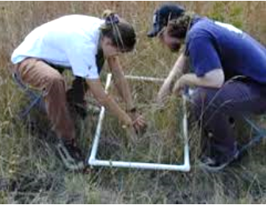
Ecosystem Classification
Ecosystem (Ecological) classification is the process of grouping sites (“stands”) based on shared biota and ecological characteristics.
As with any taxonomy, ecosystem
classification is used to simplify
the complex patterns of ecosystems in order to communicate and share
information.

Slide 3
Challenges for Ecosystem Classifications
Complexity of concept
Lack of sharp boundaries
Scale of definition (thematic, spatial)
Composition changes temporarily or cyclically (e.g., succession or fire systems)
Solutions:
    Use collaborative approaches (vegetation types, ecological sites, ecoregions)
    Focus on core Network ecosystem concepts: vegetation types / natural communities

Slide 4
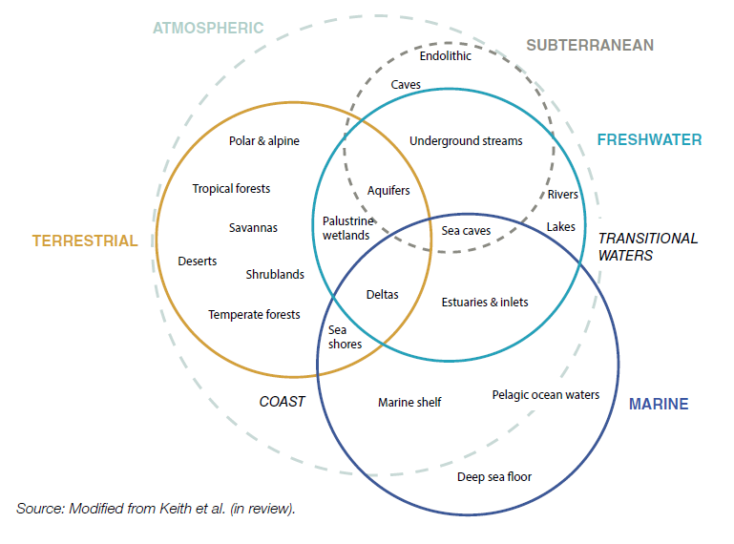

Ecosystem Realms (IUCN)
IUCN Working Group: Ecosystems of the World

Slide 5
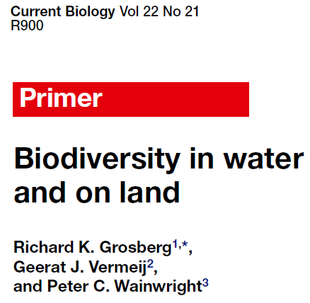
Ecosystem Realms
REALM | Percent of Earth’s Surface | Percent of Species Diversity
Marine | 71% | 15%
Terrestrial | 28% | 80%
Freshwater | 2% | 5%

Slide 6
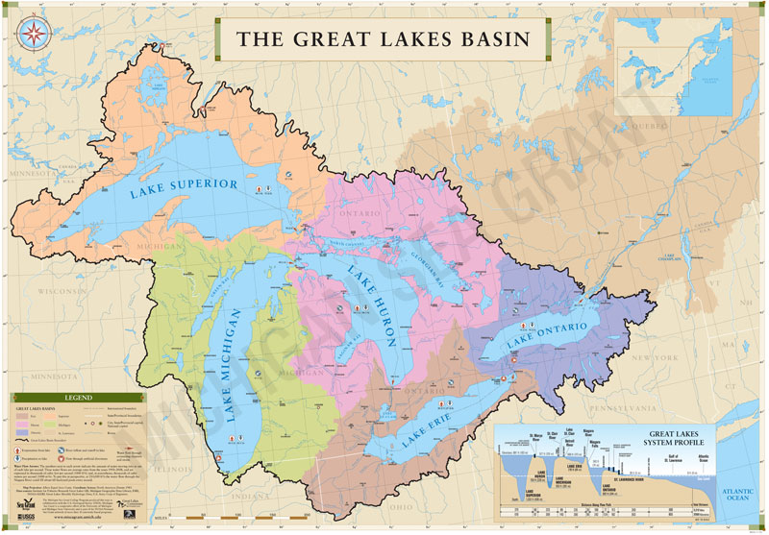
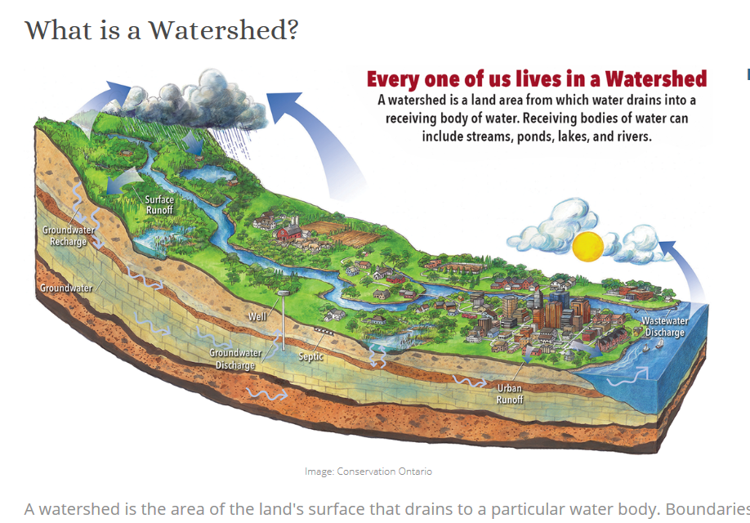

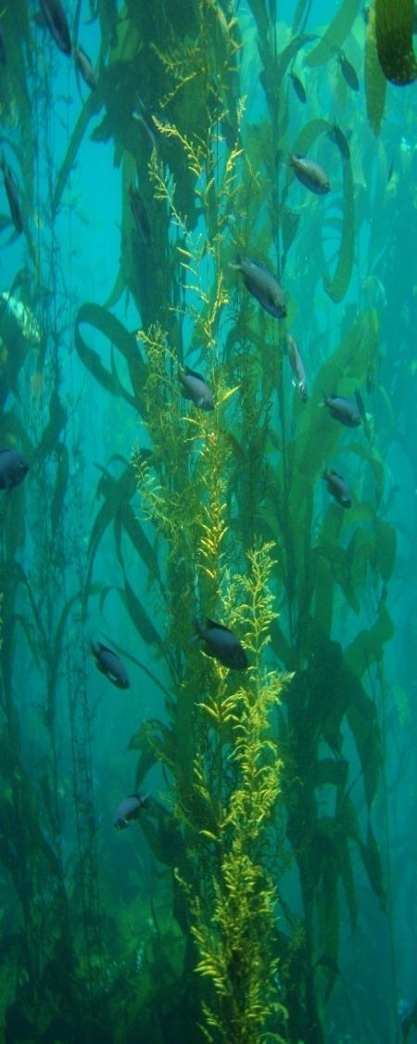
Freshwater ecosystems:
Watershed approach
Marine Ecosystems:
Coastal & Marine Ecological Classification Standard (CMECS)
Subterranean ecosystems:

Slide 7
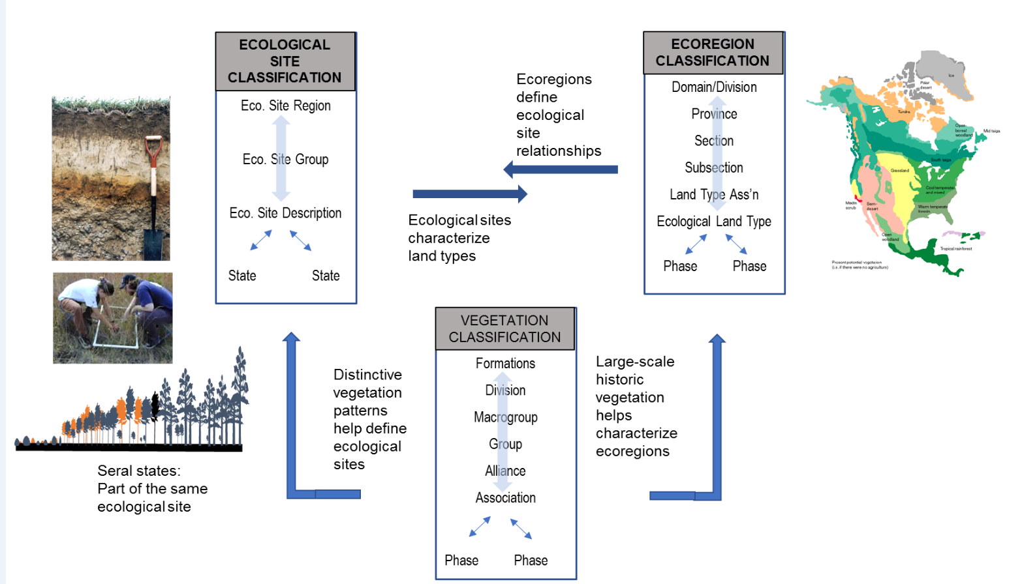
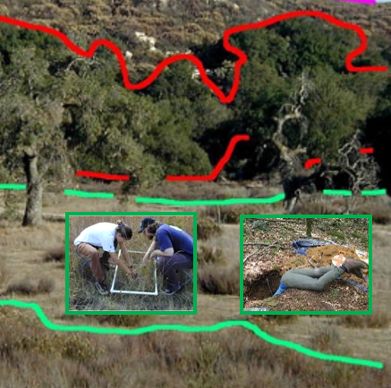
Terrestrial Ecosystem Classifications
Ecological Systems
EBAR
International Vegetation Classification
The EcoVeg backbone – Network standard

Slide 8
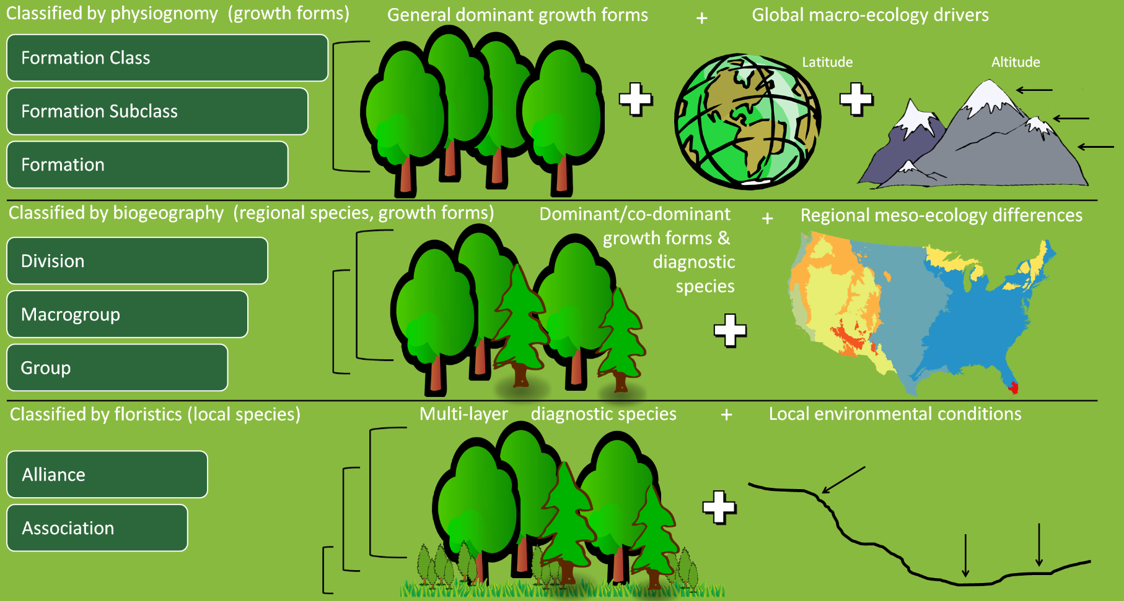
Ecological Vegetation Hierarchy: International Vegetation Classification*
General,
Dominant
Growth
Forms
Dominant/
codominant
and diagnostic
species
Multi-layer
Diagnostic species and local
environmental
conditions
http://usnvc.org/data-standard/natural-vegetation-classification/

Slide 9
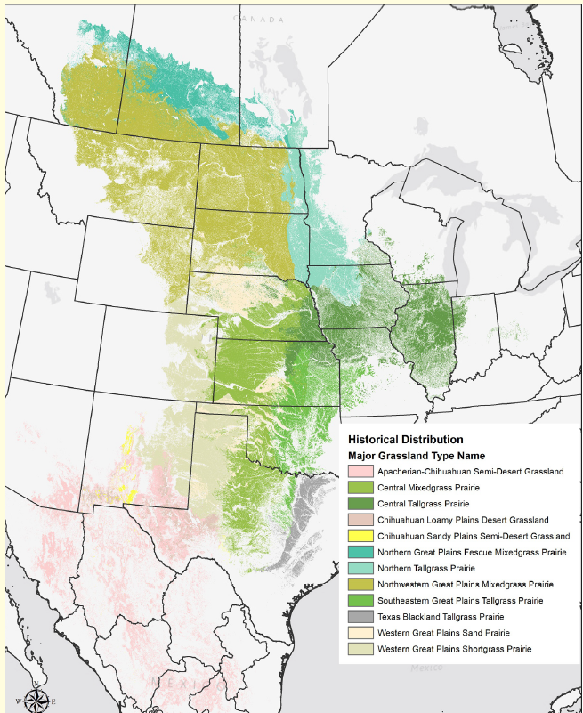
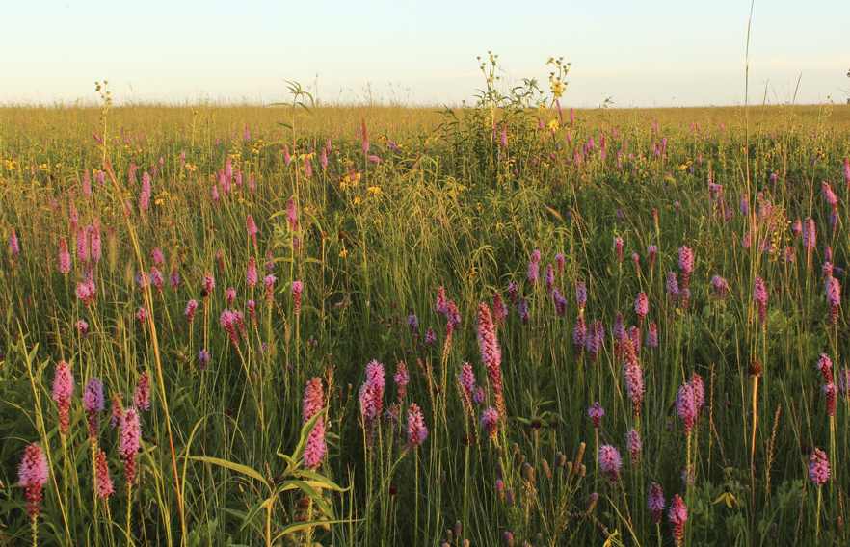
Hierarchy: Natural Vegetation
Hierarchy Levels | Example
Upper
Level 1 – Formation Class | Shrub & Herb Vegetation
Level 2 – Formation Subclass | Temperate & Boreal Shrubland & Grassland
Level 3 - Formation | Temperate Grassland & Shrubland
Mid
Level 4 – Division | Central North American Grassland & Shrubland
Level 5 – Macrogroup | Central Lowlands Tallgrass Prairie
Level 6 – Group | Central Tallgrass Prairie
Lower
Level 7 – Alliance | Big Bluestem – Indian grass Mesic Prairie
Level 8 – Association | Big Bluestem – Blazing Star Mesic Loam Prairie
Central Tallgrass Prairie
Increasing resolution
*Faber-Langendoen, D., T. Keeler-Wolf, D. Meidinger, D. Tart, C. Josse, G. Navarro, B. Hoagland, S. Ponomarenko, J-P. Saucier, A. Weakley, and P. Comer. 2014. Eco-Veg: a new approach to Vegetation Description and Classification. Ecological Monographs 84(4):533-561.
Notes:
Updated vegetation classification hierarchy (FGDC 2008, Faber-Langendoen et al. 2014)

Slide 10
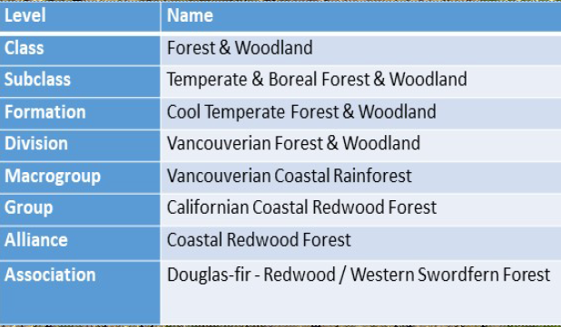
NatureServe’s
Ecosystem Elements
Major Ecosystems
Regional Ecosystems
Subregional Ecosystems
Local Ecosystems
Natural Communities

Slide 11
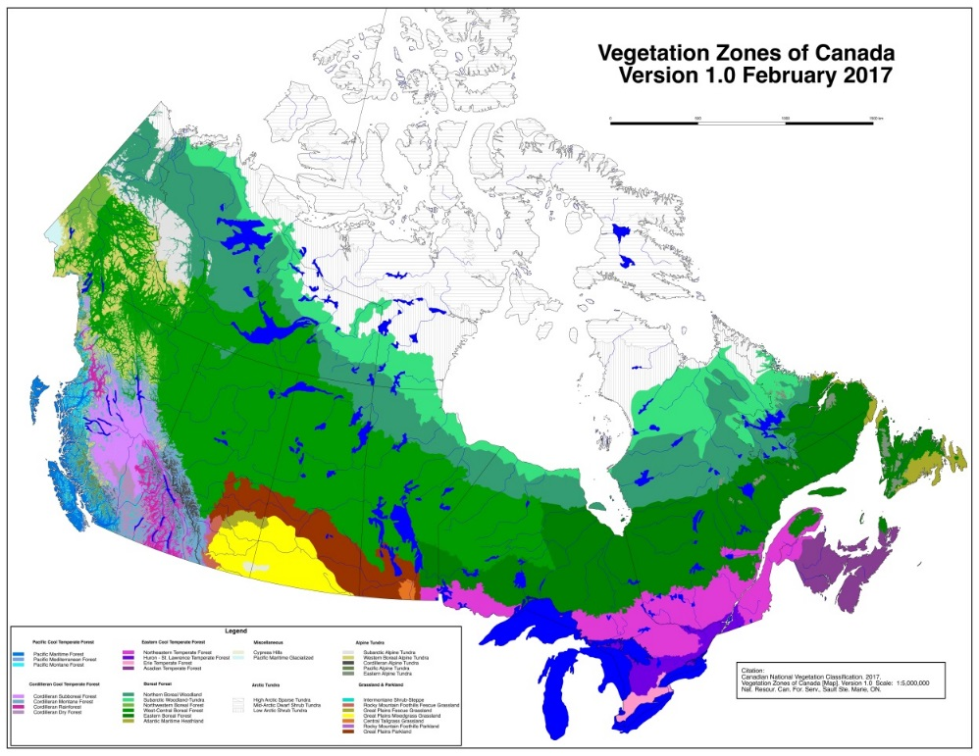
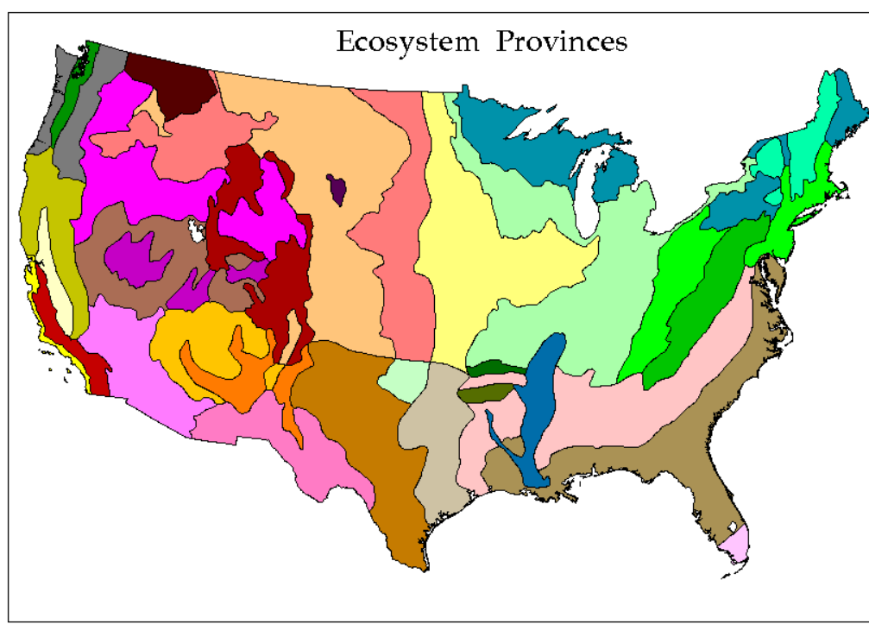
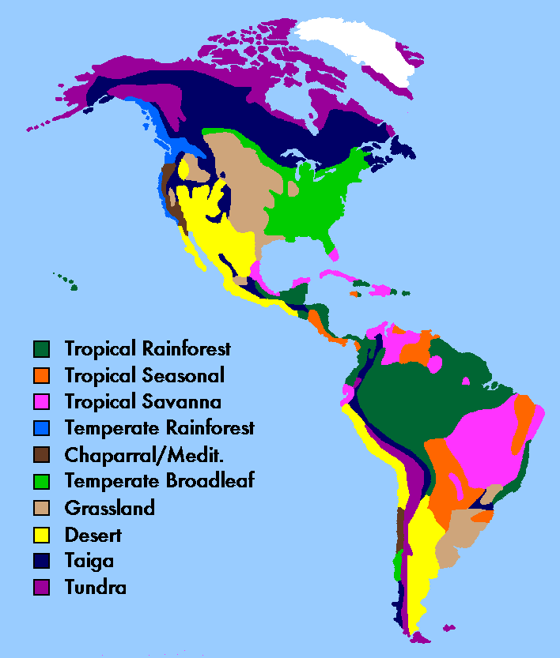


Inter/National Partnerships based on the EcoVeg Approach
CANADIAN / U.S. NATIONAL VEGETATION CLASSIFICATIONS
National classifications for all the natural and semi-natural vegetation in Canada and U.S.
INTERNATIONAL VEGETATION CLASSIFICATION
A classification of global vegetation. Best developed in the Americas
The EcoVeg backbone – Network standard
Notes:
The USNVC uses range-wide concepts for all types, nesting within a larger International Vegetation Classification, providing both a national and global perspectiveA great need to systematically inventory, classify, and map the incredible diversity of ecosystems on Earth in the face of ever intensifying land uses and changing landscapes. The implications for biodiversity, ecological processes, and ecosystem services are profound, as historic natural systems are degraded, or replaced by novel ecosystems.

Slide 12
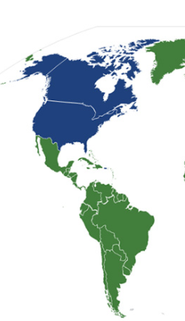
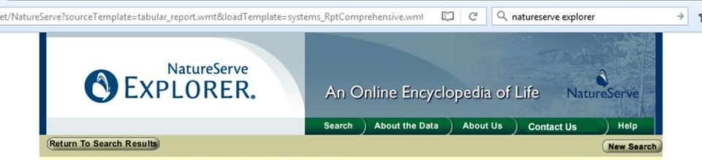
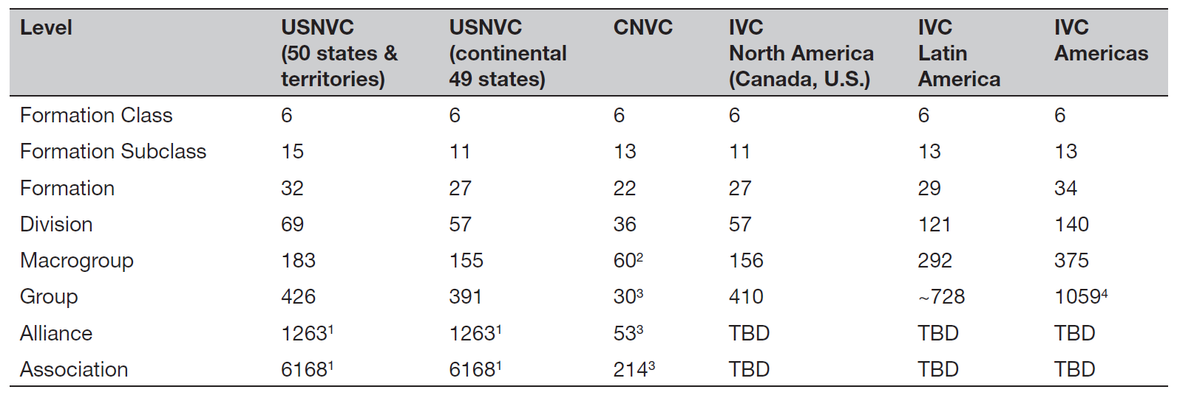
The IVC partnership
97
242
613
1739+

Slide 13
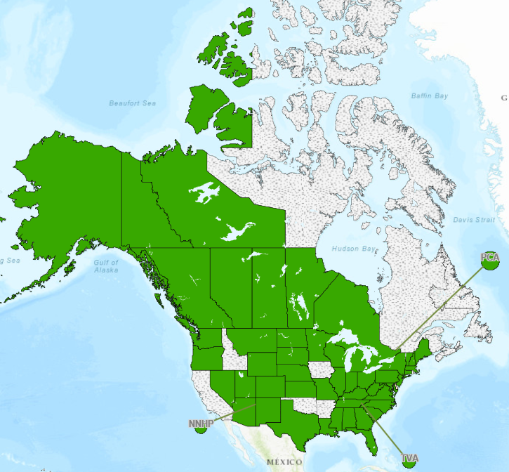
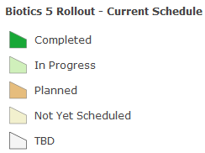
Subnational Partnerships
Many states and provinces helped build the USNVC and CNVC
Many U.S. states directly use USNVC as their state classification
Provinces / territories in Canada engaged in CNVC development
Most programs have direct access to information - Natural Heritage Network / Classification Database (Biotics 5)
Notes:
The USNVC uses range-wide concepts for all types, nesting within a larger International Vegetation Classification, providing both a national and global perspective

Slide 14
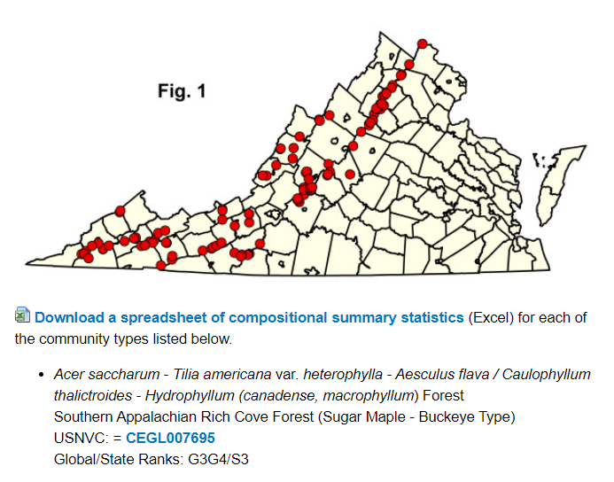
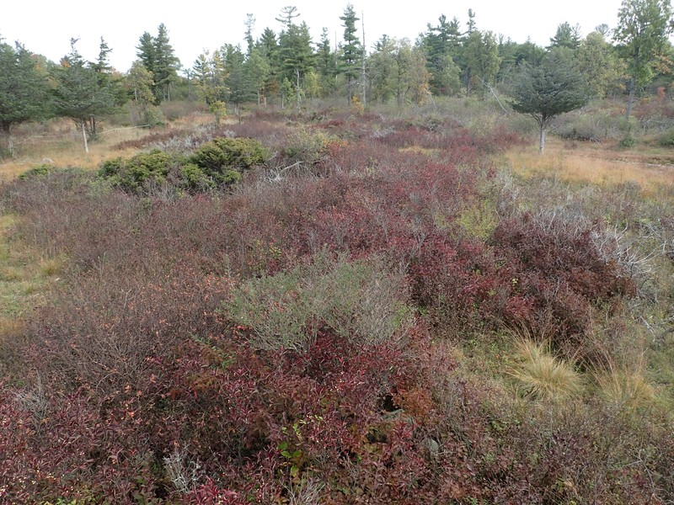
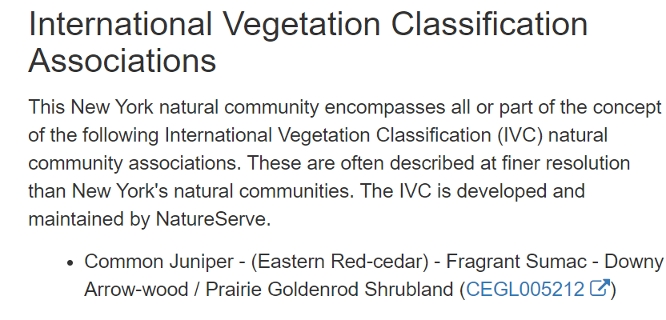
The IVC and the Network:
- direct use
- crosswalk
Virginia NHP: Southern Appalachian Rich Cove Forest (Sugar Maple-Buckeye Type)
New York NHP: Alvar Shrubland
Juniper Alvar Shrubland

Slide 15
Subnation | Ecological Vegetation Type | # of Obs
G089 Great Lakes Dune [G3G4]
ON | Juniper Dune Shrubland Type [S2] | 1
 | Sand Cherry – Wormwood …Shrub Dune Type [S1] | 1
 | Sand Cherry Dune Shrubland Type [S2] | 3
 | Hop-tree Dune Shrubland Type [S1] | 3
 | Cottonwood Dune Savannah Type [S1] | 9
 | Red Cedar Dune Savannah Type [S1] | 10
 | Little Bluestem ..Beachgrass Dune Grassland Type [S2] | 12
 | Little Bluestem ..Wheat Grass Dune Grassland Type [S2] | 54
 | American Dune Grass..Dune Grassland Type [S2] | 34
 | total | 127
IL | Foredune [S1] | Xx
IN | Foredune [S1] | Xx
MI | Open Dune [S3] | Xx
NY | Great Lakes dunes [S1S2] | Xx
VT | Sand dune [S1] | Xx
WI | Great Lakes Dune [S2] | Xx

Slide 16
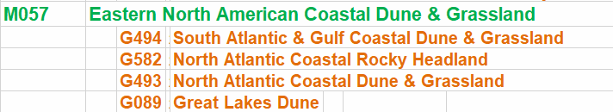
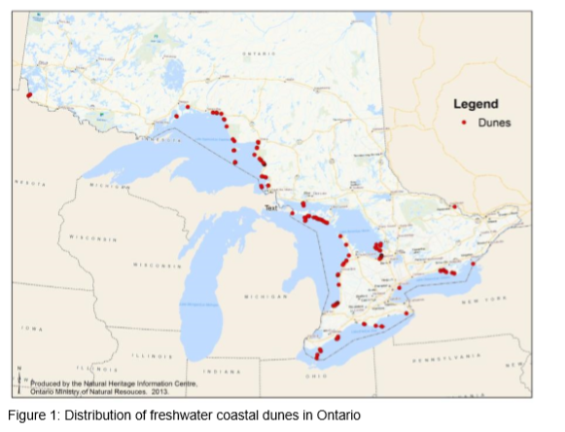
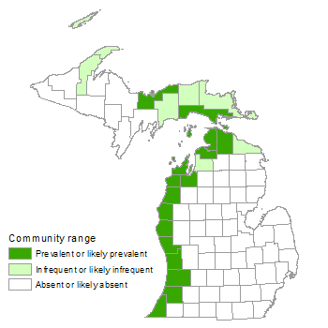
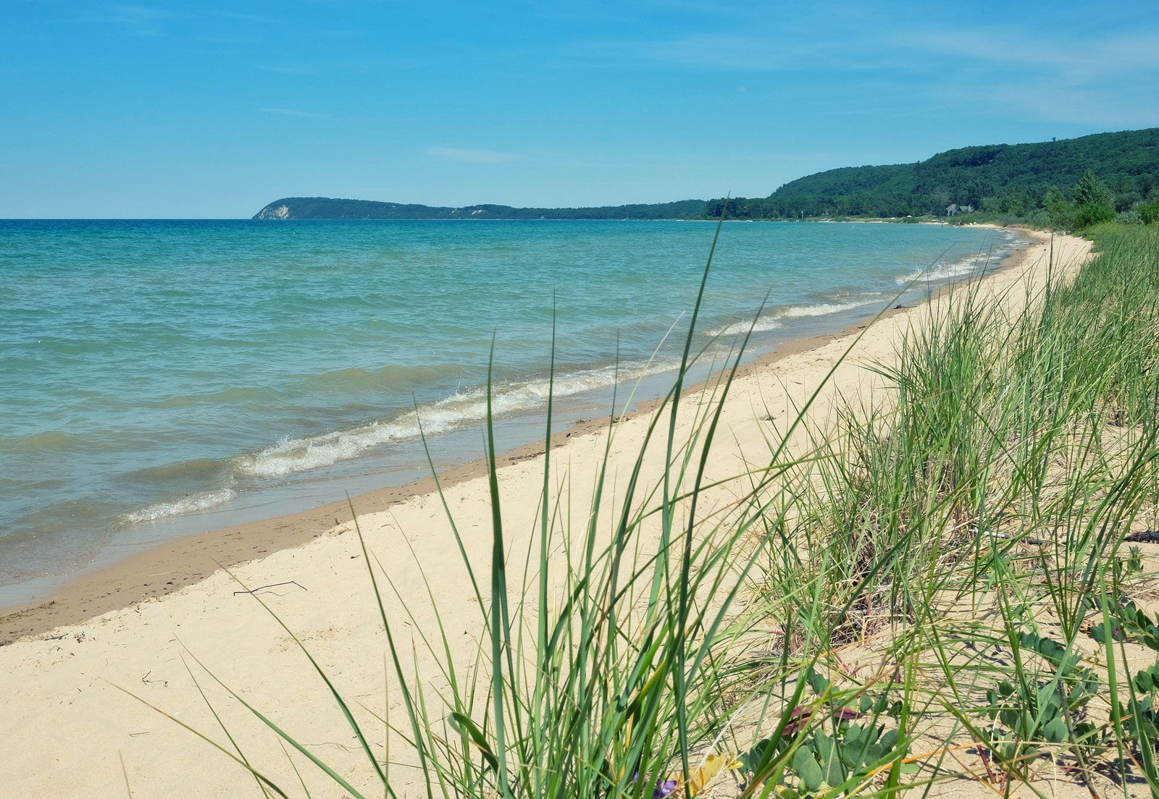

Slide 17
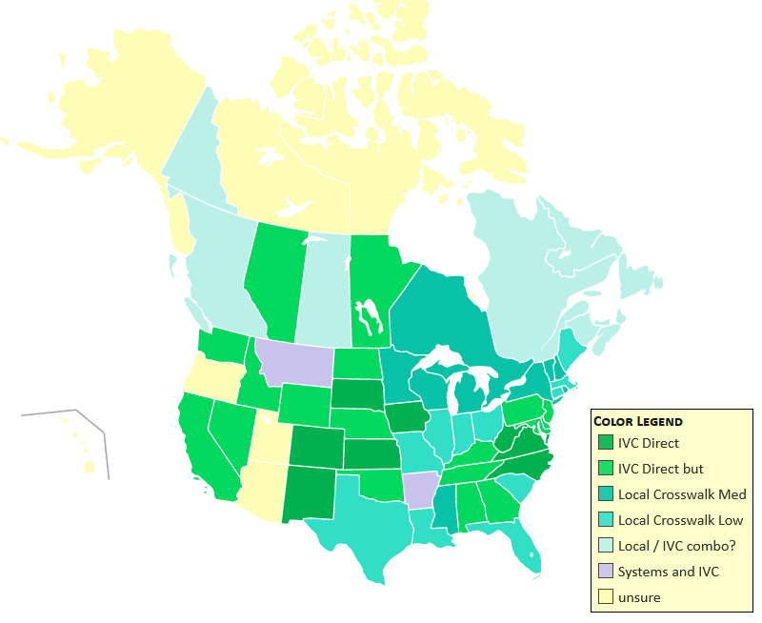
The IVC and the Network
NatureServe Network and the IVC / USNVC-CNVC partnership with states, provinces, and territories.
Goal of collaboration is to identify exemplary and at-risk ecosystems across North America. To do that, the Network needs to achieve operational linkage between program classifications and IVC.

Slide 18
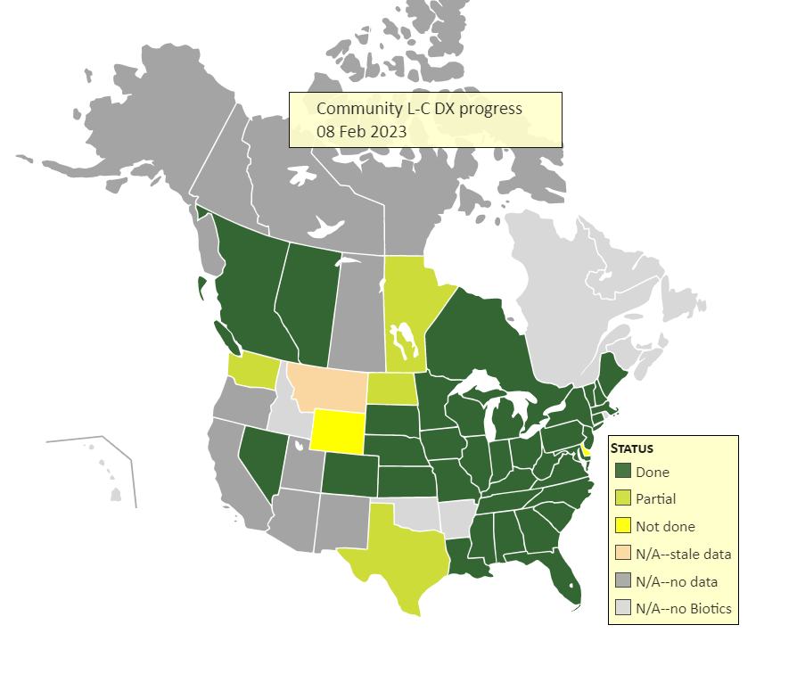

Slide 19
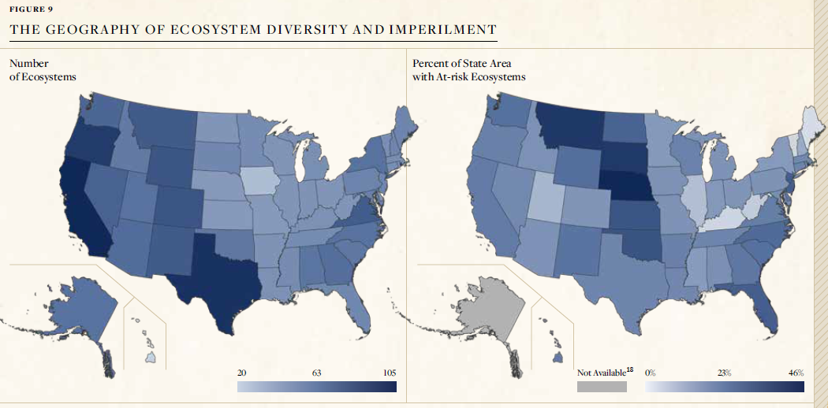
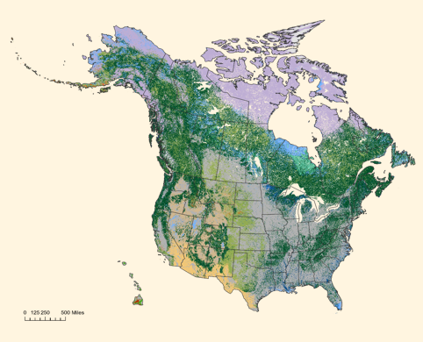
Building the Network capability to track Ecosystem Elements

Slide 20
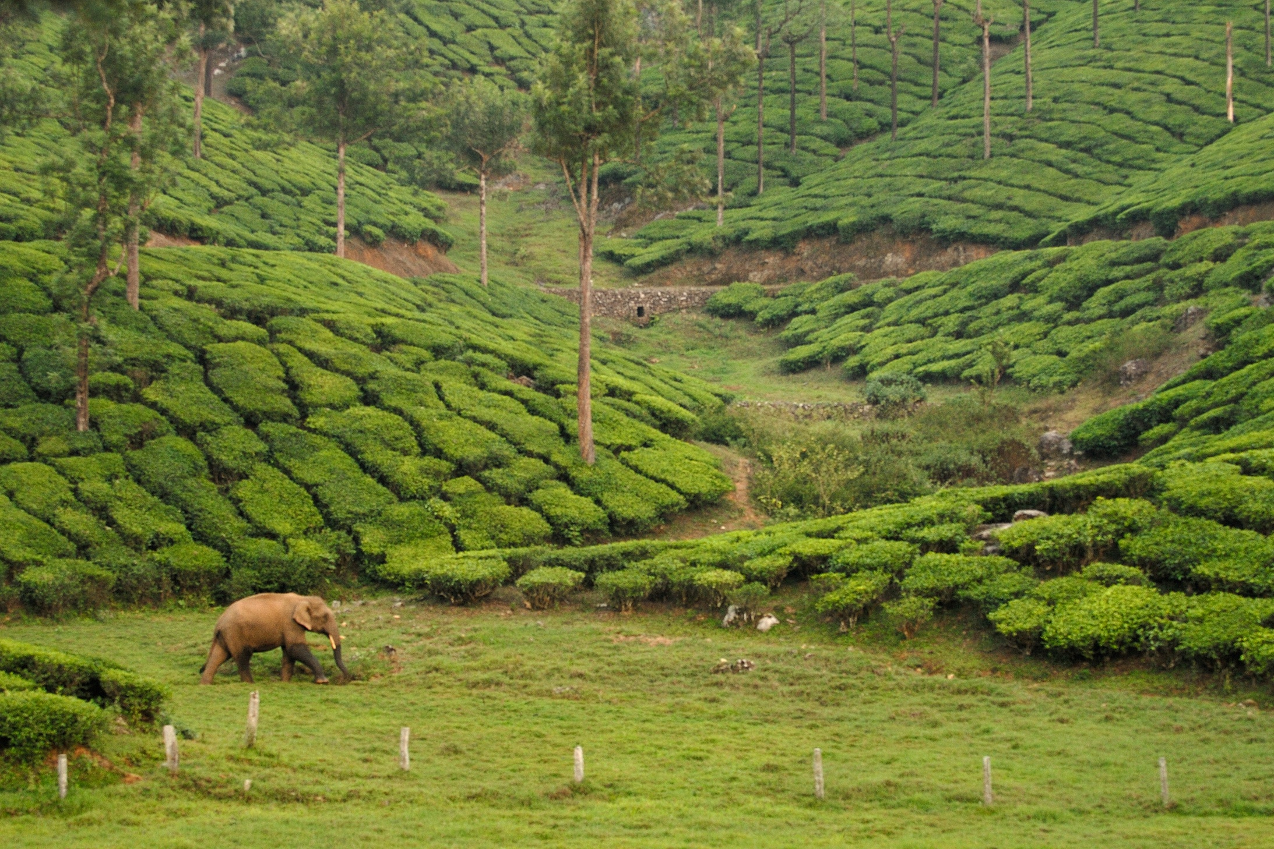
THANK YOU

