Slide 1
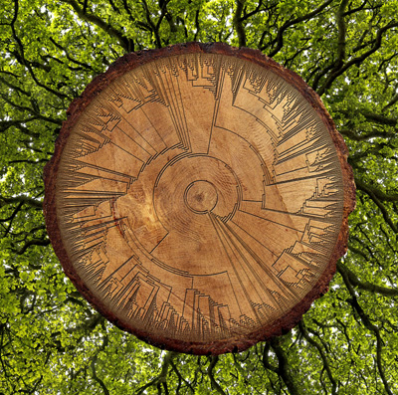
Taxonomic Concepts & Classification
What is it?
Where is it?
How is it doing?
What can we do about it?
Are our actions working?

Slide 2
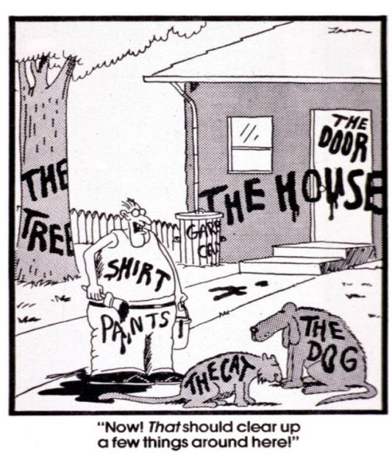
We all Depend on Classification Systems

Slide 3
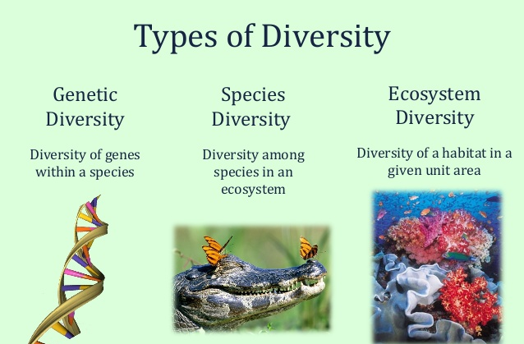

Slide 4
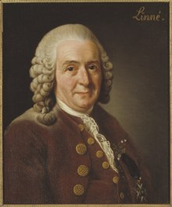
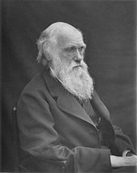
Species Concepts
Define species boundaries
  Initially described and published
  Revised by taxonomists through time
Based on species concept theories
  Biological
  Phylogenetic
  Evolutionary
  Morphological
  Combination of above

Slide 5
Assigning Names
Nomenclature:
A system of scientific names
International Code of Zoological Nomenclature (ICZN)
International Code of Botanical Nomenclature (ICBN)

Slide 6
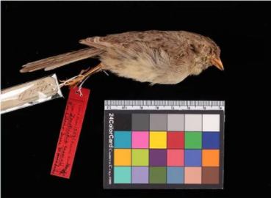
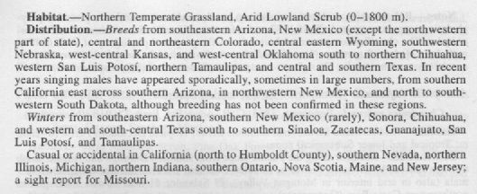
Taxon Description
Name and author combination:
Type specimen(s):
Circumscription (taxon definition):
Peucaea cassinii (Woodhouse 1852)
AOS Checklist

Slide 7
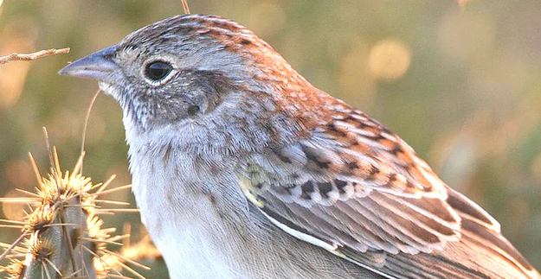
Biotics and Taxonomy
Biotics 5 is concept based and tracks Elements
Every Element has one circumscription or concept, which distinguishes it from another Element, regardless of name.
  1 Element can have many names
Zonotrichia cassinii
Aimophila cassinii
Peucaea cassinii

Slide 8
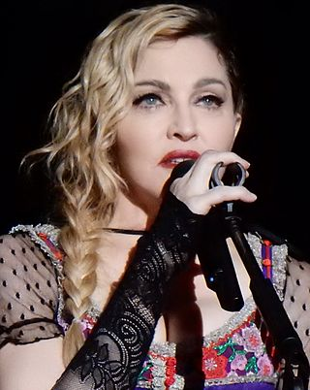
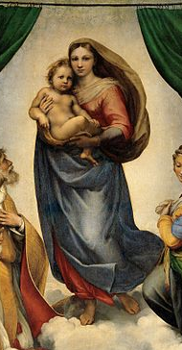
Biotics and Taxonomy
Biotics 5 is concept based and tracks Elements
Every Element has one circumscription or concept, which distinguishes it from another Element, regardless of name.
  1 Element can have many names
  1 Name can represent many concepts
Madonna
Mary, mother of Jesus
Madonna (entertainer)

Slide 9
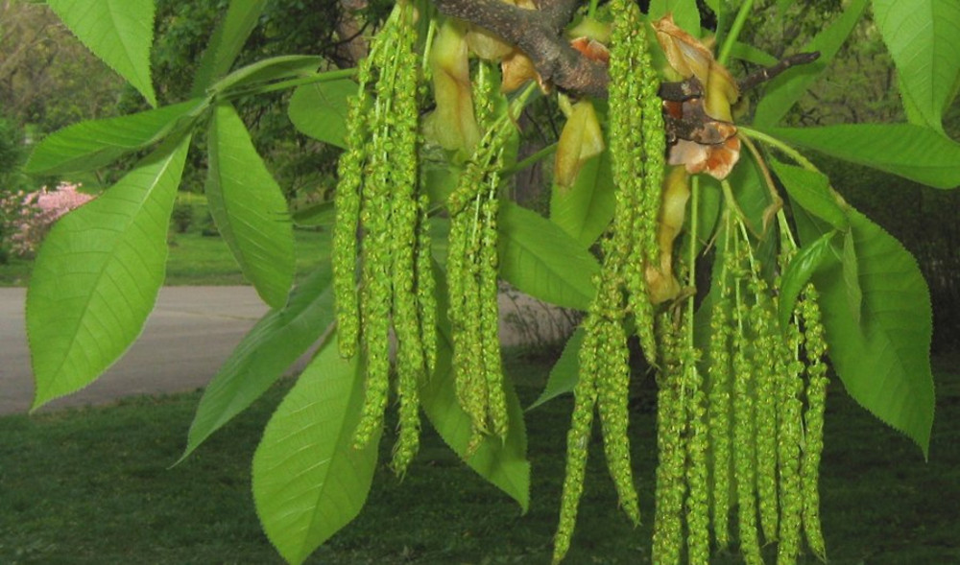
Biotics and Taxonomy
A plant example of nomenclatural ambiguity
Carya carolinae-septentrionalis
(Ashe) Engler & Graebner
Carya ovata
(Miller) K. Koch
Carya ovata
(Miller) K. Koch
sec. Gleason 1952
sec. Radford et al. 1968
Shagbark hickory

Slide 10
Biotics and Taxonomy
A plant example of nomenclatural ambiguity
Carya carolinae-septentrionalis
(Ashe) Engler & Graebner
Carya ovata
(Miller) K. Koch
Southeast
Carya ovata
(Miller) K. Koch
Eastern North America
Northeastern North America
sec. Gleason 1952
sec. Radford et al. 1968
Shagbark hickory

Slide 11




Taxonomic Standards
Birds
Mammals
Vascular Plants
Kartesz 1999
Others
Snakes, Lizards, Alligators, Crocodiles
Butterflies

Slide 12
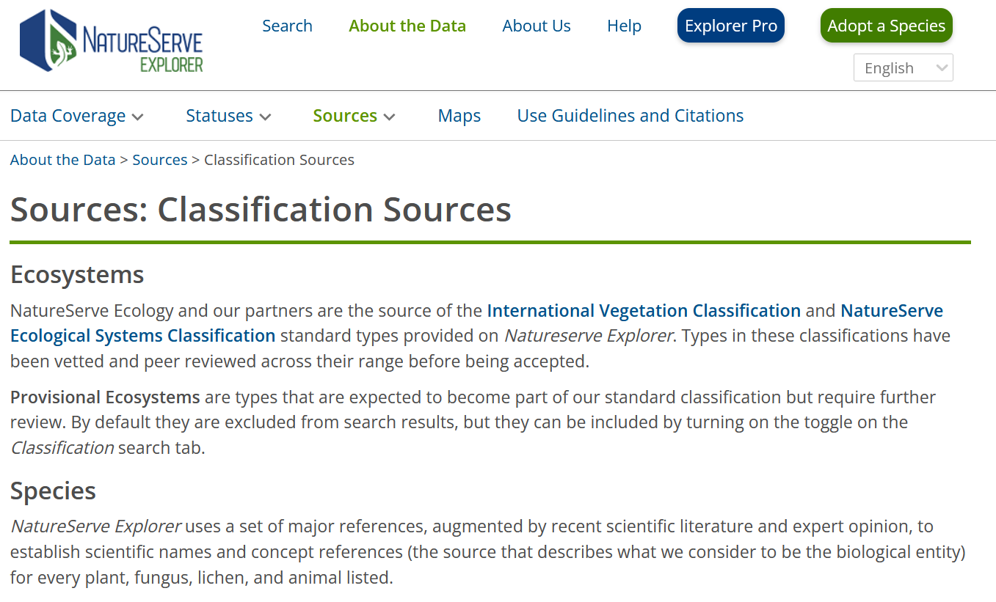
Taxonomic Standards
https://explorer.natureserve.org/AboutTheData/Sources/Classification

Slide 13
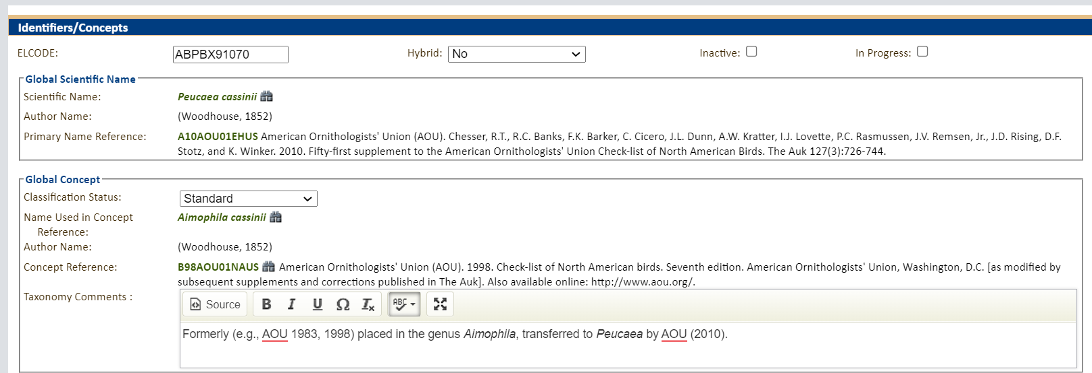
Biotics and Taxonomy

Slide 14
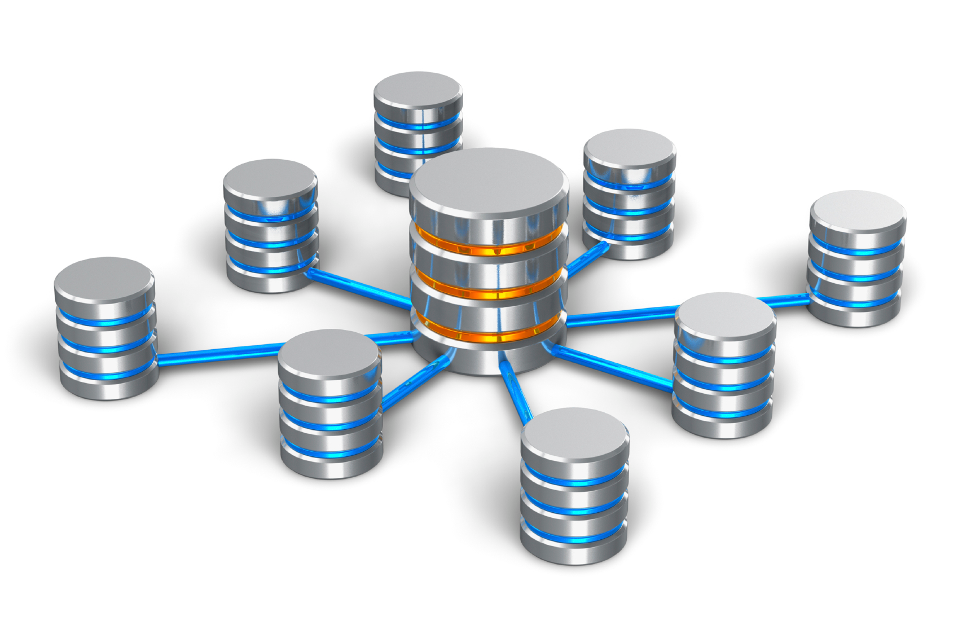

Challenge when Heritage Program follows a different standard
HP
HP
HP
CDC
HP
CDC
HP
CDC
The Taxonomy Tax

Slide 15
Classification Status in Biotics
NatureServe Central is responsible for updating taxonomy in Biotics and creating new elements
Classification Status | Definition | Reported on NatureServe Explorer?
Accepted, also called “Standard” | Accepted by NatureServe Central | Yes, default
Provisionally Accepted, also called “Provisionals” | Not yet formally addressed and accommodated in the standard classification | Yes, if requested
Not Accepted, also called “Nonstandard” | Have been addressed but not accepted by the standard. | Only those with designated federal status (ESA or COSEWIC)
Notes:
Standard , varies according to the pertinent Element type and geographic area.
Provisional Examples: Newly discovered taxa not yet formally described or not addressed in a standard classification, taxa newly discovered in geographic area covered by standard
Nonstandard Nonstandard Elements as circumscribed may be included as a part of a standard Element, or may include parts of two or more standard Elements.

Slide 16
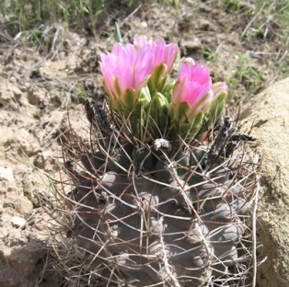
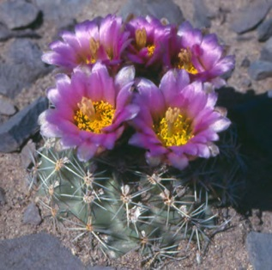
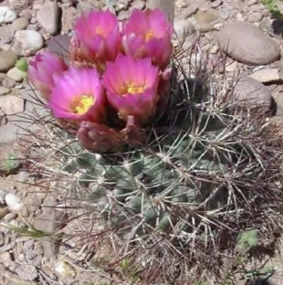
Concepts and Ranks
G4
Uinta Basin Hookless Cactus (Sclerocactus glaucus)
G1
G3G4
Colorado hookless cactus
(Sclerocactus glaucus)
Pariette cactus
(Sclerocactus brevispinus)
G3
G3
G1
Colorado hookless cactus
(Sclerocactus glaucus)
Uinta Basin Hookless Cactus
(Sclerocactus wetlandicus)
Pariette cactus
(Sclerocactus brevispinus)
Photos left to right by Gina Glenne, Ben Franklin, and Maria Ulloa.

Slide 17
Concepts and Ranks
G4
Uinta Basin Hookless Cactus (Sclerocactus glaucus)
G1
G3G4
Colorado hookless cactus
(Sclerocactus glaucus)
Pariette cactus
(Sclerocactus brevispinus)
G3
G3
G1
Colorado hookless cactus
(Sclerocactus glaucus)
Uinta Basin Hookless Cactus
(Sclerocactus wetlandicus)
Pariette cactus
(Sclerocactus brevispinus)
Photos left to right by Gina Glenne, Ben Franklin, and Maria Ulloa.
Notes:
Now let’s look at what happens behind the scenes in Biotics, focusing on the bottom 2 rows here.

Slide 18
What Happens in Biotics When There is a Split?
Colorado hookless cactus
(Sclerocactus glaucus)
Pariette cactus
(Sclerocactus brevispinus)
Element ID: 128221
Element ID: 161086
Photos left to right by Gina Glenne, Ben Franklin, and Maria Ulloa.

Slide 19
What Happens in Biotics When There is a Split?
“Lineage Tracking”
Colorado hookless cactus
(Sclerocactus glaucus)
Pariette cactus
(Sclerocactus brevispinus)
Element ID: 128221 (Inactivated)
Element ID: 161086
Colorado hookless cactus
(Sclerocactus glaucus)
Uinta Basin Hookless Cactus
(Sclerocactus wetlandicus)
Pariette cactus
(Sclerocactus brevispinus)
Element ID: 832412
Element ID: 817003
Element ID: 161086
Photos left to right by Gina Glenne, Ben Franklin, and Maria Ulloa.
Notes:
If at least one program still recognized the old S glaucus concept, we would retain it as a nonstandard. We only deactivate it if no one recognizes it.

Slide 20
Taxonomic updates: When and Why?
Why?
  Member program requests!!
  Global rank reviews
  Updates in taxonomic standard
  Federal listing
When?
  Haphazardly and opportunistically
  Ongoing task (annual priorities)

Slide 21
Comprehensively Assessed Groups
Plants
  Vascular plants
  Nonvascular plants*
Fungi
Lichens*
Animals
Vertebrates (except marine fishes)
Mollusks (freshwater mussels, freshwater & terrestrial snails)
Arthropods
Crayfishes
Fairy, clam, & tadpole shrimps
Insects (butterflies, skippers, macro moths, selected beetles, stoneflies, caddisflies, mayflies, dragonflies, damselflies, selected bees)
* Distribution data incomplete
Notes:
Why these groups? Conservation priorities, well-enough to be assessed, taxonomic authority available, expert knowledge available for assessments

Slide 22

Summary
To identify species elements, a scientific name is necessary but not sufficient
We use concepts in Biotics, indicated by the concept name and reference
Taxonomic standards guide our taxonomic decisions
Communicate with NatureServe about taxonomic issues

