Slide 1

The Observations Lifecycle
Core Methodology Training
February 2023

Slide 2
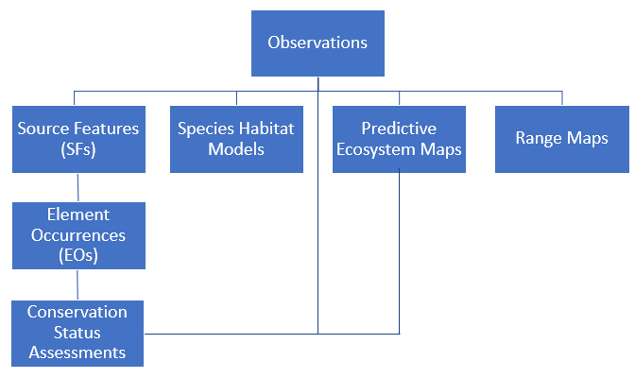
Observations form the basis for subsequent spatial data products
Learn more via this StoryMap
Notes:
The Network has long recognized the value of Observations and many programs have been collecting observation data for decades.
While still not reflected in Biotics, Observations form the basis of SFs, EOs, Conservation Status Assessments, as well as …
For more information I encourage you to visit this StoryMap

Slide 3
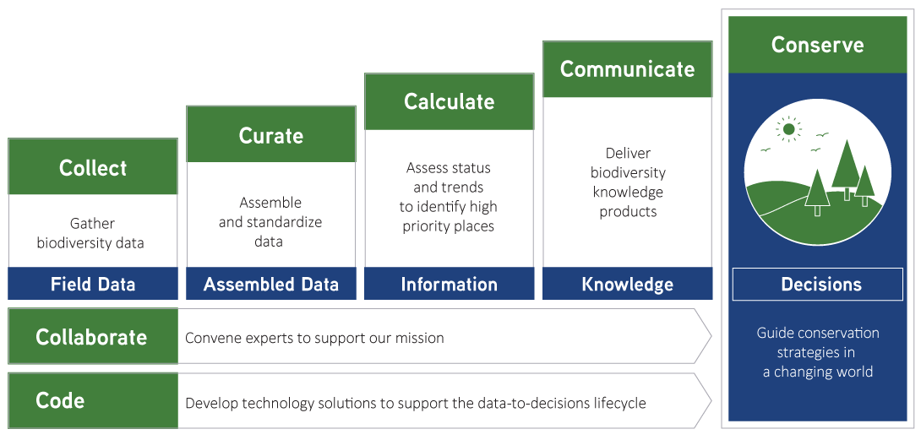
The Data-to-Decisions Lifecycle
Integrated
Technology
Develop and deploy
cutting-edge technology
to streamline every phase of
the data-to-decisions lifecycle
Notes:
One aspect of NatureServe’s Strategic Plan is to develop and deploy cutting-edge technology to streamline every phase of the data-to-decisions lifecycle.
First we’ll focus on how the Observations Lifecycle contributed to the Collaboration phase.

Slide 4









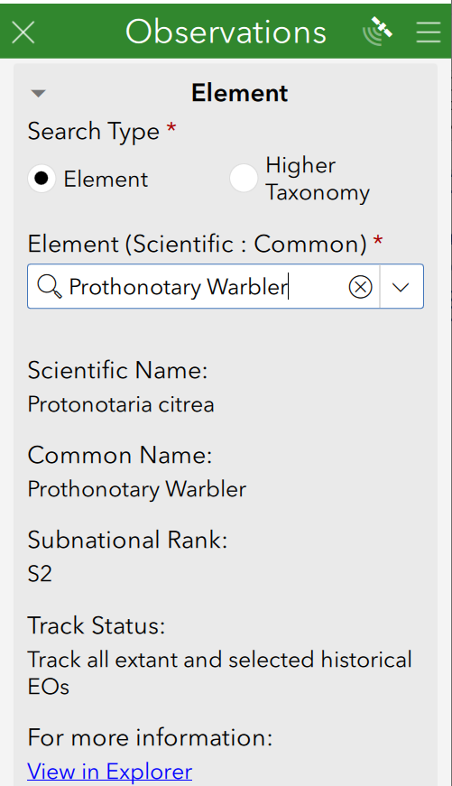





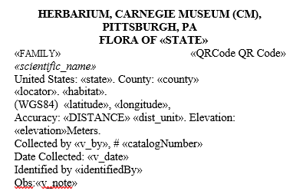
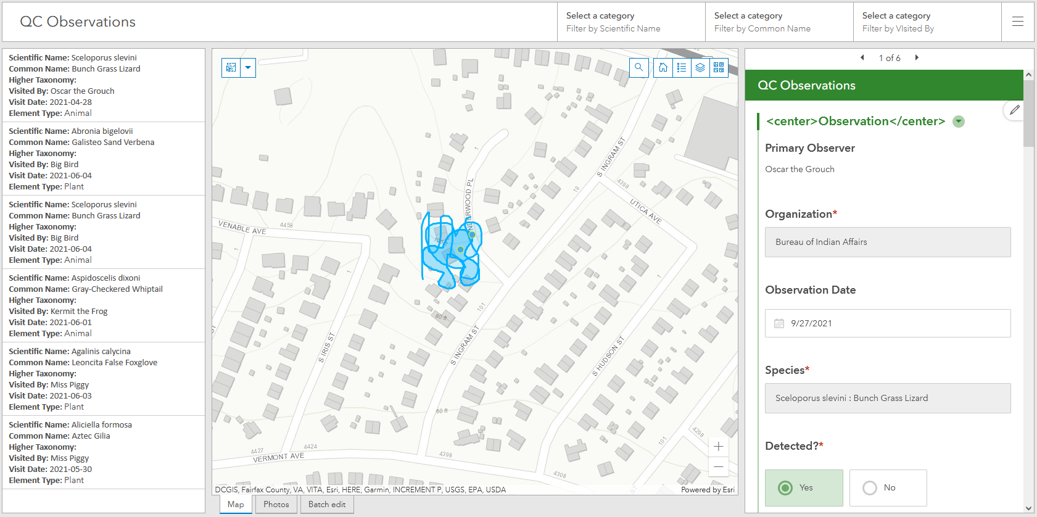
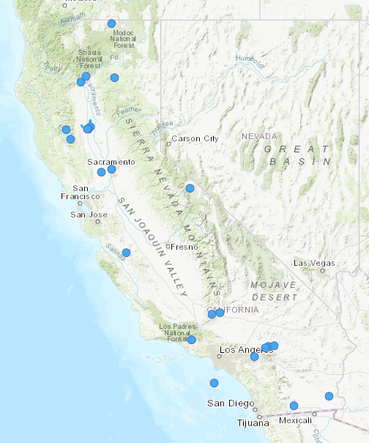

Observation Data Standard
Network Program
Developing standards through Collaboration
Survey123
Existing BLM Data
External Data Sources
ArcGIS
Online
Observation
Survey
Establish taxonomy & filter to meet quality standards
Aggregate via Append (ArcGIS Pro)
Local
Conservation
Status
Assessment
Bulk Create
tool (Local Biotics)
Local Observation
Geodatabase
Observations
assigned to EOs
Bulk Create
Template
EOs
Std. Spp.
Taxonomy
Data Exchange
Threat
Observation BLP
toolbox
(ArcGIS)
Observations
toolbox
(ArcGIS)
Bulk Import
Records tool (Central Biotics)
G Ranks
Trend
S Ranks
N Ranks
Rarity
From Non- Biotics Programs
Central
Online Products
Photos, Recordings, Files
Specimen Labels
Web Map(s)
Dashboard(s)
Aggregated EO Products
Standard Biodiversity Location Data Products via
Custom Biodiversity Location Data Products
Notes:
Over the last number of years, NatureServe has been working to incorporate Observations in an effort to minimize backlog problems.
Part of that effort was to develop the Biodiversity Observation Data Standard in collaboration with the Network.

Slide 5
Biodiversity
Observation Data Standard
Comprehensive set of biodiversity observation data fields:
Developed by a working group comprised of Network & NatureServe staff
Relevant to most of the Network’s programs and meet individual program needs
Compatible with existing NatureServe data schemas (i.e., Biotics)
Positioned to accept data from external sources (interoperable with Darwin Core)
Support the development of priority Network products:
  Spatial Distribution Products
    Element Occurrences
    range maps
    hexagon grid-observations
    habitat suitability models
  Conservation Status Assessments
    establish geographic extent to support ranking
  Quality and Condition Assessments

Slide 6
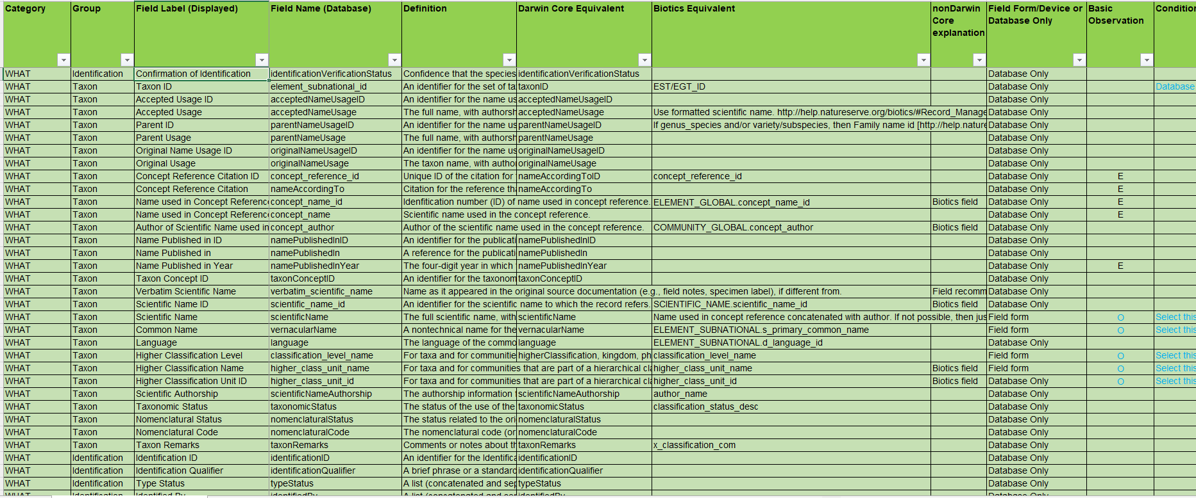
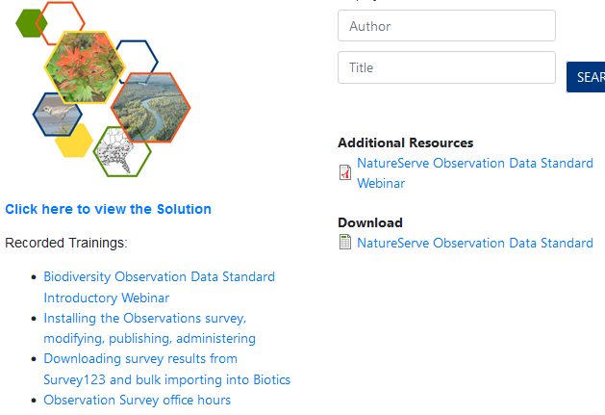
Comprehensive Fields https://www.natureserve.org/publications/biodiversity-observation-data-standard-natureserve-network
Notes:
For more information on the Biodiversity Observation Data Standard, visit this website.

Slide 7
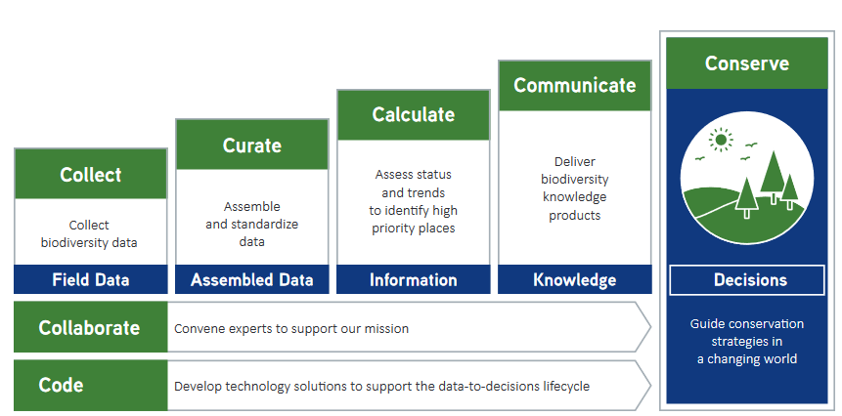
The Data-to-Decisions Lifecycle
Notes:
The next stage in the Observations Lifecycle focuses on gathering data

Slide 8
Observation Data Standard
Network Program
Survey123
Existing BLM Data
External Data Sources
Collect Data
ArcGIS
Online
Observation
Survey
Establish taxonomy & filter to meet quality standards
Aggregate via Append (ArcGIS Pro)
Local
Conservation
Status
Assessment
Bulk Create
tool (Local Biotics)
Local Observation
Geodatabase
Observations
assigned to EOs
Bulk Create
Template
EOs
Std. Spp.
Taxonomy
Data Exchange
Threat
Observation BLP
toolbox
(ArcGIS)
Observations
toolbox
(ArcGIS)
Bulk Import
Records tool (Central Biotics)
G Ranks
Trend
S Ranks
N Ranks
Rarity
From Non- Biotics Programs
Central
Online Products
Photos, Recordings, Files
Specimen Labels
Web Map(s)
Dashboard(s)
Aggregated EO Products
Standard Biodiversity Location Data Products via
Custom Biodiversity Location Data Products
Notes:
Based on the Biodiversity Observation Data Standard, a survey was developed in Survey123, which enables data collection and facilitates the remaining processes.

Slide 9
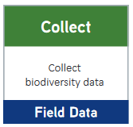
What is the Observation Survey?
Field tool for collecting observation data, which:
  Leverages existing software (ArcGIS Survey123) and capabilities
  Utilizes data model of the Biodiversity Observation Data Standard, developed by Network working group
  Compatible with existing NatureServe data schemas (i.e., Biotics)
  Supports the development of priority products

Slide 10
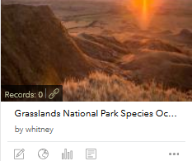
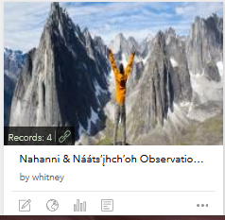
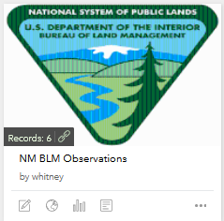
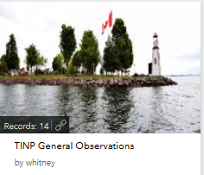
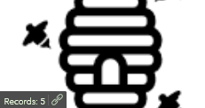
Why use the Observation Survey?
Provides ready to use field collection tool
  Minimize effort by Network members without an existing tool
  Customizable
Eliminates taxonomy concerns by populating elements from Biotics
Enables sharing of Observation data between the Network & NatureServe (for use in species habitat models, Explorer, etc.)
Facilitates edits/QC /viewing collected data by non-technical staff via ArcGIS Dashboards
Facilitates data entry in Biotics
  Toolboxes automate migration of data from observations (survey) to EOs (Biotics)
Prevents additional data backlog
Produces real-time data available for use in web maps, dashboards, story maps…

Slide 11
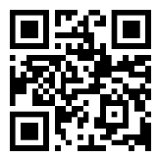
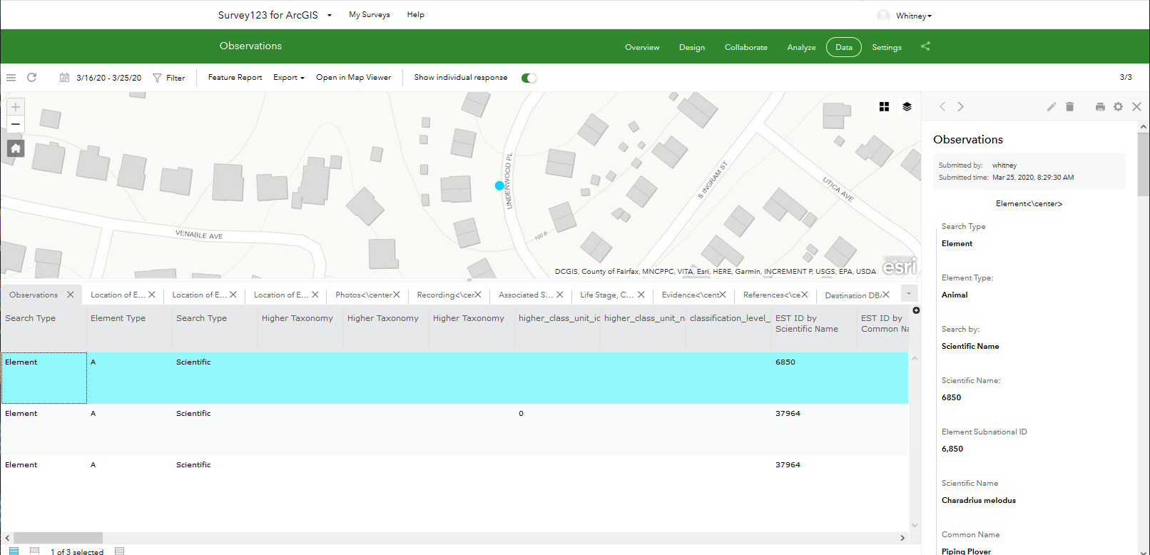
Survey 123 Demo
External Data Sources
Traditional data
entry methods
Survey123
ArcGIS
Online
Establish taxonomy & filter to meet quality standards
Aggregate via Simple Data Loader (ArcGIS)
Test out the Observations survey
Local Observation
Geodatabase
Customizable
Smartphones, tablets, laptops
Data entry by anonymous user or arcgis.com user
Online – AGOL, offline - device

Slide 12
The Data-to-Decisions Lifecycle
Notes:
And of course, it is always critical is communicating the data which has been collected.

Slide 13
Observation Data Standard
Network Program
Survey123
Existing BLM Data
External Data Sources
View, Edit, QC Observations
ArcGIS
Online
Observation
Survey
Establish taxonomy & filter to meet quality standards
Aggregate via Append (ArcGIS Pro)
Local
Conservation
Status
Assessment
Bulk Create
tool (Local Biotics)
Local Observation
Geodatabase
Observations
assigned to EOs
Bulk Create
Template
EOs
Std. Spp.
Taxonomy
Data Exchange
Threat
Observation BLP
toolbox
(ArcGIS)
Observations
toolbox
(ArcGIS)
Bulk Import
Records tool (Central Biotics)
G Ranks
Trend
S Ranks
N Ranks
Rarity
From Non- Biotics Programs
Central
Online Products
Photos, Recordings, Files
Specimen Labels
Web Map(s)
Dashboard(s)
Aggregated EO Products
Standard Biodiversity Location Data Products via
Custom Biodiversity Location Data Products
Notes:
Once data has been collected in the Observations survey via Survey123, it is immediately available for use within online products such as Dashboards and Web Maps.

Slide 14
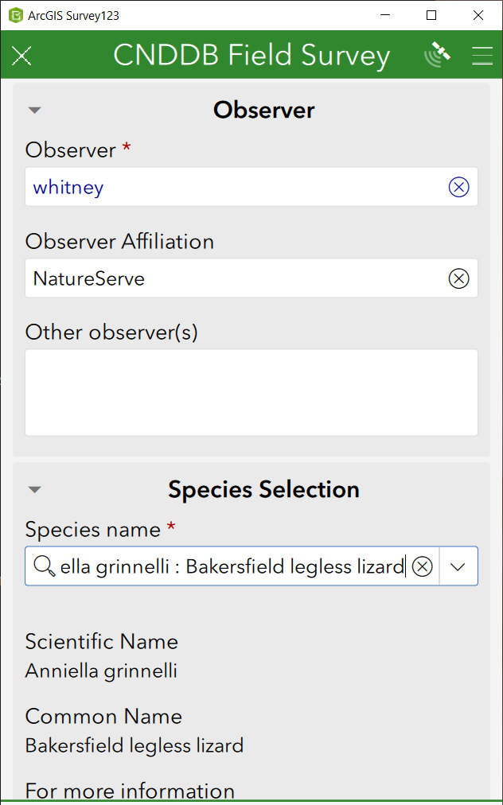
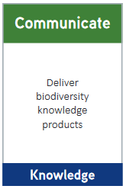
Dashboards to facilitate Review, QC, Editing
User-friendly platform reflecting data collected via the Observations survey (ArcGIS Survey123)
Leverages existing software (ArcGIS Map Viewer, Dashboard & Web AppBuilder) and capabilities
Customized, administered, maintained by each program
3 versions currently available with functionality appropriate to audience:
  Viewers: View data only
  QCer: Edit only QC fields within a survey response
  Data manager/collector: Full edit capability of data

Slide 15
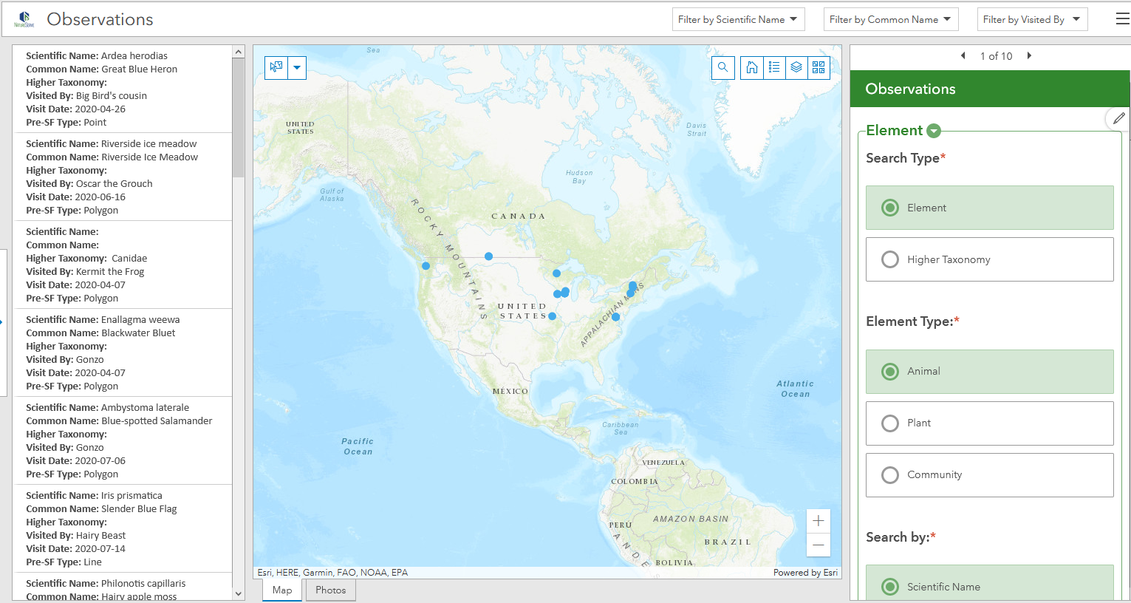
Why use the Observation Dashboard?
Facilitates edits, updates, QC & viewing by non-technical staff via ArcGIS Dashboards
Interactive elements enable easy navigation and selection of records

Slide 16
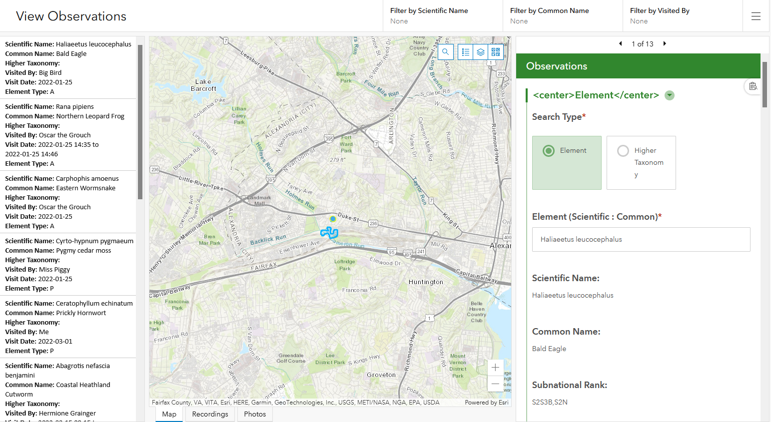
Demo Dashboards

Slide 17
Observation Data Standard
Network Program
Survey123
Existing Data
External Data Sources
Aggregate data from other data sources
ArcGIS
Online
Observation
Survey
Establish taxonomy & filter to meet quality standards
Aggregate via Append (ArcGIS Pro)
Local
Conservation
Status
Assessment
Bulk Create
tool (Local Biotics)
Local Observation
Geodatabase
Observations
assigned to EOs
Bulk Create
Template
EOs
Std. Spp.
Taxonomy
Data Exchange
Threat
Observation BLP
toolbox
(ArcGIS)
Observations
toolbox
(ArcGIS)
Bulk Import
Records tool (Central Biotics)
G Ranks
Trend
S Ranks
N Ranks
Rarity
From Non- Biotics Programs
Central
Online Products
Photos, Recordings, Files
Specimen Labels
Web Map(s)
Dashboard(s)
Aggregated EO Products
Standard Biodiversity Location Data Products via
Custom Biodiversity Location Data Products
Notes:
Another benefit of using the Observations survey is to use the geodatabase template developed from the survey for aggregating additional datasets collected from external sources.

Slide 18
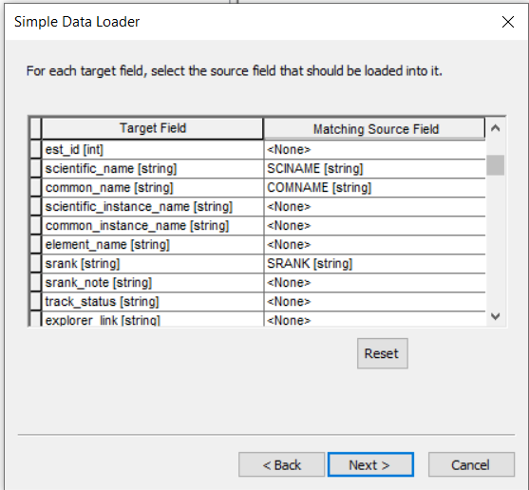
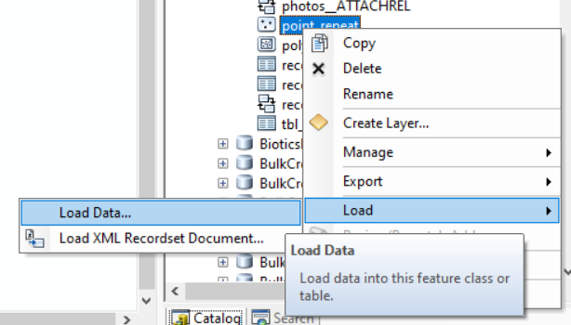
Aggregate data from other data sources
Survey123
Existing BLM Data
External Data Sources
ArcGIS
Online
Establish taxonomy & filter to meet quality standards
Esri tool: Append (ArcGIS Pro), Simple Data Loader (ArcMap
Facilitates crosswalk from one data model to another
Aggregates data from multiple sources into a single geodatabase (i.e. format)
Use the Observations.gdb template to publish Observations in a Feature Layer and/or to Bulk Create EOs
Instructions found in this Esri topic
Aggregate via Append (ArcGIS Pro)
Local Observation
Geodatabase
Notes:
Two Esri tools facilitate crosswalking data from other sources into the geodatabase template – the Append tool in ArcGIS Pro or the Simple Data Loader in ArcMap. The tools aggregate...

Slide 19
The Data-to-Decisions Lifecycle

Slide 20
To be covered in the Biotics In-Depth Session:
From Observations to EOs
Notes:
We’ll be covering this in further detail during the In-Depth Session.

Slide 21
Observation Data Standard
Network Program
Survey123
Existing BLM Data
External Data Sources
Create EOs from Observations
ArcGIS
Online
Observation
Survey
Establish taxonomy & filter to meet quality standards
Aggregate via Append (ArcGIS Pro)
Local
Conservation
Status
Assessment
Bulk Create
tool (Local Biotics)
Local Observation
Geodatabase
Observations
assigned to EOs
Bulk Create
Template
EOs
Std. Spp.
Taxonomy
Data Exchange
Threat
Observation BLP
toolbox
(ArcGIS)
Observations
toolbox
(ArcGIS)
Bulk Import
Records tool (Central Biotics)
G Ranks
Trend
S Ranks
N Ranks
Rarity
From Non- Biotics Programs
Central
Online Products
Photos, Recordings, Files
Specimen Labels
Web Map(s)
Dashboard(s)
Aggregated EO Products
Standard Biodiversity Location Data Products via
Custom Biodiversity Location Data Products

Slide 22
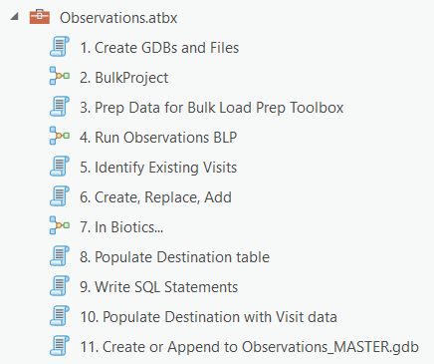
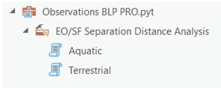
Highlights of the Observation Toolkit
Downloads survey results, including attachments
Auto-generates specimen labels
Assigns Observations to new or existing EOs according to separation distance
Prevents duplicates by identifying existing survey records in Biotics to replace data rather than create new data
Populate geodatabase template for import into Biotics 5 via Bulk Create/Replace Tools
Create/Append data to Observations_MASTER.gdb
  Overwrites observations which have been edited according to Global ID
Populates Observations feature service with Biotics IDs (Visit, Source Feature, EO)
Survey, Dashboards, etc. cloned from NatureServe AGOL Organization to yours to minimize effort
Local Observation
Geodatabase
Local
Bulk Create
tool (Local Biotics)
Observations
assigned to EOs
Bulk Create
Template
Data Exchange
taxonomy, global & national ranks
Observation BLP
toolbox
(ArcGIS)
Observations
toolbox
(ArcGIS)
Bulk Import
Records tool (Central Biotics)
EOs, subnational ranks
From Non- Biotics Programs
Central

Slide 23

Install the Survey123 app
According to Esri documentation:
Click the survey link or take a picture of the QR code
Follow the prompt to download and install the Survey123 field app.
After installation, the Observation survey should open automatically.
NOTE: This survey is for testing purposes only!
Collect Data!

Slide 24
Recorded Training Sessions
Auto-generate specimen labels via the Observations survey
Customizing the Observations survey
Post cloning of the Observations survey - need to know
Creating EOs from Observations (Survey123) using the Observations Toolbox

Slide 25
Get Started…
What’s involved: NatureServe cloning data from NS AGOL to member AGOL
Observations survey in Survey123 – All you need to know!
Submit a ticket to the Help Desk or email biotics@natureserve.org

