Slide 1
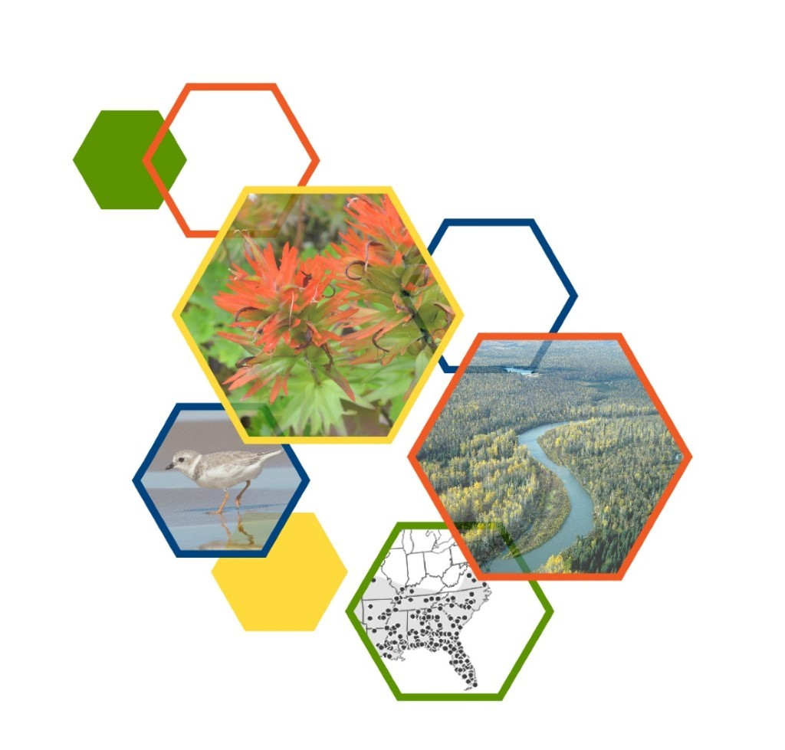
The Observations Lifecycle Utilizing Data collected via the Observations Survey
Core Methodology Training
February 2023

Slide 2
The Data-to-Decisions Lifecycle
Notes:
During the Introduction to the Observations Lifecycle session, we discussed:
Collaborating with the Network to develop the Biodiversity Observation Data Standard.
That the Observations survey was developed to Collect data via Survey 123, based on that Standard.
After the data has been collected, it is then Communicated via the Dashboards, facilitating QC, Editing, and viewing the data.
Now we’re focusing on Curating the data

Slide 3
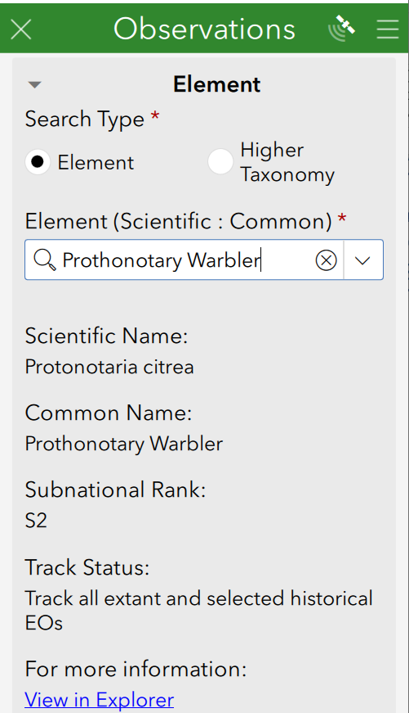
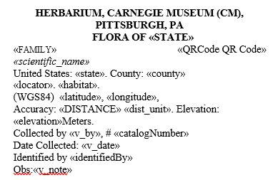
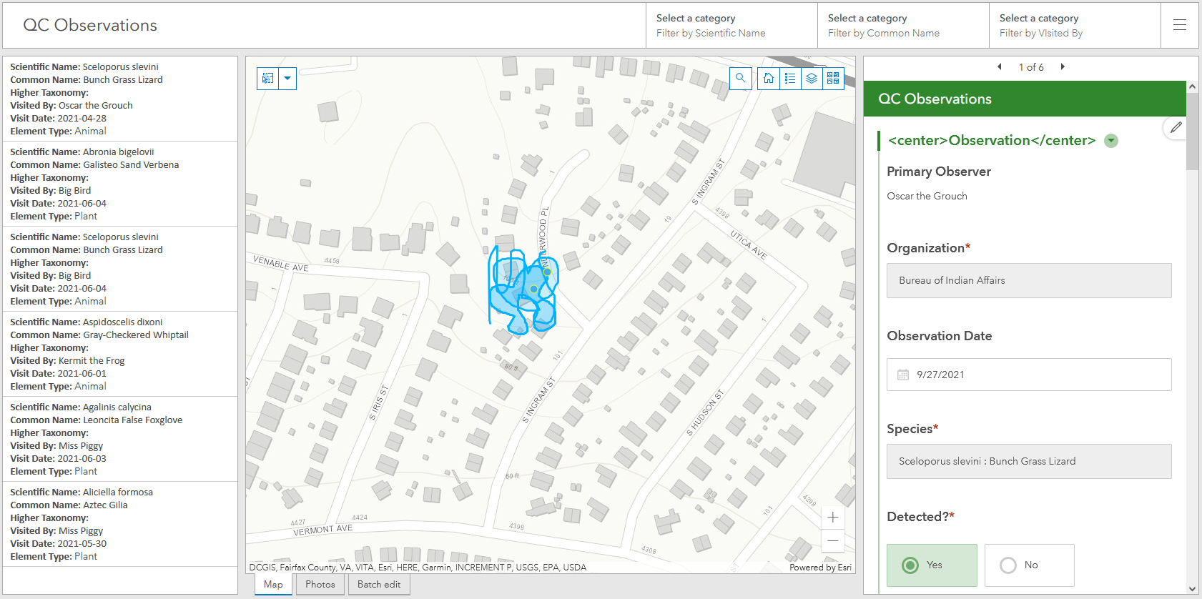
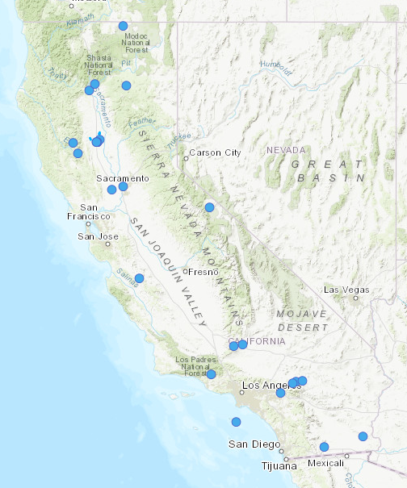
Observation Data Standard
Network Program
Survey123
Existing BLM Data
External Data Sources
Create EOs from Observations
ArcGIS
Online
Observation
Survey
Establish taxonomy & filter to meet quality standards
Aggregate via Append (ArcGIS Pro)
Local
Conservation
Status
Assessment
Bulk Create
tool (Local Biotics)
Local Observation
Geodatabase
Observations
assigned to EOs
Bulk Create
Template
EOs
Std. Spp.
Taxonomy
Data Exchange
Threat
Observation BLP
toolbox
(ArcGIS)
Observations
toolbox
(ArcGIS)
Bulk Import
Records tool (Central Biotics)
G Ranks
Trend
S Ranks
N Ranks
Rarity
From Non- Biotics Programs
Central
Online Products
Photos, Recordings, Files
Specimen Labels
Web Map(s)
Dashboard(s)
Aggregated EO Products
Standard Biodiversity Location Data Products via
Custom Biodiversity Location Data Products
Notes:
Via the use of the Observation toolkit, we’ll create EOs from the Observation data collected via the Observations survey in Survey123.

Slide 4
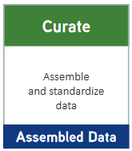
Create EOs from Observations
Following is a simple explanation of the tools used to facilitate creation of EOs from Observations:
Observation Bulk Load Prep (BLP) toolbox (ArcGIS Pro) - assigns observations to new or existing EOs according to NatureServe methodology [developed by Molly Moore, Pennsylvania NHP]
Observations toolbox (ArcGIS Pro)– formats data and populates geodatabase for import into Biotics; repopulates Observations.gdb with Biotics IDs
Bulk Create tool (Local Biotics) – creates Source Features and EOs in local Biotics
Bulk Import Records tool (Central Biotics) – creates Source Features and EOs in Central Biotics - using data from programs that don’t use Biotics.
Local Observation
Geodatabase
Local
Bulk Create
tool (Local Biotics)
Observations
assigned to EOs
Bulk Create
Template
Data Exchange
taxonomy, global & national ranks
Observation BLP
toolbox
(ArcGIS)
Observations
toolbox
(ArcGIS)
Bulk Import
Records tool (Central Biotics)
EOs, subnational ranks
Applies Standard Methodology
From Non- Biotics Programs
Central

Slide 5
Prepare to use the Tools
Facilitate Creation of EOs from Observations

Slide 6
Prepare for using the Observations.tbx
Download the Observations.zip file and unzip it to C:\Temp – this will create an Observations_v1_4 subfolder containing all the necessary files
Unzip the BulkCreateTemplate.gdb.zip and BulkLinkReplaceTemplate.gdb.zip files directly to C:\Temp.
Download your Biotics backups from the previous night and unzip to C:\Temp.
Rename shapes.gdb to BioticsBackups.gdb
Edit and run the Separation_Distance.sql to get the Separation Distances defined within the EO Specifications records in Biotics:
Determine appropriate subnation_id by running query in Query Builder, for appropriate subnation: select subnation_id from subnation where subnation_name='New York'
CTRL+H to replace the subnation_id in two places within the query from 41 to your SUBNATION_ID, as found in the SUBNATION table.
Copy and paste the updated query into QueryBuilder and run the query with Query Output of CSV .
Download the resulting file to C:\Temp and rename it Separation_Distance.csv.

Slide 7
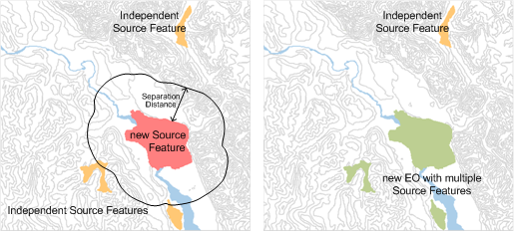
Customize Separation Distance Data
Data within the SEP_DISTANCE field, within the Separation_Distance.csv will be used within the Observations toolboxes during the Separation Distance analysis. By default, this column is populated with the Suitable Habitat Separation Distance. Update data within the SEP_DISTANCE field (in kilometers) in the Separation_Distance.csv for values that should be applied to ALL locations, for the following reasons:
your program uses Custom distances
a more appropriate distance than the 1 km default can be assigned, especially in the case of plants, in which case the Data Manager should coordinate with the program Botanist to determine the appropriate separation distance. Given that few plant species have custom Separation Distances at either the species or Element Group level, the Habitat-based Plant Element Occurrence Delimitation Guide should be used to determine the appropriate Separation Distance. The was developed and vetted by network botanists and provides a separation distance based on life history traits, suitable and unsuitable habitat.
Independent SFs within SD
New EO developed with multiple SFs
Changes per location should be made after running the 3rd tool, as indicated in the documentation.

Slide 8
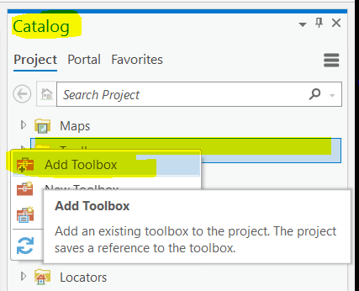
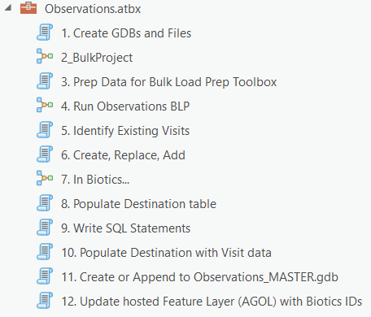
Install the Toolboxes
Copy the Observations.atbx and Observations BLP PRO.pyt files to a permanent location.
In ArcPro, within the Catalog, right click on Toolboxes and choose Add Toolbox.
Navigate to the toolbox in the saved location.
Repeat this step for both toolboxes.

Slide 9
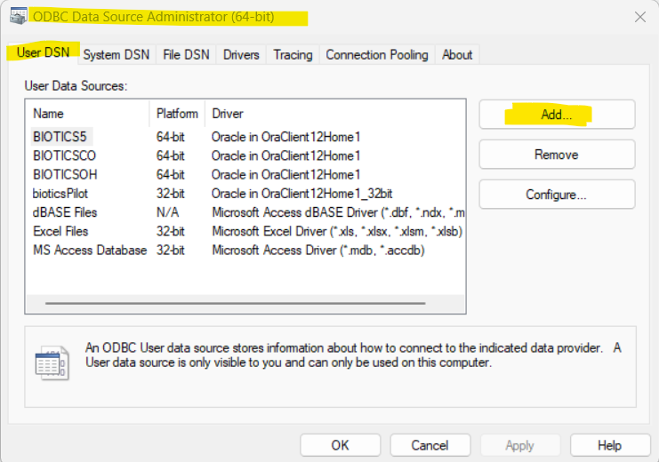
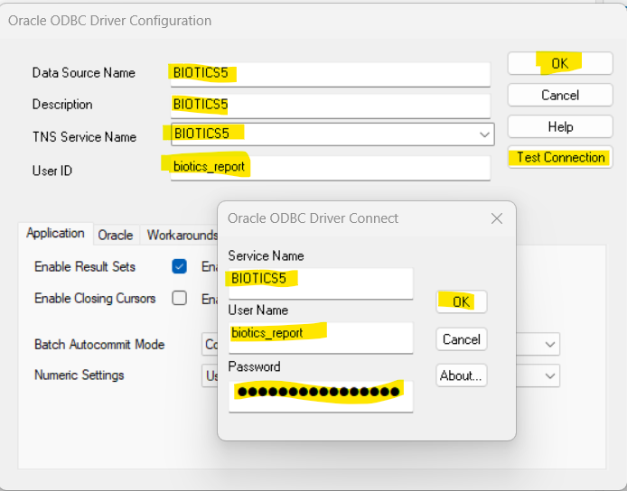
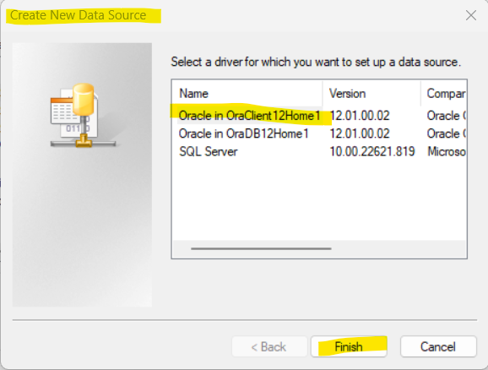
Create ODBC Data Source

Slide 10
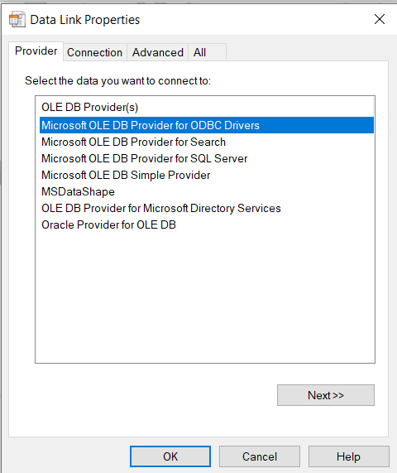
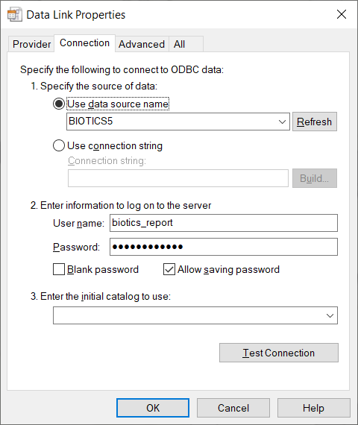
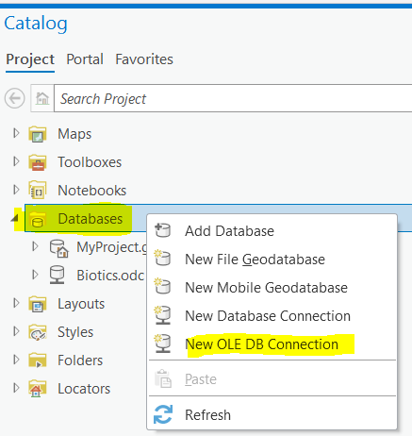
Create OLE DB Connection to Biotics

Slide 11
Run Tools within Toolboxes Facilitate Creation of EOs from Observations

Slide 12
The Data-to-Decisions Lifecycle
Notes:
The Observations Bulk Load Prep Toolbox was originally developed by Molly Moore of the Pennsylvania Natural Heritage Program and customized by NatureServe, to easily work with the data generated by the Observations toolbox, facilitating the process.
The Observations Toolbox was developed by NatureServe.

Slide 13
1. Create GDBs and files (available for non-Biotics use)
Creates the Observations.gdb according to:
Zip file: provide the manually downloaded geodatabase from the Observations survey created in Survey123;
AGOL credentials: automatically downloaded from ArcGIS Online based on an ArcGIS Online user’s credentials, the feature layer service ID and survey form ID. NOTE: the survey form and feature layer must be shared to the User or Group to whom the user belongs;
Logged in ArcGIS Pro user: automatically downloaded from ArcGIS Online based on the logged in (to ArcGIS Pro) user’s credentials, the feature layer service ID and survey form ID. NOTE: the survey form and feature layer must be shared to the User or Group to whom the user belongs;
Profile (previously created): automatically downloaded from ArcGIS Online based on the profile previously created when AGOL credentials were provided, the feature layer service ID and survey form ID. The profile provides a secure way to save the credential data via a ‘profile’. NOTE: the survey form and feature layer must be shared to the User or Group to whom the user belongs.
For records with the Voucher Specimen Collected? field indicated:
the QRCode field is populated with the direct URL to the survey record
the County and State fields are populated.
Exports records with the Voucher Specimen Collected? field indicated to the specimens_collected.csv file to enable auto-generation of specimen labels via the Microsoft Word template. See Print Specimen Labels for instructions on generating the specimen labels.
Downloads image and audio files to the specified locations (subfolders within C:\Temp\Observations).
Writes a file with user inputs for future reference.

Slide 14
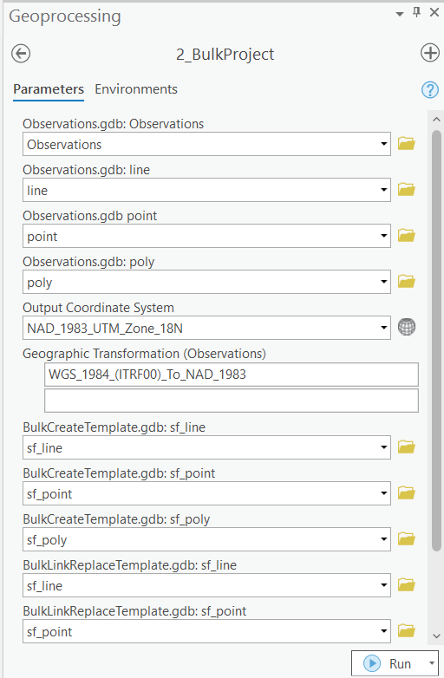
2. Bulk Project
Projects the following data sets to the provided projection, which should reflect that utilized in your Biotics instance. Enter your Biotics projection in Output Coordinate System:
Feature classes within the Observations.gdb - originally in WGS84 projection
Feature classes within BulkCreateTemplate.gdb - originally in UTM Zone 13N NAD83

Slide 15
3. Prep Data for Bulk Load Prep Toolbox
Adds the Separation Distance data required for use in the Bulk Load Prep Toolbox, as defined within the SEP_DISTANCE column of the Separation_Distance.csv.
Deletes data from line_projected, point_projected, and poly_projected feature classes which do not meet QC Status and EO Track Status, according to user inputs. These are the feature classes which are input into the Observations BLP.
Writes a unique ID to the DIG_COM (Digitizing Comments) field to enable joining back to the original data set.
Exports records with the Voucher Specimen Collected? field indicated to the specimens_collected.csv file to enable auto-generation of specimen labels via the Microsoft Word template. NOTE: If the SEP_DISTANCE should be changed for individual locations, edit the value within the SEP_DISTANCE column for the appropriate record(s) at this time. For example, if in unsuitable habitat at the given location, populate the SEP_DISTANCE column with the value from the UNSUITABLE_HAB_SEP_DISTANCE column, as found in the Separation_Distance.csv file. The Separation Distance is used in the next tool to assign observations to new or existing EOs.

Slide 16
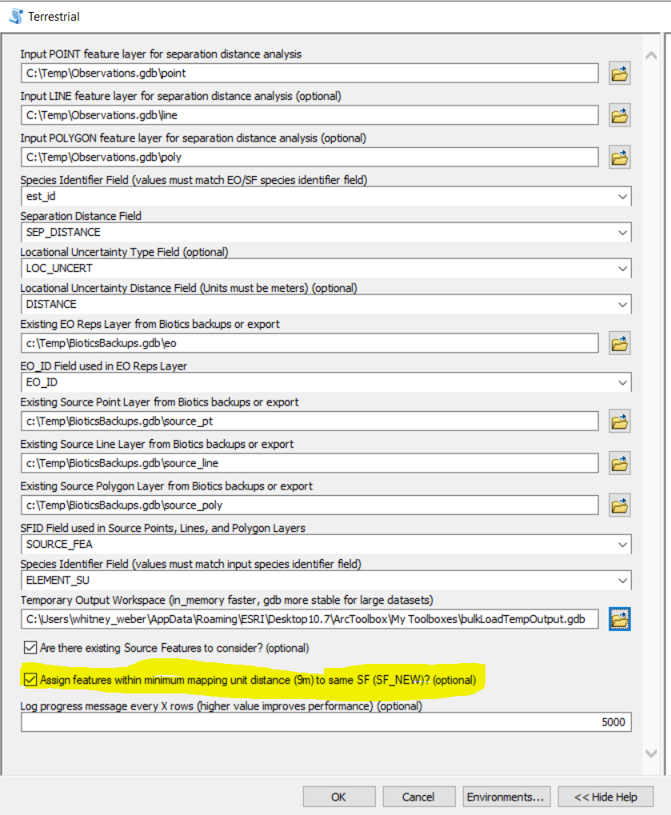
4. Run Observations BLP
Performs Separation Distance analysis:
Applies standard methodology
Assigns Observations to new or existing EOs according to separation distance
Does not alter original data but adds to it
Assign features within minimum mapping unit distance (9m) to same SF (SF_NEW)? (optional)
Identifies features located within the minimum mapping distance to one another
Assigns the same SF_NEW value.
Information not used by Biotics – it is merely to help identify possible duplicate data records
Are there existing Source Features to consider?
Populates SF_ID with Source Feature ID(s) located within the minimum mapping unit distance (typically 9m).

Slide 17
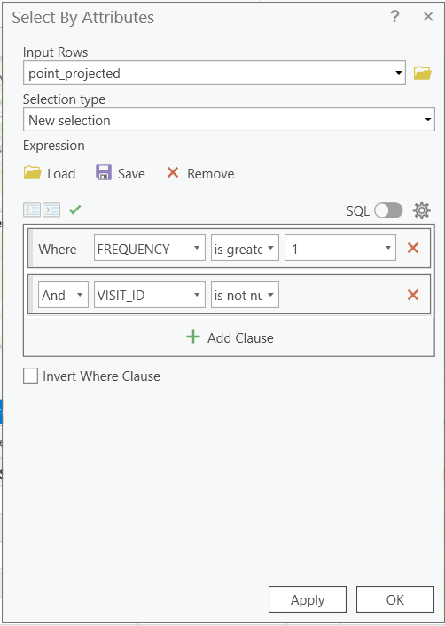
5. Identify Existing Visits
Assuming the survey export was filtered according to create and edit dates as recommended, the exported data set should only include data created or edited since the last export of the survey data and bulk creation process.
Run the 5. Identify Existing Visits script within the Observations.tbx toolbox:
Queries Biotics for existing Visit records with the Dataset name (display_value) provided
Joins the query results to the individual feature classes (point, line, poly) based on Dataset and Global ID
Determines which records are updates to an existing Visit (VISIT_ID IS NOT NULL)
Automatically indicates to replace the Visit (REPLACE_VISIT = Y) record and record the VISIT_ID.
Automatically indicates to replace the Source Feature (REPLACE_SF = Y) for any existing Visit record (VISIT_ID IS NOT NULL) which is the only Visit for the Source Feature (FREQUENCY = 1) .
Manually review and mark REPLACE_SF = Y, if appropriate, for Source Features with more than one Visit record (FREQUENCY> 1) for which at least one of the Visits has been edited (VISIT_ID IS NOT NULL). These will not be automatically indicated for replacement as it may not be appropriate given that the SF is comprised of multiple Visits.

Slide 18
Post Separation Distance Analysis QC
Records with Multiple EO_ID Values (REQUIRED)
Duplicate observations?
If Assign features within minimum mapping unit distance (9m) to same SF (SF_NEW)? (optional) was checked, features located within the minimum mapping distance to one another will be given the same SF_NEW value. This is merely to flag records for your review to determine if the records constitute duplicates. Duplicates should be removed from the data set prior to using the Bulk Create tool in Biotics.
Existing Source Features
REPLACE_SF - If SF_ID is populated and you would like to replace the existing Source Feature in Biotics with this Observation, populate this field (with anything). This may have been automatically indicated with Y if there is an existing Visit for this record (according to the globalid) and the SF only has a single Visit record. The spatial and tabular data will be used to replace the existing Source Feature (SF_ID) indicated in Biotics. This will only work for a single SF_ID, so if there are multiple, remove all but the appropriate SF_ID.
ADD_VISIT - If SF_ID is populated and you would like to add the tabular data to an existing Source Feature as a new Visit, populate this field (with anything). This will only work for a single SF_ID, so if there are multiple, remove all but the appropriate SF_ID.
Separation Barriers

Slide 19
6. Create, Replace, Add
Run the 6. Create, Replace, Add script within the Observations.tbx toolbox. This process:
Appends data from the point_projected, line_projected, and poly_projected feature classes within the Observations.gdb to the same feature class within the BulkCreate.gdb and BulkLinkReplace.gdb (for records indicated as REPLACE_SF).
Appends data regarding Visits and References to the tbl_sf_visits and tbl_sf_references within the Observations.gdb, according to elements with Track Status indicated in the tool inputs.
Close ArcGIS .
Zip the BulkCreate.gdb and BulkLinkReplace.gdb files. Do NOT rename the files.

Slide 20
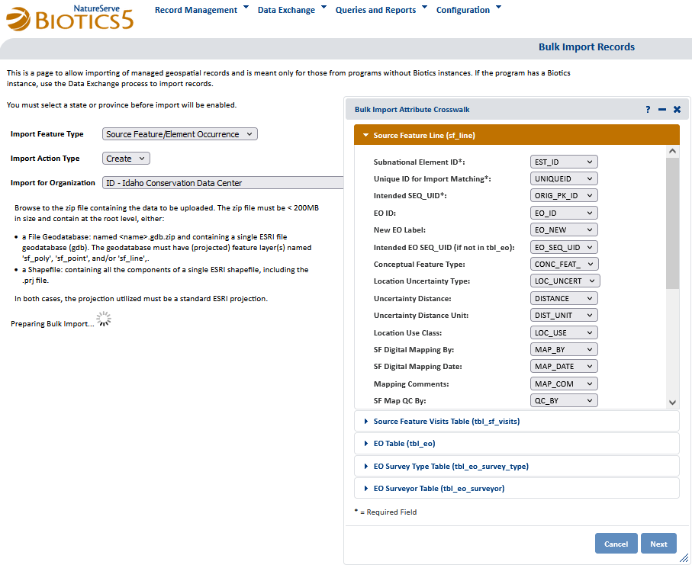
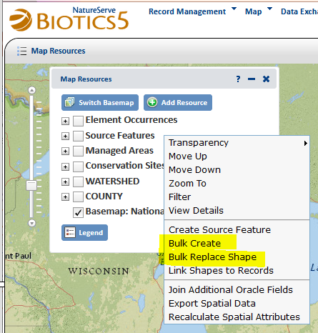
Bulk Create / Replace / Import
Bulk Create tool (Local Biotics) – creates Source Features and EOs in local Biotics
Bulk Replace tool (Local Biotics) – replaces Source Feature spatial and tabular data and regenerates EOs, in locatl Biotics
Bulk Import Records tool (Central Biotics) – creates Source Features and EOs in Central Biotics for non-Biotics programs

Slide 21
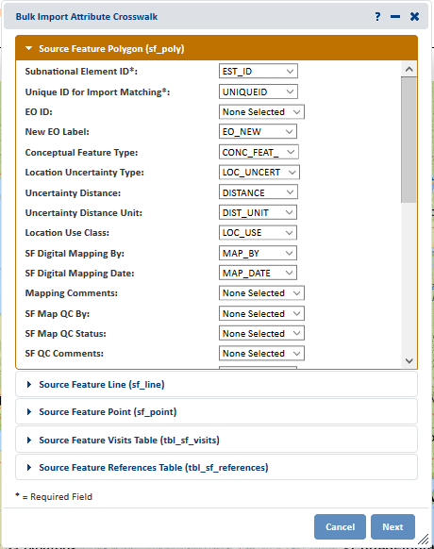
Bulk Create In Biotics
Perform Bulk Create in Biotics 5
Find SF Results button.
Save to Working List named Imported Observations
Perform Bulk Replace Shape in Biotics 5
Find SF Results button.
Save to Working List named Replaced Observations
Bulk Replace in Biotics (if indicated)

Slide 22
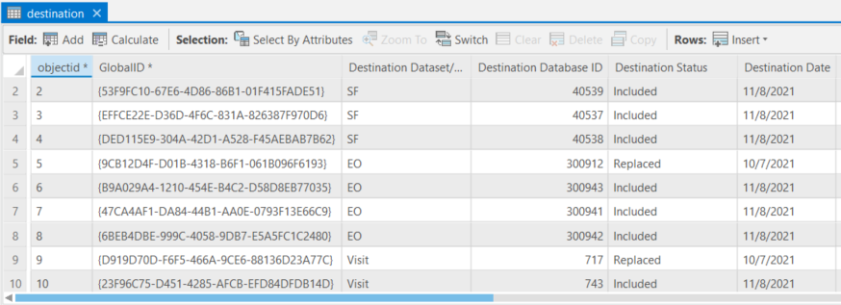
8. Populate Destination Script in Toolbox
Queries Biotics for Visit, Source Feature & EO IDs of records created/replaced according to working lists
Associates the Visit, Source Feature & EO IDs with the records within the Observations_Project (all data) layer
Populates the destination table with the pertinent data, indicating the Status as either being Included, Replaced (REPLACE_VISIT, REPLACE_SF), or Modified (ADD_VISIT).
Links data from point, line & poly fcs to Observations_Project fc to get SOURCE_FEATURE_ID of all records for purposes of writing SQL statements for Visits in script 9.

Slide 23
Data Not Accommodated by Bulk Create/Replace tools
SOURCE_FEATURES, where SOURCE_FEATURE_ID IS NOT NULL:
- Data Sensitive (SOURCE_FEATURE.d_data_sensitive_id)
- Data Sensitive Category (SOURCE_FEATURE.d_data_sensitive_category_id)
- Data Sensitive Reasons (SOURCE_FEATURE.data_sensitive_reasons)
- Dataset (SOURCE_FEATURE.d_dataset_id)
- Global ID (VISIT.global_id)
EO, where EO_ID IS NOT NULL AND UPDATE_EO IS NOT NULL:
- Data Sensitive (EO.d_data_sensitive_id)
- Data Sensitive Category (EO.d_data_sensitive_category_id
- Data Sensitive Reasons (EO.data_sensitive_reasons
- Condition of EO (EO.condition_of_eo)
- Confidence Extent (EO.d_confidence_extent_id
EO_REFERENCE, where EO_ID IS NOT NULL AND UPDATE_EO IS NOT NULL:
- Reference (EO_REFERENCE.reference_id)
- Primary Reference (EO_REFERENCE.eo_reference_primary_ind) , according to EO_REF_PRIM data

Slide 24
Prior to Script 9…
Within the Observations_Project feature class, the UPDATE_EO field has been automatically indicated for new EO records (EO_NEW is not null) for which there is only a single record (FREQUENCY=1).
Perform a Select Layer by Attributes for: FREQUENCY >1 AND EO_NEW IS NOT NULL to find records for which a new EO was created but has multiple associated records.
Sort by EO_NEW and review the data to determine which record associated with a unique EO_NEW has data which should be used to populate the EO and EO_REFERENCE data fields identified in the following step. Indicate the appropriate record in the UPDATE_EO column.
Perform a Select Layer by Attributes for: EO_NEW IS NULL and EO_ID IS NOT NULL to find records added to (an) existing EO(s).
Sort by EO_ID and review the data to determine if the EO fields identified in step 20 below, for the existing EO, should be updated/inserted according to the data in an observation record. If appropriate, indicate the record in the UPDATE_EO column.
If the Reference reflected by REF_ID should replace the Primary Reference for the EO, indicate 'Y' in the EO_REF_PRIM column. This only applies if UPDATE_EO is indicated as well.

Slide 25
9. Write SQL Statements
Run the 9. Write SQL Statements model which will generate SQL statements to populate Biotics data for those fields not accommodated by the Bulk Create & Link processes, for Source Features, EOs, and Visits
Log into your favorite third-party tool (SQL Developer, SQL Plus, Tora, Toad) as the biotics_dlink user and run the SQL statements within the SF_EO_updates.sql file.
Review the SF_EO_updates.log file for errors (CTRL-F for ORA-)

Slide 26
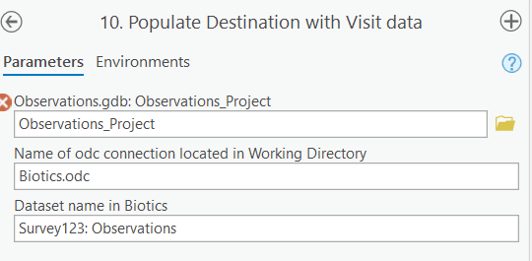
10. Populate Destination table with Visit data
Queries Biotics for Visit, Source Feature & EO IDs of Visit records added to existing SFs via SQL
Adds data to Observations_Project feature class
Populates the destination table with the pertinent data, indicating the Status

Slide 27
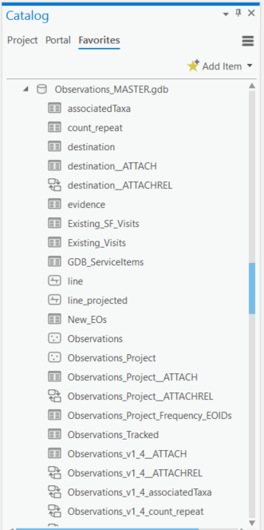
11. Create or Append to Observations_MASTER gdb
This tool will:
Create an Observations_MASTER geodatabase the first time the script is run
Delete observations with the same unique ID as those within Observations.gdb, to prevent duplications of edited data
Append data to the Observations_MASTER.gdb

Slide 28
12. Update hosted Feature Layer (AGOL) with Biotics IDs
Update hosted Feature Layer (AGOL) with Biotics IDs (VISIT_ID, SOURCE_FEATUE_ID, EO_ID).
Prompts for which geodatabase will be used to populate the ArcGIS Online (AGOL) feature layer: Observations.gdb for newly processed data or Observations_MASTER.gdb if you have existing data for which there are not IDs in the feature layer in AGOL already. NOTE: running the script using the Observations_MASTER.gdb as the source of data will take longer (more data) and hence should only be run once. Subsequent runs should use the Observations.gdb as only the new/edited data will need to be populated within the AGOL feature layer.
Adds new data
For data which has been edited and hence there could be multiple records, the most recent data according to DESTINATION_DATE is used.
Clearly communicates whether the data has been loaded into Biotics and if so, with the specific record it is associated.
This could be used to create a direct link to the Biotics record, which would of course prompt for a Biotics login.

Slide 29
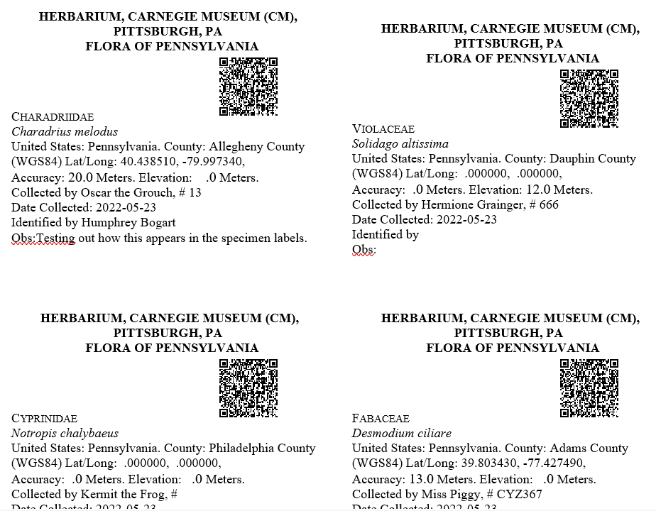
Demo
Auto-generate Specimen Labels
Open the Labels_Observations.docm
When prompted, respond Yes to run the SQL command to populate the data from the specimens_collected.csv file in C:\Temp, created by running Script 3.
Accept the default Other encoding of Unicode (UTF-8) when prompted.

Slide 30
Provide Feedback

