Slide 1
Enhancing Protection of New Hampshire Wetlands
INTRODUCTION TO ECOLOGICAL INTEGRITY ASSESSMENT
Adapted from
NH Natural Heritage Bureau (Bill Nichols)

Slide 2
Selecting survey sites
TYPE OF SURVEY
Inventory (typically polygon based)
Selective
Special community types
(G-rank , S-rank)
Wetlands
Old growth
Etc.
Exemplary Occurrences
Systematic
Within ownership
Within state
Within ecoregions

Slide 3
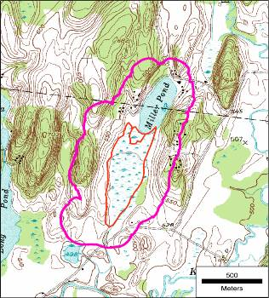
Ecological Integrity Assessment
Ecological Integrity = The ability of an ecological system to support and maintain a community of organisms that has the biotic composition, diversity, and functional organization comparable to those of natural habitats within a region¹
Increasing ecological integrity
Restoration Milestones
A
B
C
D
Increasing disturbance by stressors
¹ Parrish, J.D., D. P. Braun, and R.S. Unnasch. 2003. Are we conserving what we say we are? Measuring ecological integrity within protected areas. BioScience 53: 851-860.
Notes:
One core aspect of our methodology is documenting the relative quality/condition of biodiversity on the ground. All sites fall somewhere along this continuum. Where we can apply some sort of threshold, A = high quality, low stress, D = severely degraded, high stress. EIA came about in our work with natural communities, to clarify what we were measuring and why.
Restoration practitioners can use this framework to specify baseline, current, and desired conditions, and how one could measure performance and progress.
Some important references for our work:
Brooks, R.P., D.H. Wardrop, and J.A. Bishop. 2004. Assessing wetland condition on a watershed basis in the Mid-Atlantic region using synoptic land-cover maps. Environmental Monitoring and Assessment 94:9-22.
Cole, C. A. 2006. HGM and wetland functional assessment: Six degrees of separation from the data? Ecological Indicators 6:485-493.
Collins, J.N., E.D. Stein, M. Sutula, R. Clark, A.E. Fetscher, L. Grenier, C. Grosso, and A. Wiskind. 2006. California Rapid Assessment Method (CRAM) for Wetlands and Riparian Areas. Version 4.2.3. 136 pp.
Comer, P., D. Faber-Langendoen, R. Evans, S. Gawler, C. Josse, G. Kittel, S. Menard, M. Pyne, M. Reid, K. Schulz, K. Snow, and J. Teague. 2003. Ecological Systems of the United States: A Working Classification of U.S. Terrestrial Systems. NatureServe, Arlington, Virginia. 61 pp. + Appendices
Comer, P. and D. Faber-Langendoen. 2013. Assessing Ecological Integrity of Wetlands from National to Local Scales: Exploring the Predictive Power, and Limitations, of Spatial Models. National Wetlands Newsletter Special Issue on Wetland Mapping and Assessment. Environmental Law Institute. Washington DC. Vol. 35 No. 3 May/June 2013
Cowardin, L. M., V. Carter, F. C. Golet, and E. T. LaRoe. 1979. Classification of the wetlands and deepwater habitats of the United States. U.S. Fish and Wildlife Service, Washington, D.C., USA.
Faber-Langendoen, D. 2009. A freshwater wetlands monitoring and assessment framework for the Northeast Temperate Network, National Park Service. Natural Resource Report PS/NETN/NRR— 2009/143. National Park Service, Fort Collins, Colorado.
Faber-Langendoen, D., C. Hedge, M. Kost, S. Thomas, L. Smart, R. Smyth, J. Drake, S. Menard. 2012a. Assessment of wetland ecosystem condition across landscape regions: a multi-metric approach. Part A. Ecological Integrity Assessment overview and field study in Michigan and Indiana. EPA/600/R-12/021a. U.S. Environmental Protection Agency Office of Research and Development, Washington, DC.
Faber-Langendoen, D., J. Rocchio, S. Thomas, M. Kost, C. Hedge, B. Nichols, K. Walz, G. Kittel, S. Menard, J. Drake, and E. Muldavin. 2012b. Assessment of wetland ecosystem condition across landscape regions: A multi-metric approach. Part B. Ecological Integrity Assessment protocols for rapid field methods (L2). EPA/600/R-12/021b. U.S. Environmental Protection Agency Office of Research and Development, Washington, DC.
Faber-Langendoen, D., T. Keeler-Wolf, D. Meidinger, D. Tart, C. Josse, G. Navarro, B. Hoagland, S. Ponomarenko, J-P. Saucier, A. Weakley, and P. Comer. 2014. Eco-Veg: a new approach to vegetation description and classification. Ecological Monographs 84:533-561.
Fennessy, M.S., A.D. Jacobs, and M.E. Kentula. 2007. An evaluation of rapid methods for assessing the ecological condition of wetlands. Wetland 27:543-560.
Harwell, M.A., V. Myers, T. Young, A. Bartuska, N. Gassman, J. H.Gentile, C. C. Harwell, S. Appelbaum, J. Barko, B. Causey, C. Johnson, A. McLean, R. Smola, P. Templet, and S. Tosini. 1999. A framework for an ecosystem integrity report card. BioScience 49: 543-556.
Johnson, J. B., M. Beardsley, and J. Doran. 2008. The Functional Assessment of Colorado Wetlands (FACWet) Methodology. http://rydberg.biology.colostate.edu/FACWet/.
Karr JR, Dudley DR. 1981. Ecological perspective on water quality goals. Environmental Management 5: 55–68.
Lee, D.C. and G.A. Bradshaw. 2004. Making Monitoring Work for Managers: thoughts on a conceptual framework for improving monitoring within large-scale ecosystem management efforts. US Forest Service Pacific Southwest Region (2004 DRAFT).
Lemly, J., J. B. Johnson, L. Gilligan, and E. Carlson. 2013. Setting Mitigation in the Watershed Context: Demonstration and Description of Colorado’s Watershed Approach to Wetland Compensatory Mitigation. Prepared for U.S. EPA Region 8 by Colorado Natural Heritage Program, Fort Collins, CO.
Mack, J. J. and M.E. Kentula. 2010. Metric Similarity in Vegetation-Based Wetland Assessment Methods. EPA/600/R-10/140. U.S. Environmental Protection Agency, Office of Research and Development, Washington, D.C.
Noon, B. R. 2003. Conceptual issues in monitoring ecological systems. Pages 27-71 in D. E. Busch and J. C. Trexler, editors. Monitoring ecosystems: Interdisciplinary approaches for evaluating ecoregional initiatives. Island Press, Washington, DC., USA 447 pp.
Parrish, J.D., D. P. Braun, and R.S. Unnasch. 2003. Are we conserving what we say we are? Measuring ecological integrity within protected areas. BioScience 53: 851-860.
Roni, P. (ed.) 2005. Monitoring stream and watershed restoration. American Fisheries Society, Bethesda Maryland.
Stevenson, R.J., and F.R. Hauer. 2002. Integrating Hydrogeomorphic and Index of Biotic Integrity approaches for environmental assessment of wetlands. Journal of North American Benthological Society 21: 502-513.
Tiner, R.W. 2004. Remotely-sensed indicators for monitoring the general condition of “natural habitat” in watersheds: an application for Delaware’s Nanticoke River watershed Ecological Indicators 4 (2004) 227–243.

Slide 4
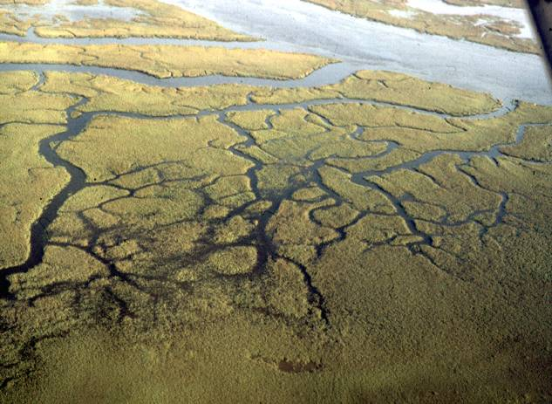
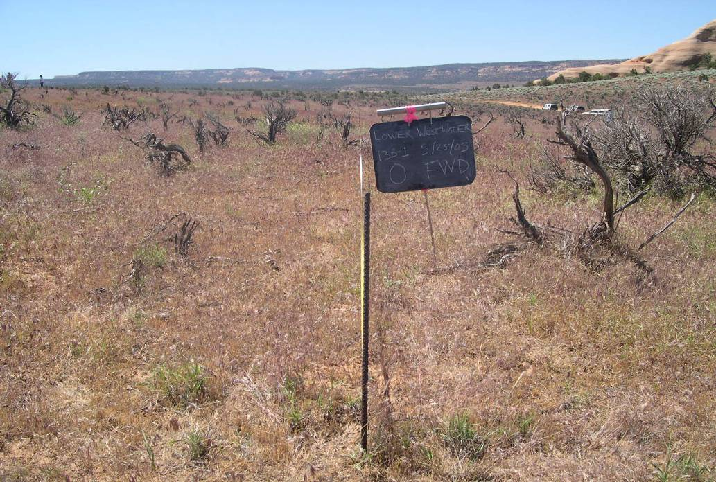
Why Measure Ecological Integrity?
Provide an estimate of current quality or condition
Help prioritize places for conservation attention
Highlight indicators to be used in restoration, management, and monitoring
Clarify ecological requirements to determine compatibilities with land uses/management practices
Notes:
Our most information-intensive work relates to gauging ecological integrity.
This is clearly where we meet the limits of our knowledge, but where we can develop this information, it has the greatest payoff in terms of guiding resource management and conservation on the ground.

Slide 5
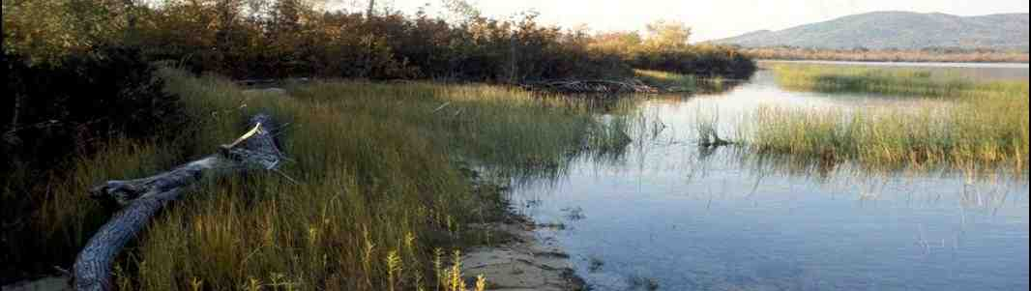
Assessment Types: Natural Community at Multiple Scales
Assemblages of natural communities that repeatedly occur together in the landscape
Communities in each group or complex are linked by a common set of characteristics, such as landform, flooding frequency, soil, and nutrient regime
North Atlantic Coastal Plain Pondshore (G916)
Sandy pond shore system (NH)
Sweet gale -alder shrub thicket
Bulblet umbrella- sedge open sandy pond shore
Bayonet rush emergent marsh
Ossipee Lake

Slide 6
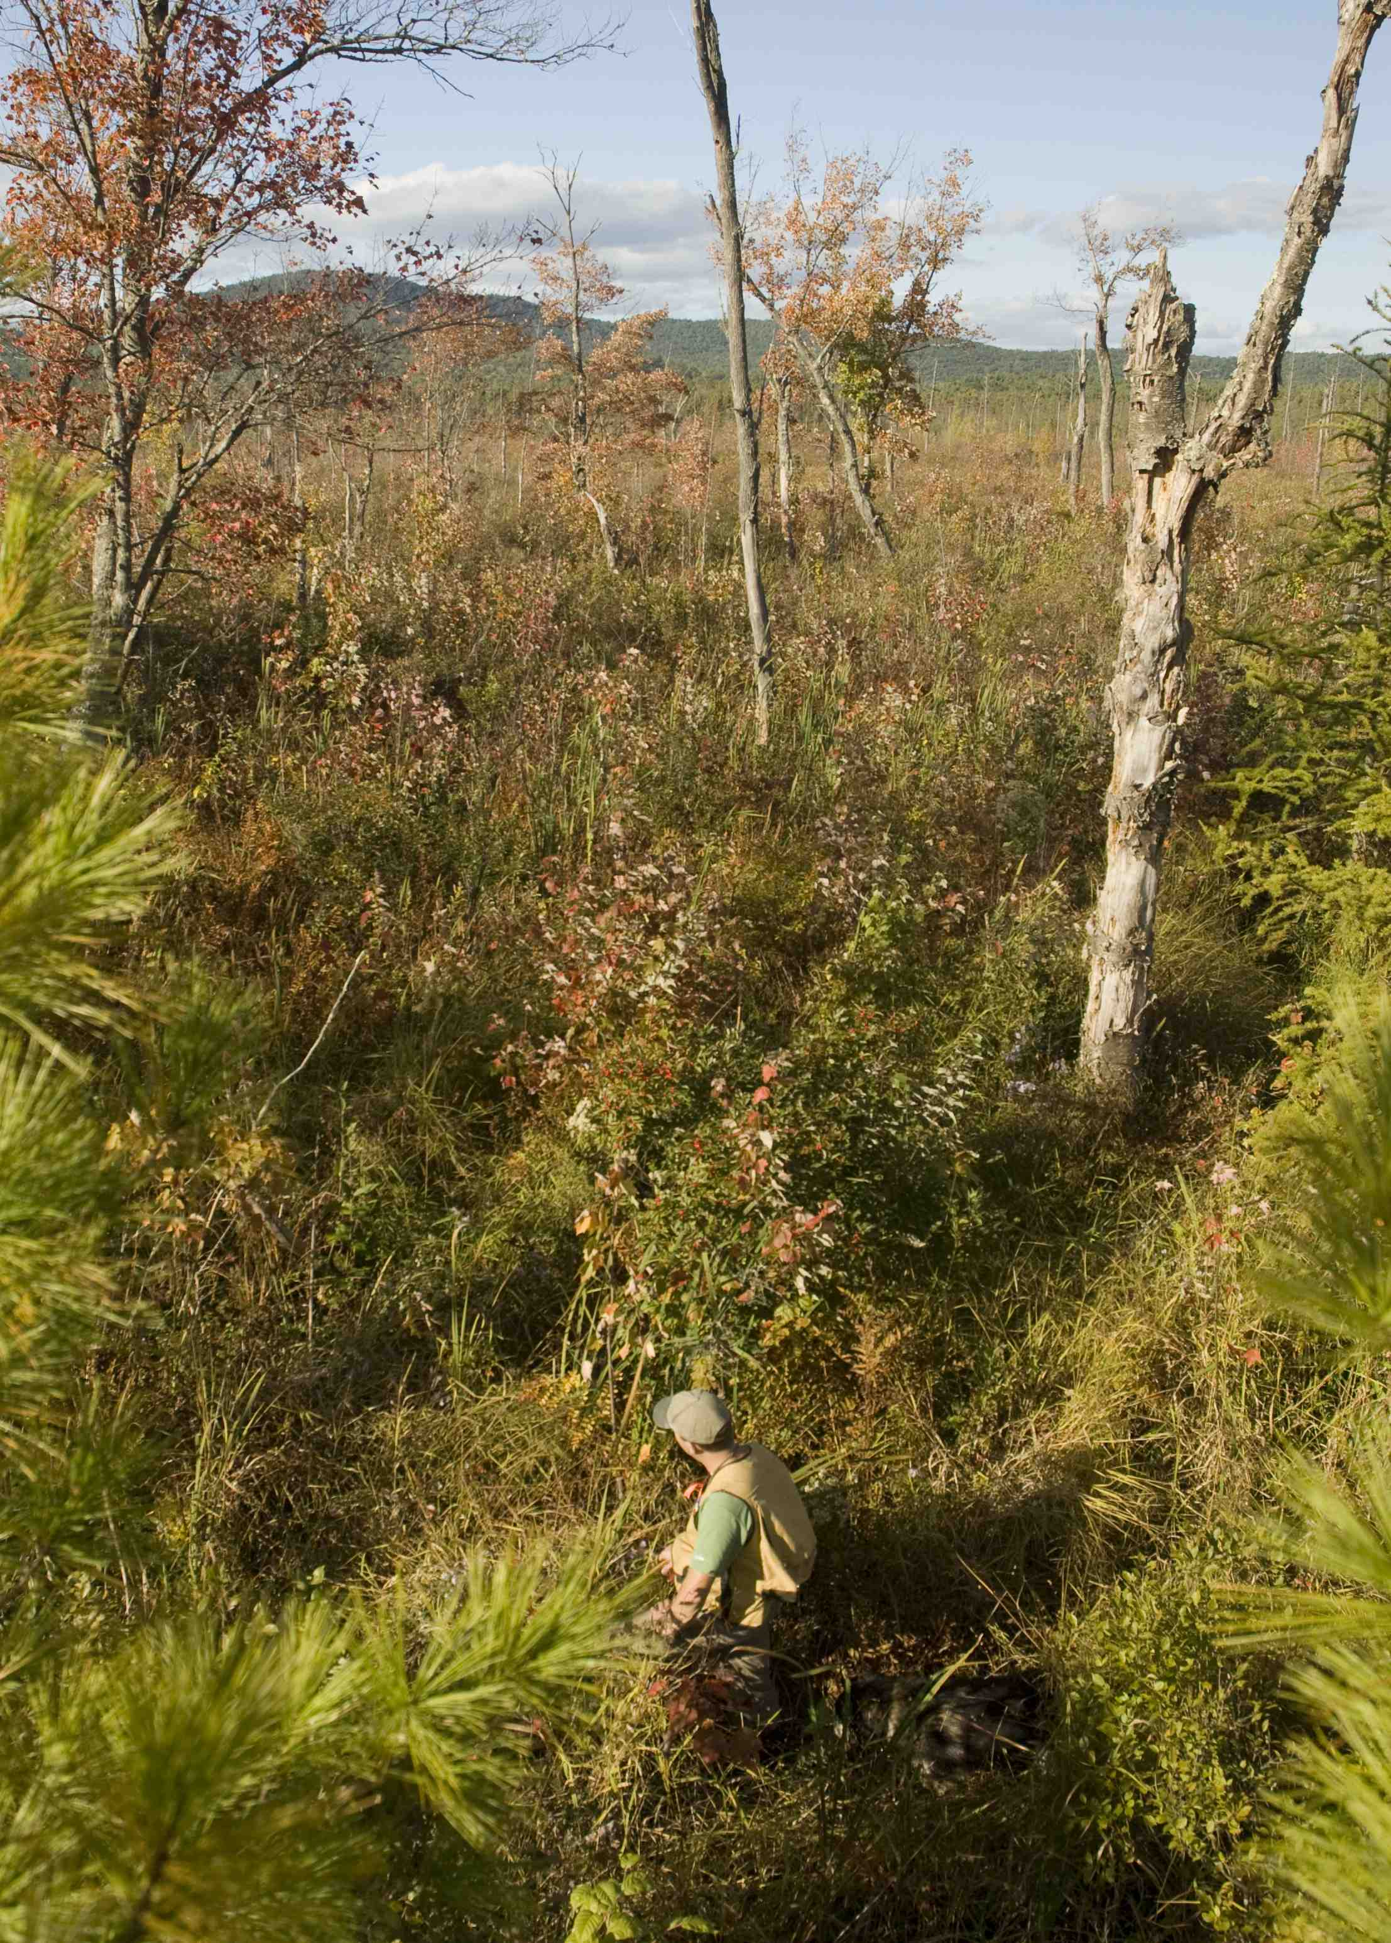
Ecological Integrity Assessment (EIA)
Step 1: EIA
Assessments are a measure of the ecological integrity of a system relative to other examples of that particular type, based on three over-arching rank factors…
size
condition
landscape context
Highbush blueberry - mountain holly wooded fen
Marston Brook, Effingham

Slide 7
Step 1: EIA
Comparison of current and previous method for assessing ecological integrity
Component | Heritage Previous Method | Heritage Current Method (EIA)
Rank Factors | Size Condition Landscape Context | Size Condition Landscape Context
Criteria for Rank Factor | Mix of qualitative and semi-quantitative criteria in a single rank factor field | Distinct sets of metrics, each of which has its own rating
Ratings for Rank Factor | Based on best professional judgment after scanning the combination of rank factor criteria | Based on roll-up of scores from individual metrics
Use of Metrics | Metrics not explicit, but often embedded in text descriptions | Metrics explicit, each with its own associated attributes and data
Level of Intensity | Typically, a rapid, ground-based assessment | 3-level approach to assessment intensity: L1: Remote-sensing based L2: Rapid field based L3: Intensive field based

Slide 8
EORANKSPECS: Ecological Integrity Assessment
EIA Score | Primary Factor | Key Ecological Attribute | Metric (examples)
A,B,C,D | Landscape Context | Landscape Structure | Land Use Index
…or an index score of 0.0 – 1.0 |  | Landscape Dynamics | Disturbance Regime (size, intensity, freq.)
...or “Good” “Fair” “Poor” | Condition | Stand Development / Maturity | Vegetation Structure: Size/Age Class Distribution
 |  | Biotic Composition | Relative Native Plant Cover
 |  | Functions and Processes | Woody Regeneration
 |  | Physical/Chemical Properties | Soil Surface Disturbance
 | Size | Area supporting landscape dynamics | Patch Size (matrix)
Notes:
NatureServe methodology has long applied to characterizing the relative quality/condition of a given location or mapped ‘occurrence’ of a community type or species location. This area has been in a process of advancement for NatureServe Ecology, mainly because we can go deeper with valuable information on the ground, applicable to many aspects of ecological conservation, restoration, management, and monitoring.
Our basic framework includes
Identify the community type of concern
identifying a minimum set of key ecological attributes that drive the function of the given focal resource.
2) We then clarify indicators we would use to measure the status of each unit.
3) we then need rules to ‘roll up’ scores from measuring each indicator, first to provide composite scores for each rank factor, and if needed, to create a composite rating for each occurrence (very good = A good = B fair = C poor = D).

Slide 9
Indicators and Level of Effort
 |  | Indicators | Applications
Level 1 | Remote Sensing | Landscape patterns On-site indicators visible remotely | Support Status and Trends Regional conservation assessment & planning Multi-site monitoring
Level 2 | Rapid Field Observation | Field indicators (stressor vs. ecological condition metrics) | Site assessment Restoration, management monitoring progress
Level 3 | Intensive sampling | Detailed quantitative field indicators. Calibrated indicators (e.g., indices of condition or integrity, FQA). | Reference sites for specific indicators Rigorous performance measures for restoration
Faber-Langendoen, D., J. Rocchio, G. Kittel, C. Hedge, M. Kost, S. Thomas, K. Walz, B. Nichols, S. Menard, J. Drake, E. Muldavin, and P. Comer. 2012. NatureServe Ecological Integrity Assessment. Wetlands Rapid Assessment Method (Level 2). NatureServe, Arlington, VA. + Appendices.
Notes:
We also don’t typically have the ability to do rigorous measurement of all indicators all of the time.
So, our framework is designed to organize indicators in 3 levels, along a gradient of investment needed for their measurement.

Slide 10
Assessment Level 1 vs. Level 2
Component | Level 1 | Level 2
Assessment method | Remote sensing | Rapid ground-based, with or w/o plots
Time needed for assessment | Less | More
Metrics | Few | Many
Confidence in metric scores and overall rank | Low | High
Ability to identify species, communities, groups | Limited | Unlimited
Utility | Landscape analysis Prioritizing sites to survey Limited assessment of system’s ecological integrity Can inform conservation in a very broad sense | Accurately identifies/classifies plant species, communities, systems Thorough assessment of system’s ecological integrity Ground-based data is the foundation for our understanding of the classification and significance of natural communities and systems Primary method used to inform conservation decisions

Slide 11
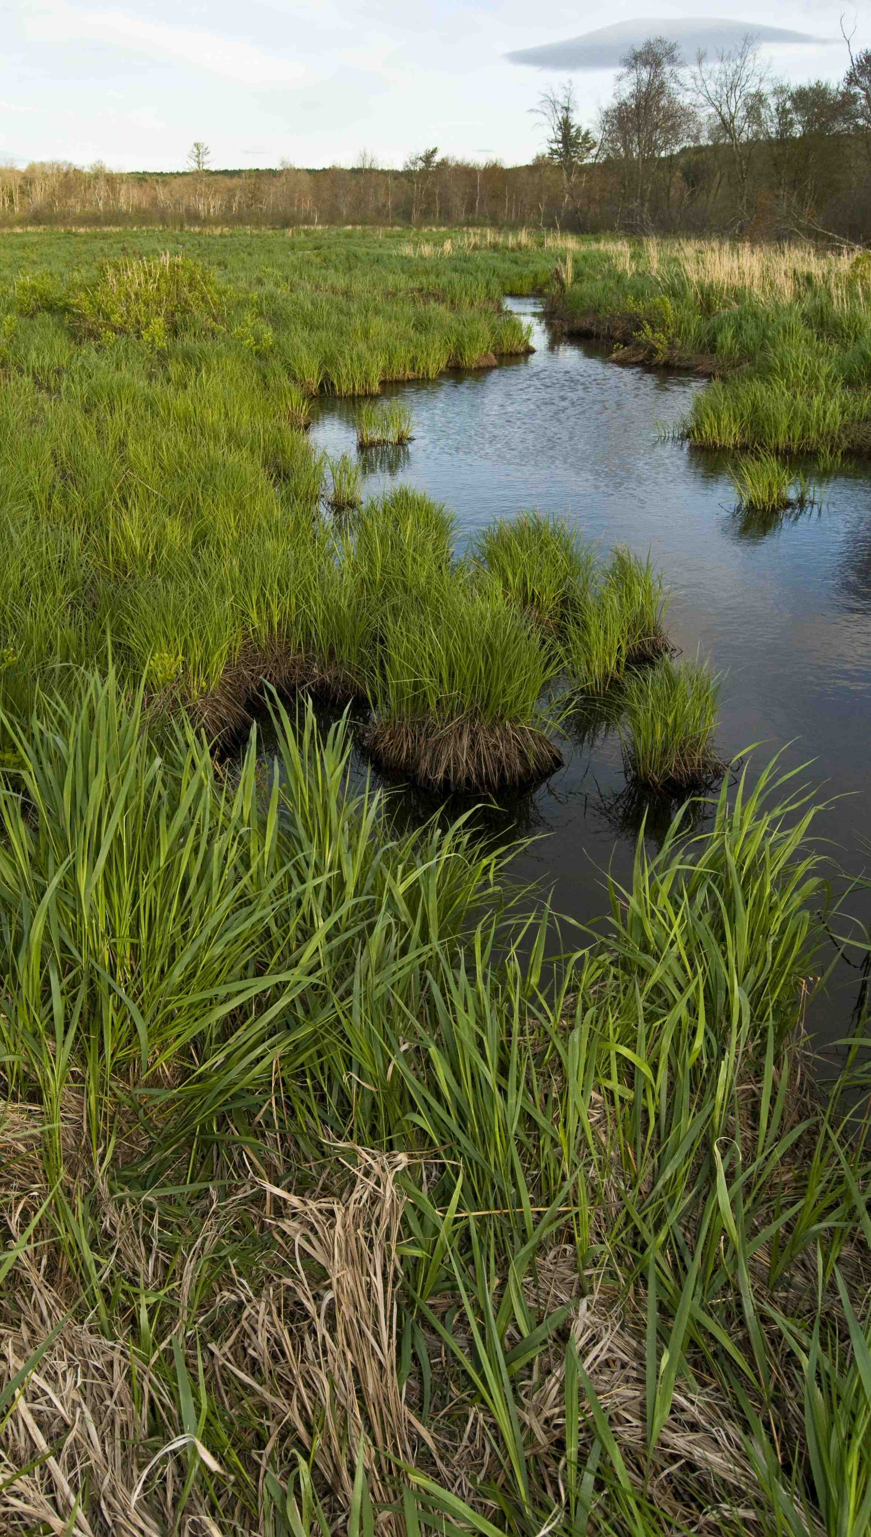
ECOLOGICAL INTEGRITY ASSESSMENT
LEVEL 1

Slide 12
Level 1 EIA (aerial photo assessment)
Step 1: EIA
SIZE
Size metrics
Absolute Patch Size
Relative Patch Size
CONDITION
Vegetation Metric
Vegetation Structure
Soil/Substrate Metrics
On-site Land Use
Soil / Substrate Disturbance
Hydrology Metrics
Hydrologic Alterations (non riparian)
Floodplain Interaction
LANDSCAPE CONTEXT
Landscape Context Metric
Land Use Index
Merrymeeting Marsh
Alton

Slide 13
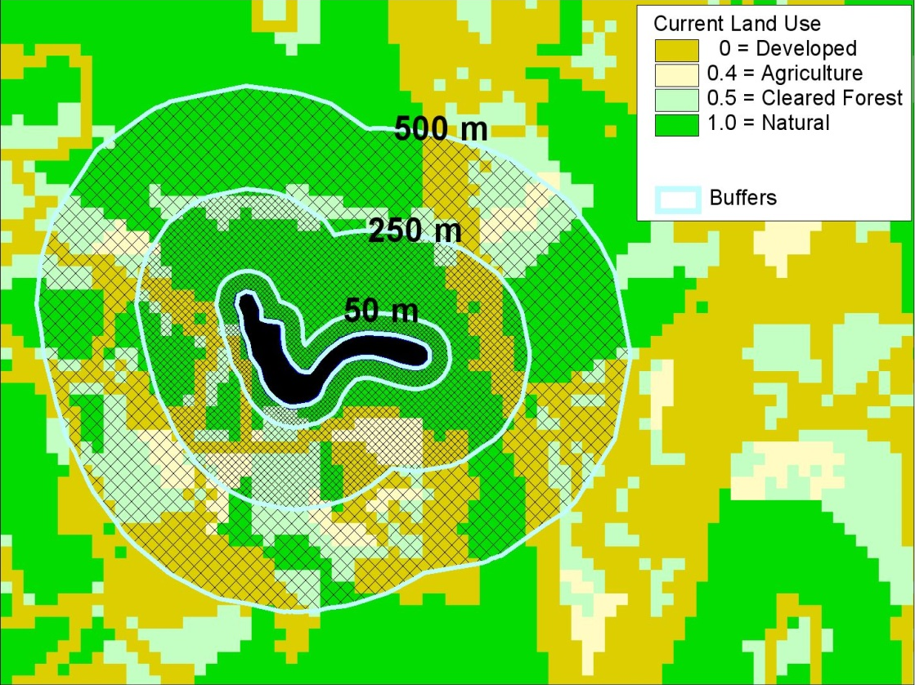
EIA Level 1 Land Use Index
Step 1: EIA
Land use index is calculated using the percent cover and coefficient value of each land cover type within three zones
Buffer immediately surrounding the wetland (0-100 m)
Surrounding land use just beyond immediate buffer (100-250 m)
Landscape connectivity (250-500 m)
Land Use Index:
Categorizes land uses by level of stress
Weights the category by area
100 m
Metric Rating
Excellent (A) | Good (B) | Fair (C) | Poor (D)
0.95 - 1.0 | 0.80 - 0.94 | 0.4 - 0.79 | < 0.4

Slide 14
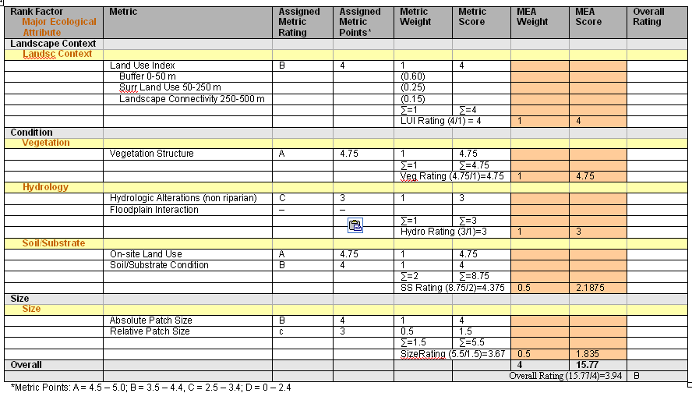
Automated Level 1 EIA Scorecard
Step 1: EIA
Calculates a numerical score for each major ecological attribute using weighted metric scores associated with attribute
Calculates an overall score using weighted major ecological attribute scores
Wetland’s overall L1 EIA score readily converts to a letter grade

Slide 15
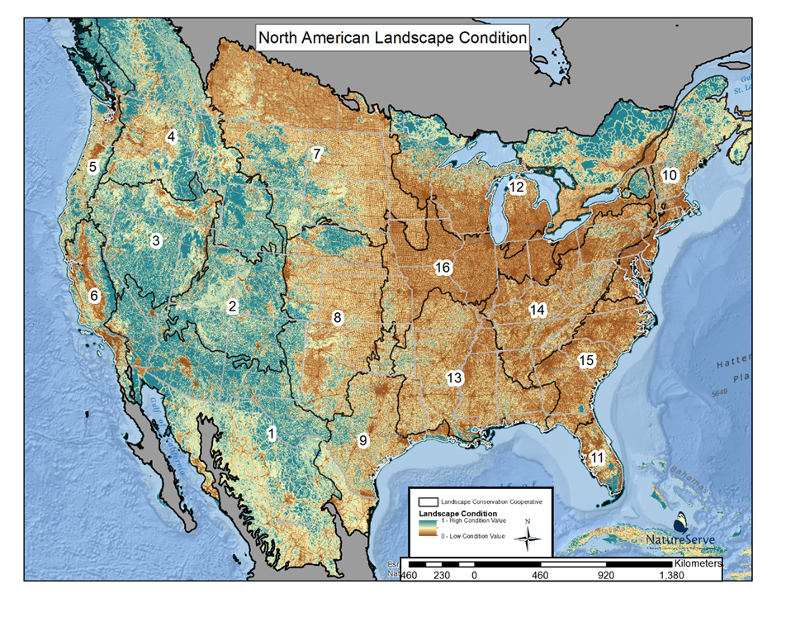
Level 1: Remote-sensing assessment
Threats-based model using 20 common land use types reflecting gradient of surface disturbance
Aims to predict quality & condition of extant natural/semi-natural landscape
Hak, J.C. and P.J. Comer. 2018. Modeling Landscape Condition for Biodiversity Assessment – Application in Temperate North America. Ecological Indicators

Slide 16
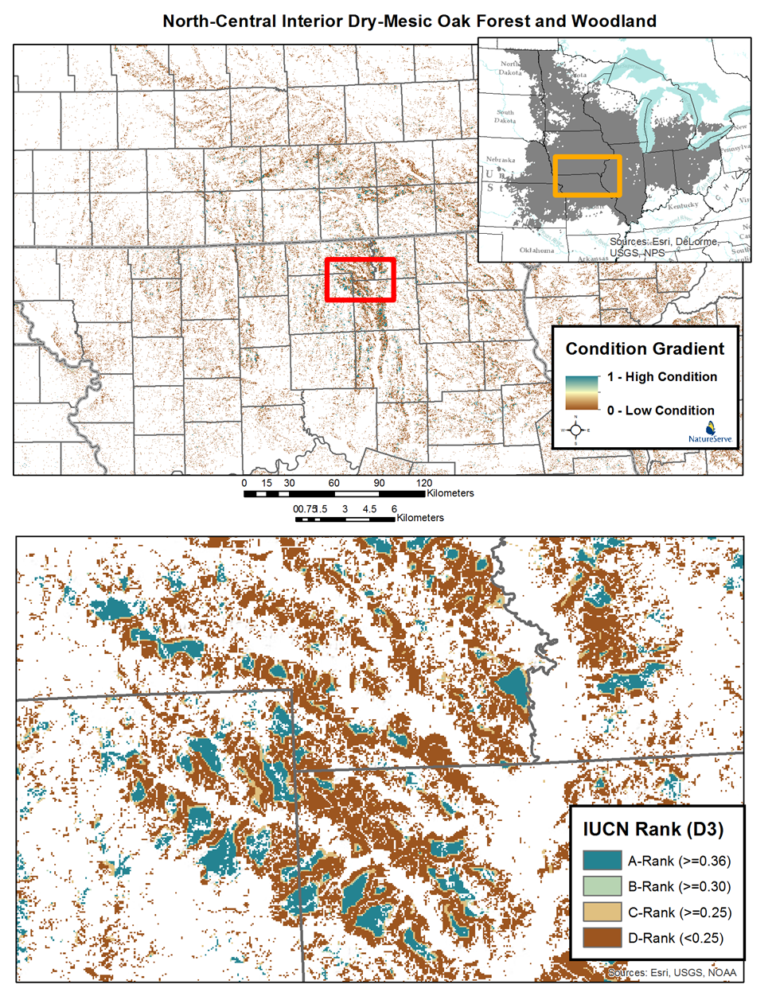
Level 1: Remote-sensing assessment

Slide 17
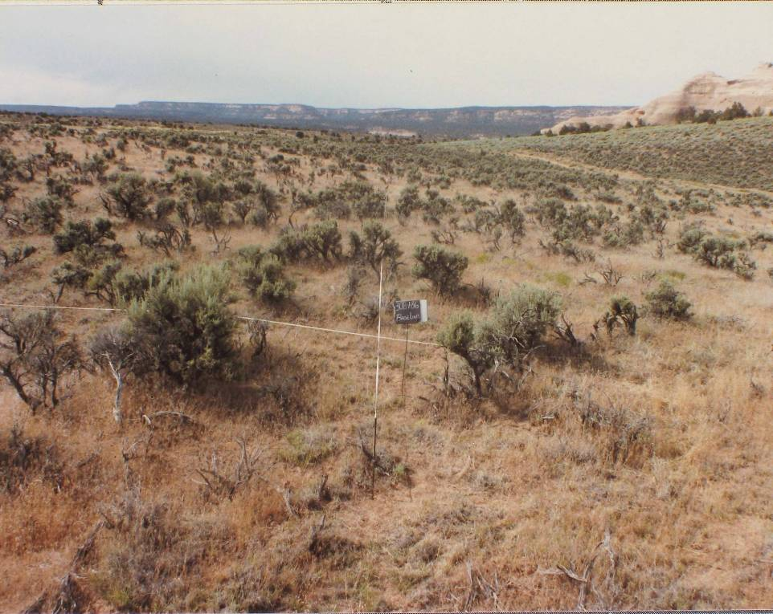
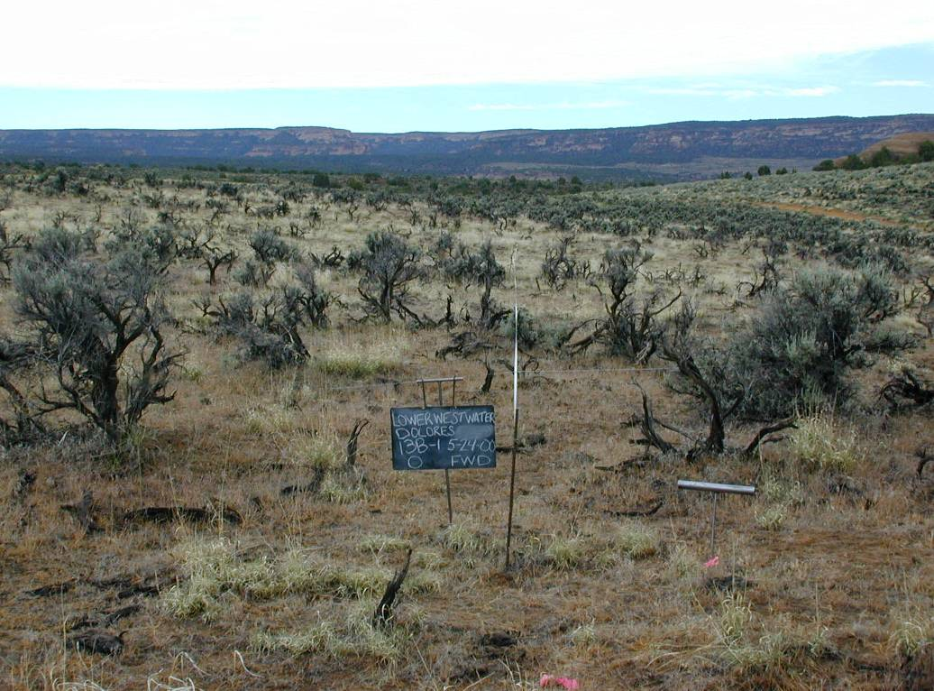
Level 2: Rapid field assessment
Field-based Natural Heritage EO Rank
1986
Sagebrush
5,133 stems/acre
2000
2005
1,240 stems/acre
Lower Westwater Site
Time Series Photopoint data from Utah DNR
60 stems/acre
Notes:
Level 2 example: The following are time series photographs from several locations around Utah to help illustrate the effects of cheatgrass invasion.
The major effect of cheatgrass is to provide fuel for wildlife.
Here you can see the density of big sagebrush, over a ground cover of native bunchgrasses (ideal nest and brood habitat for sage grouse).

Slide 18
Step 1: EIA
Rapid ground-based EIA
Level 2 (rapid, no plot data)
Level 2. 5 (rapid, plot data)
Component | Level 2 (no plot) | Level 2.5 (with plot)
EIA Level | Level 2: rapid ground-based approach | Level 2.5: rapid ground-based approach
Assessment Area | Natural community/Association, System/Group | Natural community, System/Group
Plot Sampling Intensity | Cover data for dominant plant species | Cover data for all plant species
Number of Plots | Zero, or quick plots (dominants by strata) | One+ plots completed in each dominant NC type occurring within the wetland system In addition, plot data is collected in secondary NC types as time permits
Completion of Forms | Pre-field: EIA Level 1 Land Use Index Field: EIA Level 2 General Form EIA Level 2 Metrics Rating Form EIA Level 2 Stressors Checklist Form (optional) | Pre-field: EIA Level 1 Land Use Index Plot: Field: EIA Level 2.5 General Form EIA Level 2.5 Metrics Rating Form EIA Level 2.5 Stressors Checklist Form

Slide 19
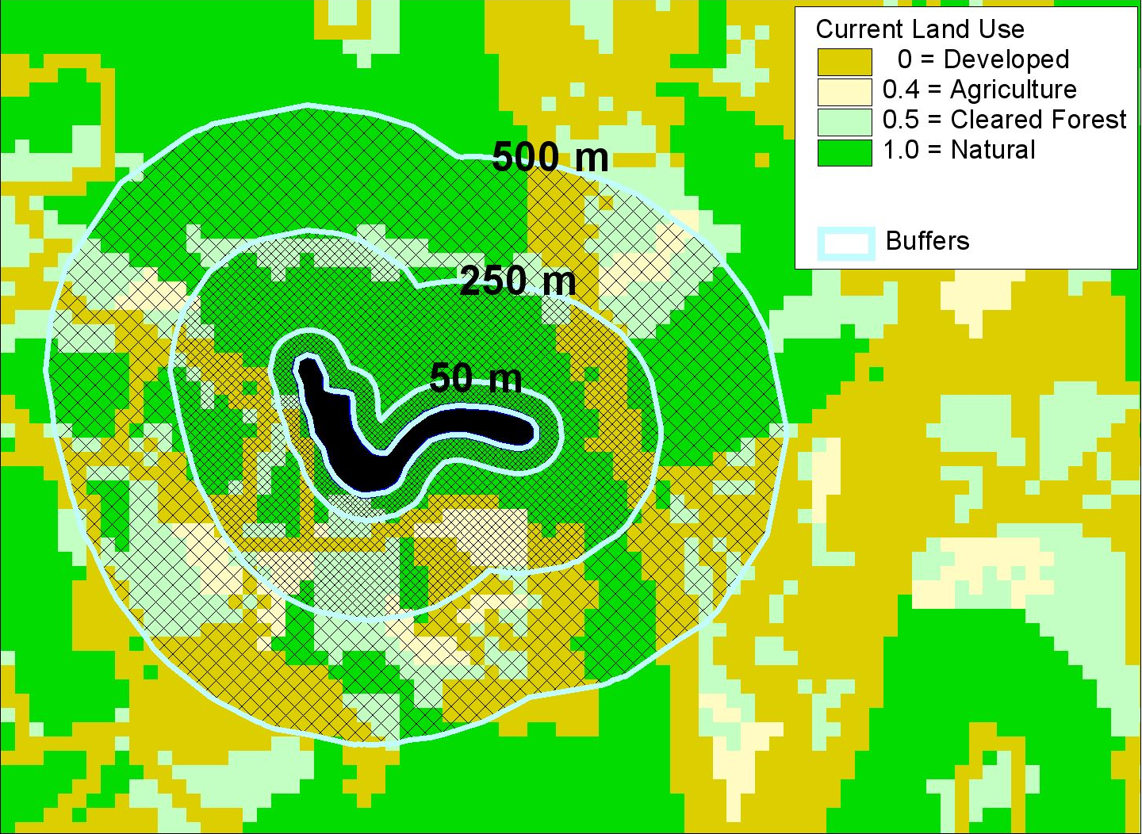
EIA Level 2 approach: Landscape Context
Step 1: EIA
Pre-field
EIA Level 1 Land Use Index:
Index is calculated using Landsat land cover data in a GIS
Land cover patterns are field checked during the survey
100 m

Slide 20
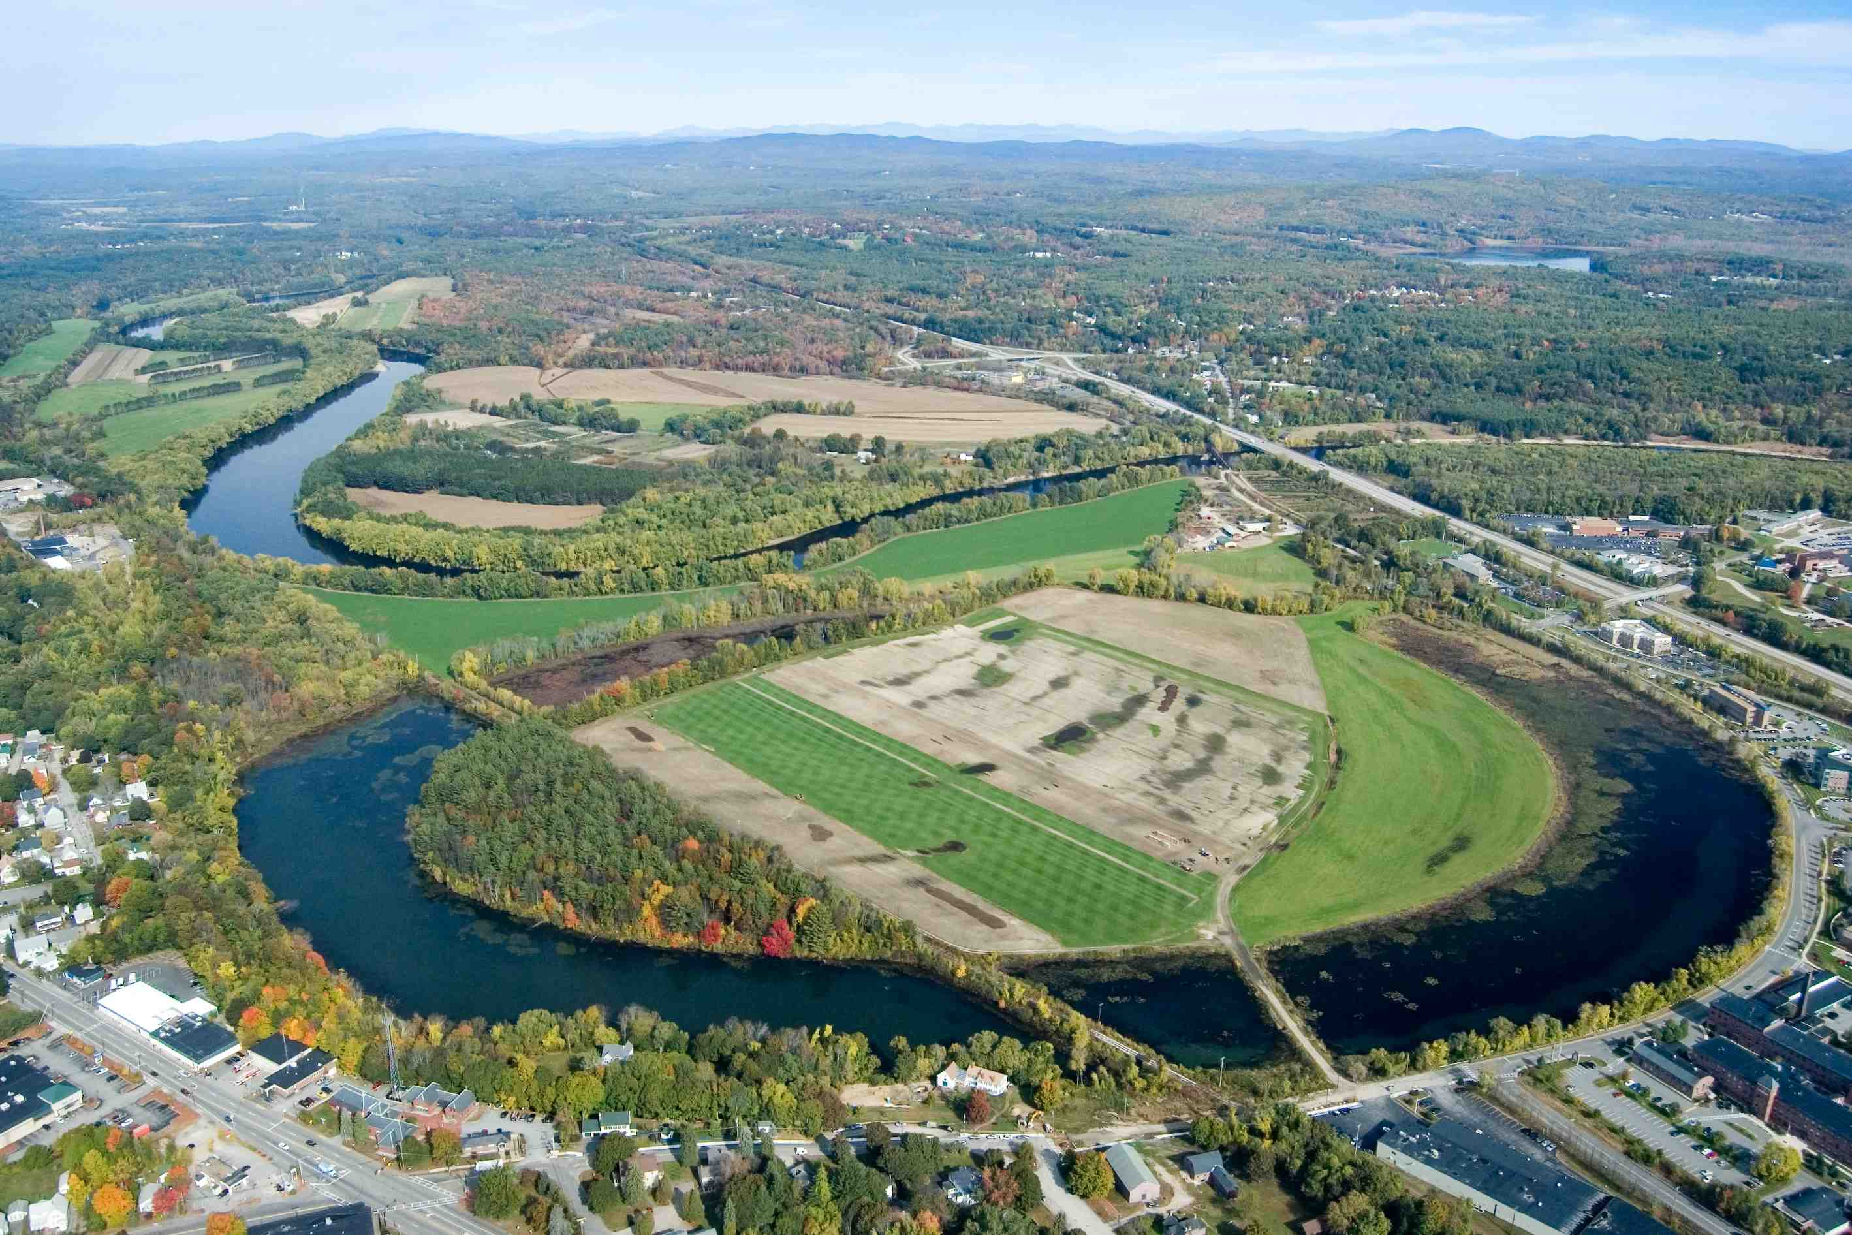
EIA Level 2 Metrics Rating Form: Condition
Step 1: EIA
For wetlands, evaluating condition entails an assessment of…
…Vegetation, Soil/Substrate, and Hydrology
Vegetation Metrics
Vegetation Structure
Relative Cover of Native Plant Species
Cover of Exotic Invasive Plant Species
Vegetation Regeneration
Vegetation Composition
Soil/Substrate Metrics
Disturbance
Physical Patch Type Diversity
Hydrology Metrics
Hydrologic Condition
Hydroperiod
Hydrologic Connectivity
Horseshoe Pond
Concord

Slide 21
EIA Level 2.5 Stressors Checklist
Step 1: EIA
EIA also involves evaluating stressors associated with Landscape Context, Vegetation, Soil/Substrate, and Hydrology (MEAs)

Slide 22
Level 2.5 Ecological Integrity Assessment
Step 1: EIA
S1-S2
Exemplary
S3-S5
Locally Significant
Overall wetland system/group rank = B
Condition Rank = C
Size Rank = A
LC Rank = B
Pre-Field
Condition Rank Specs
for system type
Size Rank Specs
for system type
LC Rank Specs
for system type
LC Index
GIS
Calculation
Condition Metric Form
Condition = C
Size Metric Form
Size = A
LC Metric Form
LC = B
Vegetation
Metric1 = B
Metric2 = C
|
Metric7 = C
Soil/Substrate
Metric1 = D
Metric2 = B
Metric3 = C
Hydrology
Metric1 = C
Metric2 = D
Metric3 = C
Metric1 = A
Metric2 = A
Metric1 = A
Metric2 = C
Metric3 = B
LC
Stressor
Checklist
Post-Field
EIA Level 2.5 Rapid Recon Form
Soil and vegetation plot data for each association / natural community
Field

Slide 23
Level 1 vs. Level 2 EIA
Component | Level 1 | Level 2.5
Assessment method | Remote sensing | Rapid ground-based
Time needed for assessment | Less | More
Metrics | Few | Many
Confidence in metric scores and overall rank | Low | High
Ability to identify species, communities, systems | Limited | Unlimited
Utility | Landscape analysis Prioritizing sites to survey Limited assessment of system’s ecological integrity Can inform conservation in a very broad sense | Accurately identifies/classifies plant species, communities, systems Thorough assessment of system’s ecological integrity Ground-based data is the foundation for our understanding of the classification and significance of natural communities and systems Primary method used to inform conservation decisions

Slide 24
Survey Highlights: New Hampshire Example
Step 2: Inventory and analysis
Pine River Effingham | Status
Floodplain system | Exemplary
Silver maple - false nettle - sensitive fern floodplain forest | Exemplary
Tall graminoid meadow marsh | Exemplary
Red maple floodplain forest: low variant | Exemplary
Red maple floodplain forest: low/medium variant
Red maple floodplain forest: medium/high variant
Mixed tall graminoid - scrub-shrub marsh
Emergent marsh
Alder - dogwood - arrowwood alluvial thicket
Alder alluvial shrubland

