Slide 1
IN DEPTH ECOLOGY SESSION
Turn on Recording

Slide 2



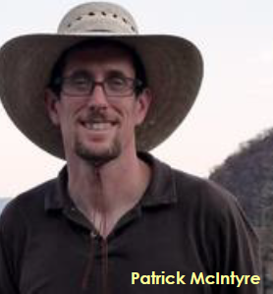


Ecology Department
Vice-President for
Data and Methods
Regan Smyth
Spatial Analysis
Don Faber-Langendoen
Patrick McIntyre
Chris Tracey
Ecology Data Management
Kristin Snow
Mary Harkness
Notes:
Our current org chart

Slide 3
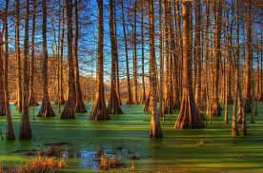
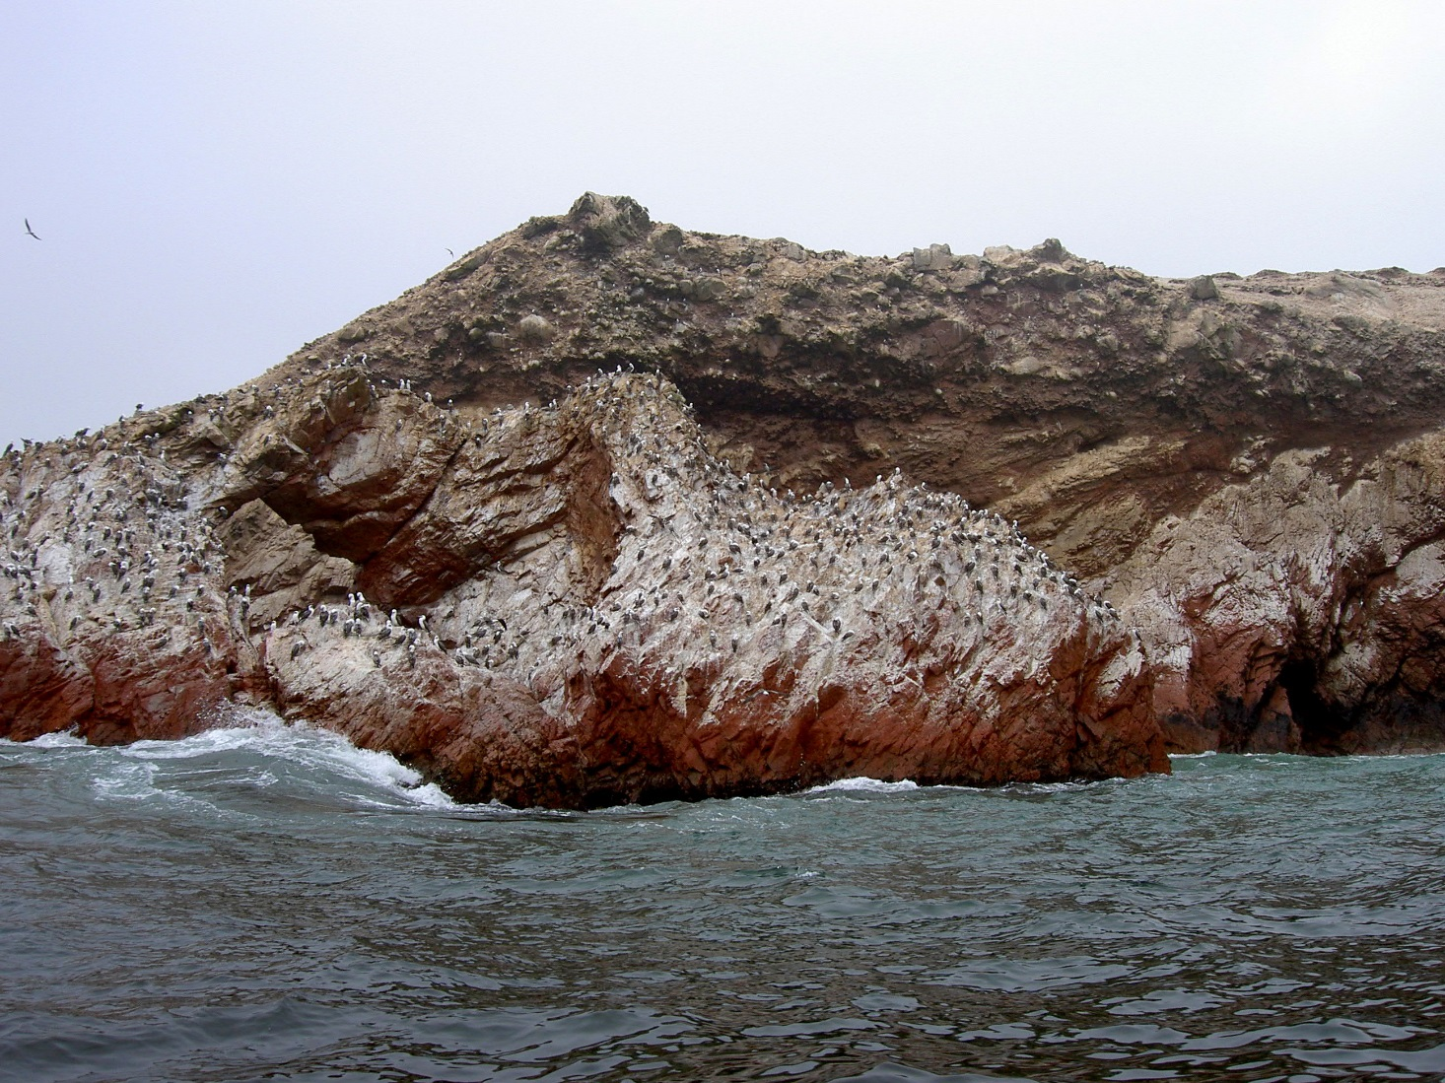
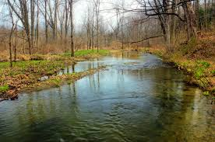
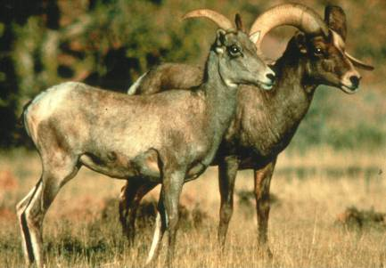
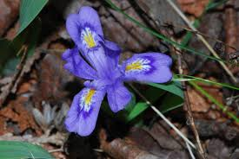
Coarse Filter & Fine Filter Approach
Exemplary Ecosystems
  natural landscape patterns and processes at scales useful for management and monitoring
At Risk Ecosystems
  unique environments
  rare terrestrial communities
  rare aquatic communities
  vulnerable species aggregations, migratory stopover points, etc.
Focal Species/Subspecies
  imperiled, declining, endemic, vulnerable, “umbrella”
Notes:
Elements of concern are hierarchical in nature and are grouped into species, communities, and ecological systems categories.
This encompasses what is commonly called the “coarse-filter/fine-filter approach.” Using this approach, spearheaded by The Nature Conservancy and NatureServe back in the 1970s, all characteristic ecological systems, then a subset of rare and vulnerable communities and species are used to represent the environmental variation and ecological processes that support all biological diversity.
The “coarse-filter” is provided by representing characteristic ecological system types (e.g. different forest, shrubland, grassland, wetland, and riverine systems). The “fine-filter” encompasses rare communities and species at risk that require special consideration to ensure that the ecological processes supporting them are considered in planning.
Our focus is on standard ecological classification and its application to conservation.

Slide 4
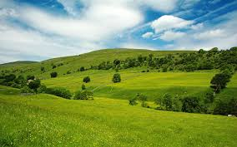
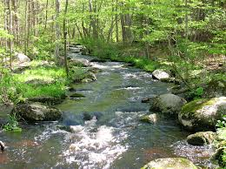
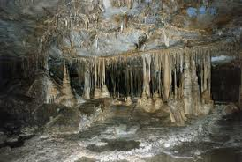

Ecosystem Classifications
Terrestrial
  Uplands
  Wetlands
  Subterranean
Aquatic
  Continental
    Riverine
    Lacustrine
    Subterranean
  Marine
    Estuarine
    Nearshore
    Deep Ocean
Notes:
Pat – We are discussing terrestrial classification – to be clear, we include uplands and wetlands under “terrestrial” concepts. “Wetlands” commonly defined as including rooted vascular vegetation.

Slide 5
Ecology Overview
NatureServe Ecology Department
Coarse Filter & Fine Filter Approach
Core Methods for Ecology
  Classification / Peer Review 2023 Edition (What is it?)
    Crosswalks to state classification – Taxonomic Tax [case study]
  Points, Plots, Polygons, EOs (Where is it?) [element tracking in action]
  Element Ranking: (How is it doing globally?)
    G-ranks Groups
    S-ranks Associations/Natural Communities [case study]
  EORANKS / Ecological Integrity Assessment (How is doing locally?)
  Monitoring changes in extent, ecological integrity, threats (How is it changing?)
    Case study – EIA. [How is it changing?][case study]
Cons. planning, restoration, adaptation (what can we do about it?)

Slide 6
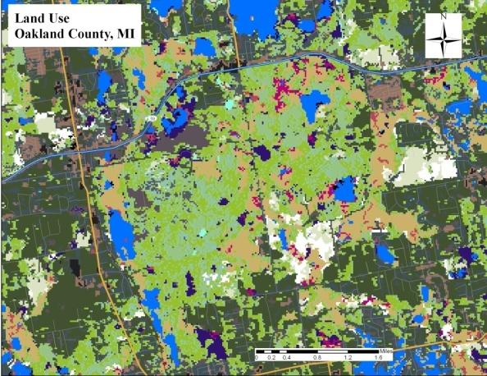
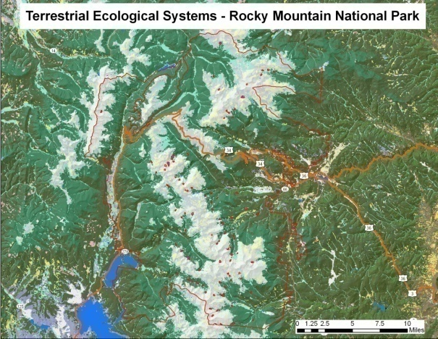
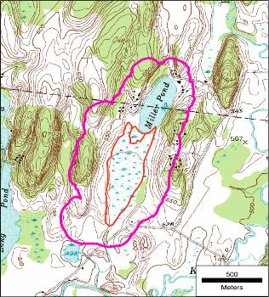
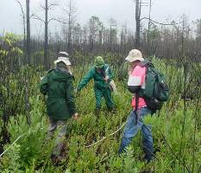
What is it?
Where is it?
Taxonomy & Classification
Maps and Surfaces
Field
Element Occurrences
Field Observations
Notes:
So our core methodology has been expanding over time. Because field samples – community observations are gathered first for classification development; they also get used a georeferenced locations to support map development. So these two componants, field observations and maps are becoming fundamental aspects of our work.

Slide 7
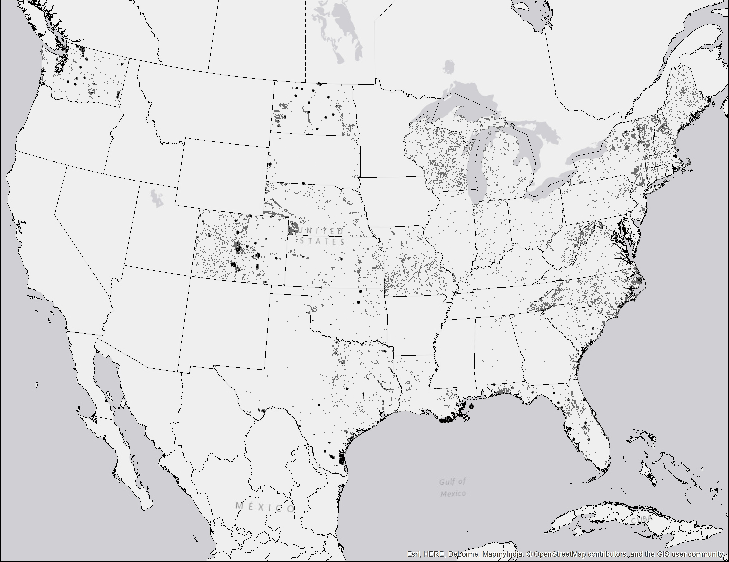
Natural Community EOs
~67,000 Element Occurrence for Natural Communities derived from NHP field inventories

Slide 8
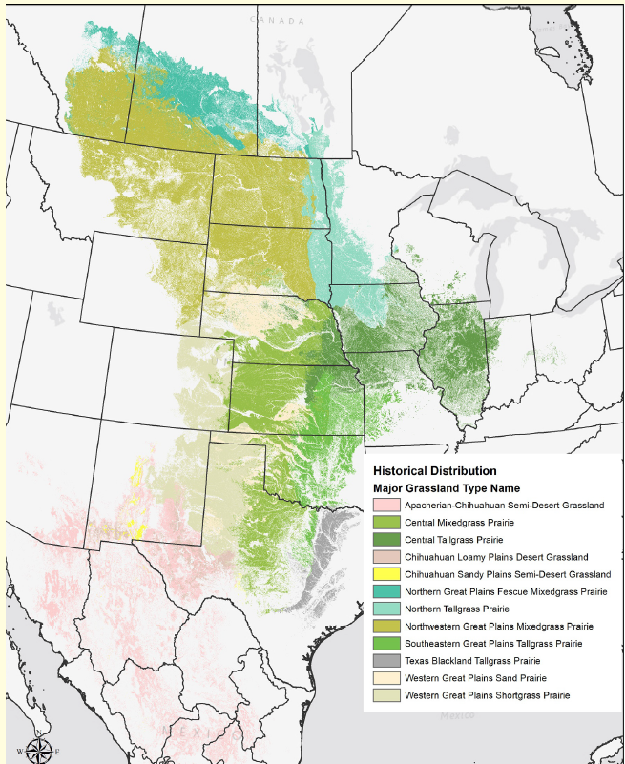
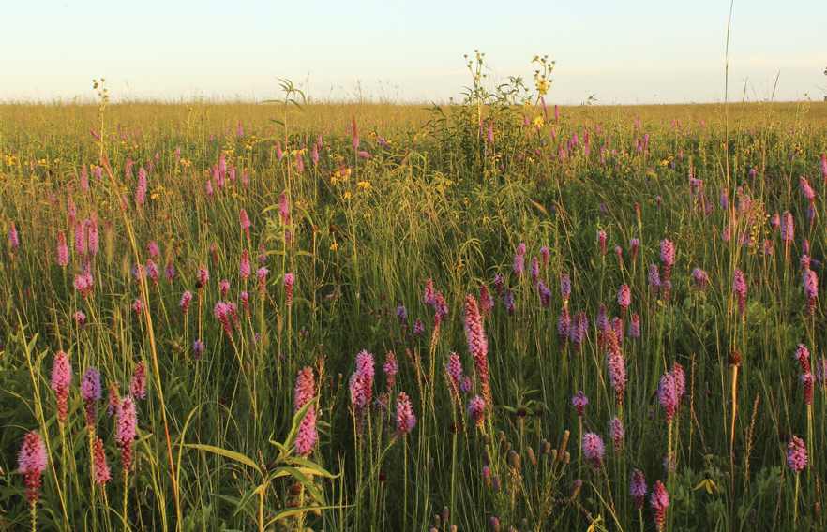
Hierarchy: Natural Vegetation
Hierarchy Levels | Example
Upper
Level 1 – Formation Class | Shrub & Herb Vegetation
Level 2 – Formation Subclass | Temperate & Boreal Shrubland & Grassland
Level 3 - Formation | Temperate Grassland & Shrubland
Mid
Level 4 – Division | Central North American Grassland & Shrubland
Level 5 – Macrogroup | Central Lowlands Tallgrass Prairie
Level 6 – Group | Central Tallgrass Prairie
Lower
Level 7 – Alliance | Big Bluestem – Indian grass Mesic Prairie
Level 8 – Association | Big Bluestem – Blazing Star Mesic Loam Prairie
Central Tallgrass Prairie
Increasing resolution
*Faber-Langendoen, D., T. Keeler-Wolf, D. Meidinger, D. Tart, C. Josse, G. Navarro, B. Hoagland, S. Ponomarenko, J-P. Saucier, A. Weakley, and P. Comer. 2014. Eco-Veg: a new approach to Vegetation Description and Classification. Ecological Monographs 84(4):533-561.
Notes:
Updated vegetation classification hierarchy (FGDC 2008, Faber-Langendoen et al. 2014)

Slide 9
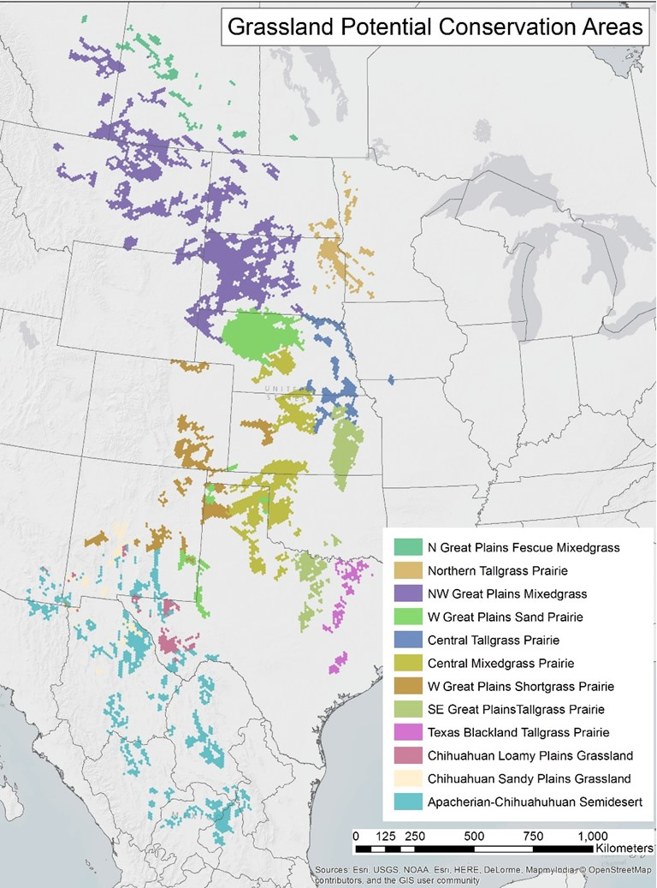

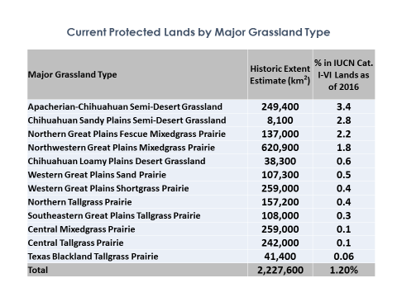
Potential Conservation Areas to Represent Major Temperate Grassland Diversity
Sites Selected to meet % area representation goals based on historical extent to advance Aichi Target 11 for ecologically representative and connected landscapes
“Gap Analysis” of Representation
Notes:
We aimed to represent at least 17% of estimated historical extent in landscape that are least in conflict with other land uses and most likely to support at-risk species and successfully restore connectivity

Slide 10

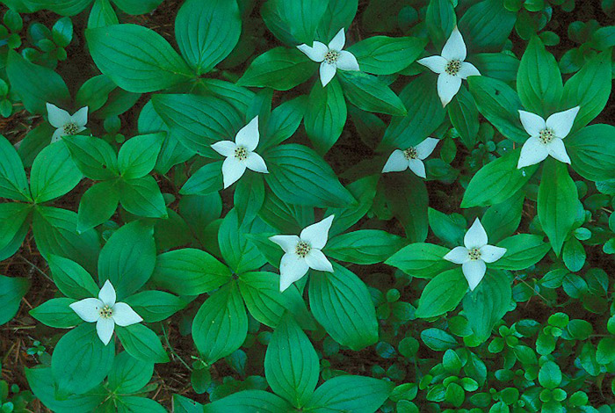
Questions & Discussion
Photo by Jared Hobbs

