Slide 1
Species Science In-Depth
Agenda
Your Questions (Bruce)
Overview (Bruce)
Life of a Heritage Botanist (Tara)
Break
Breakouts: 1: Ranking (Bruce) 2: EOs (Tara)
Break
Breakouts: Switch groups
Break
Wrap up (Bruce & Tara)

Slide 2
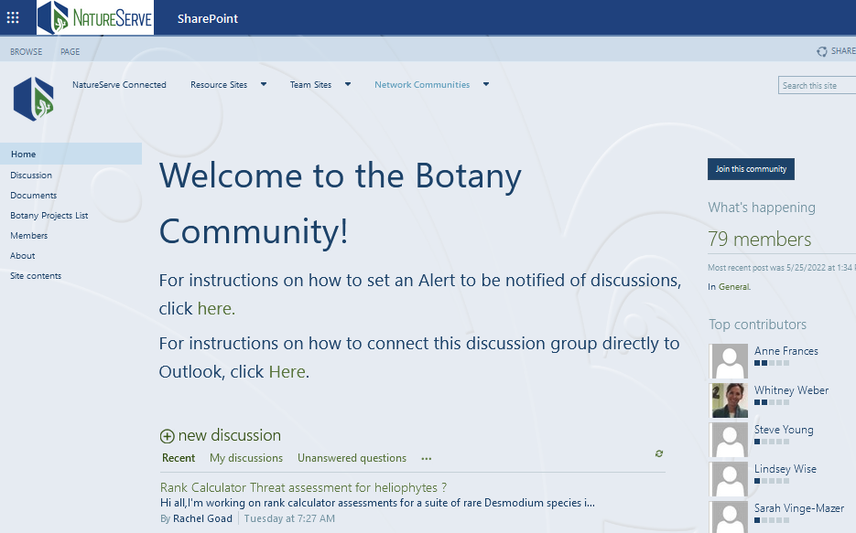
Botany Forum
Use your Sharepoint login: https://natureserve01.sharepoint.com/communites/botany/SitePages/Community%20Home.aspx
Contact Cliff_alton@natureserve.org if you have trouble

Slide 3
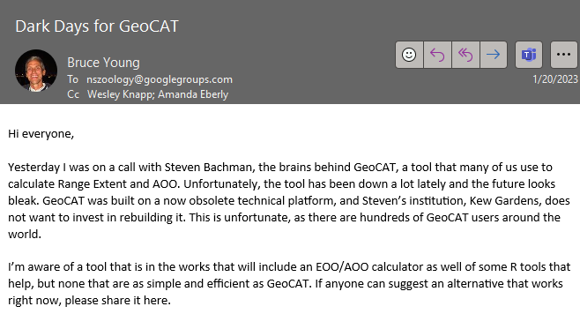
Zoology google group
Write to Nicole Sears (nicole_sears@natureserve.org) and ask to be added to the NSZoology google group

Slide 4
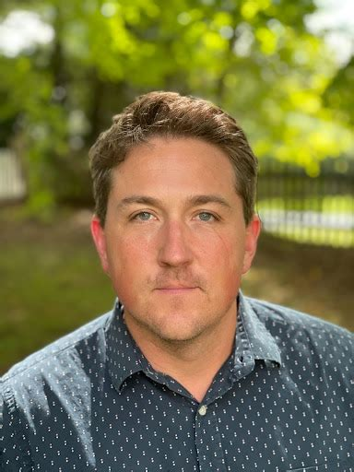
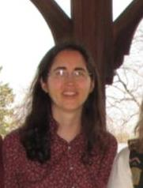
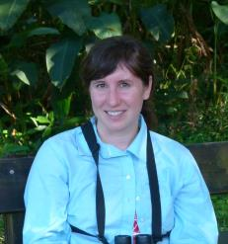

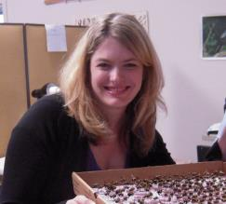

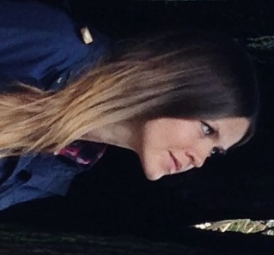
NatureServe Central – Points of Contact
Botany
Wes Knapp (lead) wesley_knapp@natureserve.org
Adele Tomaino Adele_Tomaino@natureserve.org
Amanda Treher amanda_Treher@NatureServe.org
Zoology
Bruce Young (lead) Bruce_young@natureserve.org
Nicole Sears Nicole_Sears@natureserve.org
Margaret Ormes Margaret_Ormes@natureserve.org
Canada
Amie Enns Amie_enns@natureserve.org

Slide 5
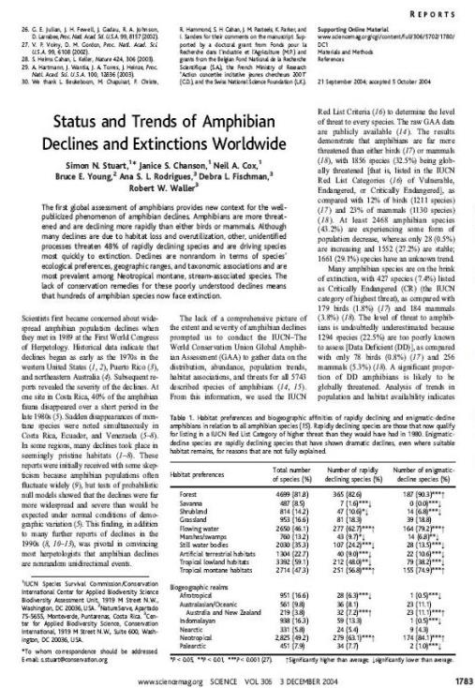
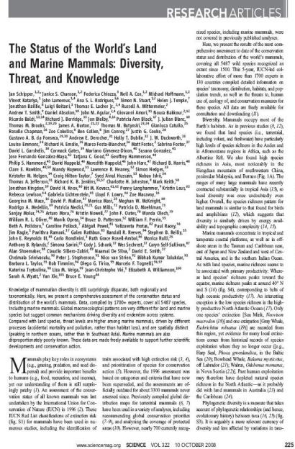
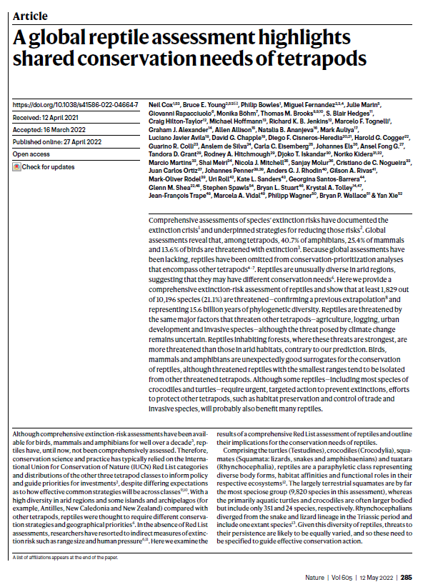
Examples of Our Work -- Global Assessments

Slide 6
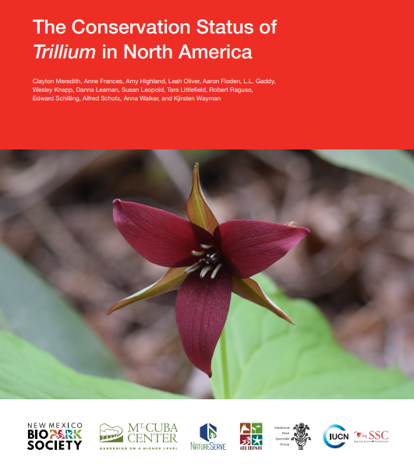
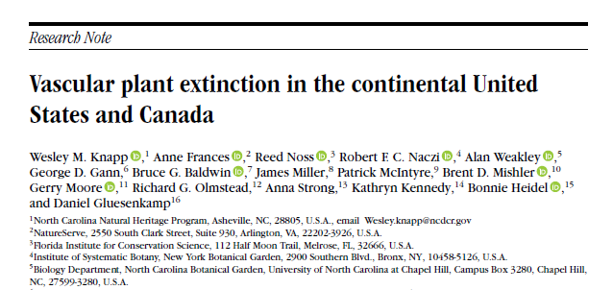
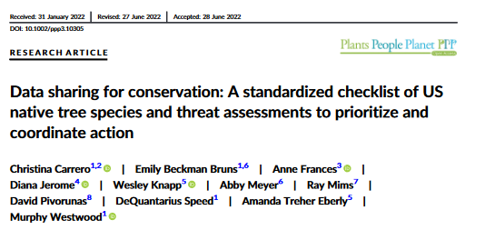
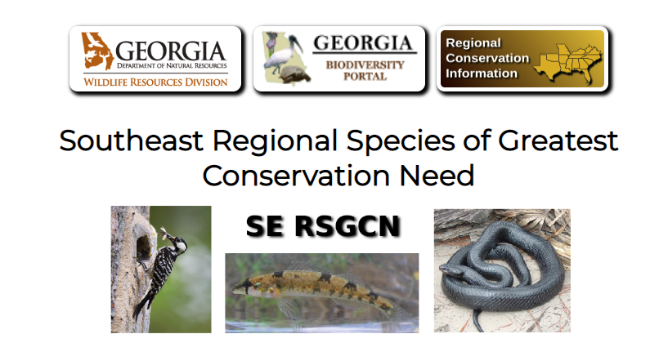
Examples of Our Work - Botany

Slide 7
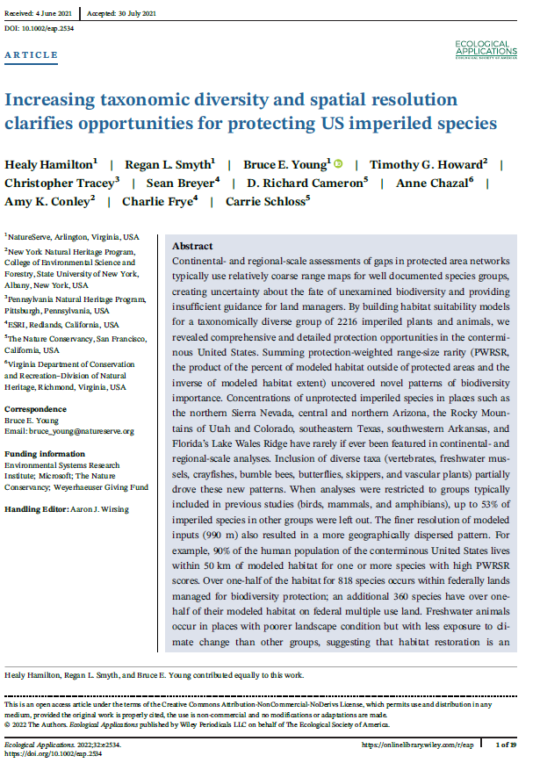
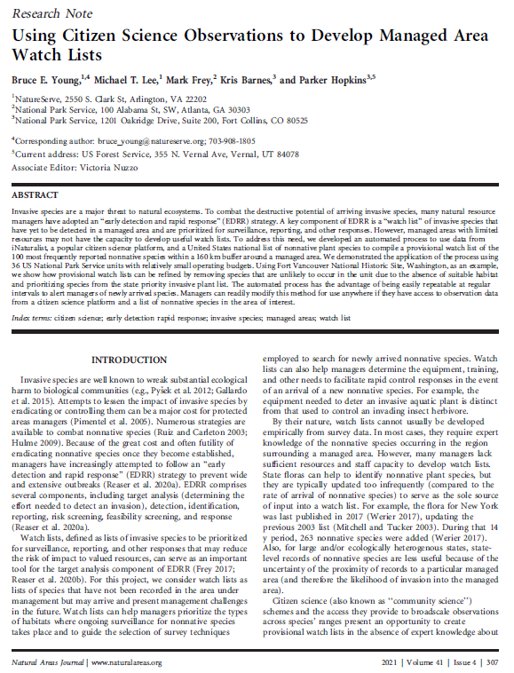
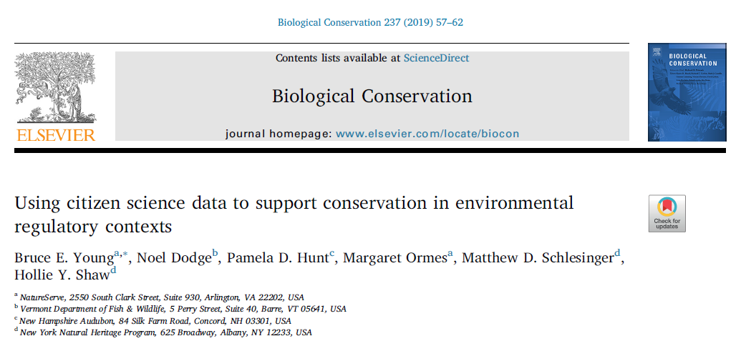
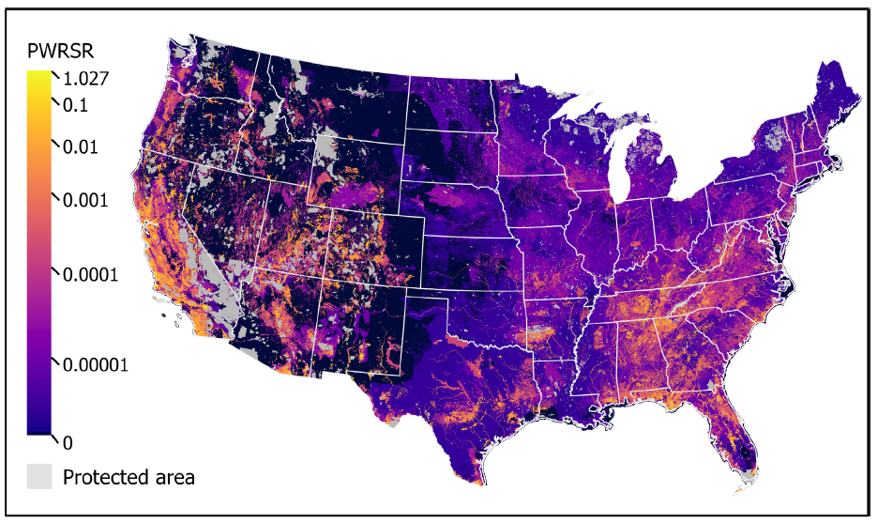
Examples of Our Work – Conservation in North America

Slide 8
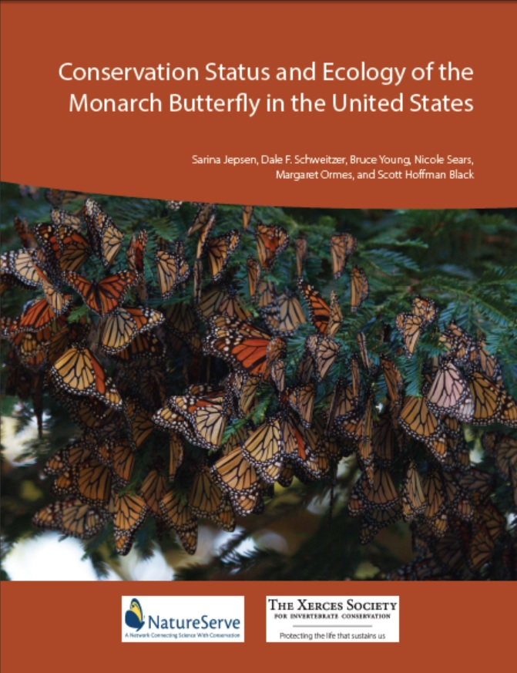
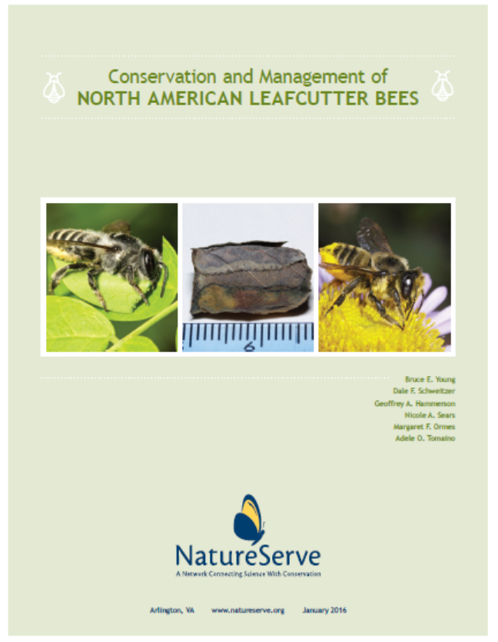
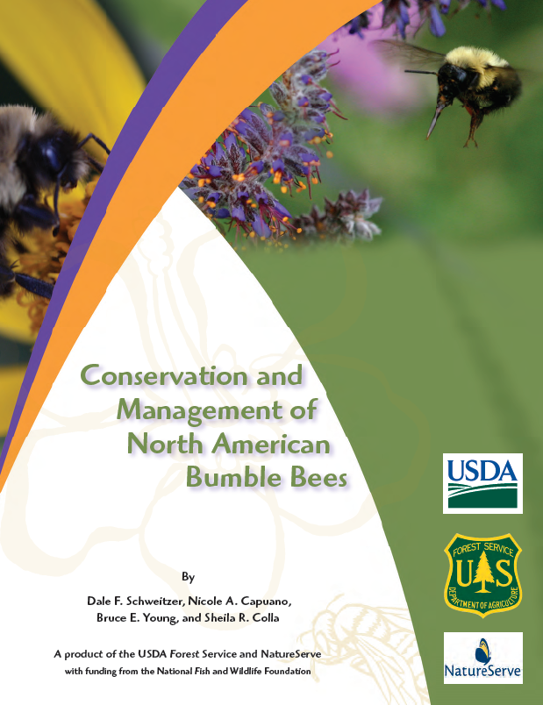

Examples of Our Work – Pollinator Reports

Slide 9
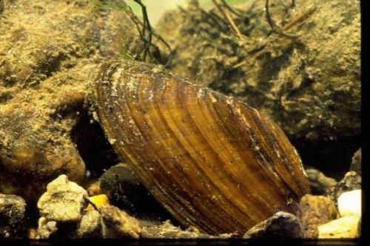
What We Track – Comprehensively Assessed Groups
Animals
Vertebrates (except marine fishes)
Invertebrates
Mollusks (terrestrial & freshwater snails, freshwater mussels)
Shrimps (fairy, clam, tadpole)
Crayfishes
Insects
Bees (bumble, mason, leafcutter, carpenter, digger, digger-cuckoo, carder, chimney, squash, selected sweat)
Beetles (tiger, hairy flower scarab, Trichodes checkered)
Butterflies and skippers
Macro-moths (giant silkworm and royal, notodontid*, Papaipema, sphinx, tiger, underwing)
Aquatic (mayflies, stoneflies, caddisflies, dragonflies and damselflies)
Currently working on flower flies

Slide 10
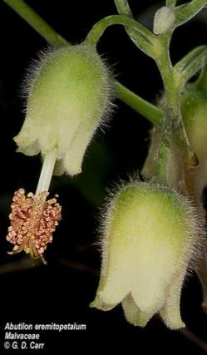
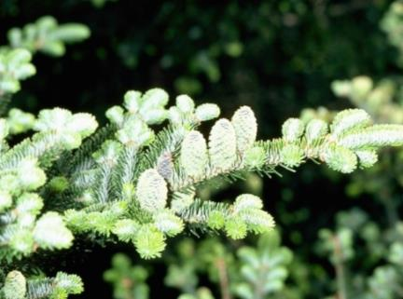
What We Track – Comprehensively Assessed Groups
Plants
Vascular plants
Non-vascular plants*
Fungi
Lichens*
* Complete species and ranks, incomplete distribution

Slide 11
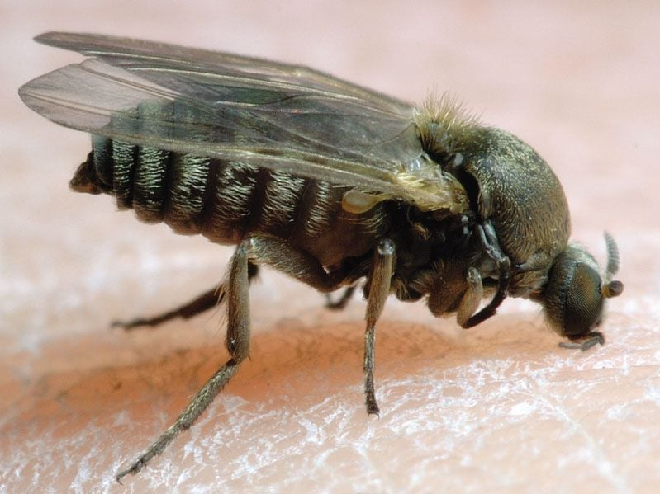
What We Don’t Track – Non-Comprehensively Assessed Groups
Animals
Marine fishes & inverts
Worms
“Terrestrial” flies
Most beetles
Most bees and all non-bee Hymenoptera
Most other non-Lepidopteran insects
Fungi
Non-lichenized
**All ESA/COSEWIC species tracked**

Slide 12
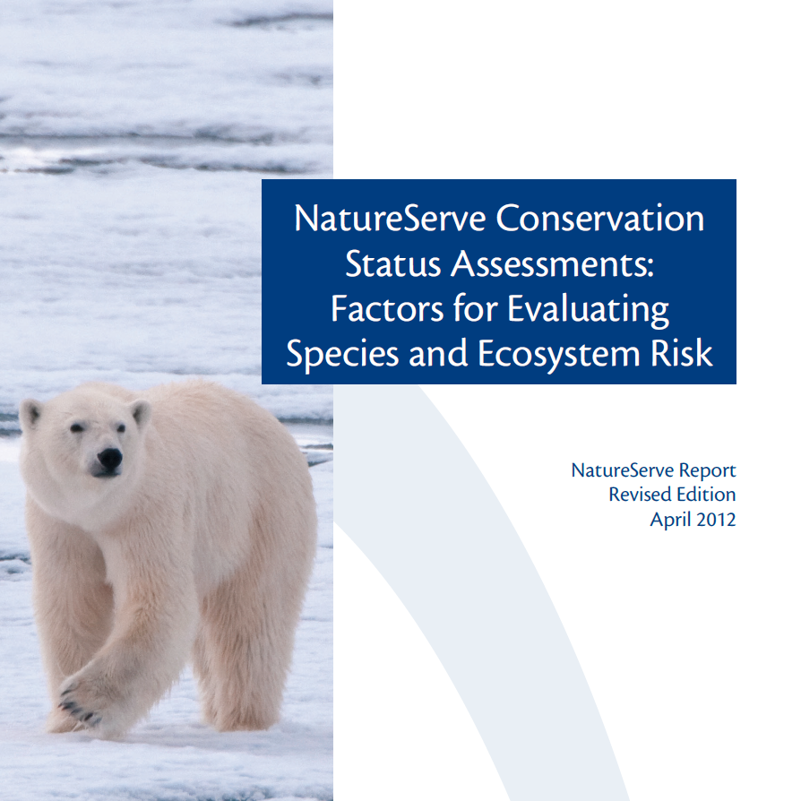
Threats
When to score a threat?
Threat categories
Scope, Severity, Timing
Overall Threat Impact
Intrinsic Vulnerability

Slide 13
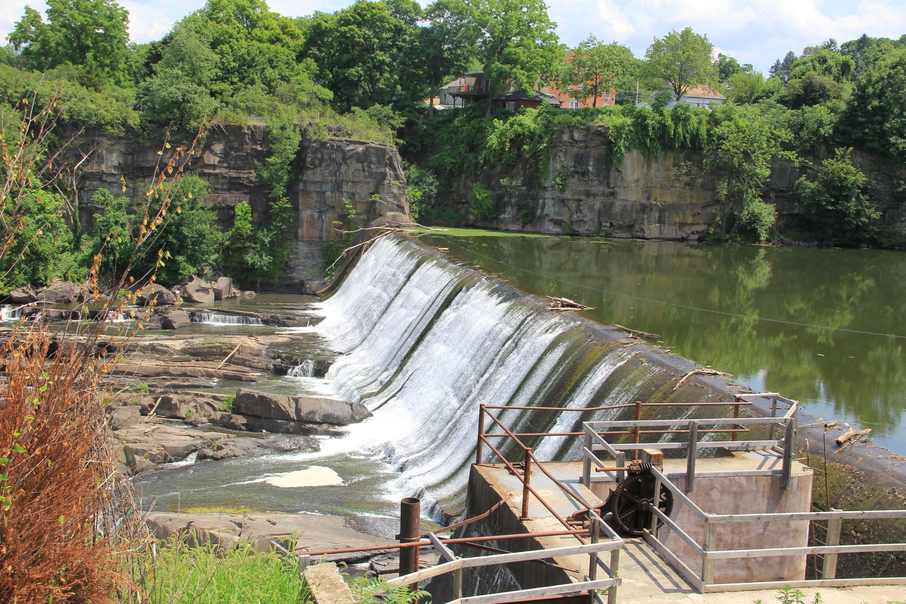
Threats
Remember
Score only direct threats
Think about next 10-20 yr
Effects of past threats are covered in Trends
Use scope, severity, timing of each threat to calculate Threat Impact
Read the definitions of the threat categories

Slide 14
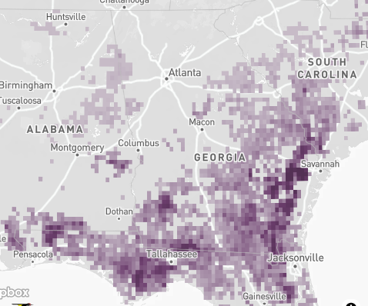

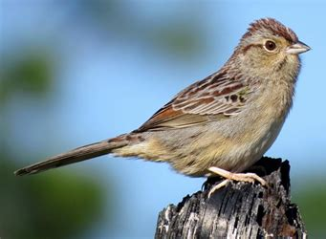
Threats - Definitions
Scope: Proportion of population affected by threat

Slide 15
Threats - Definitions
Scope: Proportion of population affected by threat
Severity: Level of damage to be expected with continuation of current circumstances
  10 yr or 3 generations (<100 yr)
  Measured as reduction of population
Timing:
  High – Continuing
  Moderate – Short term only
  Low – Future
  Insignificant/Negligible – Past

