Slide 1
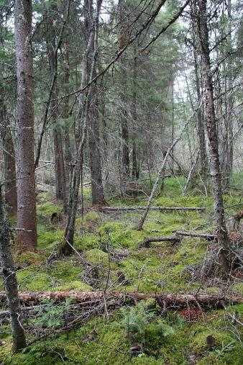
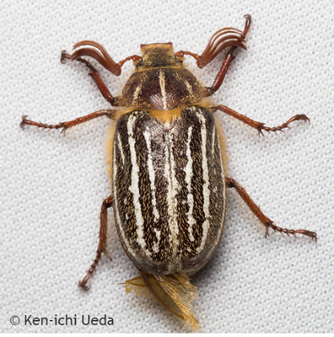
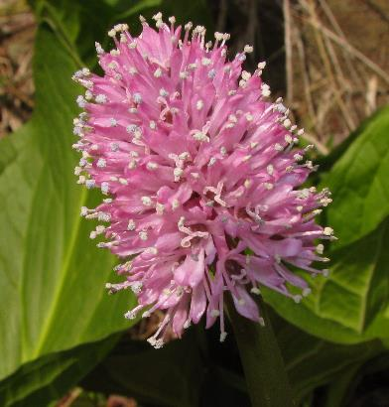
Introduction to NatureServe’s Conservation Status Assessments
OVERVIEW
Ken Baldwin

Slide 2
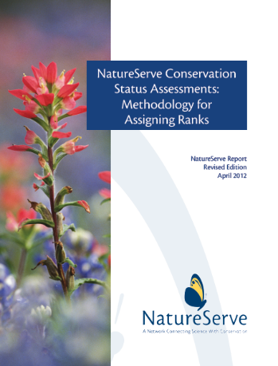
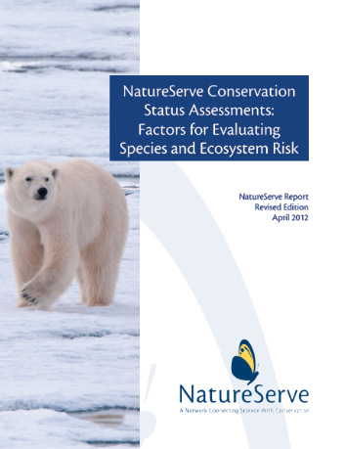
What is a Conservation Status Assessment?
An estimation of species extinction/ecosystem elimination risk
Focus on current, natural populations
The Rank Calculator automates the process, promotes accuracy & transparency
Download the methodology and factor description guidance, and the rank calculator:
www.natureserve.org/conservation-tools/conservation-rank-calculator

Slide 3
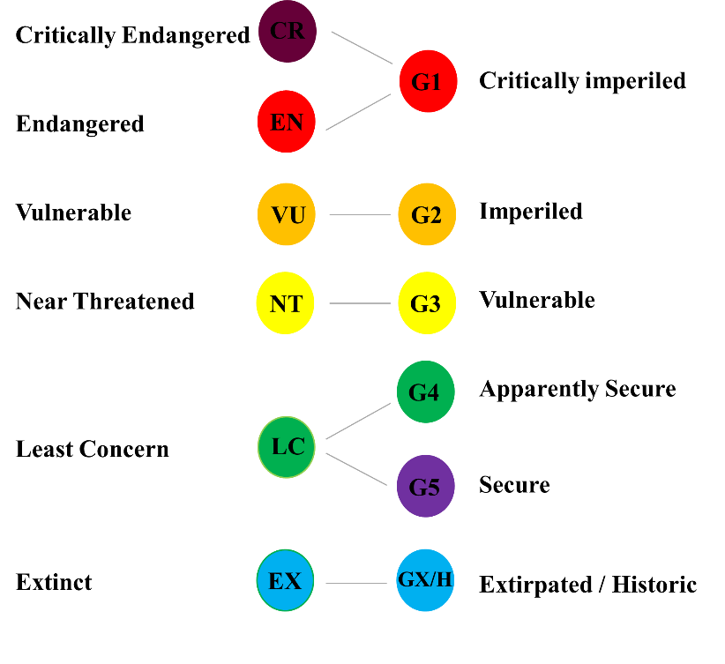
What is the Conservation Status Assessment Rank?
A category indicating geographic scale and extinction/elimination risk:
A letter prefix of G, N, or S indicates geographic scale
Numbers from 1-5 indicate extinction/elimination risk
Subnational
Global
National
Critically Imperiled
Imperiled
Vulnerable
Apparently Secure
Secure
G1
G2
G3
G4
G5
S1
S2
S3
S4
S5

Slide 4
Other Ranks
Subnational
Global
National
Extinct/Extirpated
GX
NX
SX
Possibly Extinct
GH
NH
SH
Critically Imperiled
G1
N1
S1
Imperiled
G2
N2
S2
Vulnerable
G3
N3
S3
Apparently Secure
G4
N4
S4
Secure
G5
N5
S5
Unrankable
GU
NU
SU
Not Applicable
GNA
NNA
SNA
Not Ranked (yet)
GNR
NNR
SNR

Slide 5
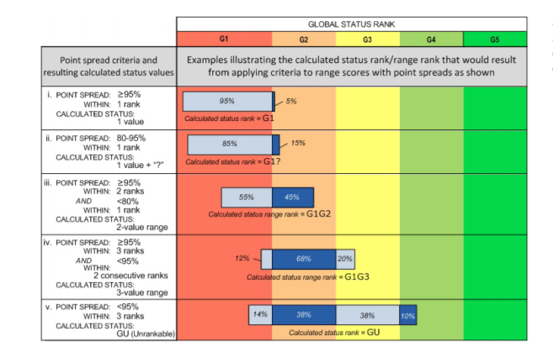
Other Ranks
Uncertainty
Rank Qualifiers
G1?; N3?; S2?
Range Ranks
G2G3; N2N5; S1S3
Global Rank Qualifiers
Questionable taxonomy
G2Q
Captive or cultivated only (extinct in the wild)
GXC or GHC
Subspecies, Varieties, & Populations
G2T1

Slide 6
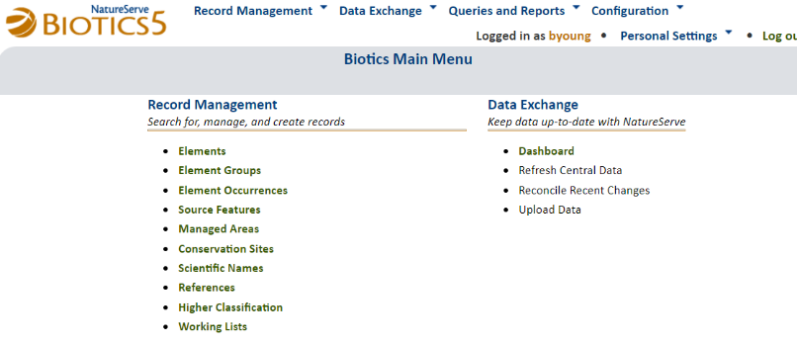
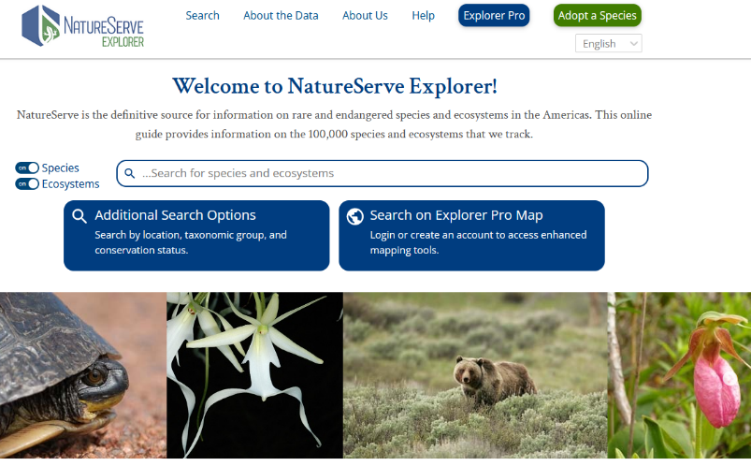
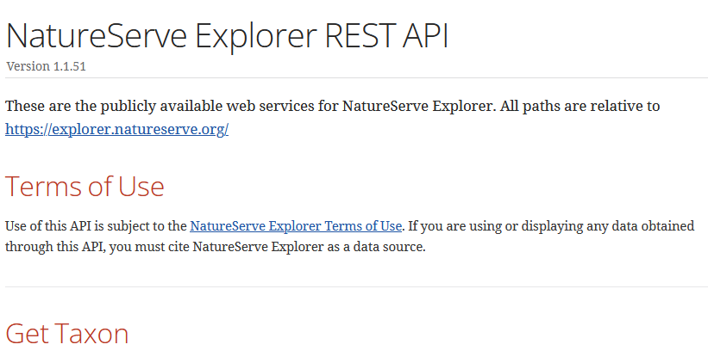
How to access Conservation Status Assessments?
https://explorer.natureserve.org

Slide 7
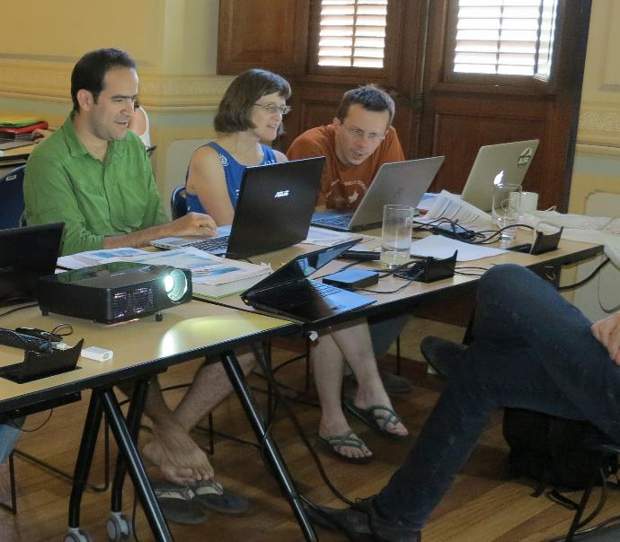
Let’s Learn about Ranking
(How many of you tuned into the Network Ranking Webinars?)

Slide 8
How does ranking work?
Identify geographic and taxonomic scope
Research and gather data, contact experts
Input data into Biotics Element Ranking forms (or Rank Calculator)
Review calculated rank
Record assessment details

Slide 9
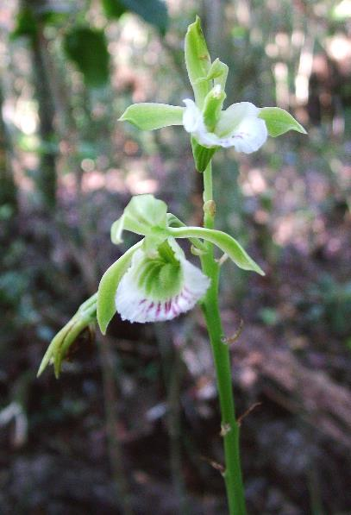
1. Identify the Scope
NC Orchid
Galeandra bicarinata

Slide 10
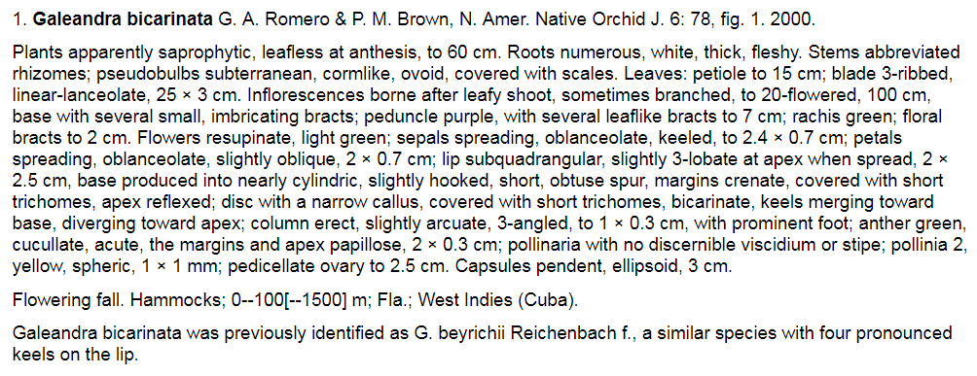
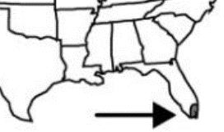
1. Identify the Scope
Geographic Scope:
Global: Florida and the Caribbean
National (USA): Florida
Subnational (FL): Florida

Slide 11
1. Identify the Scope
Global Assessments
Expand the search for occurrence data beyond the bounds of the network
Expect variation in threats and trends across the species range
National, Subnational Assessment
Is there significant immigration or propagules, capable of reproducing entering the area of assessment?
Is the population(s) in the area of assessment unable to sustain itself without this immigration?
Rescue Effect
Rescue Effect on page 38 of the Polar Bear Document

Slide 12
2. Research and gather data
Research focuses on the 3 factor groups:
Rarity
Range Extent
Area of Occupancy
Population Size
Number of Occurrences
Number of Occurrences with Good Viability or Percent Area with Good Viability/Ecological Integrity
Environmental Specificity
Threat Impact
Intrinsic Vulnerability
Long-term
Short-term

Slide 13
2. Research and gather data
Do I need to determine a score for all factors?!
Option 1: Minimum Factors Requirements
1 Rarity Factor And 1 Threat or Trend Factor
Range Extent
Area of Occupancy
Population Size
Number of Occurrences
Threat
Long-term
Short-term
Option 2: Minimum Factors Requirements
1 factor from each rarity category (Abundance or Range/Distribution)
Abundance
Number of Occurrences
Population Size
Range/Distribution
Range Extent
Area of Occupancy
Extreme rarity on page 15 of the Paintbrush document

Slide 14
2. Research and gather data
Review current data in Biotics Element Ranking forms
Review Element Occurrence data including their attributes
Review information from additional data sources:
maps, inventory and monitoring data
published literature and unpublished reports
expert input from member programs, land managers, field biologists, and taxonomists
occurrence data, e.g., GBIF, museum database or specimens, iNaturalist, eBird

Slide 15
3. Input data
Refer to the guidance on factor descriptions and the Rank Calculator Tool:
www.natureserve.org/conservation-tools/conservation-rank-calculator

Slide 16
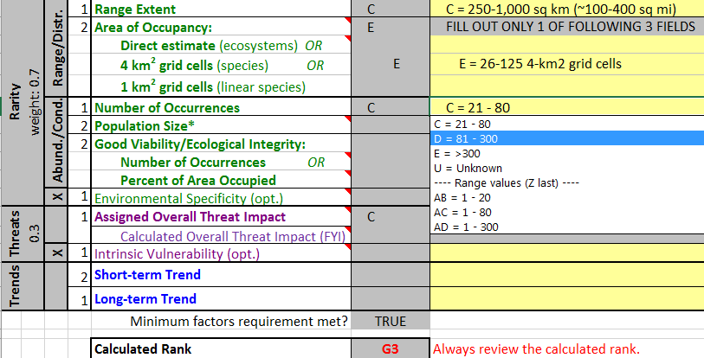
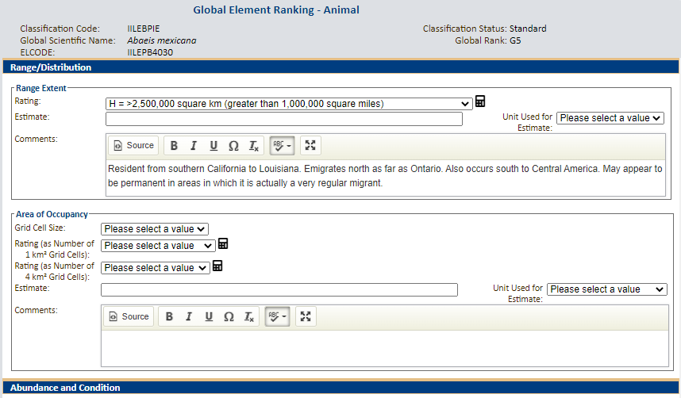
3. Input data
Rank Calculator or Biotics

Slide 17
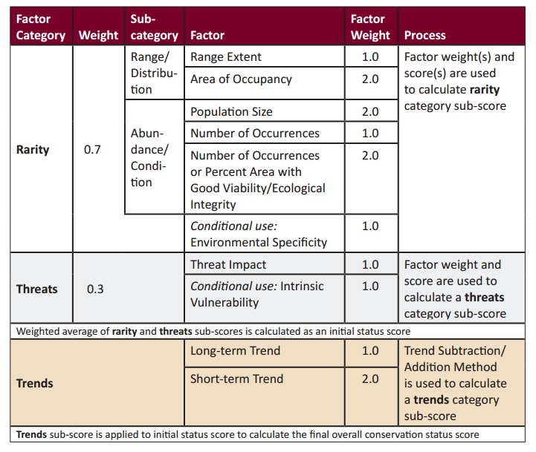
3. Input data
Behind the scenes, Biotics and the Rank Calculator enforce the methodology

Slide 18
4. Review calculated rank
Review the rank and consider how the data supporting the rank influenced the rank. Reconsider uncertain data or review factor guidance
Apply Rescue Effect to state/national ranks through a manual adjustment
Apply Q to global rank for questionable taxonomy (G2Q)

Slide 19
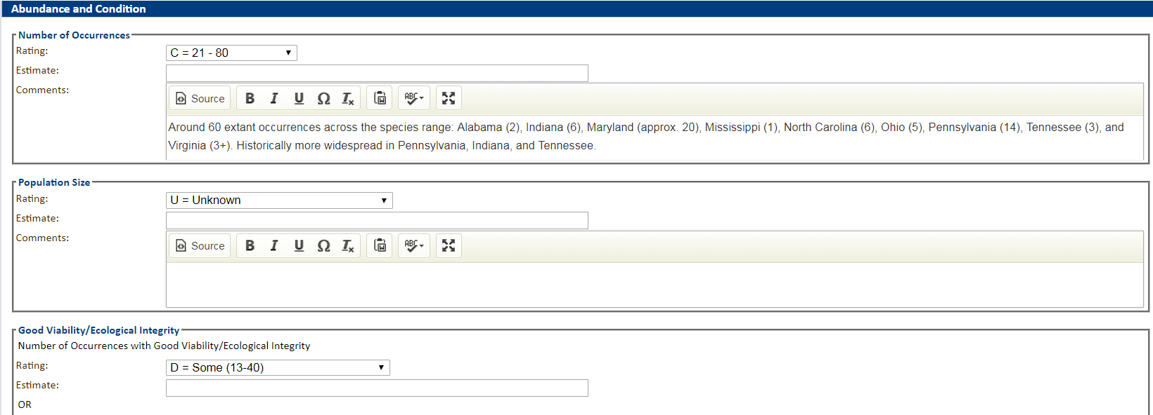
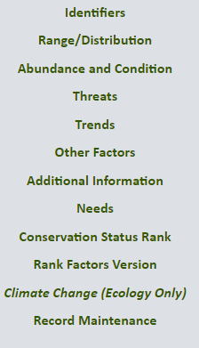
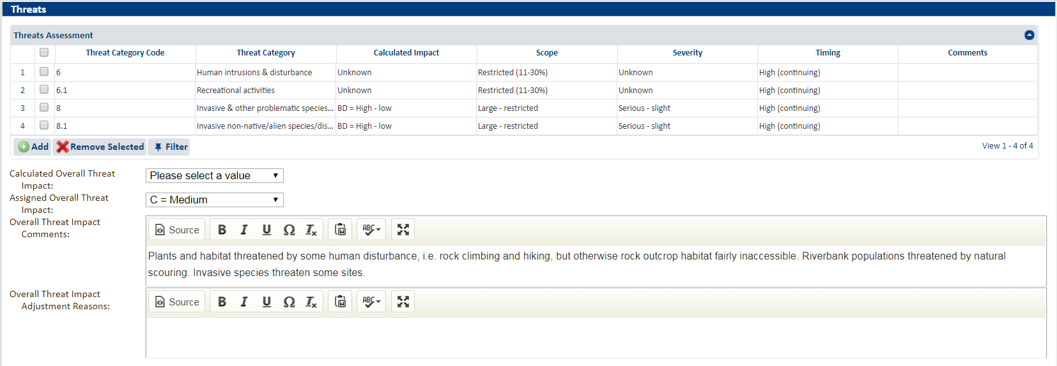
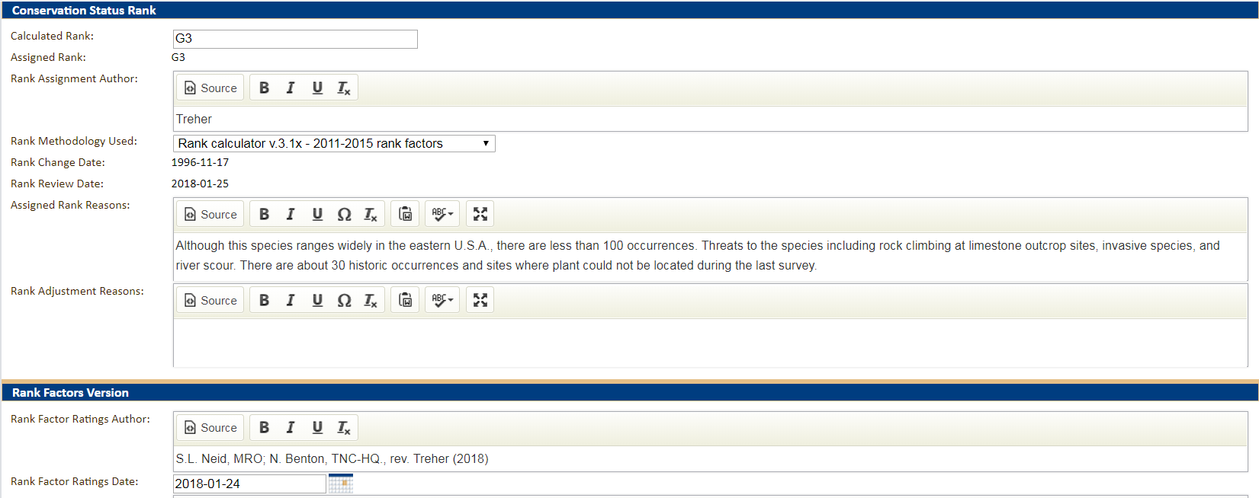
5. Record assessment details
Element Ranking (EGR, ENR, ESR)

Slide 20
5. Record assessment details
Goals of the Assessment
Justify the current global rank, document factor scores and describe their supporting data
Relay important information for prioritization and management
Educate a wide-ranging audience

Slide 21
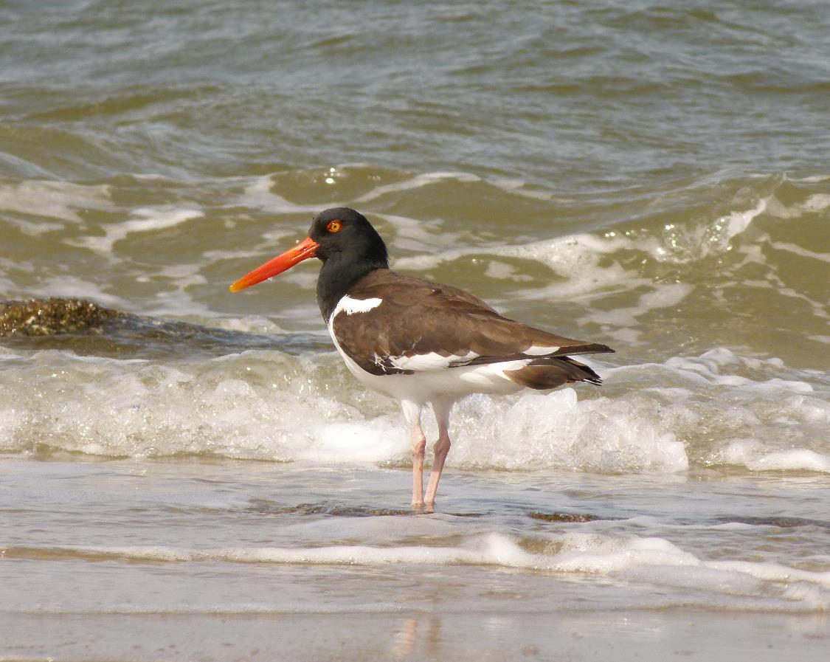
Questions?

Slide 22
Introduction to the Status Assessment Factors
Rarity
Rarity Factors
Range Extent
Area of Occupancy
Population Size
Number of Occurrences
Number of Occurrences or Percent Area with good Viability/Ecological Integrity
Environmental Specificity
Trends Factors
Long-term
Short-term
Threats Factors
Threats
Intrinsic Vulnerability

Slide 23
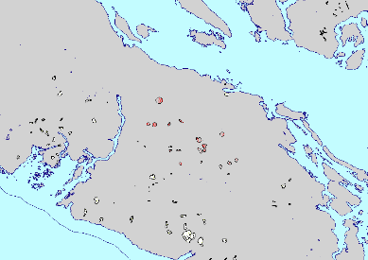
Status Assessment Factors
Rarity
Range Extent
Definition: The aerial extent of a species or ecosystem’s range
Area (km2)
Minimum convex polygon
Calculate Area of polygon
Calculate using GIS Software
Range Extent = 1,700 km²
Intent: What is the spread of risk to the species from threatening factors?
The smaller the range extent, the greater the potential impact

Slide 24
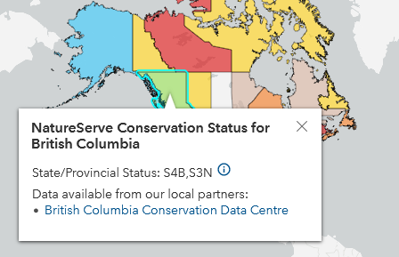
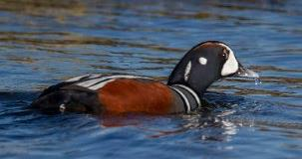
Status Assessment Factors
Rarity
Range Extent
Definition: The aerial extent of a species or ecosystem’s range
For migratory species:
Global: Calculate Range Extent for either breeding or nonbreeding range, whichever is smaller
National/Subnational: Rank breeding and nonbreeding populations separately
Histrionicus histrionicus
Larry Master

Slide 25
Status Assessment Factors
Rarity
Area of Occupancy
Definition: the area that is occupied by a species or ecosystem
26 grid cells
Apply 2km by 2km grid
Count the number of occupied grid cells
Rating Codes (4 km² grid cells)
Z = 0
A = 1
B = 2
C = 3 - 5
D = 6 - 25
E = 26 - 125
F = 126 - 500
G = 501 -2,500
H = 2,501 - 12,500
Calculate using GIS Software
Intent: How common is the species or ecosystem across its range?
It might be wide ranging but habitat limited

Slide 26
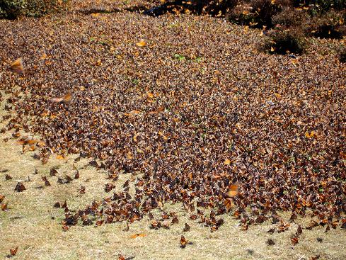
Status Assessment Factors
Rarity
Population Size (used only for species)
Estimated current wild population within the area of interest
Refer to the factor guidance for details: clonal species, fluctuating populations, and reintroduced individuals
Avoid scoring this factor when:
Population size may provide a false sense of security (seed banking annuals or invertebrates)
It is too difficult to estimate

Slide 27
Status Assessment Factors
-
Rarity
Number of Occurrences
locations where the species or ecosystem is currently extant or recently occurred
should have practical conservation value for the species or ecosystem as evidenced by historical or potential continued presence and/or regular recurrence at a given location
Should be delineated appropriately

Slide 28
Status Assessment Factors
-
Rarity
When assessing the number of occurrences….
Review the element occurrence records
Are there locations that may represent new EOs after considering separation distances?
Does the literature, personal experience, or expert input suggest there are more EOs than currently represented?
Factor scores
Z = 0
A = 1-5
B = 6-20
C = 21-80
D = 81-300
E = > 300
U = Unknown
Null = Factor not assessed
4 Element Occurrences in Franklin Co. PA
2 recently collected specimens discovered during research; 1 from Cumberland Co. and 1 from Dauphin Co. Both are on private land but aerial photo reveals intact habitat.
Final Factor Score could be A, AB or B, depending on the assessors confidence in the supporting data or input

Slide 29
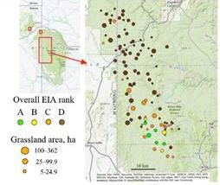
Status Assessment Factors
Number of Occurrences with Good Viability or Percent Area with Good Viability or Ecological Integrity
“an occurrence with good to excellent viability …. with respect to population size and quality occupied habitat. The occurrence is likely to persist for the foreseeable future in its current condition or better.”
Rarity
For Element Occurrences, those ranked A and B are considered to have good viability

Slide 30
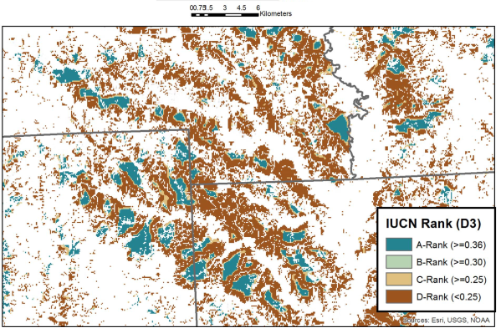
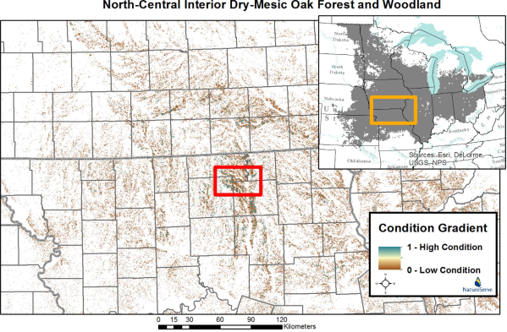
Status Assessment Factors
Number of Occurrences with Good Viability or Percent Area with Good Viability or Ecological Integrity
Rarity
Ecological Integrity
= 4.3%
= 4.4%
= 0.75%
= 90.5%
= 8.7%

Slide 31
Status Assessment Factors
Rarity
Environmental Specificity, conditional
-the degree to which a species or ecosystem depends on a relatively scarce set of habitats, substrates, food types, or other abiotic and/or biotic factors within the overall range
A = Very narrow. Specialist or ecosystem with key requirements scarce
B = Narrow. Specialist or ecosystem with key requirements common
C = Moderate. Generalist or ecosystem with some key requirements scarce
D = Broad. Generalist or ecosystem with all key requirements common
U = Unknown

Slide 32
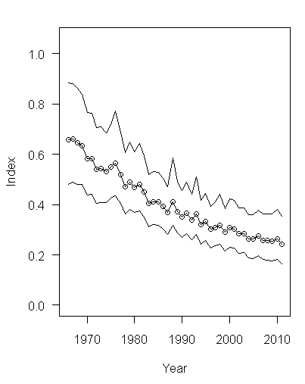
Status Assessment Factors
Short-term trend: Species: Past 10 yrs or 3 generations (≤100 yrs.) Ecosystems: 50 yrs
Long-term trend: Past 200 yrs.
Trends can be measured based on changes in population size, range extent, area of occupancy, number of occurrences, or the number of occurrences with good viability.
Trends
American Kestrel
Maryland BBS
Factor Values:
A = Decline of >90%
B = Decline of 80 - 90%
C = Decline of 70 - 80%
D = Decline of 50 - 70%
E = Decline of 30 - 50%
F = Decline of 10 - 30%
G = Relatively Stable (<=10% change)
H = Increase of 10 - 25%
I = Increase of >25%
U = Unknown

Slide 33
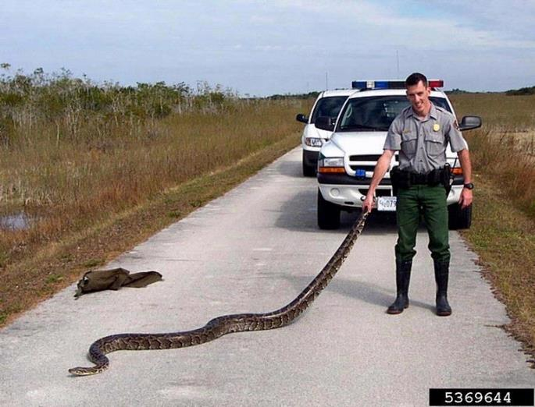
Status Assessment Factors
Threat impact
-indicates the degree to which a species or ecosystem is observed, inferred, or suspected to be directly or indirectly threatened in the assessment area.
1. Classify known threats into a hierarchical list.
2. Starting at the finest classification level, calculate threat impact, summarizing lower threats into the next highest level.
3. Assign overall threat impact.

Slide 34
Status Assessment Factors
Intrinsic Vulnerability, conditional, only used when threats are unknown
-is the observed, inferred, or suspected degree to which characteristics of species or ecosystems make it vulnerable to natural or anthropogenic stresses or catastrophes.
- For species, pertains to frequency of reproduction, fecundity, dispersal capability
-For ecosystems, consider the dominant species that characterize the ecosystem or ecological processes that make an ecosystem lack resiliency (e.g., pine forest type dependent on masting event to recover from a catastrophic fire).
Intrinsic Vulnerability Factor Values
A = Highly vulnerable
B = Moderately vulnerable
C = Not intrinsically vulnerable

Slide 35
Status Assessment Factors
Refer to the guidance often
Document uncertainty and assumptions in Biotics 5 factor text fields
Use a range of values for factors when needing to express uncertainty,
Don’t force the use of a factor when you have low confidence in scoring it
Maintain a precautionary, yet realistic attitude

Slide 36
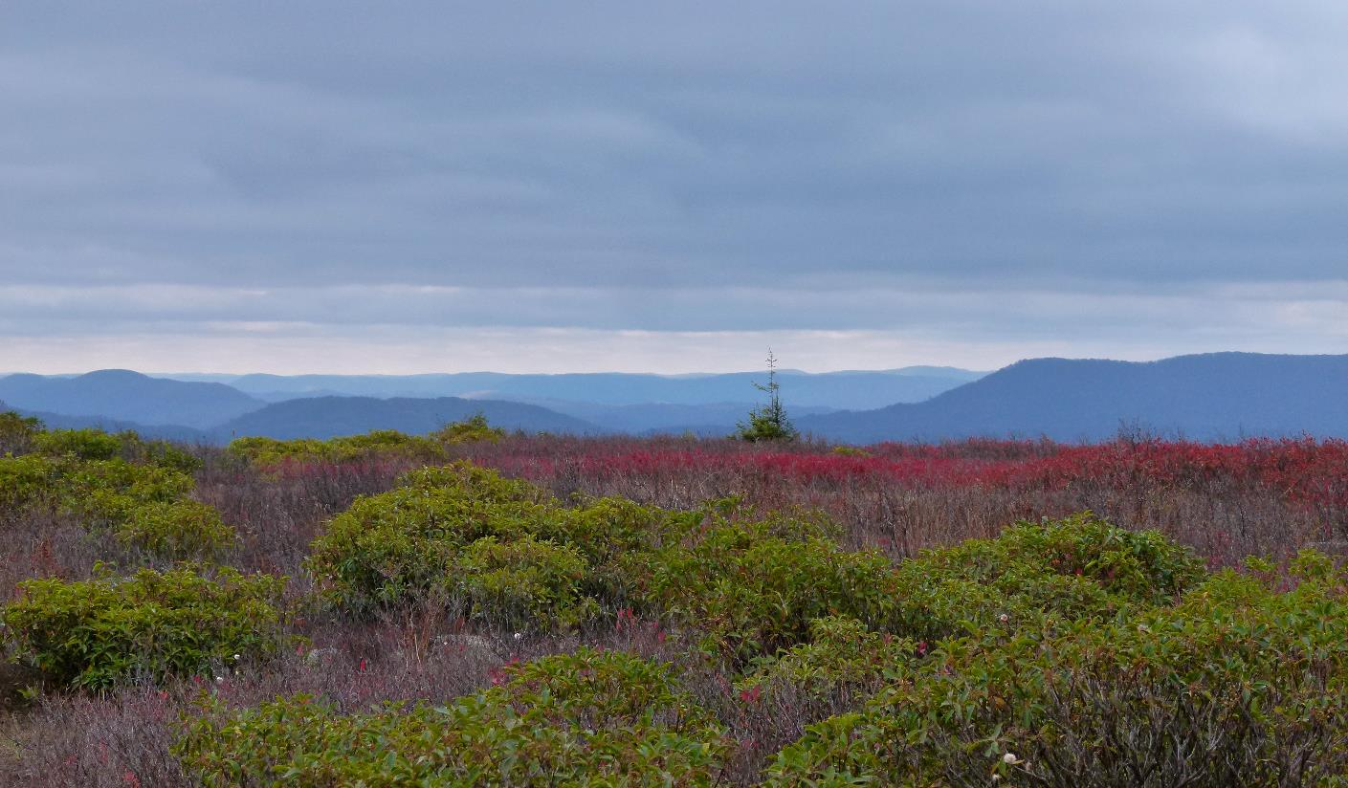
Thank you!

Slide 37
Ranking Exercises
Download Rank Calculator (“Estimator”)
Download Element Ranking Exercises document
Sharepoint -> Ranking Session Days 3-4
Note your breakout group number to determine which element to start ranking
Try using GioCAT to estimate Range Extent, AOO, and Number of Occurrences: https://natureserve.shinyapps.io/rapid-rank-review/
Choose a rapporteur to perform voting upon return to plenary
Pop into Main room if you have a question for Don/Bruce

