Slide 1
North carolina ERT 0.4 release friday, july 11, 2014 1:00 – 2:00 PM EST

Slide 2
Agenda
New Release – 0.4
Demo
Development Release Plan
Pending Items
Submit Feedback
Discussion/Questions
Notes:
Biotics 4
Living with Aging system
Compatibility issues in new environments (Windows, Oracle)
Other common problems (DM comments)
Phasing out Biotics 4 – Support will continue through FY13 and be phased out in FY14 (discuss with Lori)
Four stages;
Market introduction / General Availability (2003- 2004)
Growth/Extended (2004 – 2010)
Maturity (2010 – 2013)
No new versions or patches
Standard support provided (helpdesk and email)
Continued expansion of online information and Knowledgebase
With release of Biotics 5 in 2013 we will enter the last 12 month of this stage
Limited support provided (helpdesk and email)
New environments not certified
Few updates to online information (i.e., Knowledgebase)
Saturation and decline/Retired (2014) – final phase of Biotics 4
Standard helpdesk and email support ends
Access to very limited support through Biotics 4 online help archives

Slide 3
Release 0.4 Highlights
Map
Reference layers added
Filter function for NHEO, SNHA, and MAREA
Configuration of Feature Search
Shapefile upload working for project creation
Project Analysis
Project boundary shapefile corresponding to each project review process
PDF Report name reflects project title
Customer Project # added to My Projects and List All Projects
Sortable columns for My Projects and List All Projects
View of Project page altered related to (behind-the-scenes) improvements to the project review process
Administrative/Miscellaneous
Home page text updated – image pending
Link to Species/Community Search
Readable path name generation
Tooltips replaced with text
Notes:
Biotics 4
Living with Aging system
Compatibility issues in new environments (Windows, Oracle)
Other common problems (DM comments)
Phasing out Biotics 4 – Support will continue through FY13 and be phased out in FY14 (discuss with Lori)
Four stages;
Market introduction / General Availability (2003- 2004)
Growth/Extended (2004 – 2010)
Maturity (2010 – 2013)
No new versions or patches
Standard support provided (helpdesk and email)
Continued expansion of online information and Knowledgebase
With release of Biotics 5 in 2013 we will enter the last 12 month of this stage
Limited support provided (helpdesk and email)
New environments not certified
Few updates to online information (i.e., Knowledgebase)
Saturation and decline/Retired (2014) – final phase of Biotics 4
Standard helpdesk and email support ends
Access to very limited support through Biotics 4 online help archives

Slide 4
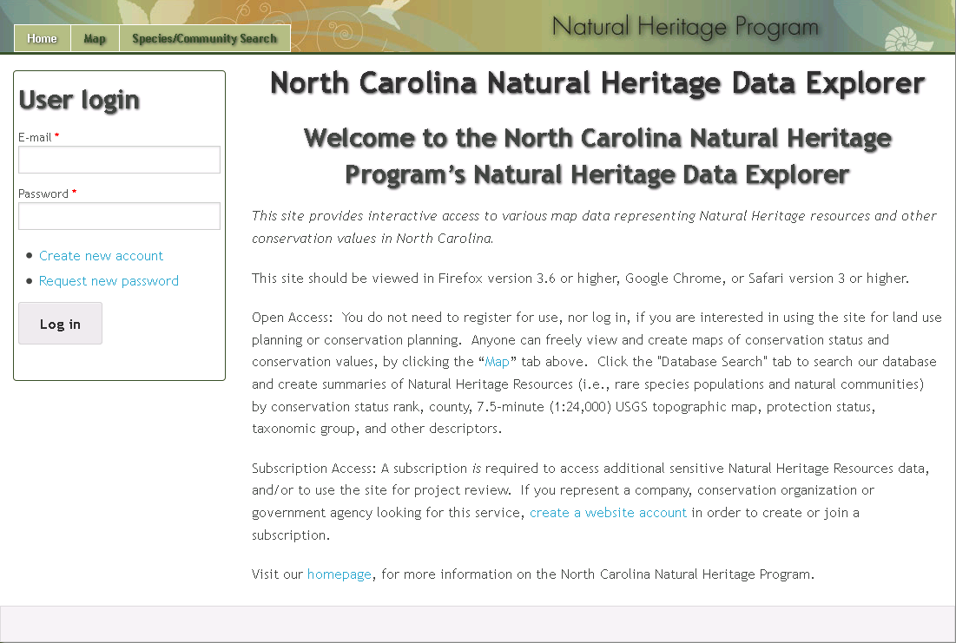
ERT Demo Version 0.4

Slide 5
Development Release Plan – 0.5
Adjust reporting based on review analysis feedback
Admin Notification for Projects of Interest
Subscriptions
NC ERT Site Styling
NC ERT Home Page
B/WA Identify
Terms and Conditions
Monthly Reports - TBD
Notes:
Biotics 4
Living with Aging system
Compatibility issues in new environments (Windows, Oracle)
Other common problems (DM comments)
Phasing out Biotics 4 – Support will continue through FY13 and be phased out in FY14 (discuss with Lori)
Four stages;
Market introduction / General Availability (2003- 2004)
Growth/Extended (2004 – 2010)
Maturity (2010 – 2013)
No new versions or patches
Standard support provided (helpdesk and email)
Continued expansion of online information and Knowledgebase
With release of Biotics 5 in 2013 we will enter the last 12 month of this stage
Limited support provided (helpdesk and email)
New environments not certified
Few updates to online information (i.e., Knowledgebase)
Saturation and decline/Retired (2014) – final phase of Biotics 4
Standard helpdesk and email support ends
Access to very limited support through Biotics 4 online help archives

Slide 6
Needs Input
NC ERT Home Page – Image
Terms of Use
Response letter updates
Analysis/reporting logic changes
Tabular updates
Signature block
Project Details
Monthly Reports – Rob is sorting this out based on VA practices and feedback
Notes:
Biotics 4
Living with Aging system
Compatibility issues in new environments (Windows, Oracle)
Other common problems (DM comments)
Phasing out Biotics 4 – Support will continue through FY13 and be phased out in FY14 (discuss with Lori)
Four stages;
Market introduction / General Availability (2003- 2004)
Growth/Extended (2004 – 2010)
Maturity (2010 – 2013)
No new versions or patches
Standard support provided (helpdesk and email)
Continued expansion of online information and Knowledgebase
With release of Biotics 5 in 2013 we will enter the last 12 month of this stage
Limited support provided (helpdesk and email)
New environments not certified
Few updates to online information (i.e., Knowledgebase)
Saturation and decline/Retired (2014) – final phase of Biotics 4
Standard helpdesk and email support ends
Access to very limited support through Biotics 4 online help archives

Slide 7
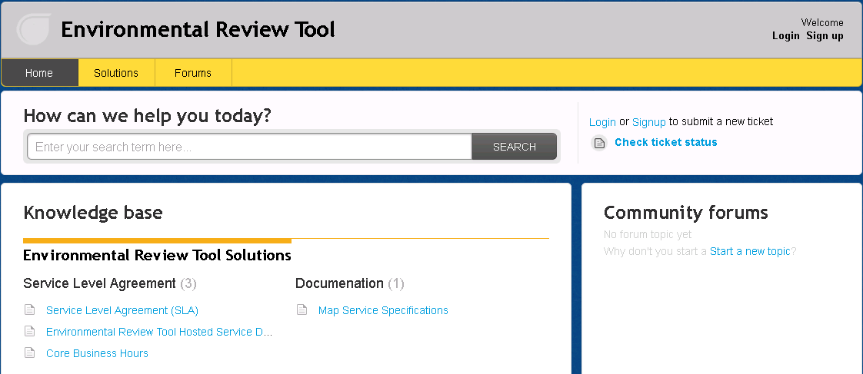
Submit Feedback
Ertsupport.natureserve.org

Slide 8
Discussion/Questions

