Slide 1
North carolina ERT 1.2 release thursday, june 16, 2016 11:00 – 12:00 aM EST

Slide 2
Agenda
New Functionality
ERT Core Highlights Review
Staging Demo
Discussion
Notes:
Biotics 4
Living with Aging system
Compatibility issues in new environments (Windows, Oracle)
Other common problems (DM comments)
Phasing out Biotics 4 – Support will continue through FY13 and be phased out in FY14 (discuss with Lori)
Four stages;
Market introduction / General Availability (2003- 2004)
Growth/Extended (2004 – 2010)
Maturity (2010 – 2013)
No new versions or patches
Standard support provided (helpdesk and email)
Continued expansion of online information and Knowledgebase
With release of Biotics 5 in 2013 we will enter the last 12 month of this stage
Limited support provided (helpdesk and email)
New environments not certified
Few updates to online information (i.e., Knowledgebase)
Saturation and decline/Retired (2014) – final phase of Biotics 4
Standard helpdesk and email support ends
Access to very limited support through Biotics 4 online help archives

Slide 3
New Functionality
Demo
April 2016 data updates (not tested)
Replace EOStatus with EORank in report table
Update project review letterhead
Remove email address from review letter
Notify for projects with CWMTF conflict (not tested)
Enhance User, Subscription, and Project admin views
Support phone extension in registration/user profile
Discussion required
Add North Arrow to report map images
Site Admin create Subscription on user behalf
Pending
Update site theme
Notes:
Biotics 4
Living with Aging system
Compatibility issues in new environments (Windows, Oracle)
Other common problems (DM comments)
Phasing out Biotics 4 – Support will continue through FY13 and be phased out in FY14 (discuss with Lori)
Four stages;
Market introduction / General Availability (2003- 2004)
Growth/Extended (2004 – 2010)
Maturity (2010 – 2013)
No new versions or patches
Standard support provided (helpdesk and email)
Continued expansion of online information and Knowledgebase
With release of Biotics 5 in 2013 we will enter the last 12 month of this stage
Limited support provided (helpdesk and email)
New environments not certified
Few updates to online information (i.e., Knowledgebase)
Saturation and decline/Retired (2014) – final phase of Biotics 4
Standard helpdesk and email support ends
Access to very limited support through Biotics 4 online help archives

Slide 4
ERT Core Highlights Review
Map Viewer
Improved Draw Tools
Save Spatial Bookmarks per User
Enhanced Identify Tool
Export Table Results to CSV
View Description and Optional View Details
Insecure Map Layers
Miscellaneous
View Project On Map
Reset Login Failures
Password Recovery Workflow
Submit Button Spinner

Slide 5
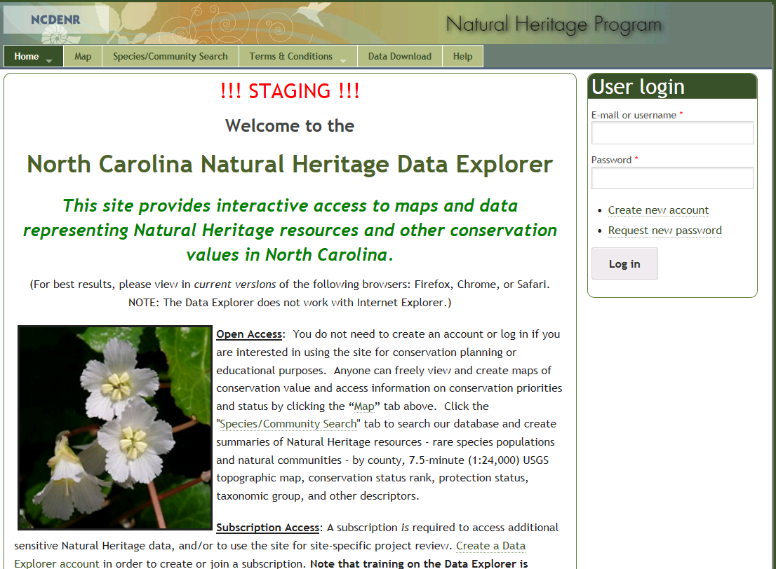
ERT Staging Demo v1.2a https://ncnhde-stg.natureserve.org

Slide 6
Remaining Items
Add North Arrow to report map image
Support Site Admin creating Subscription on user behalf
Site theming to reflect new department
Updated June GIS Data
Notes:
Biotics 4
Living with Aging system
Compatibility issues in new environments (Windows, Oracle)
Other common problems (DM comments)
Phasing out Biotics 4 – Support will continue through FY13 and be phased out in FY14 (discuss with Lori)
Four stages;
Market introduction / General Availability (2003- 2004)
Growth/Extended (2004 – 2010)
Maturity (2010 – 2013)
No new versions or patches
Standard support provided (helpdesk and email)
Continued expansion of online information and Knowledgebase
With release of Biotics 5 in 2013 we will enter the last 12 month of this stage
Limited support provided (helpdesk and email)
New environments not certified
Few updates to online information (i.e., Knowledgebase)
Saturation and decline/Retired (2014) – final phase of Biotics 4
Standard helpdesk and email support ends
Access to very limited support through Biotics 4 online help archives

Slide 7
Discussion/Questions

