Slide 1


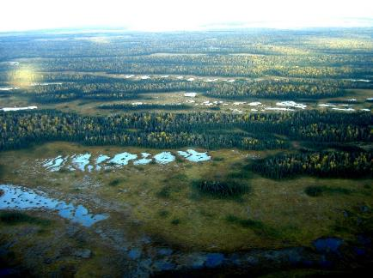
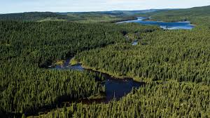
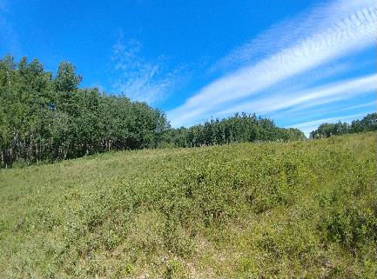
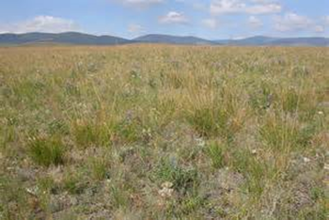
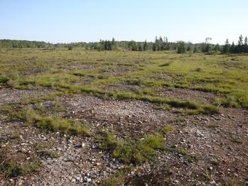
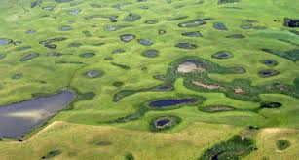
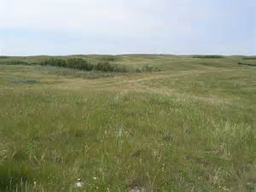
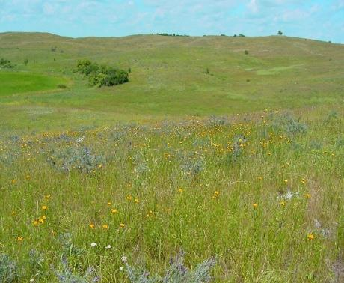
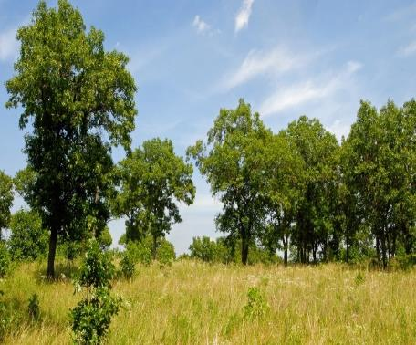


IUCN Red List of Ecosystems and their Role
of Mapping for Key Biodiversity Areas
Outline
Review
  Red Listed Ecosystems
KBA Identification under A2 & B4
KBA Delineation
Northwestern Great Plains Aspen Parkland
Northern Great Plains Fescue Mixed-Grass Prairie
Great Lakes Alvar
Northwest Great Plains Mixed-Grass Prairie
North-Central Interior Oak Savanna
Northern Tallgrass Prairie
Great Plains Prairie Pothole
Pat Comer, Chief Ecologist, NatureServe
KBA Workshop 2 – Canadian Prairies
June 29, 2020
Notes:
Red Listing Ecosystems and Key Biodiversity Areas – introduction and discussion of applications to Canada
Synopsis: One important step in biodiversity conservation is documenting the at-risk status of ecosystem types. NatureServe programs have traditionally documented at-risk status for biodiversity (G/N/S Ranks). Building from this experience, we have also worked with global partners to establish methods for the IUCN Red List of Ecosystems (RLE). Like the IUCN Red List of Species, a system that ranks species based on their risk of extinction, the RLE ranks ecosystem types as "Vulnerable - VU" "Endangered-EN" or "Critically Endangered - CR" The ranking process includes technical issues such as ecosystem type classification, distribution mapping, and measures of ecosystem degradation. We are currently testing these methods in Temperate North America. Pat Comer will provide an orientation to the IUCN RLE framework and initial findings applicable to temperate Canada. He will also discuss the application of red listed ecosystems to identification of Key Biodiversity Areas. Opportunities and challenges to advance this work across Canada will be discussed.
Pat Comer is Chief Ecologist for NatureServe, based in Colorado. Since 1985, Pat’s applied research has focused on ecosystem classification, modeling, ecological integrity assessment, and subsequent documentation of ecosystem status and trends, regional conservation planning, site design for restoration, and monitoring of biodiversity and ecosystem services.

Slide 2
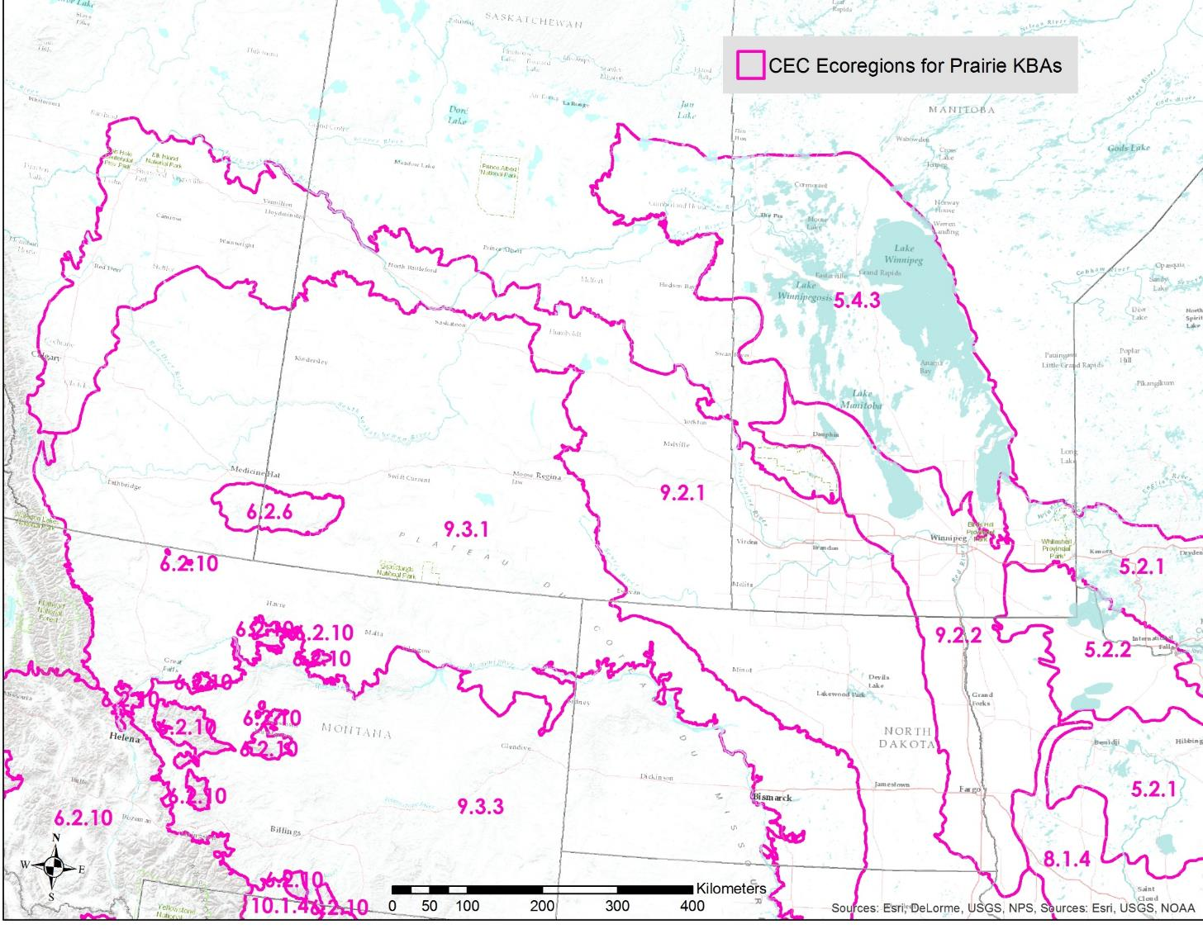
Canadian Prairies

Slide 3

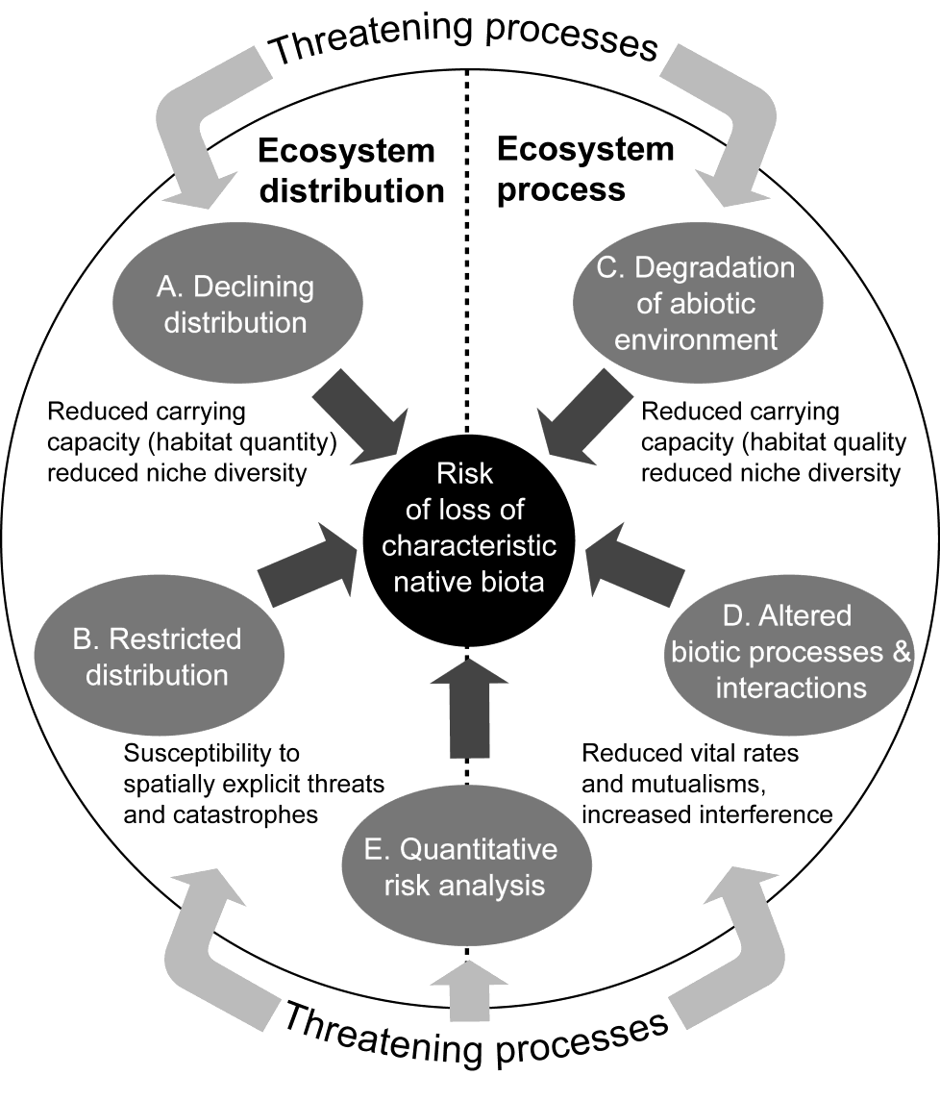
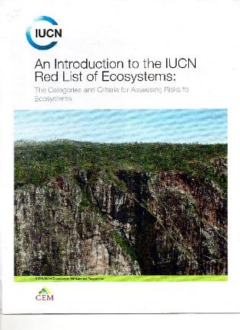
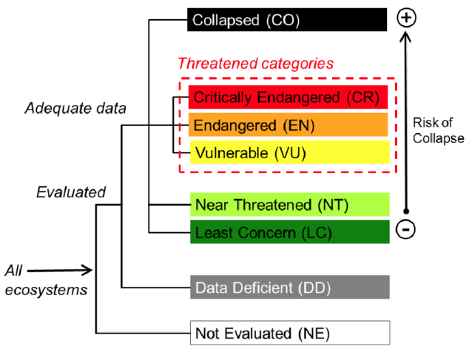
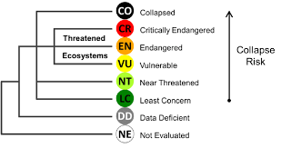
Keith, D.A., J.P. Rodríguez, K. M. Rodríguez-Clark, K. Aapala, A.Alonso, M.Asmussen, S. Bachman, A., Bassett, E.G. Barrow, J.S. Benson, M.J. Bishop, R. Bonifacio, T.M. Brooks, M.A. Burgman, P.J. Comer, F., Comín, F. Essl, D. Faber-Langendoen, P.G. Fairweather, R. Holdaway, M. Jennings, R. T. Kingsford, R.E. Lester, R. Mac Nally, M.A. McCarthy, J. Moat, E. Nicholson, M.A. Oliveira-Miranda, P. Pisanu, B. Poulin, U. Riecken, M.D. Spalding, S. Zambrano-Martínez.
2013.
Scientific Foundations for an IUCN Red List of Ecosystems. PLoS ONE. Vol. 8 Issue 5
Ecosystem Collapse is the transformation of identity, loss of defining features, and replacement by a novel ecosystem or cultural system.
Notes:
Scientific foundations for the RLE were based on a series of global expert forums and publications. It is intended to work in parallel to the Red List of Species (networks of populations for a given taxa), but addresses aspects relevant to ecosystem types (made up of many taxa all interacting with each other and their environment).
They primarily focus on 4 criteria, two based on trends in ecosystem area, or susceptibilities due to spatially-explicit threats. The other two based on trends in ecosystem quality (condition, function, or integrity from both abiotic and biotic perspectives).
A fifth criterion may be applied in circumstances where sufficient data exist to quantitatively predict rangewide ecosystem “collapse” (e.g., like a population viability model for species).

Slide 4

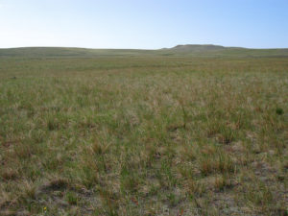
Vegetation-Based Hierarchy*
Example from the Canadian Prairies
Hierarchy Levels | Example
Upper
L1 – Formation Class | Shrub & Herb Vegetation
L2 – Form. Subclass | Temperate & Boreal Grassland & Shrubland
L3 - Formation | Temperate Grassland & Shrubland
Mid
L4 – Division | Central North American Grassland & Shrubland
L5 – Macrogroup | Great Plains Mixedgrass & Fescue Prairie
L6 – Group | Northern Great Plains Rough Fescue Prairie
Lower
L7 – Alliance | Festuca altaica Northern Great Plains Grassland Alliance
L8 – Association | Festuca altaica - Danthonia intermedia Grassland
Level 1 Terrestrial
Level 2 Biome
Level 3 EFG
*Faber-Langendoen, D., T. Keeler-Wolf, D. Meidinger, D. Tart, C. Josse, G. Navarro, B. Hoagland, S. Ponomarenko, J-P. Saucier, A. Weakley, and P. Comer. 2014. Eco-Veg: a new approach to Vegetation Description and Classification. Ecological Monographs 84(4):533-561.
NA Red List units approximate these levels
Level 4 BioEcotype
Level 5 Global EcoType
Level 6 Subglobal Type
NatureServe Ecological Systems Classification: Comer, P., D. Faber-Langendoen, et al. 2003. Ecological Systems of the United States: A Working Classification of U.S. Terrestrial Systems. NatureServe, Arlington, VA.
Notes:
Vegetation-based classification hierarchy, as one example to define terrestrial ecosystems for red listing. As you go down in the hierarchy, each classification unit describes a more specific unit that applies to increasingly localized areas.
One example worked through the hierarchy that occurs in the SE. Multiple alliances make up the “Western Interior Riparian Forest & Woodland” group, and many associations make up each of those alliances.
For our current work in temperate North America, the classification units fall into the Group to Alliance level of this vegetation hierarchy; around 90 units falling within the state.

Slide 5
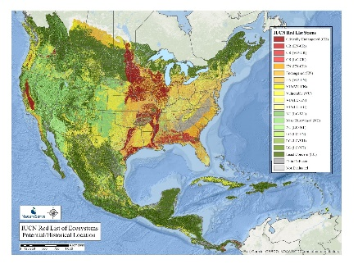
Prairies, Aspen Parklands, Wetlands
- candidate red listed ecosystems to trigger KBAs
Northern Tallgrass Prairie (CR)
Northern Great Plains Fescue Mixedgrass Prairie (EN)
Northwestern Great Plains Mixedgrass Prairie (LC)
Northwestern Great Plains Dry Mixedgrass Prairie (IVC Group) Northwestern Great Plains Mesic Mixedgrass Prairie (IVC Group)
Eastern Great Plains Tallgrass Aspen Parkland (VU)
Northwestern Great Plains Aspen Forest and Parkland VU (VU-EN)
Great Plains Prairie Potholes (VU)
Great Lakes Alvar (VU) (MB disjunct)

Slide 6
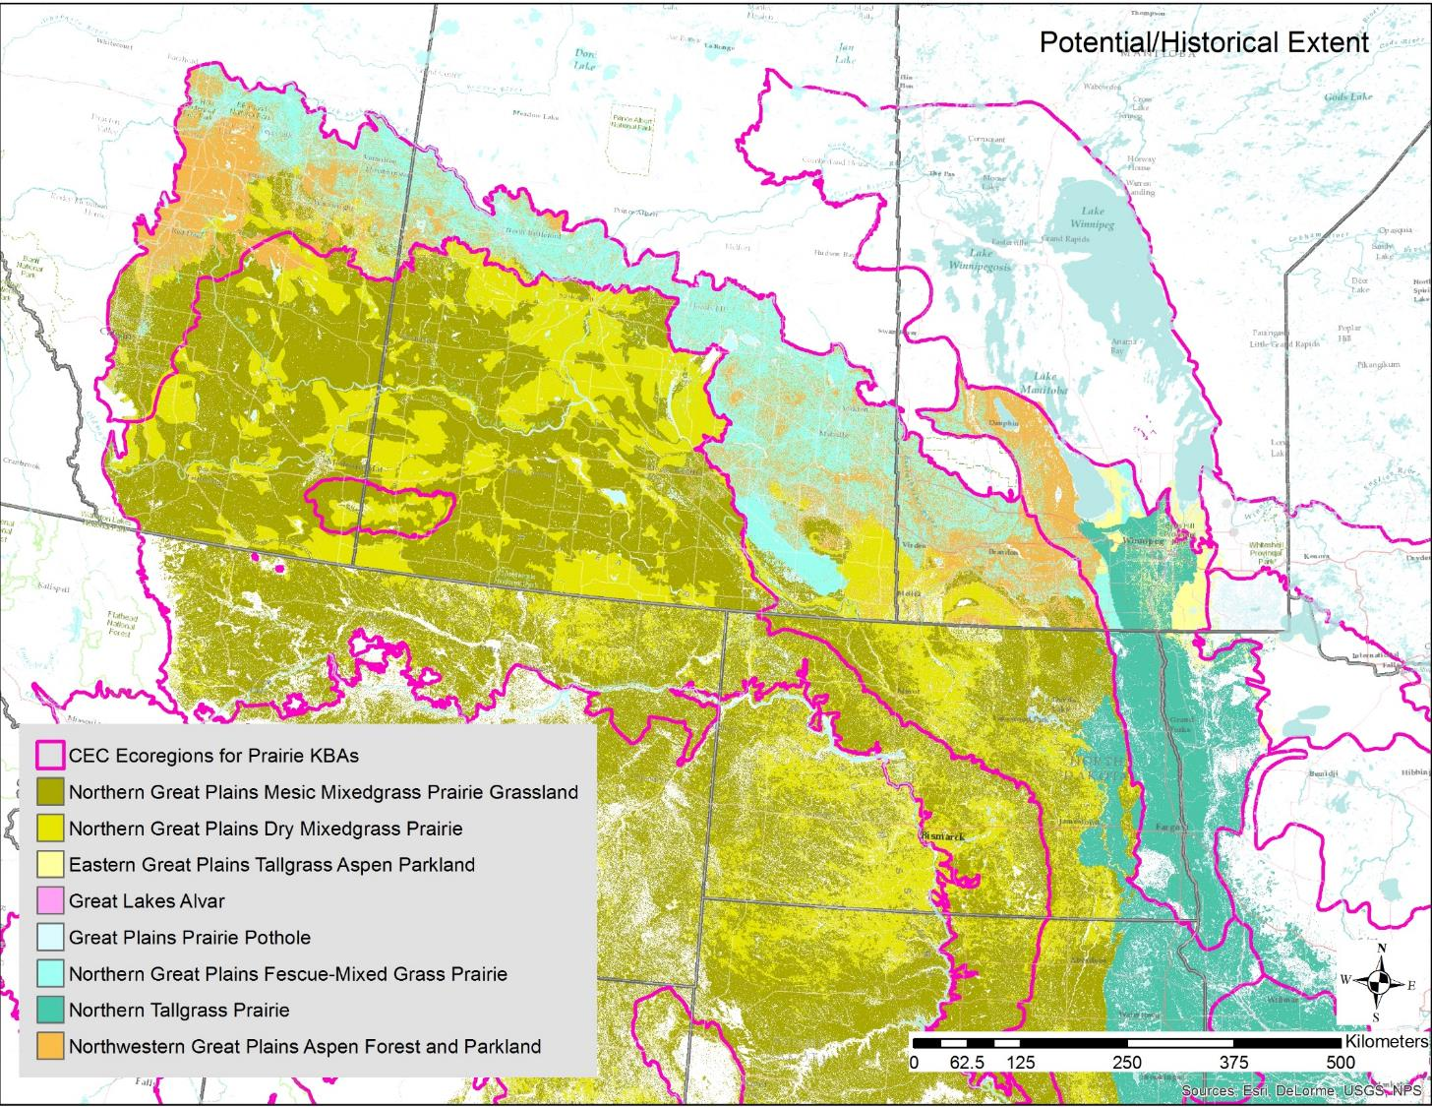
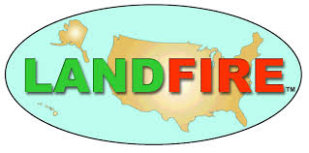
Updated Ecosystem Distributions
Canadian side:
Agriculture and Agri-Food Canada Land use/land cover:
“managed” vs. unmanaged” grassland
- Sandy vs. loamy soils
USA side:
LANDFIRE EVT 2016: USNVC Groups

Slide 7
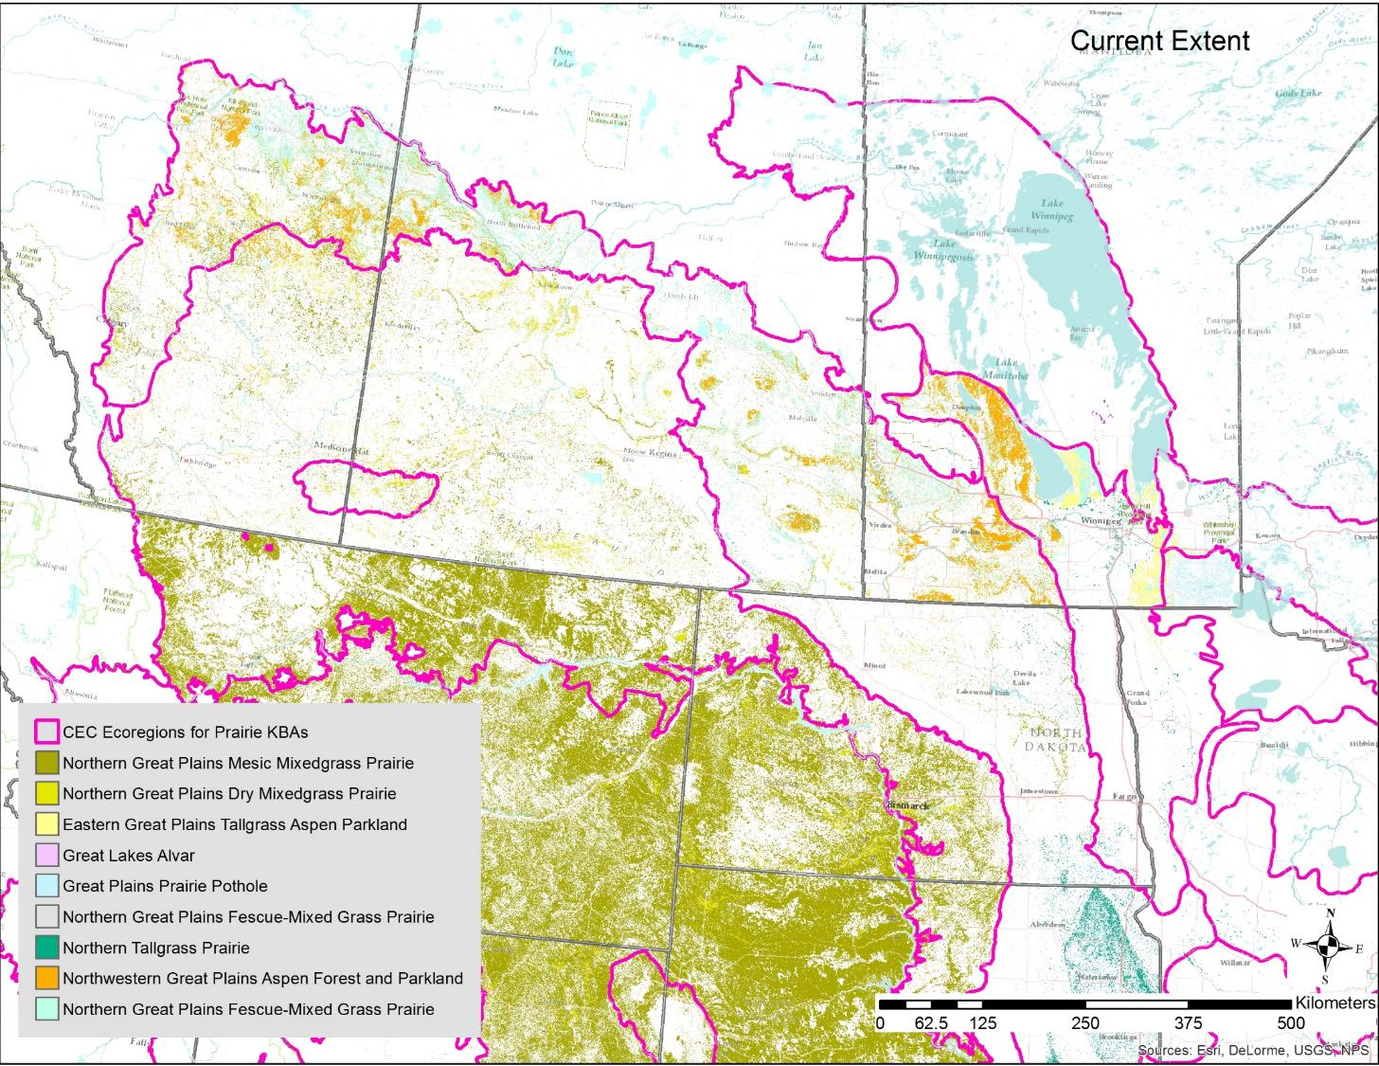
Updated Ecosystem Distributions
Canadian side:
Agriculture and Agri-Food Canada Land use/land cover:
“managed” vs. unmanaged” grassland
- Sandy vs. loamy soils
USA side:
LANDFIRE EVT 2016: USNVC Groups

Slide 8
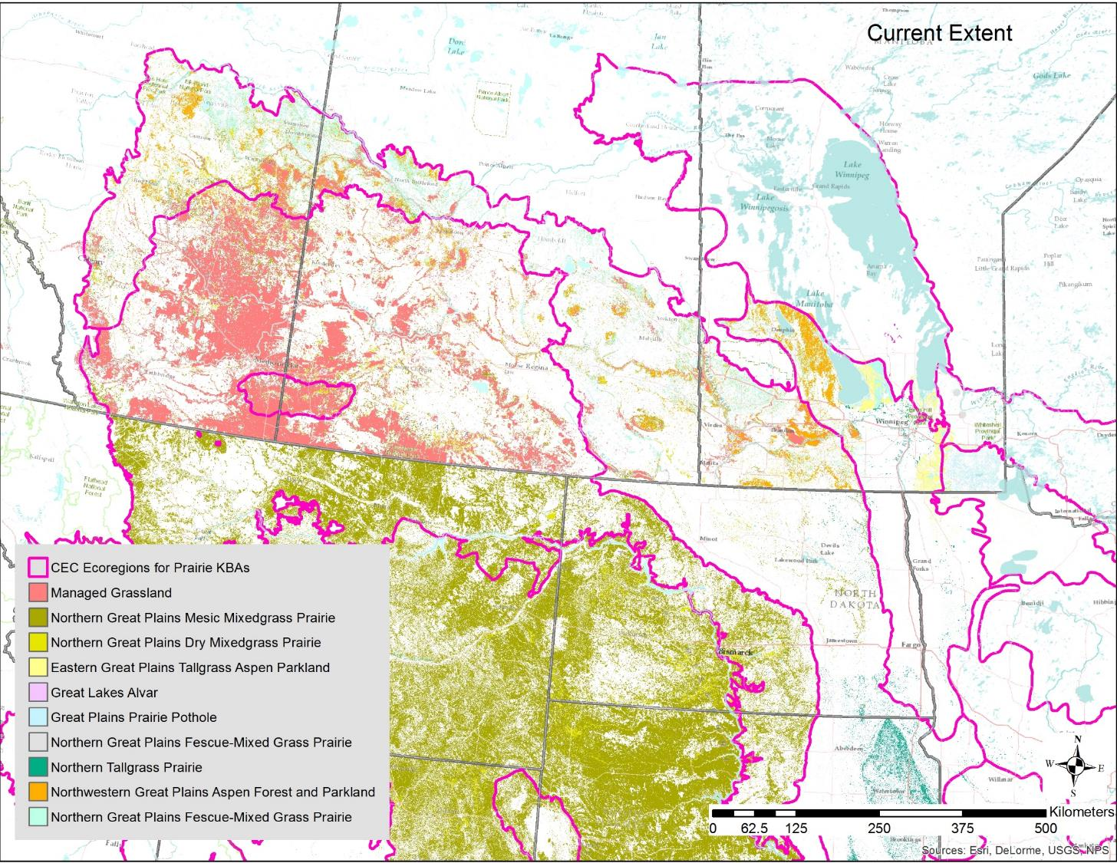
Updated Ecosystem Distributions
Canadian side:
Agriculture and Agri-Food Canada Land use/land cover:
“managed” vs. unmanaged” grassland
- Sandy vs. loamy soils
USA side:
LANDFIRE EVT 2016: USNVC Groups

Slide 9
Long-term Loss in Conversion (Criterion A3)
IUCN Status
CR – Critically Endangered
EN - Endangered
VU - Vulnerable
LC – Least Concern
Notes:
Summary trends for 12 types, historic and current
Overall long-term trends, using IUCN Red Listing thresholds of 50%, 70%, and 90% provide a practical indication of conservation status for each type.

Slide 10
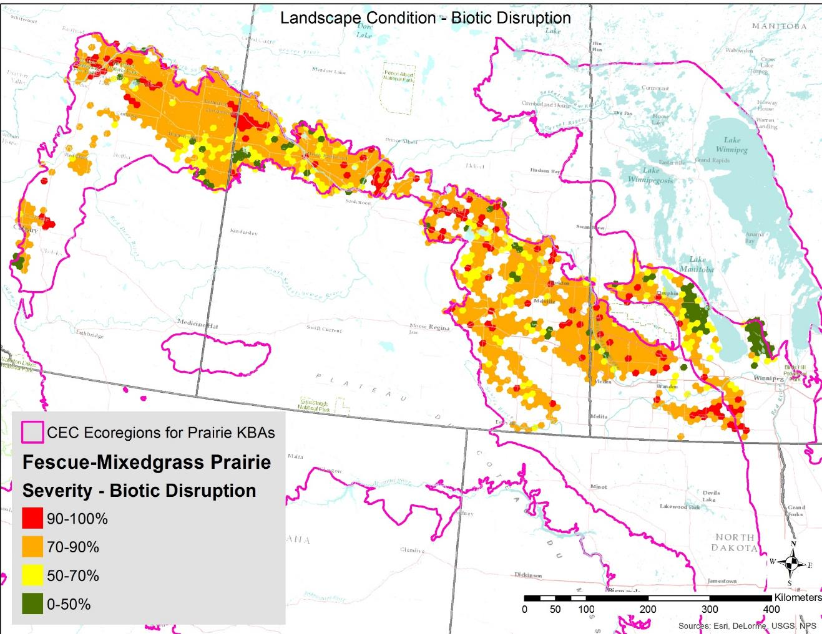
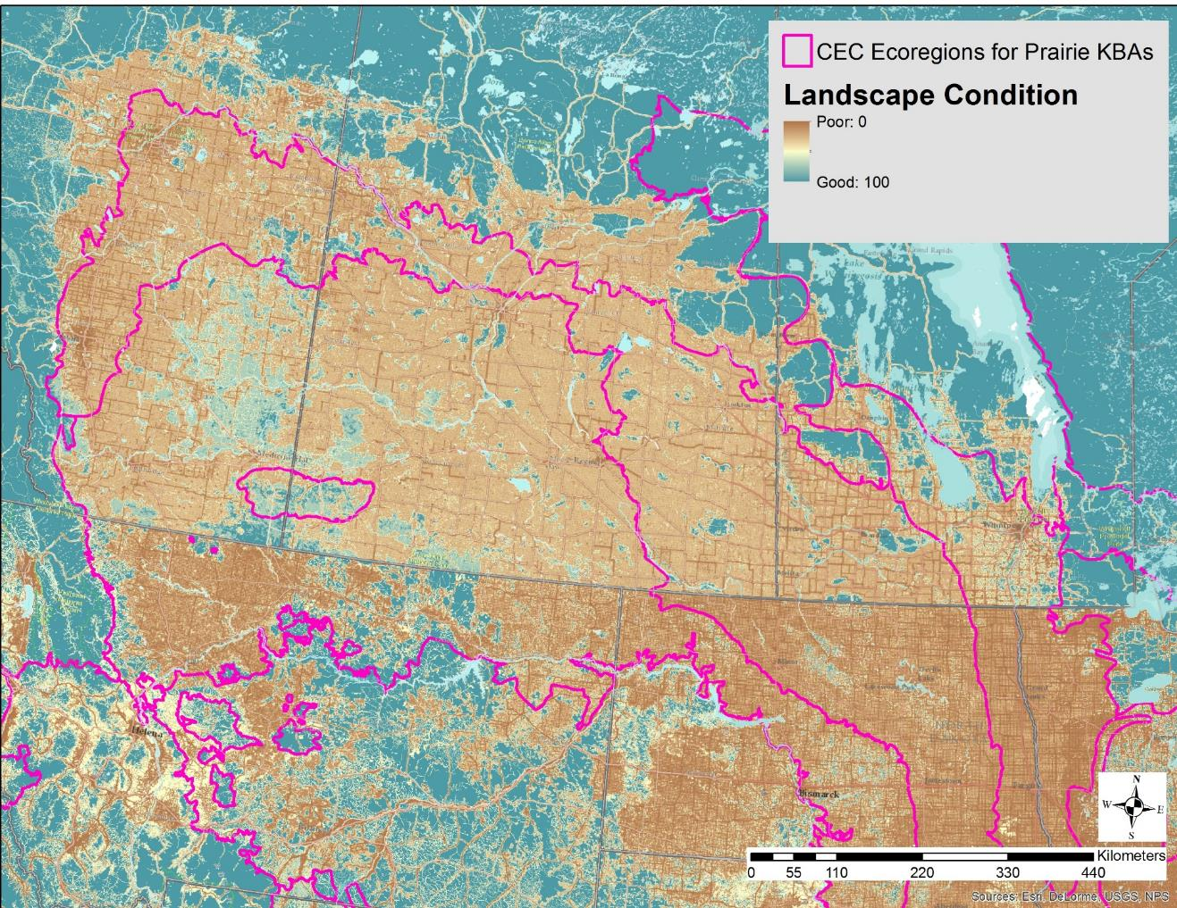
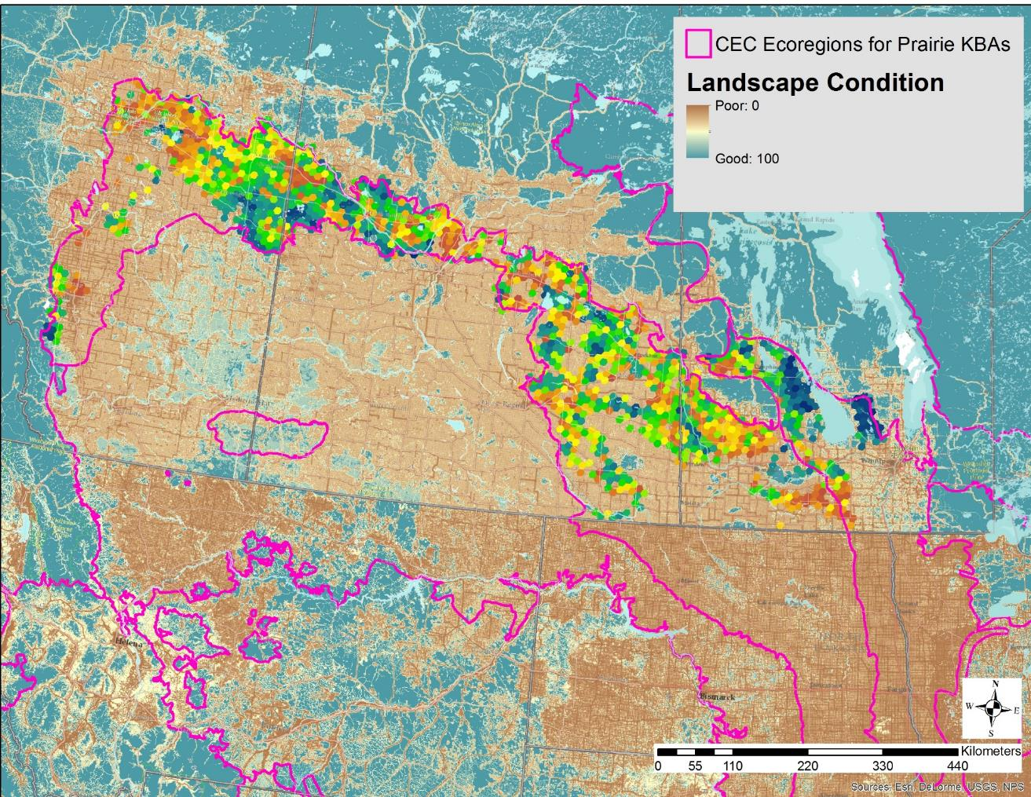
Red Listing Ecosystems: Criterion D
Landscape Condition
Hak, J.C. and P.J. Comer. 2017. Modeling Landscape Condition for Biodiversity Assessment – Application in Temperate North America. Ecological Indicators Vol. 82:206-216
other indicators under C & D:
Invasive Plant Species
Hak, J.C. and P.J. Comer. 2020. Modeling Invasive Annual Grass Vulnerability in the Cold Deserts of the Intermountain West. Rangeland Ecology and Management 73 171-180 https://doi.org/10.1016/j.rama.2019.09.003
Wildfire Regime Departure
Rollins, M.G., 2009. LANDFIRE: a nationally consistent vegetation, wildland fire, and fuel assessment. International Journal of Wildland Fire, 18(3), pp.235-249.

Slide 11
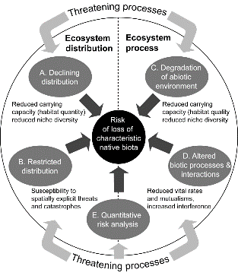

IUCN RLE Criteria, Categories & Scoring
Northern Great Plains Fescue Mixed-Grass Prairie
 | CRITERIA
 | A Reduced Extent | B Restricted Distribution | C Environmental Degradation | D Biotic Process Disruption | E (risk model) | Overall Status
Subcrit.1 (past 50 yrs) | NE | LC | DD | DD | NE | EN
Subcrit. 2 (next 50 yrs) | NE | LC | DD | DD
Subcrit. 3 (since 1750) | EN | LC | DD | EN
“worst” component score determines the overall status score
- express uncertainty with range of values
CR= Critically Endangered, EN = Endangered, VU = Vulnerable, NT = Near Threatened LC = Least Concern, DD = Data Deficient, NE = Not Evaluated
Notes:
This table illustrates an example of scoring several RLE criteria for this big sagebrush shrubland.
Not yet accounting for climate change, this type approaches the thresholds for VU status, but will be scored for now as NT.
And as with Red Listing for species, the “worst” score for one criterion translates to the overall score.

Slide 12
Updated Findings

Slide 13

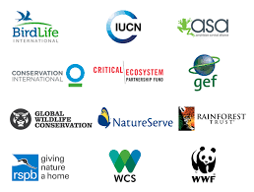
Key Biodiversity Areas
A2. Threatened ecosystem types -
Site holds one or more of the following:
a) ≥5% of the global extent of a globally CR or EN ecosystem type;
b) ≥10% of the global extent of a globally VU ecosystem type.
B4: Geographically restricted ecosystem types
Site holds ≥20% of the global extent of an ecosystem type.

Slide 14
A2 Minimum Area Requirements
Targeted Ecosystem Type | Current Extent Estimate (km²) | Overall RLE | KBA% | A2 KBA AREA (km2) | # 100KM2 Hexagons
Northern Tallgrass Prairie | 6,500 | CR | 5% | 325 | 4
Northern Great Plains Fescue Mixedgrass Prairie | 19,981 | EN | 5% | 999 | 10
Northwestern Great Plains Dry Mixedgrass Prairie | 57,897 | EN | 5% | 2,895 | 29
Eastern Great Plains Tallgrass Aspen Parkland | 4,515 | VU | 10% | 452 | 5
Northwestern Great Plains Aspen Forest and Parkland | 23,055 | VU (VU-EN) | 10% | 2,306 | 23
Great Plains Prairie Pothole | 6,457 | VU | 10% | 646 | 7
Great Lakes Alvar | 181 | VU | 10% | 18 | 1

Slide 15
B4: Geographically restricted ecosystem types
Site holds ≥20% of the global extent of an ecosystem type.
Targeted Ecosystem Type | Current Extent Estimate (km²) | Overall RLE | KBA% | A2 KBA AREA (km2) | # 100KM2 Hexagons | B4 KBA AREA (km2) | # 100KM2 Hexagons
Northern Tallgrass Prairie | 6,500 | CR | 5% | 325 | 4 | 650 | 7
Northern Great Plains Fescue Mixedgrass Prairie | 19,981 | EN | 5% | 999 | 10 | 3,996 | 40
Northwestern Great Plains Dry Mixedgrass Prairie | 57,897 | EN | 5% | 2,895 | 29 | 11,579 | 116
Eastern Great Plains Tallgrass Aspen Parkland | 4,515 | VU | 10% | 452 | 5 | 903 | 9
Northwestern Great Plains Aspen Forest and Parkland | 23,055 | VU (VU-EN) | 10% | 2,306 | 23 | 4,611 | 46
Great Plains Prairie Pothole | 6,457 | VU | 10% | 646 | 7 | 1,291 | 13
Great Lakes Alvar | 181 | VU | 10% | 18 | 1 | 36 | 1

Slide 16
Updated Ecosystem Distributions
Canadian side:
Agriculture and Agri-Food Canada Land use/land cover:
“managed” vs. unmanaged” grassland
USA side:
LANDFIRE EVT 2016: USNVC Groups

Slide 17


Slide 18
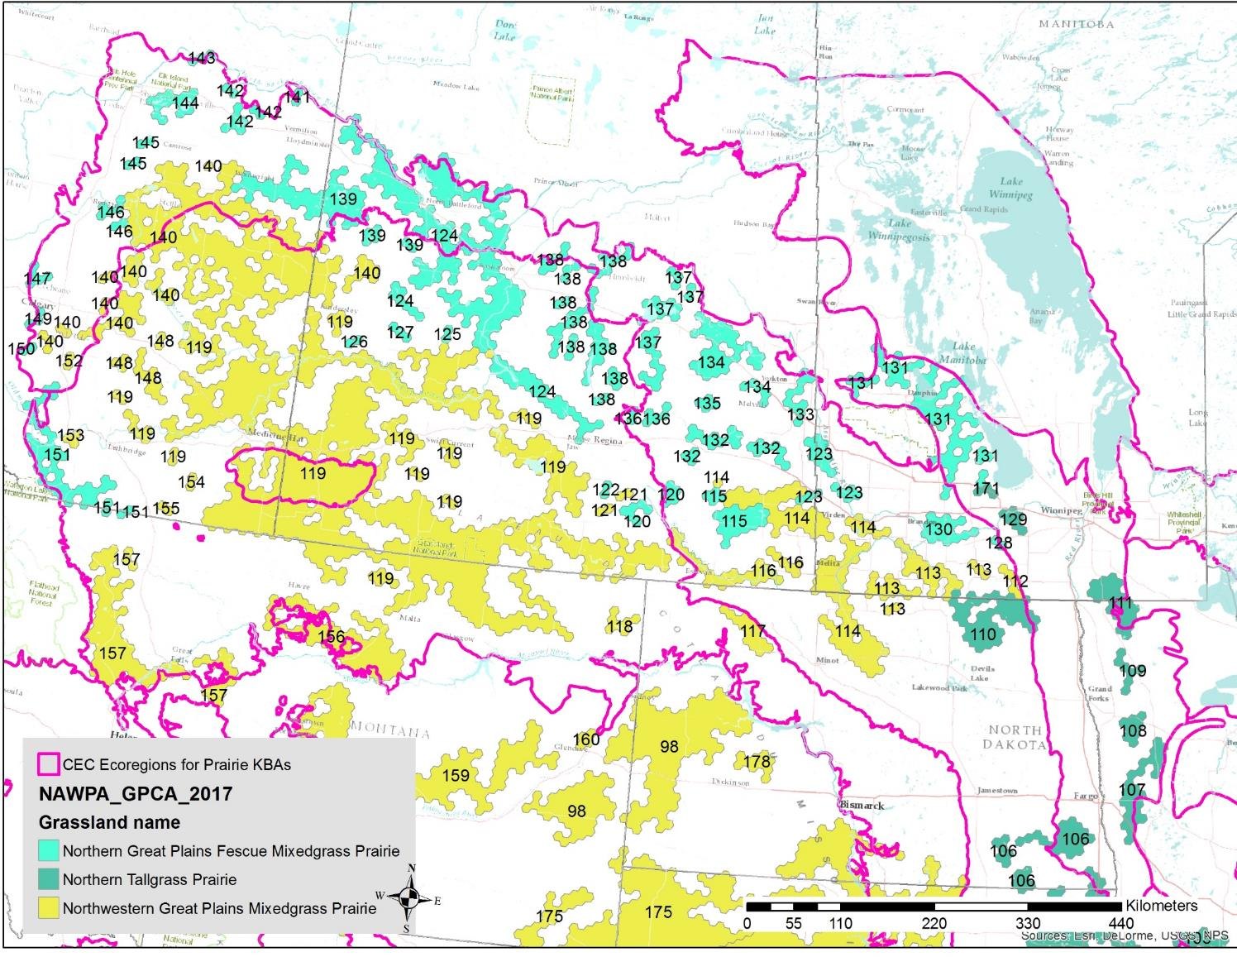

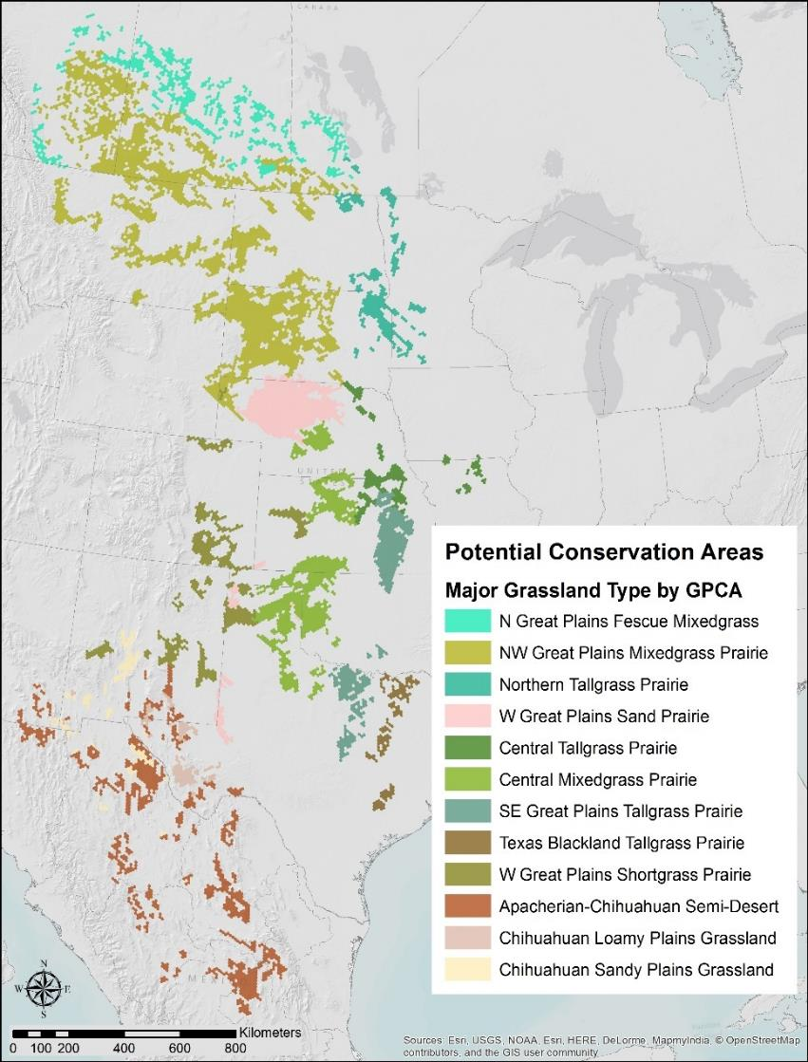
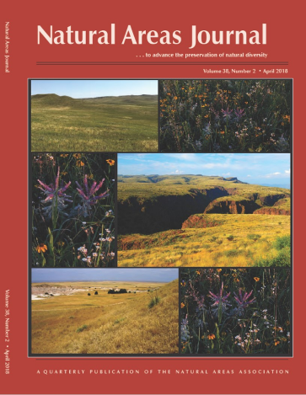
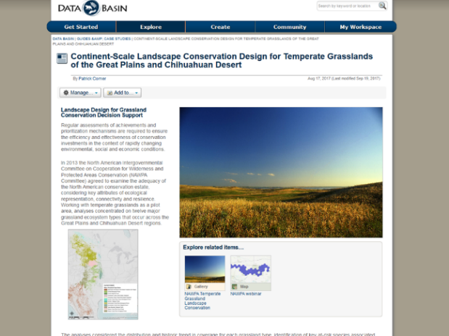
Potential Conservation Areas to Represent Major Temperate Grassland Diversity
Sites Selected to meet % area representation goals based on historical extent to advance Aichi Target 11 for ecologically representative and connected landscapes
Notes:
We aimed to represent at least 17% of estimated historical extent in landscape that are least in conflict with other land uses and most likely to support at-risk species and successfully restore connectivity

Slide 19
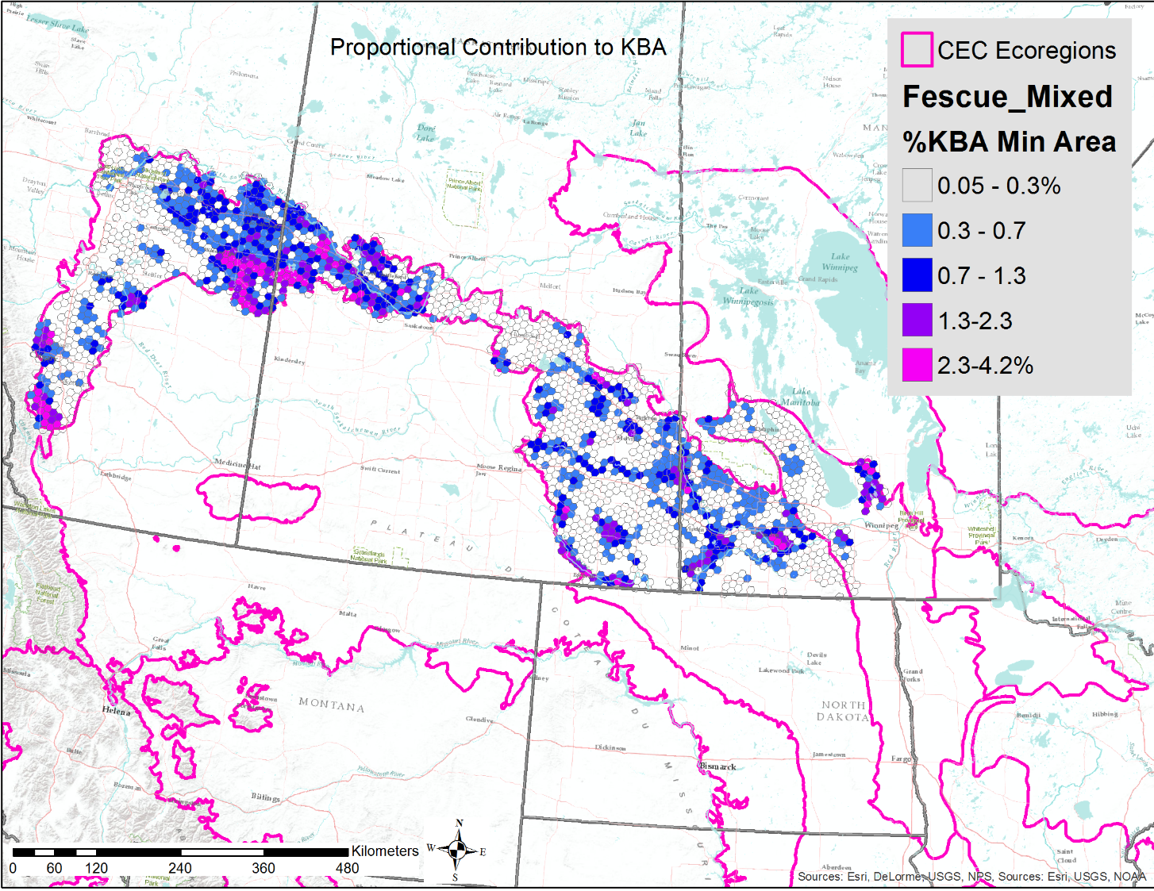
Draft KBA Identification

Slide 20
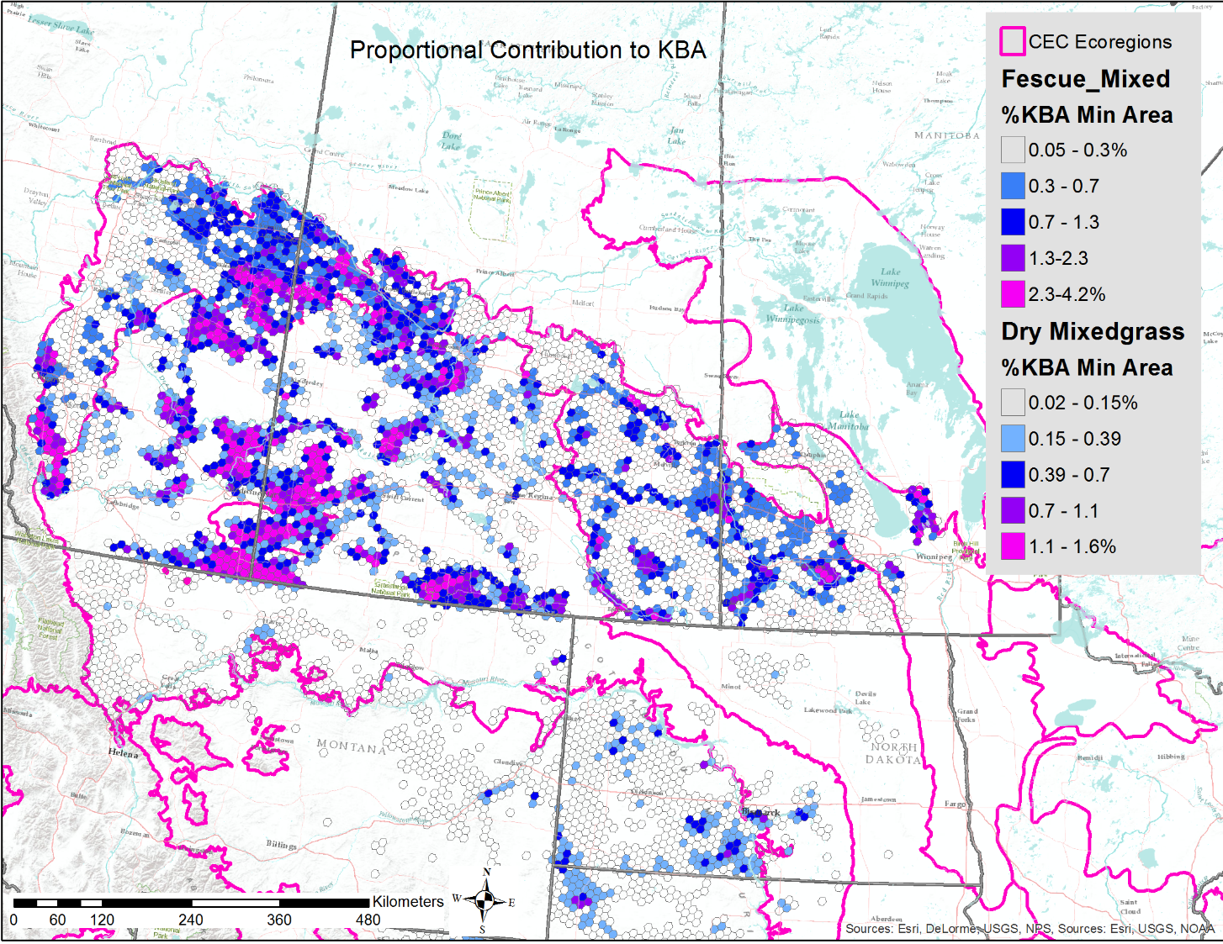
Draft KBA Identification

Slide 21
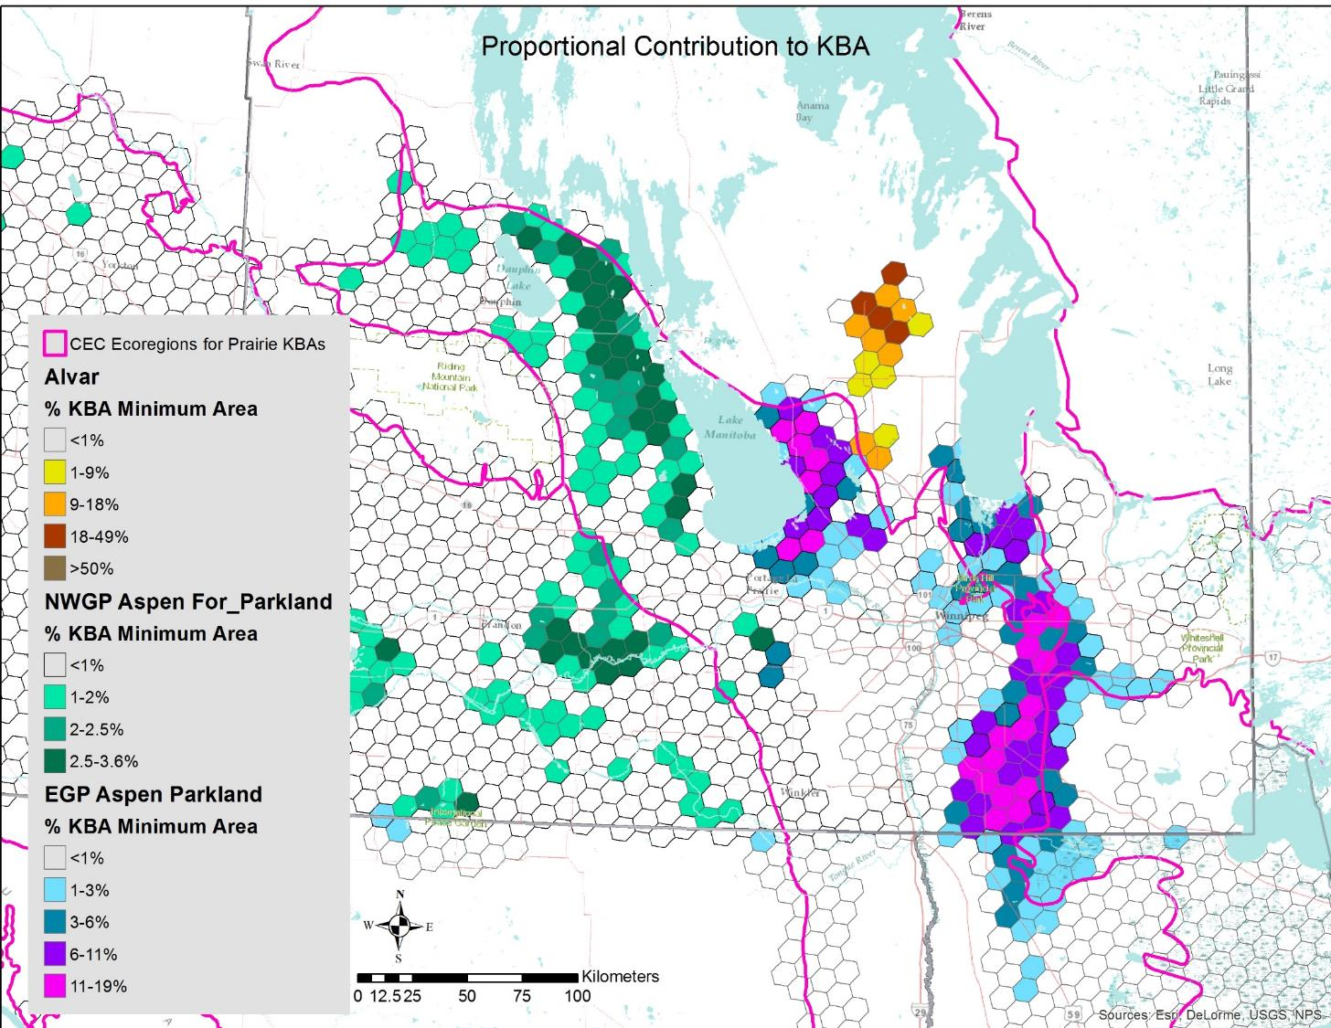
Draft KBA Identification

Slide 22
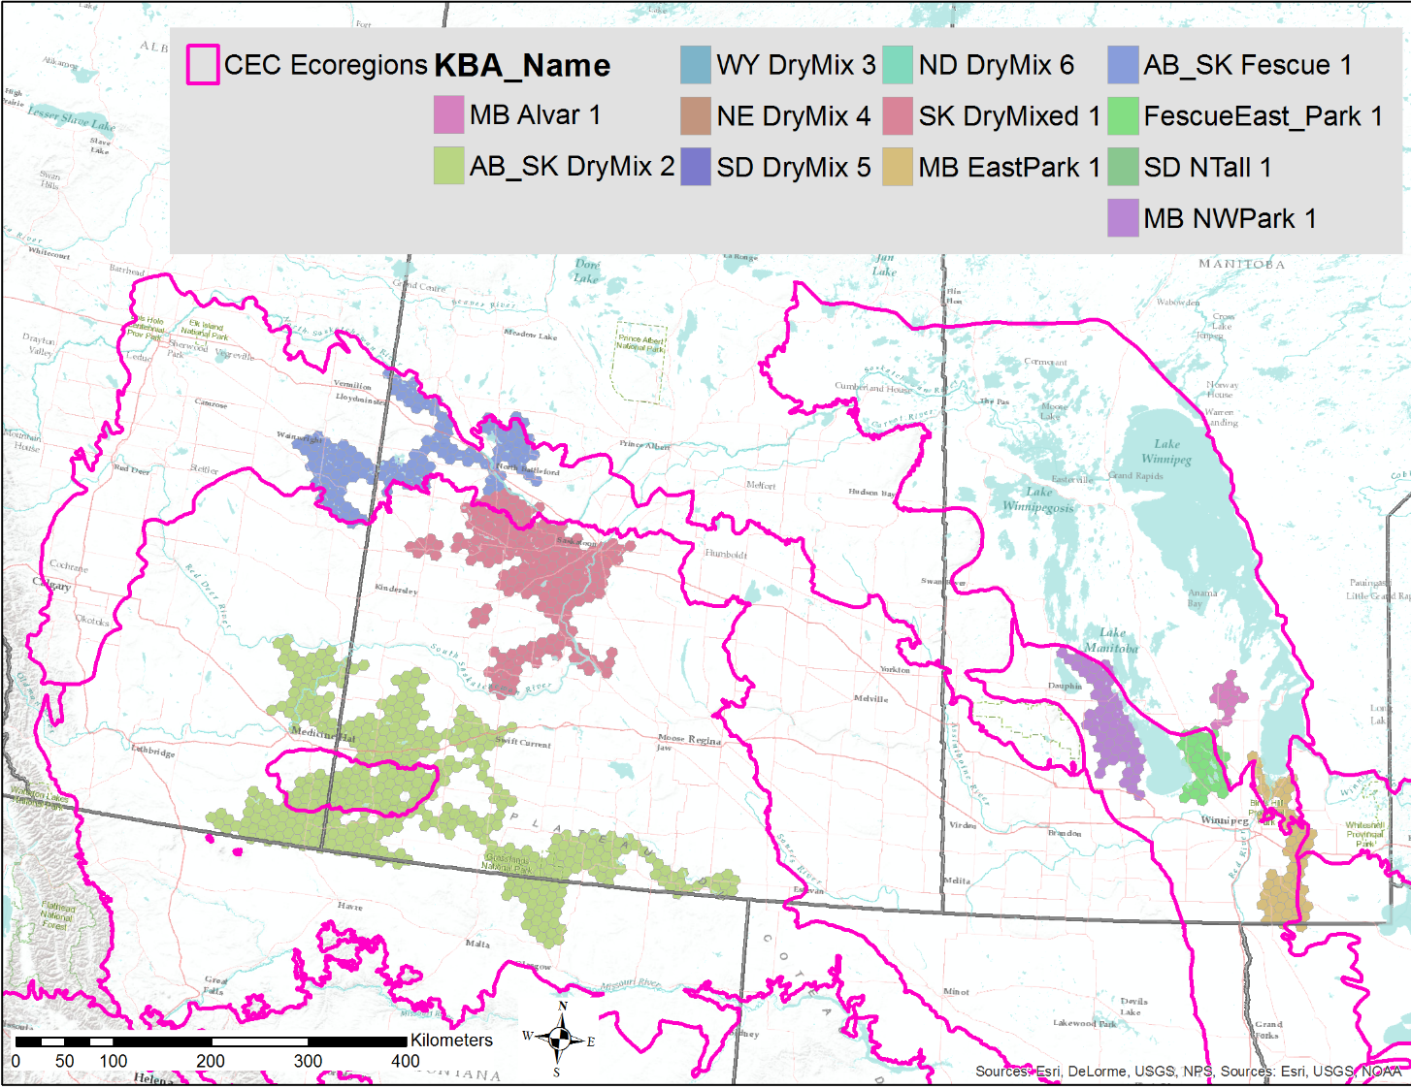
Draft KBA Identification

Slide 23
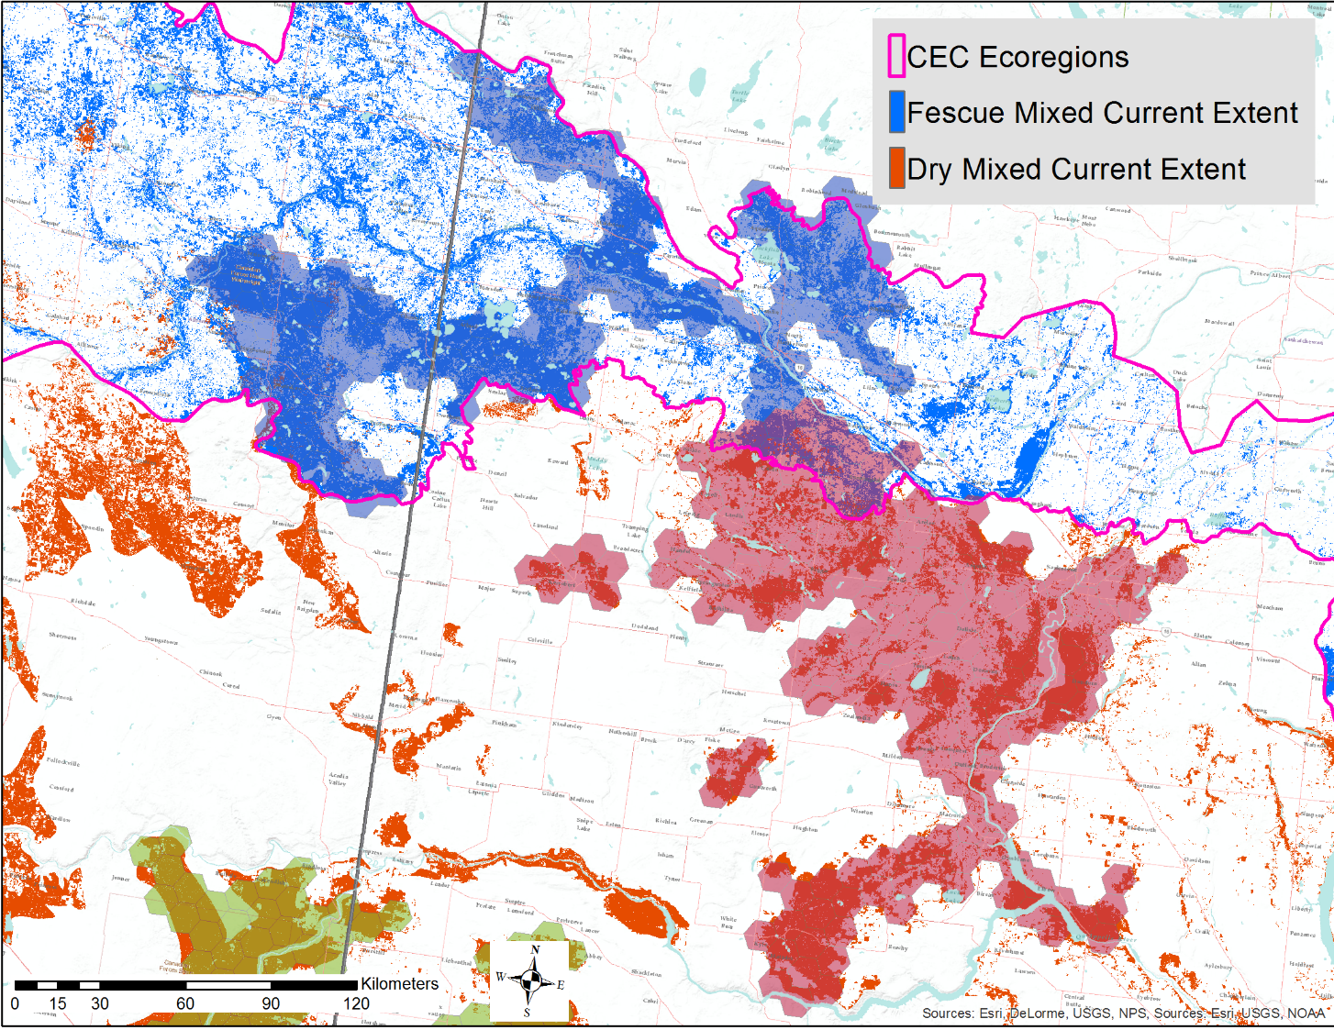

Slide 24
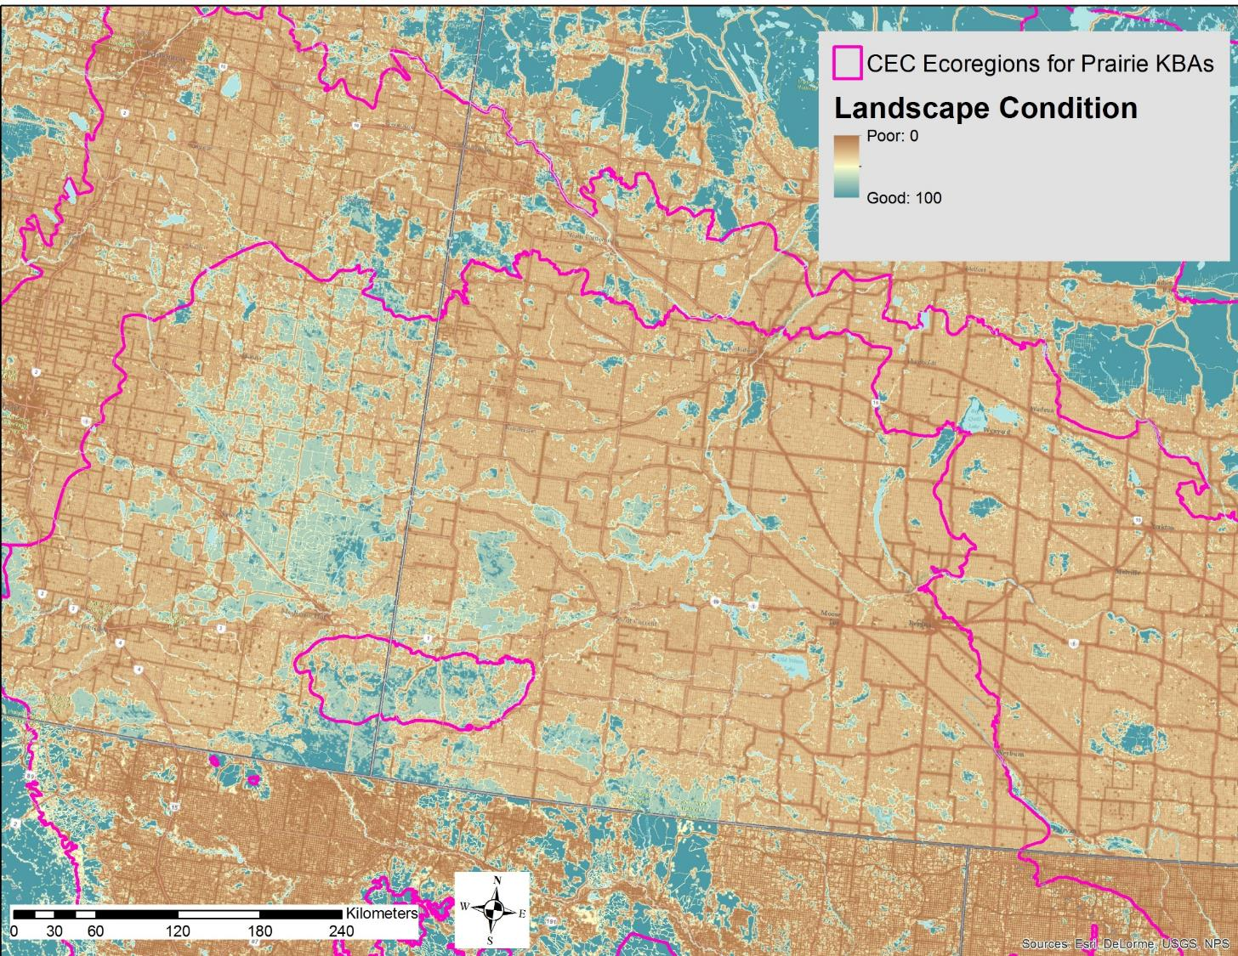

Slide 25
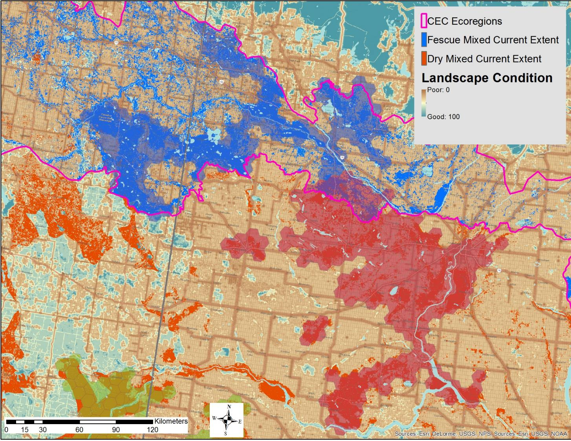

Slide 26
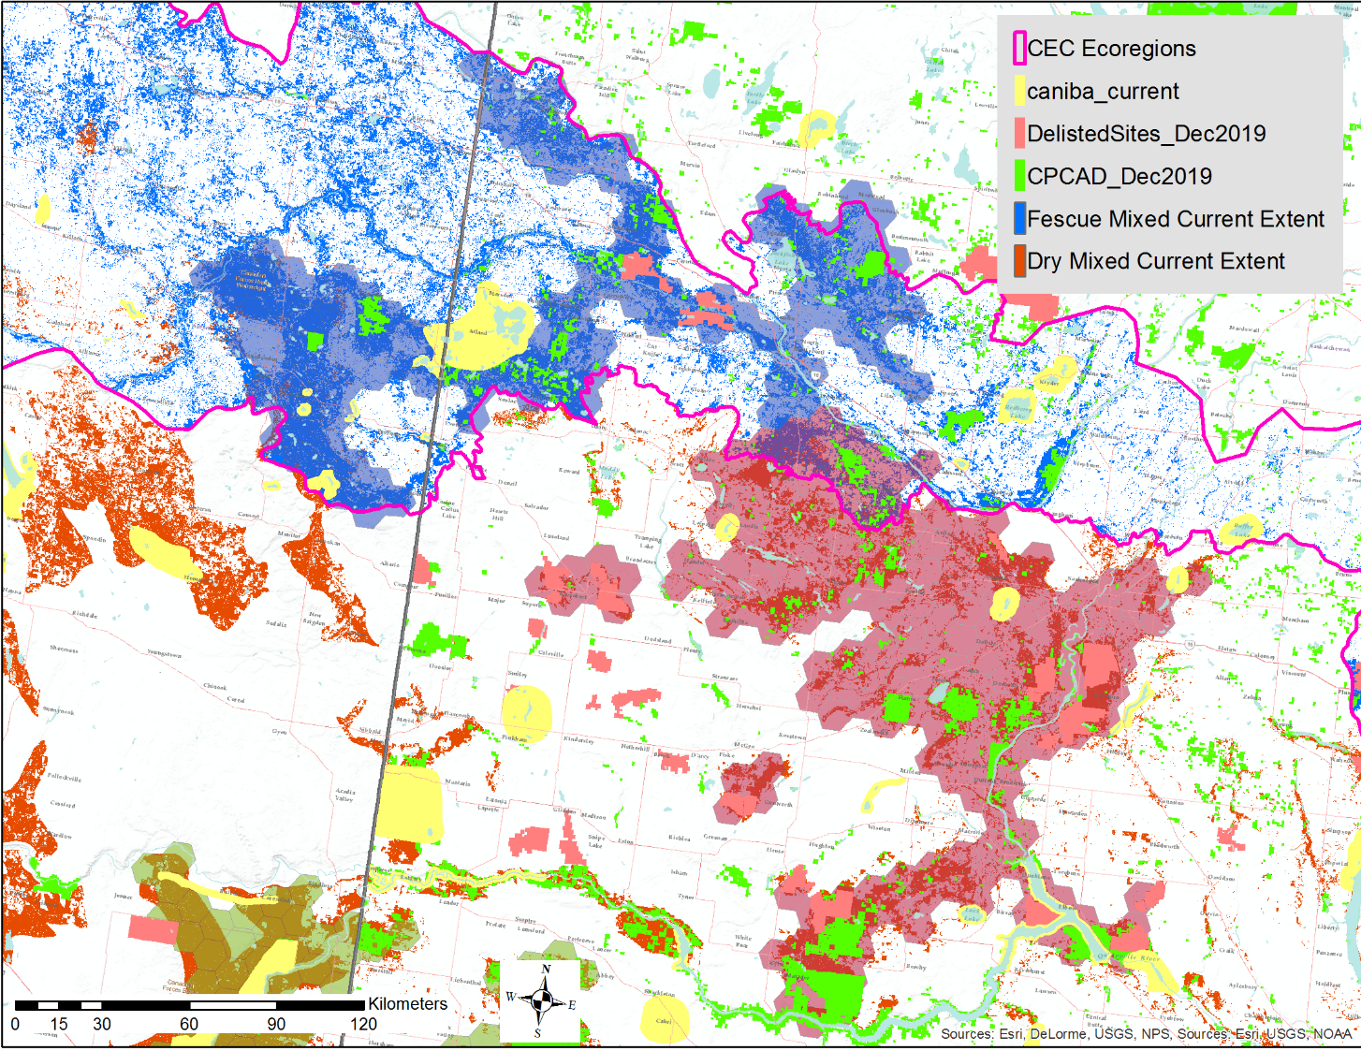

Slide 27
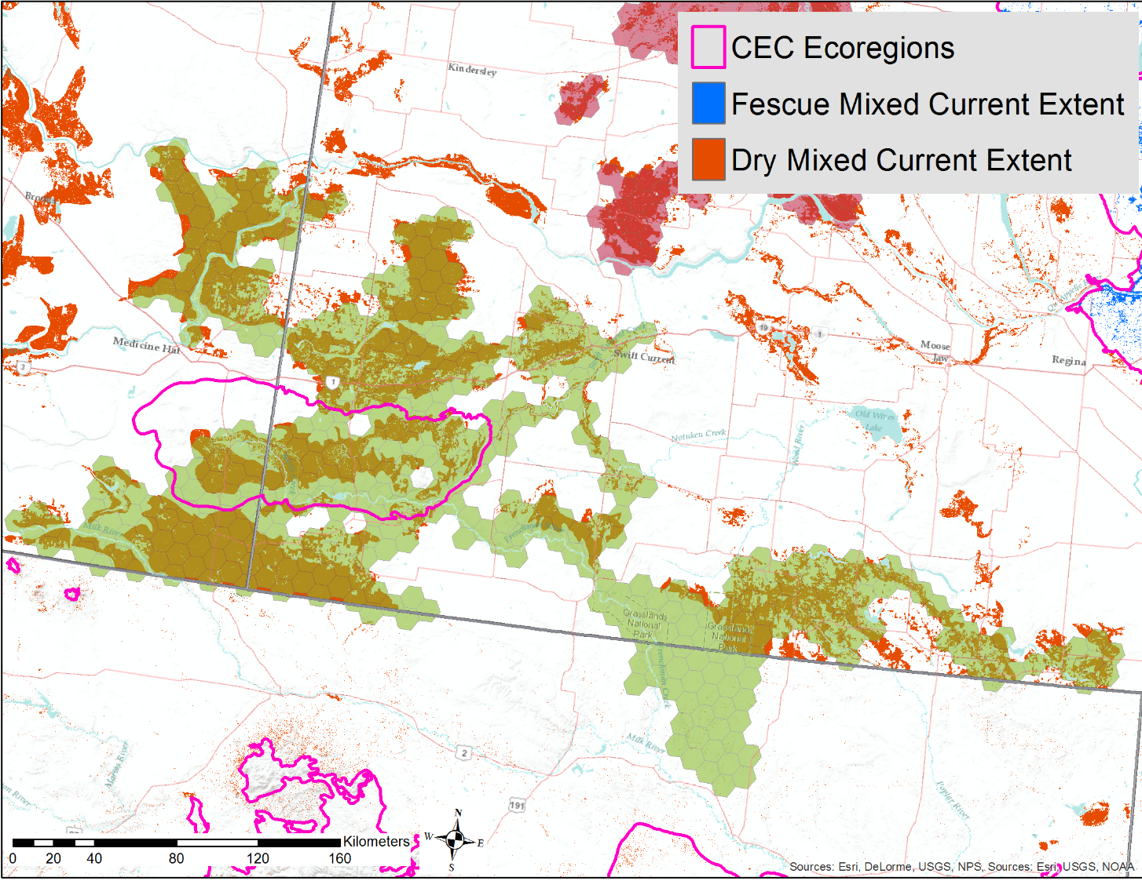

Slide 28
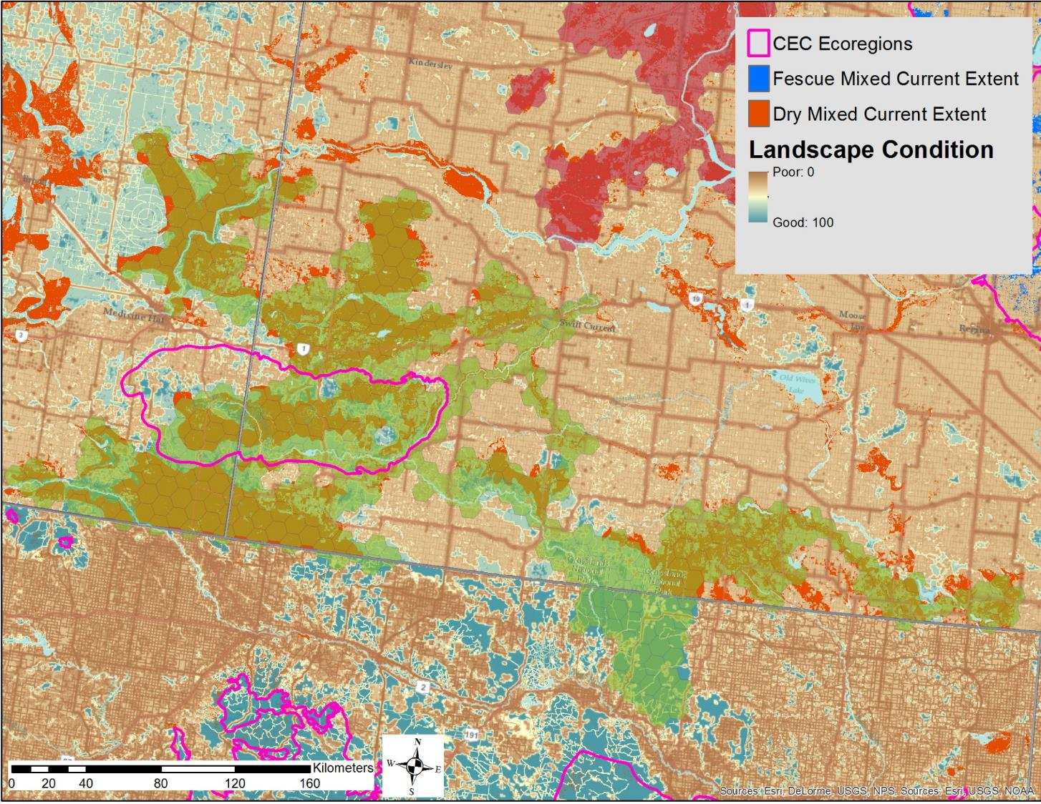

Slide 29
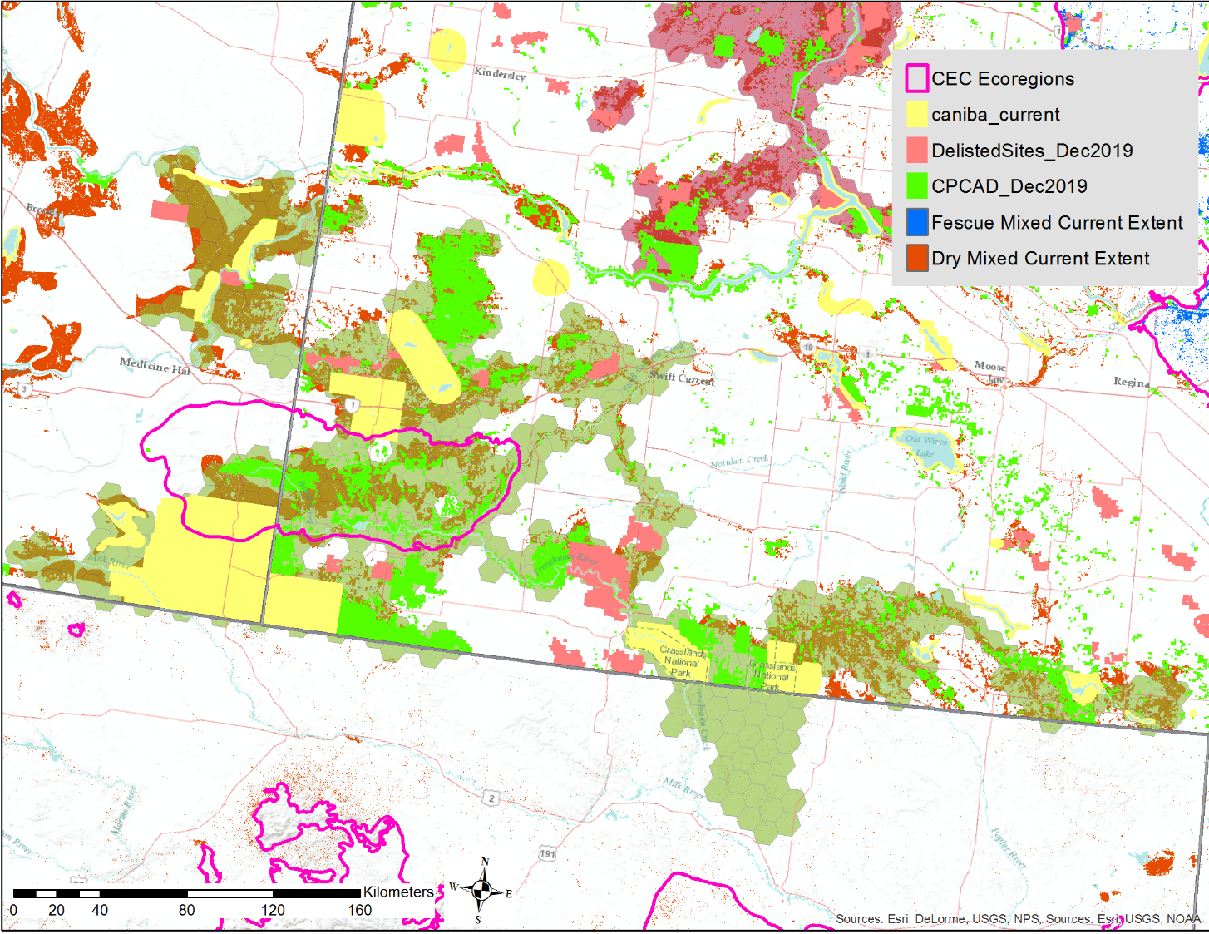

Slide 30
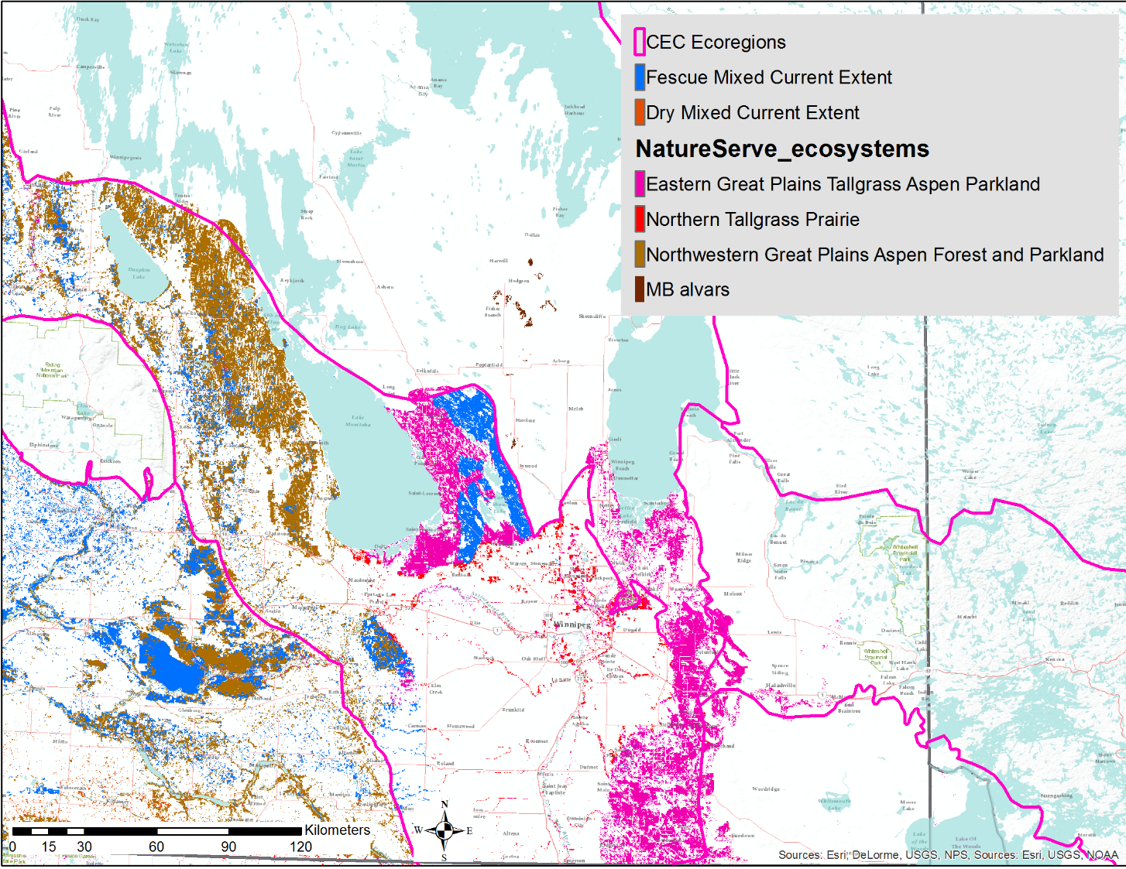

Slide 31
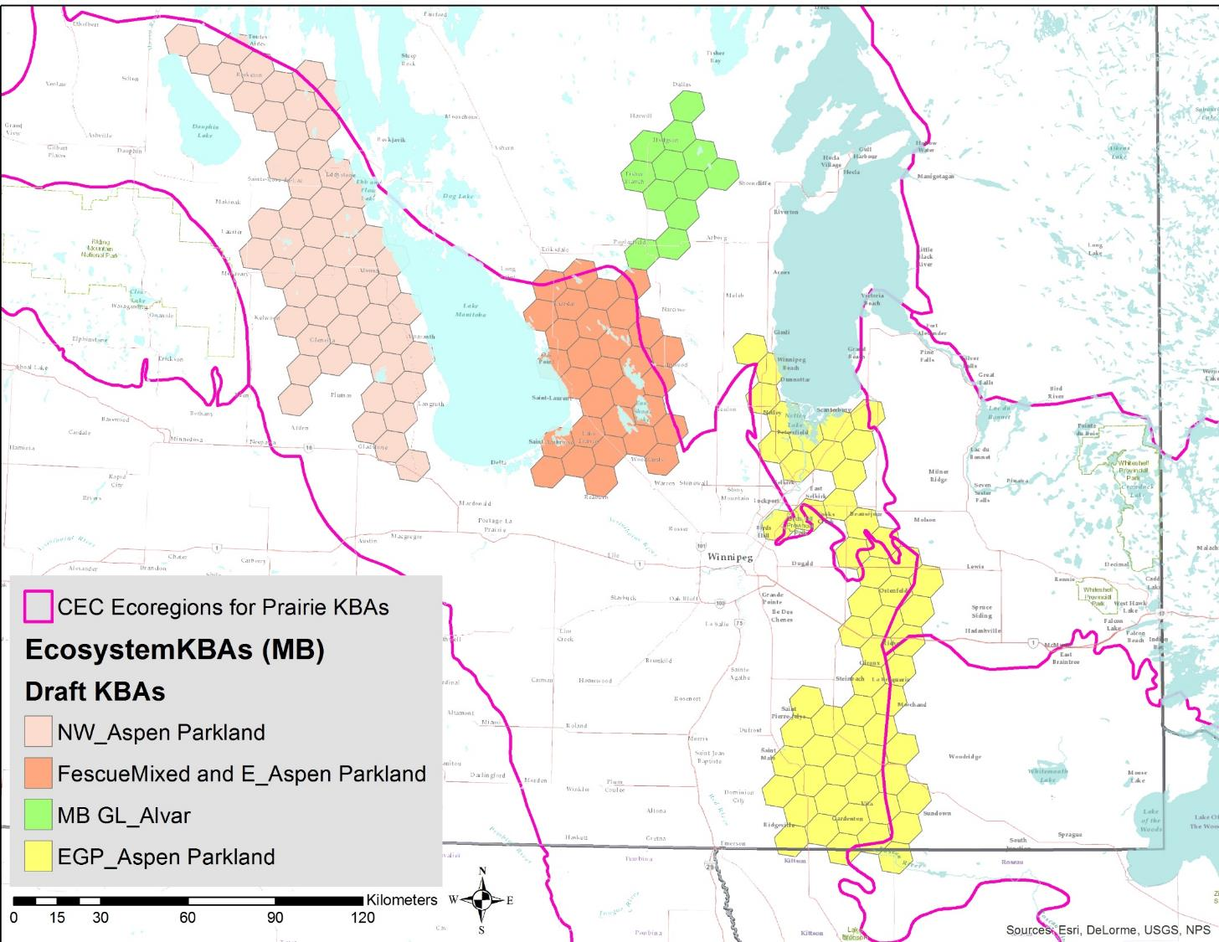
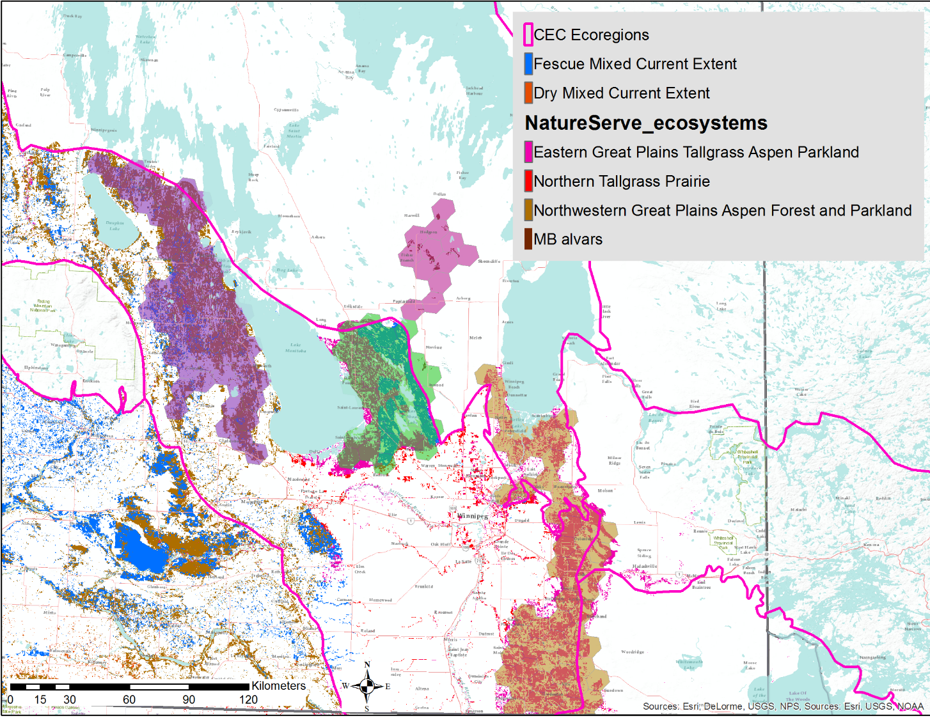

Slide 32
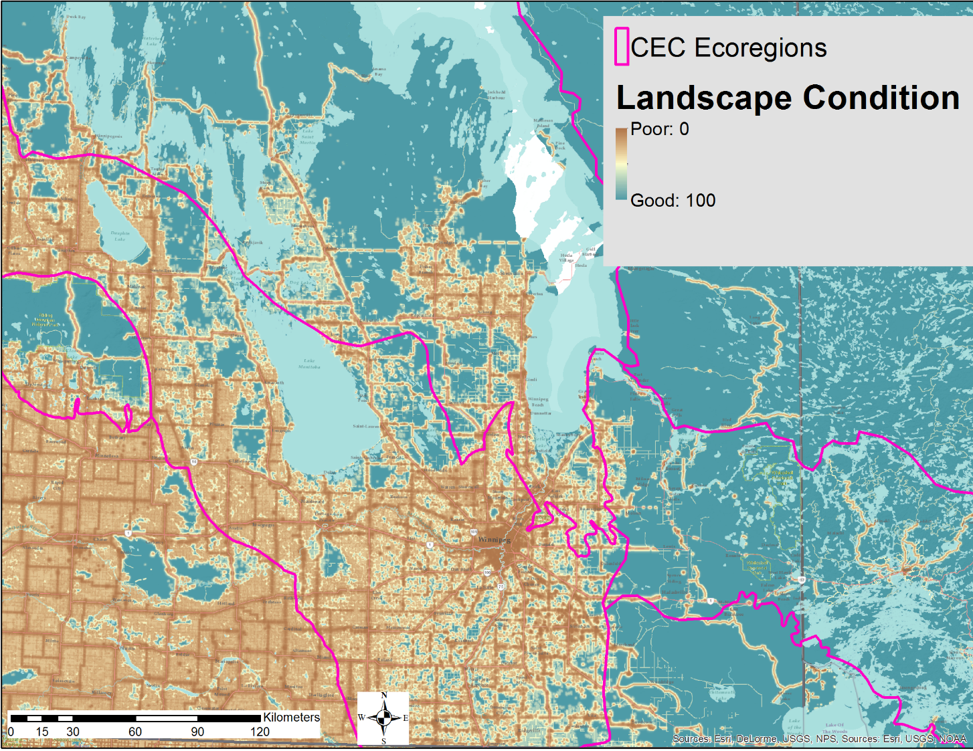

Slide 33
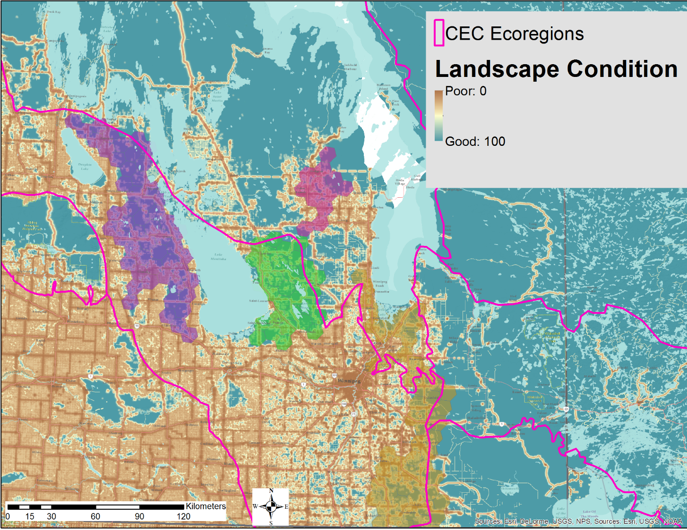

Slide 34
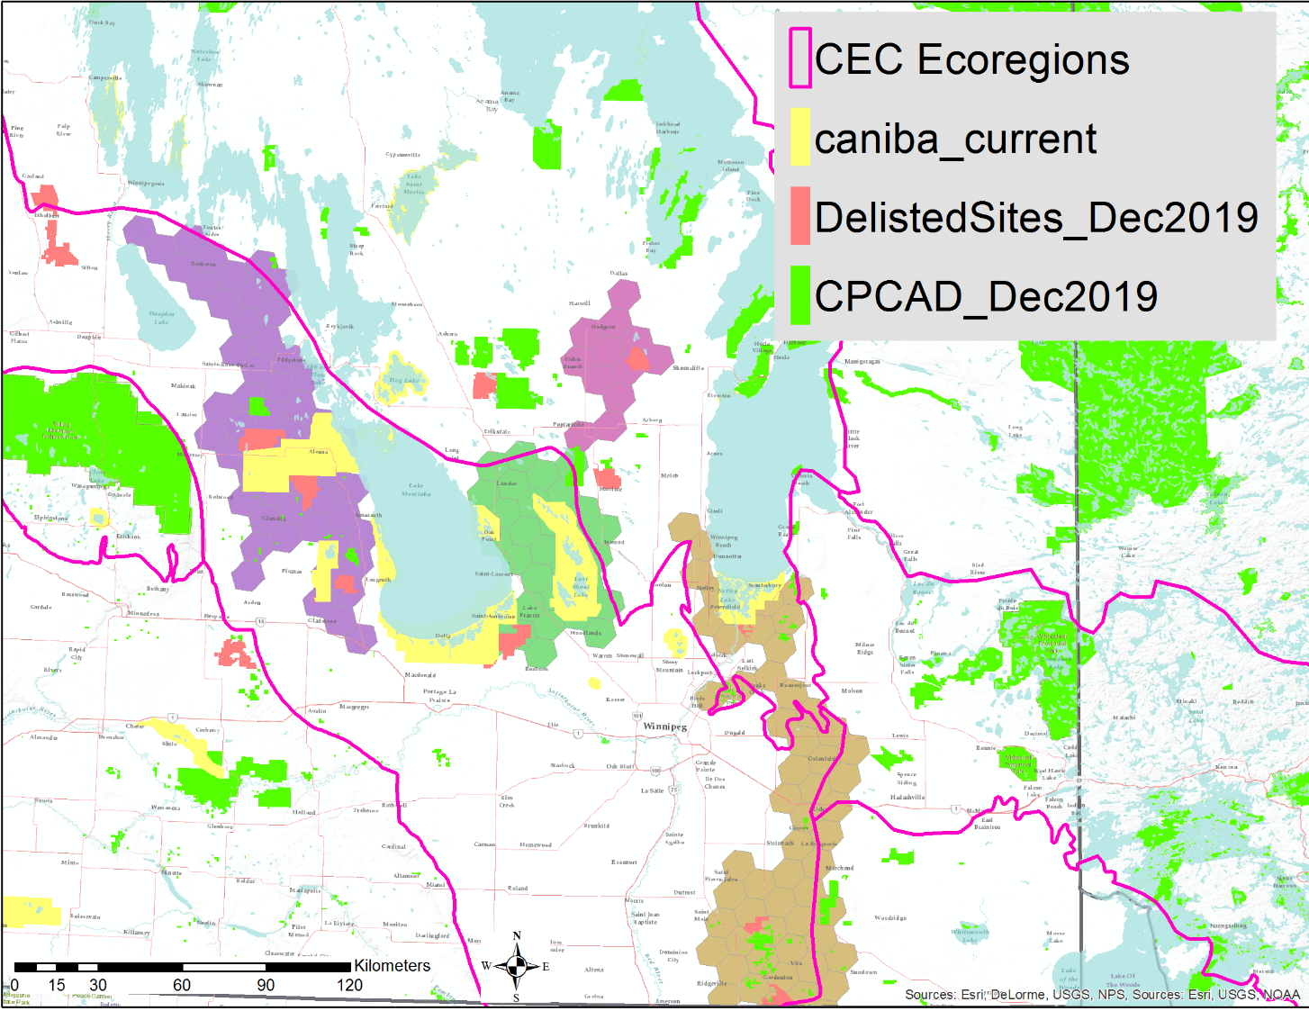

Slide 35
KBA Delineation
Definitions
Site = A geographical area on land and/or in water with defined ecological, physical, administrative or management boundaries that is actually or potentially manageable as a single unit
Manageability = The possibility of some type of effective management across the site.

Slide 36
IUCN Red List of Ecosystems and their Role
of Mapping for Key Biodiversity Areas
Interactive Review
KBA Delineation
Northwestern Great Plains Aspen Parkland
Northern Great Plains Fescue Mixed-Grass Prairie
Great Lakes Alvar
Northwest Great Plains Mixed-Grass Prairie
North-Central Interior Oak Savanna
Northern Tallgrass Prairie
Great Plains Prairie Pothole
Patrick Comer, Chief Ecologist, NatureServe
Pat_comer@natureserve.org
Notes:
Red Listing Ecosystems and Key Biodiversity Areas – introduction and discussion of applications to Canada
Synopsis: One important step in biodiversity conservation is documenting the at-risk status of ecosystem types. NatureServe programs have traditionally documented at-risk status for biodiversity (G/N/S Ranks). Building from this experience, we have also worked with global partners to establish methods for the IUCN Red List of Ecosystems (RLE). Like the IUCN Red List of Species, a system that ranks species based on their risk of extinction, the RLE ranks ecosystem types as "Vulnerable - VU" "Endangered-EN" or "Critically Endangered - CR" The ranking process includes technical issues such as ecosystem type classification, distribution mapping, and measures of ecosystem degradation. We are currently testing these methods in Temperate North America. Pat Comer will provide an orientation to the IUCN RLE framework and initial findings applicable to temperate Canada. He will also discuss the application of red listed ecosystems to identification of Key Biodiversity Areas. Opportunities and challenges to advance this work across Canada will be discussed.
Pat Comer is Chief Ecologist for NatureServe, based in Colorado. Since 1985, Pat’s applied research has focused on ecosystem classification, modeling, ecological integrity assessment, and subsequent documentation of ecosystem status and trends, regional conservation planning, site design for restoration, and monitoring of biodiversity and ecosystem services.

