Slide 1
Ecosystem Criteria A2 and B4 - lessons learned
A. THREATENED BIODIVERSITY
A1. Threatened species
A2. Threatened ecosystems types
B. GEOGRAPHICALLY RESTRICTED BIODIVERSITY
B1. Individual geographically restricted species
B2. Co-occurring geographically restricted species
B3. Geographically restricted assemblages
B4. Geographically restricted ecosystem types
C. ECOLOGICAL INTEGRITY
D. BIOLOGICAL PROCESSES
D1. Demographic aggregations
Pat Comer, NatureServe
Stephen Woodley, WCPA
D2. Ecological refugia
D3. Recruitment sources
E. IRREPLACEABILITY THROUGH QUANTITATIVE ANALYSIS

Slide 2
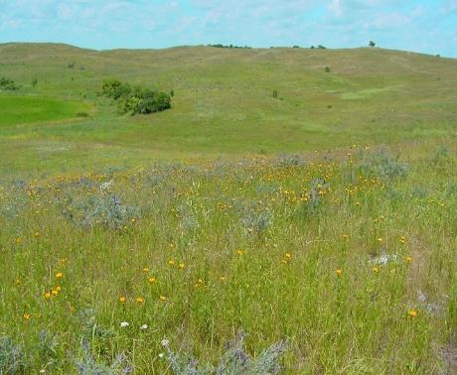
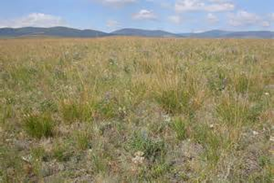
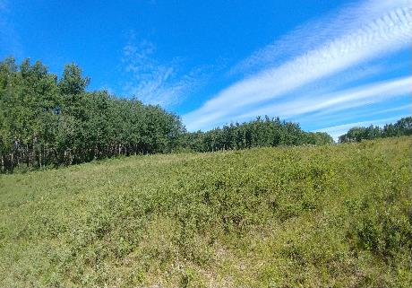
Ecosystem Criteria
A2. Threatened ecosystem types -
Site holds one or more of the following:
a) ≥5% of the global extent of a CR or EN ecosystem type
b) ≥10% of the global extent of a VU ecosystem type
Northern Tallgrass Prairie
Northern Great Plains Fescue Mixed-Grass Prairie
B4: Geographically restricted ecosystem types
Site holds ≥20% of the global extent of an ecosystem type
Northwestern Great Plains Aspen Parkland

Slide 3
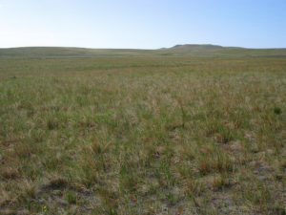
Vegetation-Based Hierarchy* Example from the Canadian Prairies
Hierarchy Levels | Example
Upper
L1 – Formation Class | Shrub & Herb Vegetation
L2 – Form. Subclass | Temperate & Boreal Grassland & Shrubland
L3 - Formation | Temperate Grassland & Shrubland
Mid
L4 – Division | Central North American Grassland & Shrubland
L5 – Macrogroup | Great Plains Mixedgrass & Fescue Prairie
L6 – Group | Northern Great Plains Rough Fescue Prairie
Lower
L7 – Alliance | Festuca altaica Northern Great Plains Grassland Alliance
L8 – Association | Festuca altaica - Danthonia intermedia Grassland
Level 1 Terrestrial
Level 2 Biome
Level 3 EFG
*Faber-Langendoen, D., T. Keeler-Wolf, D. Meidinger, D. Tart, C. Josse, G. Navarro, B. Hoagland, S. Ponomarenko, J-P. Saucier, A. Weakley, and P. Comer. 2014. Eco-Veg: a new approach to Vegetation Description and Classification. Ecological Monographs 84(4):533-561.
NA Red List units§ approximate these levels
Level 4 BioEcotype
Level 5 Global EcoType
Level 6 Subglobal Type
§ NatureServe Ecological Systems Classification: Comer, P., et al. 2003. Ecological Systems of the United States: A Working Classification of U.S. Terrestrial Systems. NatureServe, Arlington, VA.
Notes:
Vegetation-based classification hierarchy, as one example to define terrestrial ecosystems for red listing. As you go down in the hierarchy, each classification unit describes a more specific unit that applies to increasingly localized areas.
One example worked through the hierarchy that occurs in the SE. Multiple alliances make up the “Western Interior Riparian Forest & Woodland” group, and many associations make up each of those alliances.
For our current work in temperate North America, the classification units fall into the Group to Alliance level of this vegetation hierarchy; around 90 units falling within the state.

Slide 4
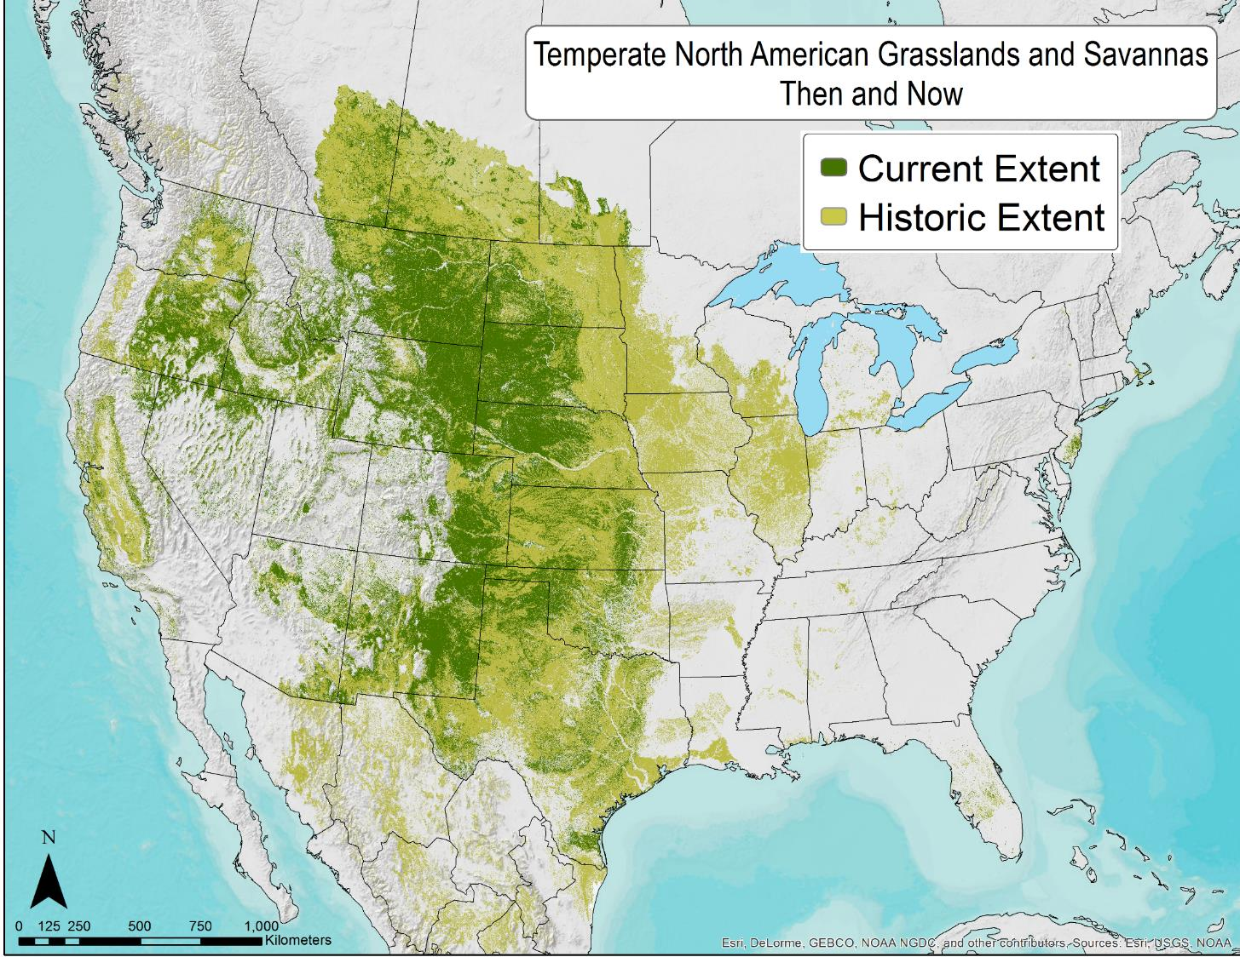
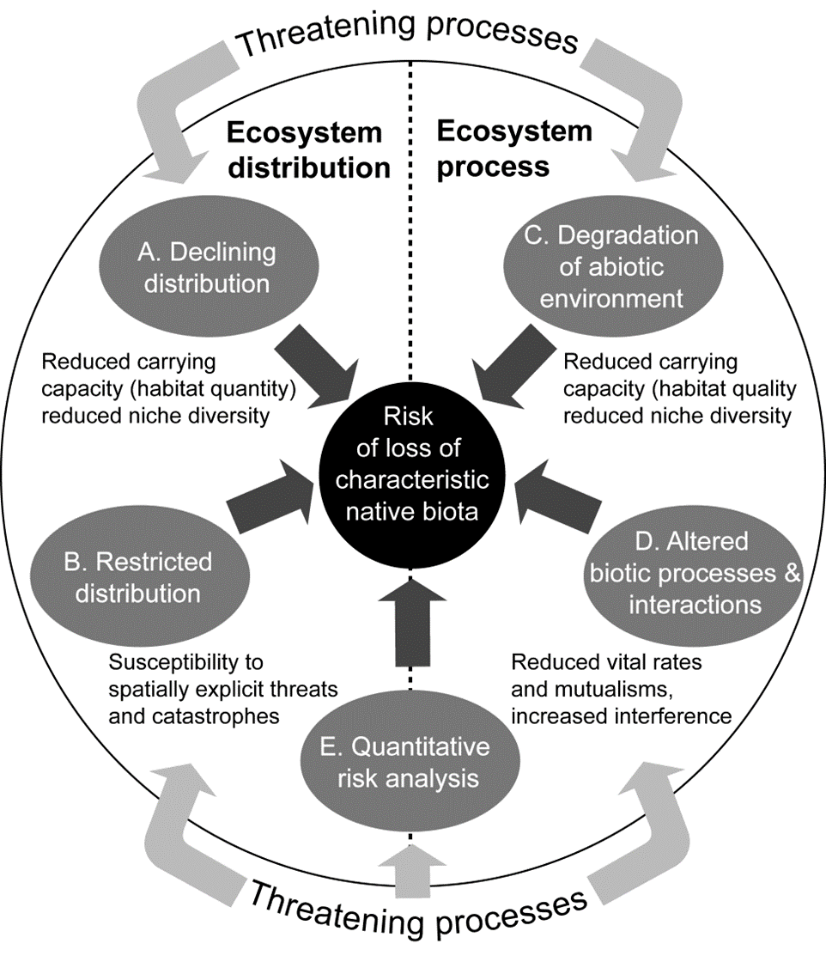
NatureServe terrestrial ecological system types @ Level 6 of vegetation hierarchy
Analysis of 107 grassland and savanna ecosystems in temperate North America, 63% of grassland and savanna ecosystem types scored as threatened.
Comer, P.J., J.C. Hak, et al.. in prep. Documenting At-risk Status of Terrestrial Ecosystems in Temperate and Tropical North America. For Conservation Biology
Comer, P.J. 2020. Red Listing Temperate Grasslands and Savannas in North America. Imperiled: The Encyclopedia of Conservation. Elsevier.
Notes:
Overall results, mapped on historical extent and current footprint.

Slide 5
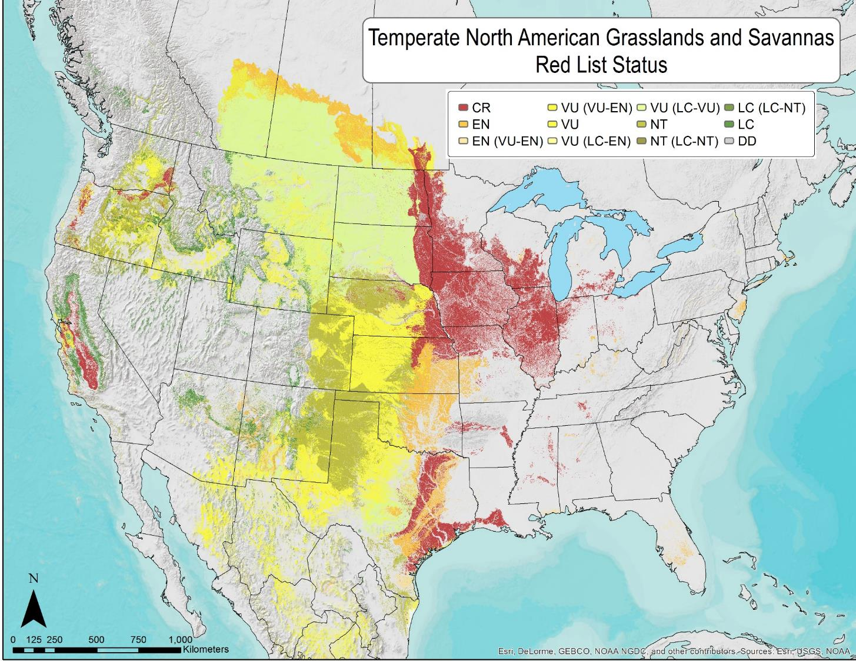
NatureServe terrestrial ecological system types @ Level 6 of vegetation hierarchy
Analysis of 107 grassland and savanna ecosystems in temperate North America, 63% of grassland and savanna ecosystem types scored as threatened.
Comer, P.J., J.C. Hak, et al.. in prep. Documenting At-risk Status of Terrestrial Ecosystems in Temperate and Tropical North America. For Conservation Biology
Comer, P.J. 2020. Red Listing Temperate Grasslands and Savannas in North America. Imperiled: The Encyclopedia of Conservation. Elsevier.
Notes:
Overall results, mapped on historical extent and current footprint.

Slide 6
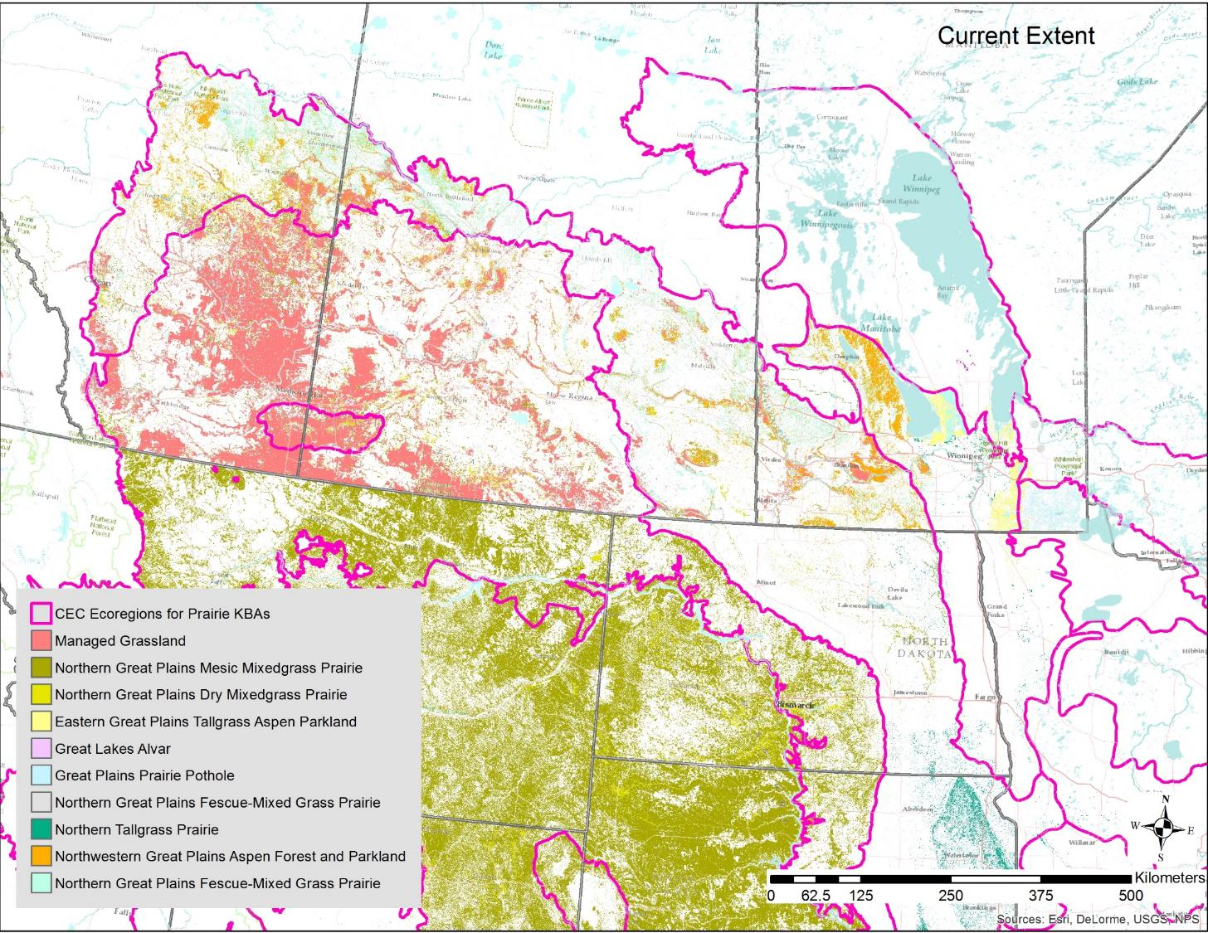
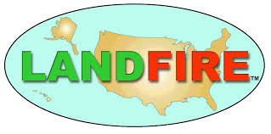
Updated Ecosystem Distributions
Canadian side:
Agriculture and Agri-Food Canada Land use/land cover:
“managed” vs. unmanaged” grassland
- Sandy vs. loamy soils
USA side:
LANDFIRE EVT 2016: USNVC Groups

Slide 7
A2 & B4 Minimum Area Requirements
Targeted Ecosystem Type | RLE Status | Current Global Extent Estimate (km²) | Current National Extent Estimate (km²) | KBA% | A2 KBA Global Target (km2) | A2 KBA National Target (km2) | B4 KBA Global Target (@20%) (km2)
Northern Tallgrass Prairie | CR | 6,213 | 582 | 5% | 311 | 29 | 1,242
Northern Great Plains Fescue Mixedgrass Prairie | EN | 19,981 | 19,800 | 5% | 999 | 990 | 3,996
Northwestern Great Plains Dry Mixedgrass Prairie | EN | 57,897 | 38,166 | 5% | 2,895 | 1,908 | 11,580
Eastern Great Plains Tallgrass Aspen Parkland | VU | 4,515 | 3,986 | 10% | 451 | 399 | 902
Northwestern Great Plains Aspen Forest and Parkland | VU | 23,055 | 23,002 | 10% | 2,305 | 2,300 | 4,610
Great Plains Prairie Pothole | VU | 6,457 | 4,329 | 10% | 646 | 433 | 1,290
Great Lakes Alvar (MB disjunct) | VU | 181 | 44 | 10% | 18 | 4 | 36

Slide 8
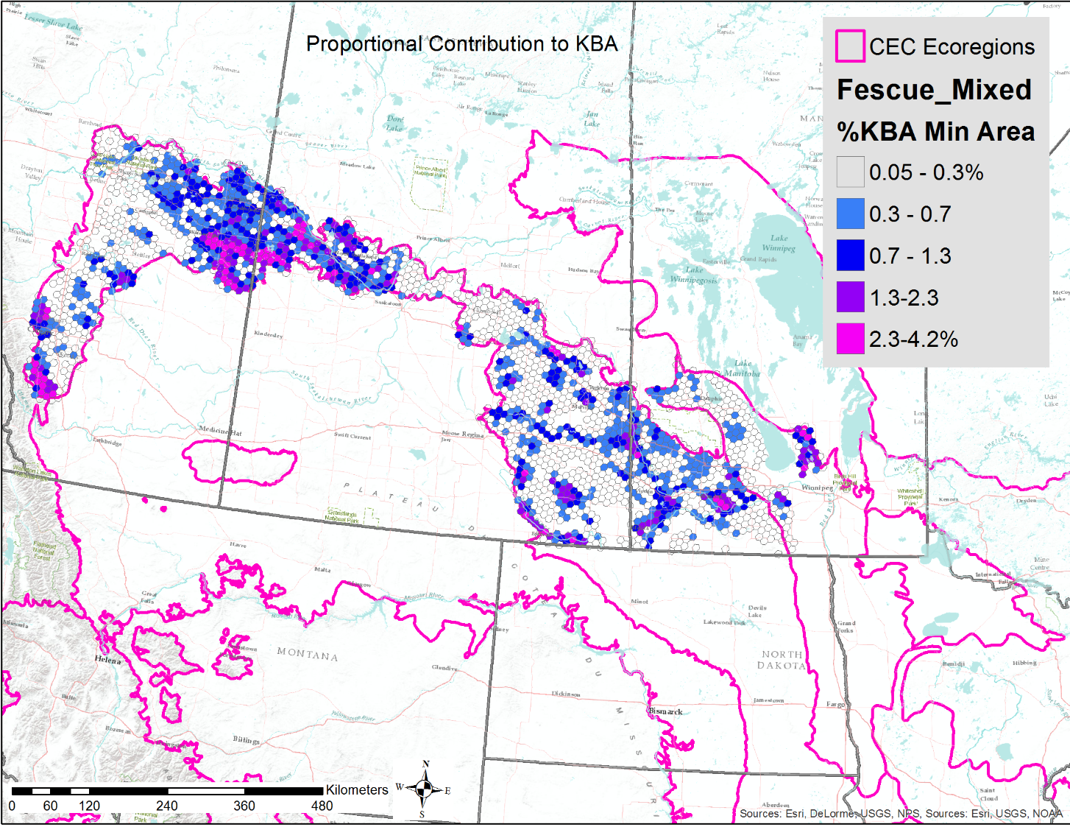
Draft KBA Identification 100km² hexagon spatial analysis units

Slide 9
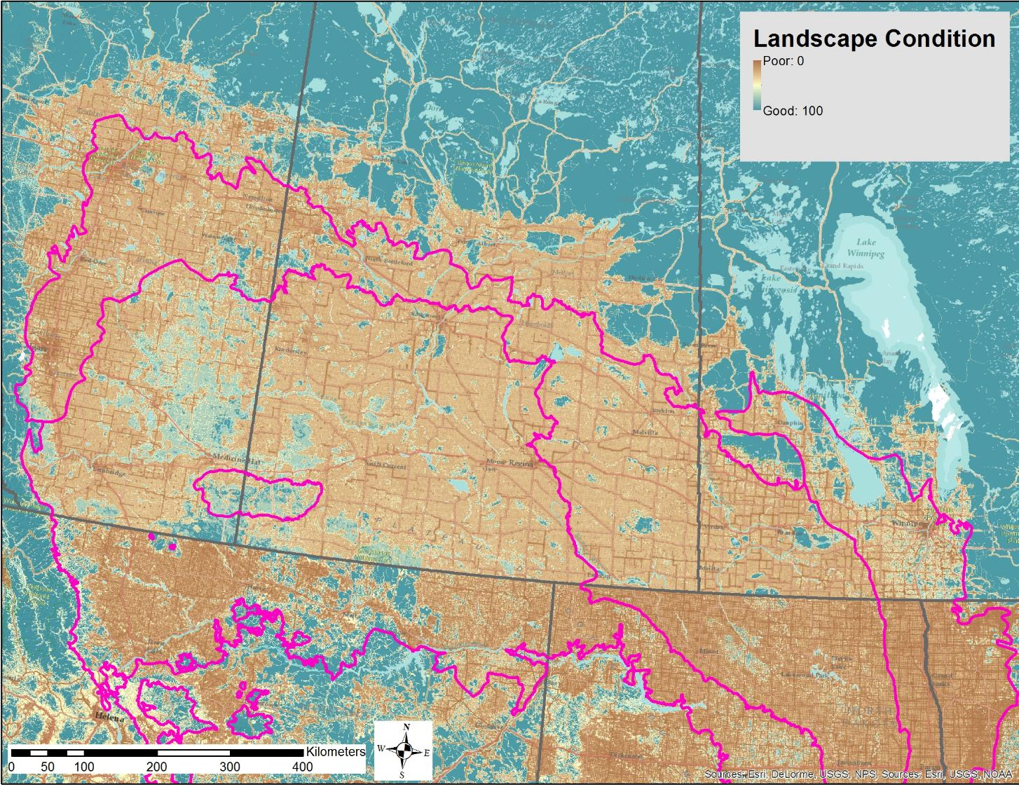
Draft KBA Identification Landscape Condition
Managed Lands
Hak, J.C. and P.J. Comer. 2017. Modeling Landscape Condition for Biodiversity Assessment – Application in Temperate North America. Ecological Indicators Vol. 82:206-216

Slide 10
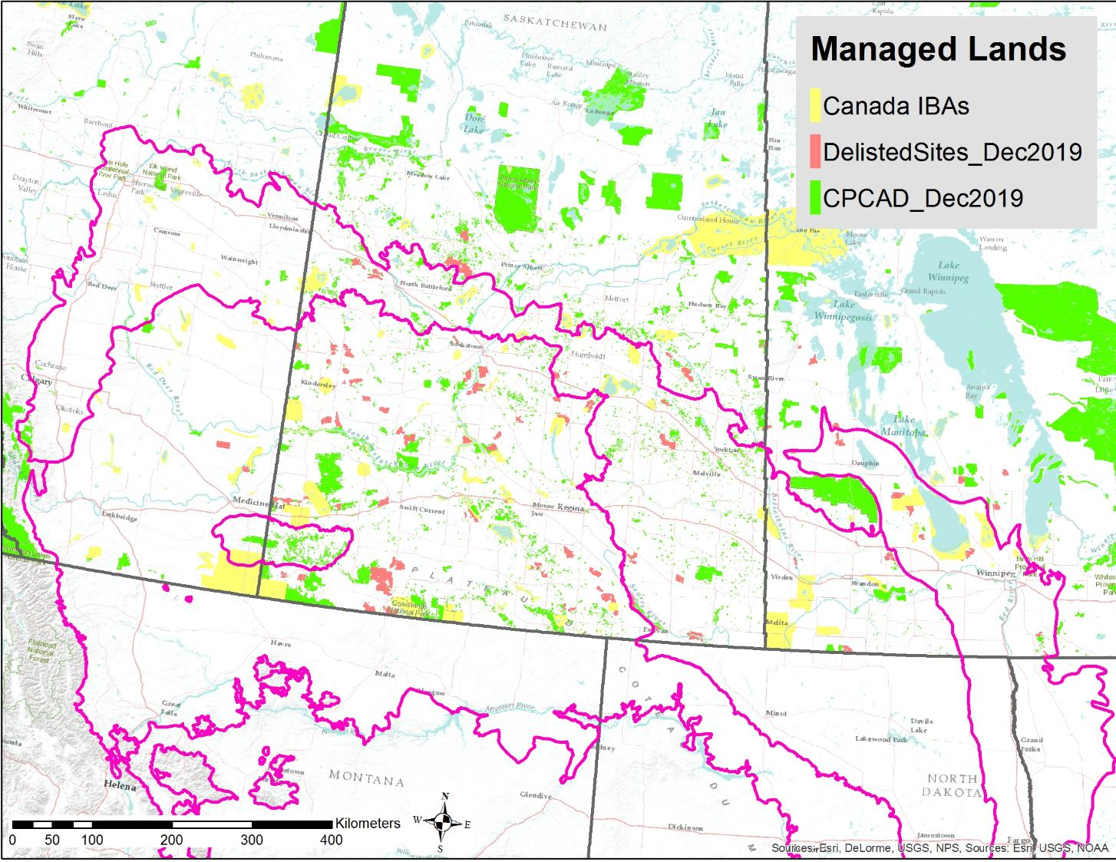
Draft KBA Identification Landscape Condition
Managed Lands
Hak, J.C. and P.J. Comer. 2017. Modeling Landscape Condition for Biodiversity Assessment – Application in Temperate North America. Ecological Indicators Vol. 82:206-216

Slide 11
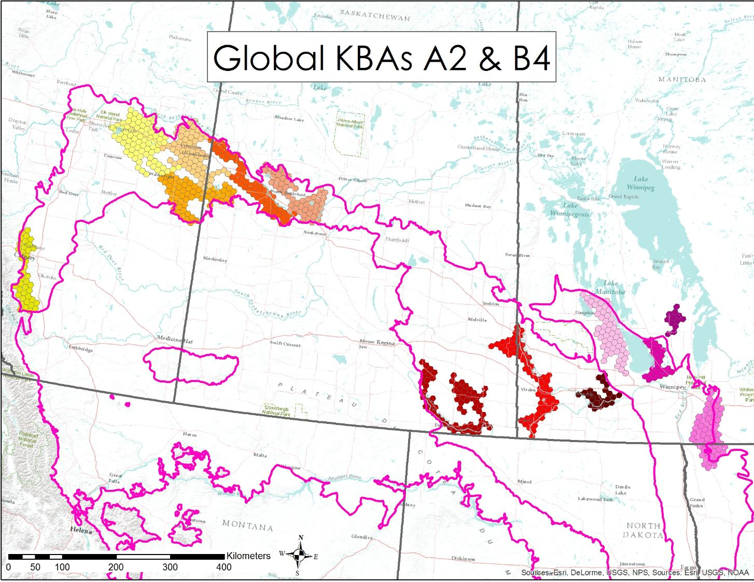
Draft KBA Identification Hex-based Draft Boundaries
Smoothed Boundaries

Slide 12
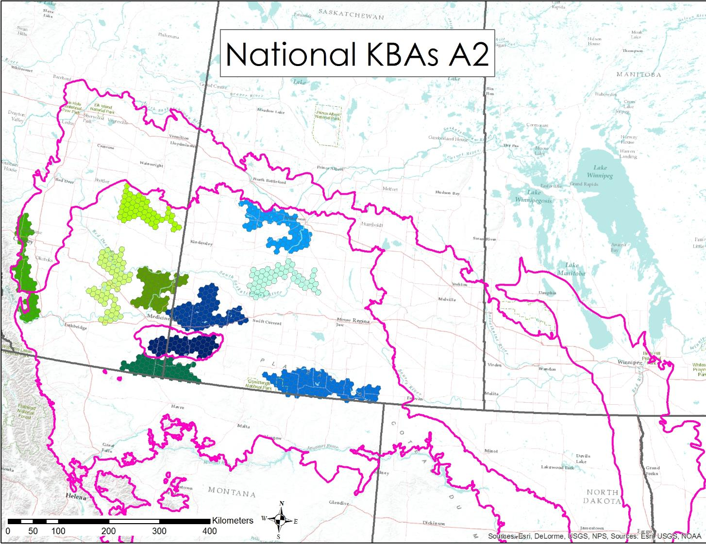
Draft KBA Identification Hex-based Draft Boundaries
Smoothed Boundaries

Slide 13
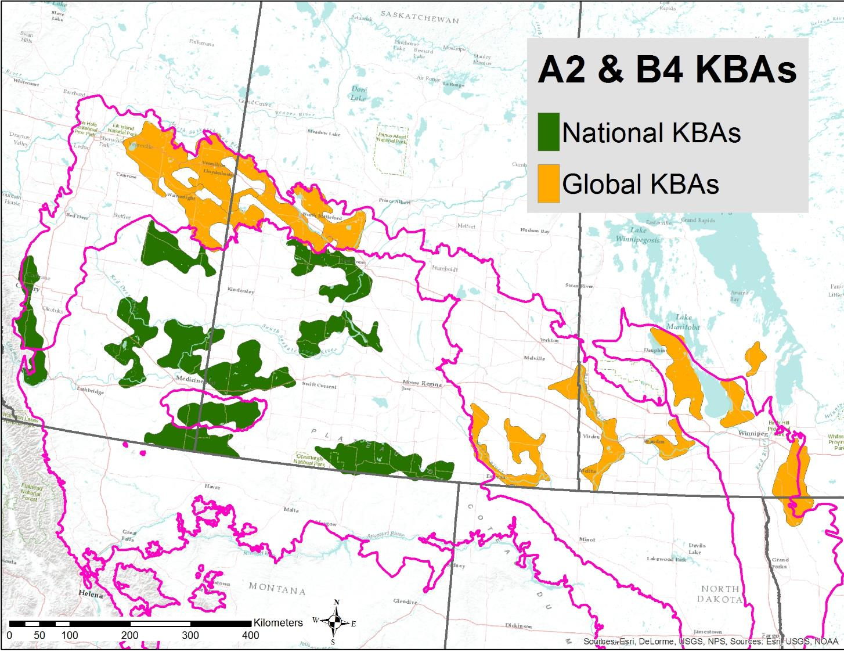
Draft KBA Identification Hex-based Draft Boundaries
Smoothed Boundaries

Slide 14
Results & Lessons Learned from Applying Ecosystem Criteria A2 and B4 in Canada
Results
Likely 13 global KBAs under A2 and 9 National KBAs will be identified
One B4 site identified – alvar ecosystem
Lessons
A2 - Red Listing ecosystems is challenging because it requires:
Common classification systems and mapping to look at both national and global extent
Data are limited on ecological condition (plowing, grazing, planted pasture)
Classification expertise required to ‘crosswalk’ to the Red List of Ecosystems global typology

Slide 15
Lessons Learned from Applying Ecosystem Criteria A2 and B4 in Canada
More Lessons
Designation of KBA boundaries in heavily modified landscapes
- Measuring size of unit is challenging in fragmented grasslands – very large and irregular
- Follow up needed to determine actual ecological integrity
- In an agricultural landscape of private lands, there is few discernible “manageable units” for use in delineation
National KBAs will likely be as important or more important for national conservation goals - e.g., A2 – Dry Mixedgrass Prairie severely reduced in Canada but more common in USA.

